Slide 1
1 in 5
ROSE is an evidence-based program
Reduces rates of postpartum depression by 50%
people with financial difficulties experience postpartum depression.

Slide 2
Timeline
4 Sessions during Pregnancy
Life with Baby
Final meeting within 8 weeks postpartum.
We will contact you to schedule.
You have completed all 4 ROSE sessions
Congratulations!
You have taken an important step towards

Slide 3
Topics Covered
Differences between PPD and baby blues, education on PPD
A
What is PPD?
Role changes, relaxation exercises, pleasant activities
B
Self-care
Getting support, asking for help, assertiveness
C
Communication pt 1
Saying “no” to requests. Resources for abusive relationships.
D
Communication pt 2
Review of skills, troubleshooting
E
Check in (6 wk f/u)

Slide 4
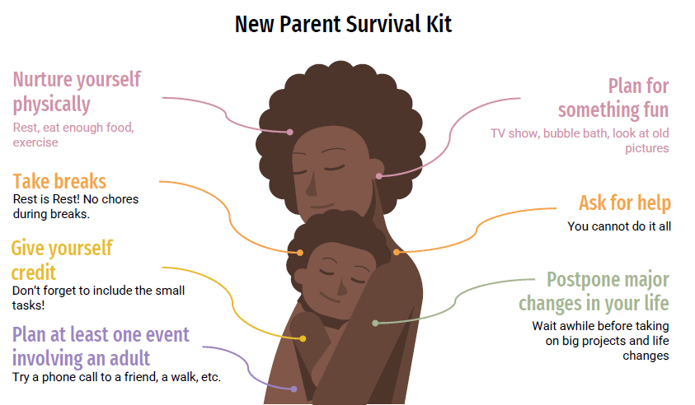

Slide 5

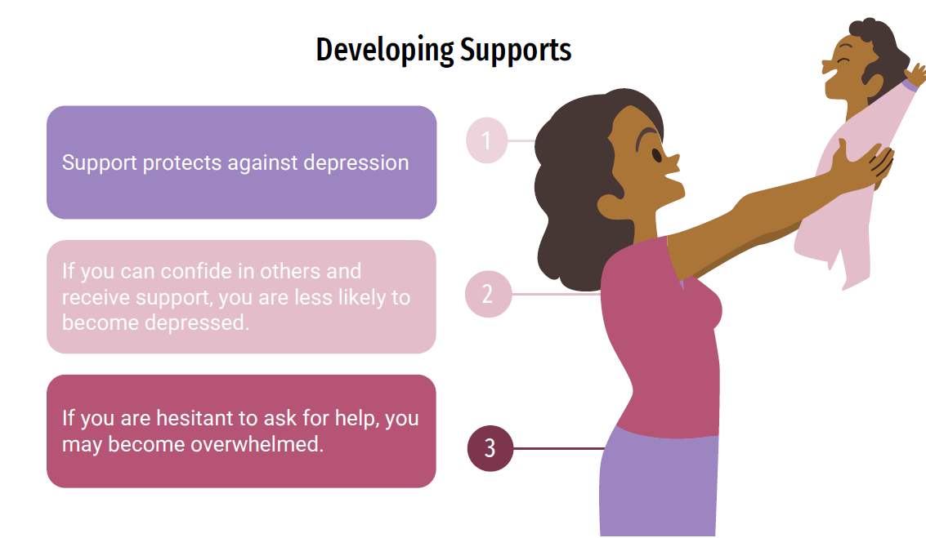
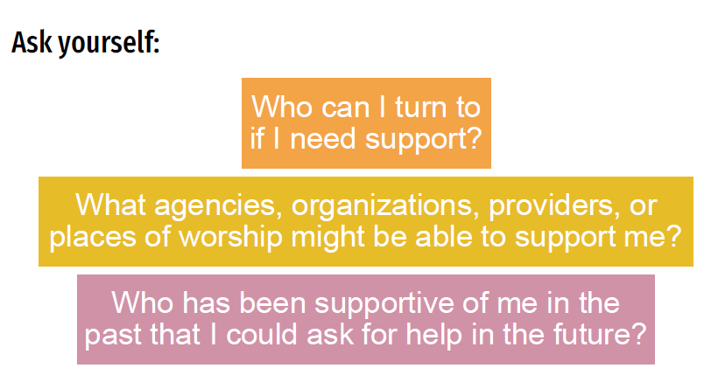

Slide 6



Recruitment
We invite pregnant patients at GOG and SCC to join the ROSE program at multiple intervals throughout their pregnancy.
26 Weeks
Mailer is sent with information about ROSE and how to join the ROSE weekly zoom group
First Prenatal Packet
Contains information about ROSE and how to join the weekly zoom group
28 Weeks
My Chart message is sent with information about ROSE and how to join the ROSE weekly zoom group
Second Prenatal Packet
Contains information about ROSE and how to join the weekly zoom group
MW and UOG patients will need to be informed about the program by their providers.

Slide 7
Rose Program
I think my patient could benefit from ROSE!
GOG
Join group zoom link (no RSVP necessary)
Schedule individual appointment with OAS staff
SCC
Join group zoom link (no RSVP necessary)
Schedule individual appointment with OAS staff
MW
Join group zoom link (no RSVP necessary)
UOG
Join group zoom link (no RSVP necessary)
All appointments are free of charge.

Slide 8
Thank you
Questions?

