Slide 1
Assessment and Management of Eating Disorders

Slide 2

Eating Disorders
Mary Diguardi MD Primary Care Pediatrician,
Binghampton NY
James Wallace MD Child and Adolescent Psychiatrist
Rochester NY
James_Wallace@urmc.Rochester.edu

Slide 3
Disclosures
We have no significant financial disclosures

Slide 4
?
True or False
Anorexia Nervosa has the highest mortality rate of all psychiatric disorders.
Notes:
True - 5% die within 4 years of diagnosis and up to 20% eventually die from complications or suicide

Slide 5
?
Anorexia Nervosa
A. Amenorrhea is a diagnostic criteria
B. 15 % weight deficit is required to meet criteria
C. Is rarely found in males
D. A, B & C
E. None of the above
Notes:
C. 4% vs .3% (Females vs males)

Slide 6
?
Avoidant/Restrictive Food Intake Disorder (ARFID)
A. Is not an eating disorder
B. Is a feeding disorder
C. Can be associated with Autism Spectrum Disorder
D. A & C
E None of the above
Notes:
D -?

Slide 7
Is there a way to prevent eating disorders?
How can we raise our children not to worry about whether they are thin enough?
How can we feel good about ourselves without worrying about whether we are thin enough?
Notes:
Role model, variety of healthy foods, involve children in shopping/cooking, keep mealtime positive, healthy snacks with limited sugary drinks

Slide 8
Ambivalence towards treatment
Notes:
How do you feel about these phrases??

Slide 9
Treatment resistance

Slide 10
Persuasion

Slide 11
Perceived Coercion

Slide 12
Compulsion

Slide 13
What is often the first thing people say to one another when they meet after a long time?
(if they wish to be nice)

Slide 14
You look terrific!

Slide 15
Have you lost weight?

Slide 16
Personal Impact
Most people in this room either know a close family member or friend who has had an eating disorder or has had one him or herself.

Slide 17


Slide 18
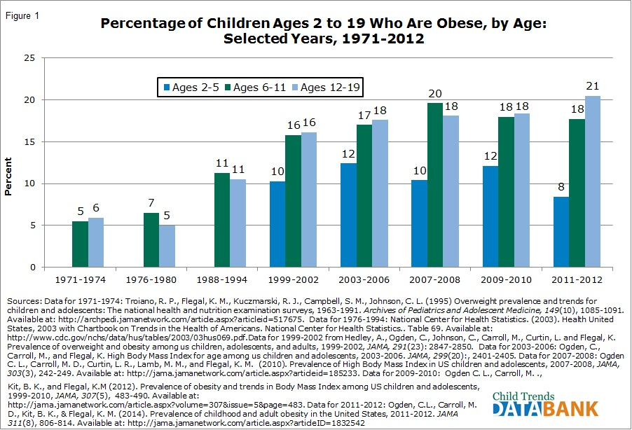

Slide 19


Slide 20
Levels of care to consider
Initial Management
  Medical “level of care” assessment
  Acute Pediatric/Medical ER/Inpatient
  - Hypokalemia
  - Bradycardia
  - Orthostatic Hypotension
-Inpatient Pediatric/Medical
-Inpatient Adolescent/Adult Psychiatric
-Inpatient Special Psychiatric Eating Disorder
-Day Treatment
-Outpatient/Intensive Outpatient Program

Slide 21
EATING DISORDERS: Characteristics of levels of care
Levels of care
  Specialized pediatric or medical inpatient
  General pediatric or medical inpatient
  Specialized psychiatric inpatient
  General psychiatric
  Residential programs
  Partial hospital
  Intensive outpatient
  Outpatient
Characteristics of different settings
  Unit security
  Patient legal status
  Physician on-site 24/7
  Nursing on-site 24/7
  Medical monitoring
  Hours of operation
  Able to maintain work/school
Available interventions
  Option for IV hydration
  Option for nasogastric tube feedings
  Option for treatment over objection
  Medical management
  Psychiatric management
  Psychological management
  Group-based therapies
  Individual psychotherapies
  Family psychotherapies
  Meal supervision and support
  Milieu therapy
  Nutritional management
  Multidisciplinary team-based management

Slide 22
APA Practice guideline for THE treatment of eating disorders https://www.psychiatry.org/psychiatrists/practice/clinical-practice-guidelines
2023
Notes:
Full practice guideline citation
Online and pdf versions available at: https://www.psychiatry.org/psychiatrists/practice/clinical-practice-guidelines
Executive Summary available at: XXX

Slide 23
EATING DISORDERS: Screening
Psychiatric Assessments should include screening for Eating Disorders
Rationale: Risk to health if present
Prevalence estimates based on the study design and country.
Rates for eating disorders that do not meet full criteria are even higher.
 | 12-month prevalence | Lifetime prevalence
Anorexia nervosa | 0.5% ♀ 0.1% ♂ | 1.4% ♀ 0.2% ♂
Bulimia nervosa | 0.7% ♀ 0.4% ♂ | 1.9% ♀ 0.6% ♂
Binge eating disorder | 1.4% ♀ 0.6% ♂ | 2.8% ♀ 1.0% ♂

Slide 24
EATING DISORDERS: Quantitative Measures
Initial Eating Disorder Assessment should include exact weight and quantifying of eating and weight control behaviors
(e.g., frequency, intensity, or time spent on dietary restriction, binge eating, purging, exercise, and other compensatory behaviors).
Rationale:
Establishes level of severity
Permits tracking of change with greater reliability than recall.
Consistent with suggestion to use quantitative measures.

Slide 25
EATING DISORDERS: Physical Examination and other signs
Abnormal vital signs
Height, weight, and BMI
- Indication of medical instability that warrants a higher-level care
e.g., heart rate <50 bpm, systolic blood pressure <90 mmHg, or temperature <36°C (96.8°F)
- Normal results may not exclude an eating disorder
Evaluate initially and at all follow-up visits
Notes:
Freeman R, Wieling W, Axelrod FB, et al: Consensus statement on the definition of orthostatic hypotension, neurally mediated syncope and the postural tachycardia syndrome. Auton Neurosci 161(1–2):46–48, 2011 21393070
Raj SR, Guzman JC, Harvey P, et al: Canadian Cardiovascular Society position statement on postural orthostatic tachycardia syndrome (POTS) and related disorders of chronic orthostatic intolerance. Can J Cardiol 36(3):357–372, 2020 32145864
Singer W, Sletten DM, Opfer-Gehrking TL, et al: Postural tachycardia in children and adolescents: what is abnormal? J Pediatr 160(2):222–226, 2012 21996154

Slide 26
EATING DISORDERS: Identification of Co-occurring Conditions
Assess for co-occurring health conditions and psychiatric disorders.
Rationale:
Health conditions confound the diagnosis, are associated with higher EDO frequency and contribute to complications.
Psychiatric comorbidity is common (depression, anxiety, trauma-related disorders, ADHD, misuse of substances such as stimulants).

Slide 27
EATING DISORDERS: Identification of Co-occurring Conditions (continued)
Substance Abuse Disorders
caffeine, tobacco, alcohol, cannabinoids, and others
smoking (including electronic cigarettes or vaping) to suppress appetite
the use or misuse of prescribed or non-prescribed medicines to suppress appetite (e.g., OTC weight loss products, stimulants) or enhance muscularity (e.g., supplements, androgens)
Trauma History and Suicide Risk
physical, emotional, or sexual abuse; bullying (including cyberbullying); neglect (including food insecurity); symptoms related to PTSD
suicide risk, including current suicidal ideas, plans, or intentions, prior suicidal plans or attempts, and the presence of non-suicidal self-injury
Notes:
Ferrell EL, Russin SE, Flint DD: Prevalence estimates of comorbid eating disorders and posttraumatic stress disorder: a quantitative synthesis. J Aggress Maltreat Trauma 31(2):264–282, 2020
Mason TB, Tackett AP, Smith CE, et al: Tobacco product use for weight control as an eating disorder behavior: recommendations for future clinical and public health research. Int J Eat Disord 55(3):313–317, 2021 34866222
Naveed A, Dang N, Gonzalez P, et al: E-cigarette dependence and weight-related attitudes/behaviors associated with eating disorders in adolescent girls. Front Psychiatry 12:713094, 2021 34526923

Slide 28
Planning Treatment
  Base treatment on comprehensive medical and psychiatric evaluations and assessment of co-morbidity
  Eating disorders rarely present as the sole psychopathology
  Assess for medical stability and safety first (suicidality or non-suicidal self-injury)

Slide 29
High Risk
Evidence-Based
Management
  Begin with medical stabilization
  Food is the mainstay of treatment
  Family Based Treatment (FBT) is the evidence- based approach for the younger patient
Close medical monitoring due to the risk of sudden death from hypokalemia and bradycardia

Slide 30
ANOREXIA NERVOSA: Family-Based Treatment in Adolescents and Emerging Adults
Eating disorder-focused Family-Based Treatment (FBT), which should include caregiver education aimed at normalizing eating and weight control behaviors and restoring weight.
Rationale:
Support from expert opinion and from a Network Meta-analysis of studies of psychotherapies for Anorexia Nervosa
FBT (with family in charge of the patients’ eating) led to greater changes in BMI than no treatment and greater changes in Initial Body Weight than treatment as usual.

Slide 31
Psychopharmacology of
Eating Disorders
There is no medicine for anorexia or bulimia nervosa
Co-morbid conditions should be treated
- anxiety, depression, inattention, mood fluctuations, psychosis
Fluoxetine (Prozac) may be helpful to reduce binge frequency in bulimia nervosa, but CBT is the treatment of choice
Lisdexamfetamine (Vyvanse) can somewhat reduce frequency of binge episodes with Binge Eating Disorder

Slide 32
Psychotherapy of
Eating Disorders
Family-Based Treatment (FBT) requires the capacity of the family to be engaged and cooperative (not playin’)
Cognitive Behavioral Therapy (CBT) is the E-B treatment for Bulimia
Dialectical Behavioral Therapy (DBT) may reduce suicidal thoughts and behavior and non-suicidal self injury, especially with trauma history
Notes:
Let Jim describe FBT and pcp react to level of care protocols (calorie count, ensure compensation, NGT, cut-off for inpatient, etc.)

Slide 33
Psychotherapy of
Eating Disorders
Individual psychotherapy is important once there is medical stabilization.
Family Therapy is important, regardless of the age of the patient, except with family-based abuse or neglect.

Slide 34
Nutritional Rehabilitation
No meaningful psychotherapy can occur with the malnourished brain
Food is the mainstay of treatment

Slide 35
Historical perspective
Anorexia Nervosa
Medieval times- Fasting Saints
1873 - Sir William Gull – Anorexia Nervosa
1980 – DSM-III – Anorexia Nervosa (25 % weight deficit)
1987 – DSM-IV – Anorexia Nervosa (15 % weight deficit)
2013 – DSM-5 – Anorexia Nervosa
(elimination of amenorrhea criterion & percentage weight cut-off )

Slide 36
DSM 5 criteria for
Anorexia Nervosa
Food restriction with low weight
Intense fear of gaining weight or becoming fat
Disturbance in body experience
Eliminates amenorrhea and percentage weight loss criteria

Slide 37
Historical perspective
Bulimia Nervosa
Gerald Russell, 1979 –
“an ominous variant of anorexia nervosa”
1980 – DSM-III Bulimia Nervosa
1987 – DSM-III-R Bulimia Nervosa
1990 – DSM-IV Bulimia Nervosa
2013 – DSM-5 Bulimia Nervosa

Slide 38
DSM 5 criteria of
Bulimia Nervosa
Recurrent episodes of binge eating
A sense of lack of control of eating
Recurrent inappropriate compensatory behaviors
Average once per week or more for 3 months
Self-evaluation unduly influenced by shape or weight

Slide 39
ARFID
Avoidant/Restrictive Food Intake Disorder
Apparent lack of interest in eating or avoidance based on sensory characteristics of food or concern about aversive consequences of eating (choking, vomiting)
The avoidance/restricted eating leads to failure to gain as expected
Often associated with sensory reactivity in Autism Spectrum Disorder

Slide 40
Course of illness
Prognosis
Mortality rates

Slide 41
?
True or False
Anorexia Nervosa may have the highest mortality rate of all psychiatric disorders.

Slide 42
?
Anorexia Nervosa
A. Amenorrhea is a diagnostic criteria
B. 15 % weight deficit is required to meet criteria
C. Is rarely found in males
D. A, B & C
E. None of the above

Slide 43
?
Avoidant/Restrictive Food Intake Disorder (ARFID)
A. Is not an eating disorder
B. Is a feeding disorder
C. Can be associated with Autism Spectrum Disorder
D. A & C
E None of the above

Slide 44
Minnesota Experiment of
Human Starvation
https://www.youtube.com/watch?v=8iH5htWIwo0

Slide 45
Questions

