Slide 1
Aggression:
Treatment
Zoya Popivker, DO
Child and Adolescent Psychiatrist
Northwell Health

Slide 2
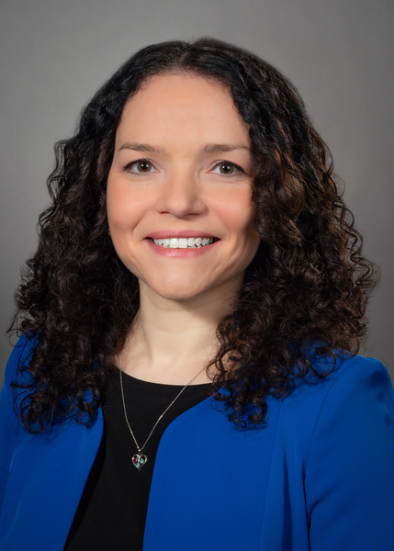
Speaker:
Zoya Popivker, D.O.
Northwell Health
zpopivker@northwell.edu
516-927-1630
Notes:
2

Slide 3
Disclosures
“Neither we nor our spouses/partners has a relevant financial relationship with a commercial interest to disclose.
Notes:
3

Slide 4
Learning Objectives
Learn about a resource to help guide assessment and treatment of aggression
Identify the components of an effective treatment team including family members and professionals
Understand the psychopharmacologic approach to clinical aggression

Slide 5
Poll:
How common it is in your practice for families to come to you specifically with concerns about a child's aggressive behaviors?
  Very Common
  Once in a While
  Rare

Slide 6
Poll:
When a patient has presented with concerns about aggression, which of these strategies have you typically used?
(Select all that apply)
  Referred to a mental health or another specialist.
  Prescribed or adjusted medication.
  Monitored the situation with planned follow-up.
  Felt unable to adequately address the issue.
  Called Project TEACH.

Slide 7
Notes:
7
Updated 8/26/13 by PSJ
NOTICE THAT ON THE SECOND “CLICK”, THE PEDIATRICS REFERENCE COMES UP. YOU CAN USE THIS TO ASK THEM IF THEY HAVE EVER HEARD OF T-MAY, AND THEN SURPRISE THEM BY CLICKING THE 2ND TIME, AND THE REFERENCE WILL SHOW UP – IN THEIR OWN JOURNAL!
Unit L: Aggressive Behavior

Slide 8
TMAY - Treatment of Maladaptive Aggression in Youth
Published in Pediatrics 2012
Expert panel guidelines

Slide 9
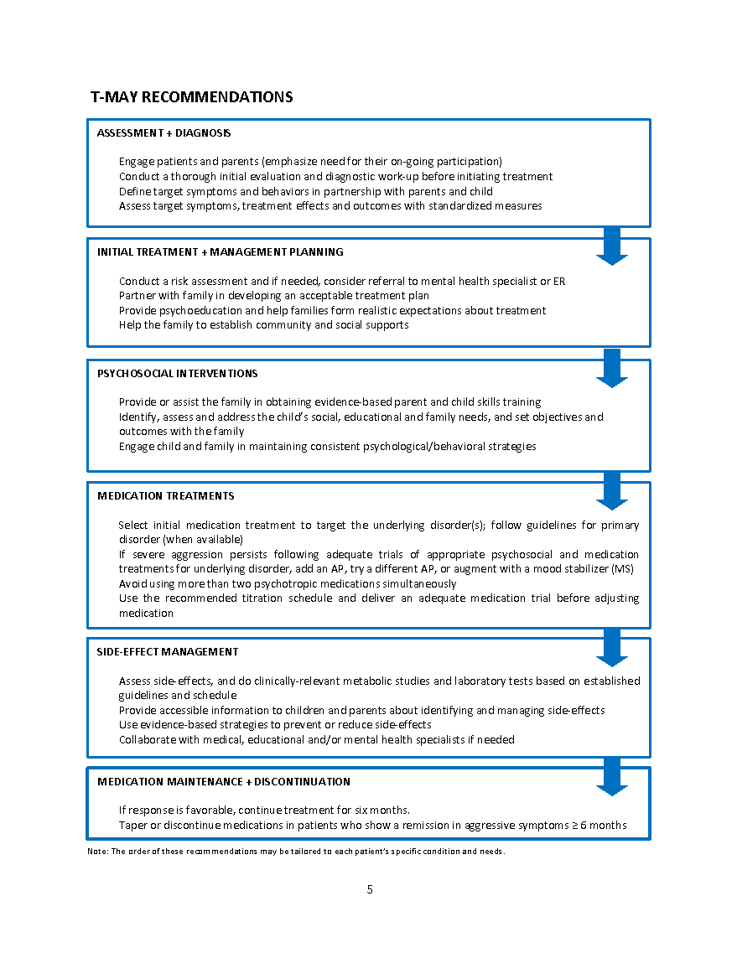
T-MAY Algorithm:
Assessment & Diagnosis
Treatment Planning
Treatment
Ongoing Management
9
Notes:
Updated 8/26/13 by PSJ
The finalized treatment recommendations are shown here in a flow chart or algorithmic format. The recommendations represent a conservative and systematic approach to treatment and were designed to assist with physician decision making at a variety of different phases of intervention.
Note: It should be stressed that the T-MAY recommendations do not apply neatly to all cases and are intended to support physicians’ decision-making, not replace it. In addition, these recommendations must be revised regularly to keep pace with current treatment options and may be updated as new information becomes available.

Slide 11
T-MAY Recommendations
Treatment Planning
Conduct a risk assessment & if needed, consider referral to a MH specialist or ER, Urgent Care, CPEP, Mobile Crisis service
Partner with family in developing an acceptable treatment plan
Provide psycho-education to help families form reasonable expectations
Help the family establish community & social supports
Notes:
11
Updated 8/26/13 by PSJ
Unit L: Aggressive Behavior

Slide 12

www.AACAP.org
-CHADD
-Parent To Parent of NYS www.ptopnys.org
-NY State Parent Network parentnetworkwny.org
-Families Together in New York State www.ftnys.org
- Advocacy Group –Parent support
-HealthyChildren.org
-Understood www.understood.org – high quality information
about schools. ADHD, learning
-National Alliance for the Mentally Ill: www.nami.org

Slide 13
T-MAY Recommendations
Psychosocial Interventions:
Provide or assist family in obtaining evidence-based parent- and child- skills training
Identify, assess, and address the child’s social, educational, & family needs, and set objectives & outcomes with the family
Enlist & engage the child and family in maintaining consistent psychological & behavioral strategies
Notes:
13
Updated 8/26/13 by PSJ
Unit L: Aggressive Behavior

Slide 14
Psychosocial Interventions
Address the ongoing safety and ACES in the home
Address educational issues
  Assess school support: IEP, 504, need for behaviorist consult, FBA
Refer for afterschool/summer activities
  Structured community activities
Counsel your families on parenting approaches
Refer for evidence-based psychosocial interventions
Notes:
CHADD?
Community support groups ?
14

Slide 15
Psychosocial therapies for aggression and comorbidity targets
Individual child therapies
  CBT (cognitive behavioral) therapies for self management
  Treatments for trauma or other comorbidity
Parent-child therapies for behavior
  Parent education
  PCIT
  Triple P/PPP
  Behavioral therapies focusing on managing antecedents and consequences (ABA)
School related supports and therapies
  Data gathering and positive behavioral supports
Systemic therapies for older patients
  Individual/parental/marital/family therapies
  Multisystemic therapy
Notes:
Breck slide
15

Slide 16
Child Only Psychotherapies
  Coping skills for child: learning how to calm self, what puts them in the aggressive “red zone”, what to do to prevent, when best time to intervene
  An individualized recipe such as “modular” therapies for comorbidity of anxiety, trauma, depression, ADHD, conduct
  But BEST in concert with parent-child work

Slide 17
Parent-Child Therapies for Aggression
Cycles of coercive aggression within a family can be intergenerational and trauma based (Gerald Patterson,1980s)
  Child observes modeled “successful” aggression in family
  Escalation of violence by child to have family submit to child’s wants (appeasement)
  Pattern of aggression is reinforced in all family members
Antecedents and consequences of aggression are important to consider in all cases. Assess disciplining styles of parents. Getting dads involved can turn the case around.
THINK ABOUT A-B-C’s

Slide 18
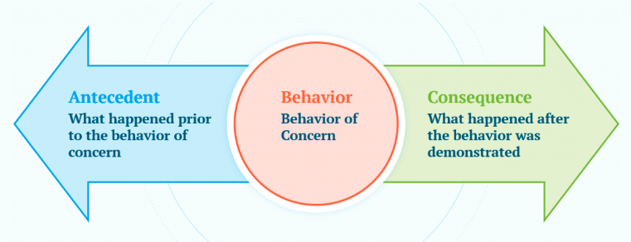
Back to the ABC’s

Slide 19
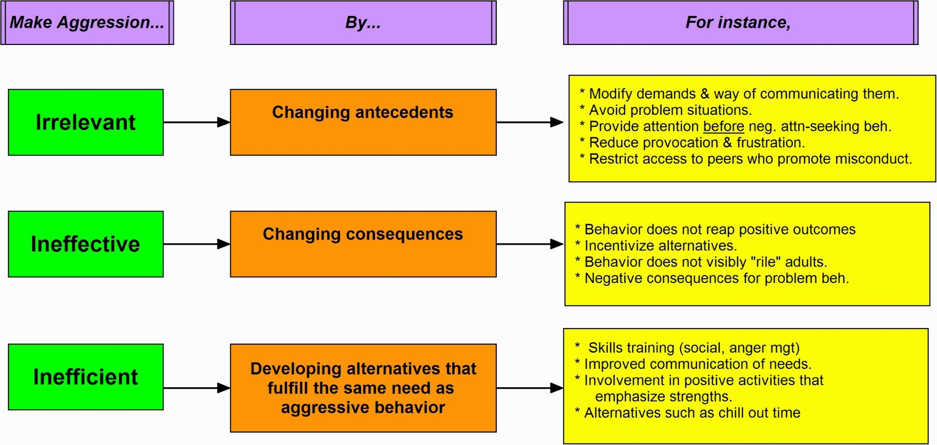
Psychosocial Treatments
Blader & Jensen, 2007; Blader & Connor, 2017. Based on O’Neill et al, 1997
Notes:
19

Slide 20
Psychosocial Treatments: Antecedents
Blader & Jensen, 2007; Blader & Connor, 2017. Based on O’Neill et al, 1997
Notes:
20

Slide 21
Psychosocial Treatments
Blader & Jensen, 2007; Blader & Connor, 2017. Based on O’Neill et al, 1997
Notes:
21

Slide 22
Psychosocial Treatments
Blader & Jensen, 2007; Blader & Connor, 2017. Based on O’Neill et al, 1997
Notes:
22

Slide 23
Behavioral Principles
Involve the parent: “I can’t do it without you. Pills alone won’t give your child the skills he/she needs.”
First focus on engagement and the positive (e.g. play, read, “catching them being good”)
Attention to how limits set and structure provided at home
  Proactive parents better than reactive. Pre-decided realistic positive rewards and consequences are most useful.
  Parents to be clear about which problem behaviors targeted and be clear about when occurrence is a problem.
  Ignore behaviors. Parents should track relative positive and negative comments. Under stress we all tend to be negative in tone.
  Apply fairly and nonjudgmentally/ “emotionally neutral”.
  Consistency: All parental figures work together and follow through.
23
Notes:
Updated 8/26/13 by PSJ
.

Slide 24
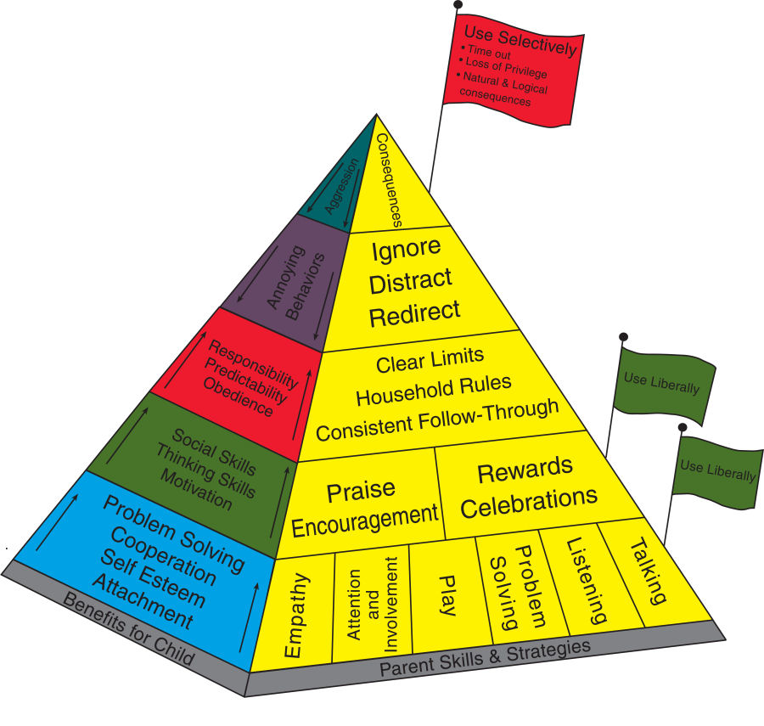
Incredible Years Parenting Pyramid
“Connect before you Correct”
24
Notes:
Relationship Is bigger greater than this one event
PACE: Dan Hughes. Pause/Play, Accept, Curiosity, Empathy
24

Slide 25
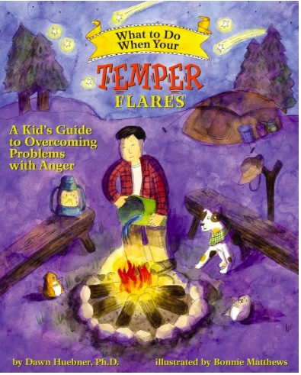
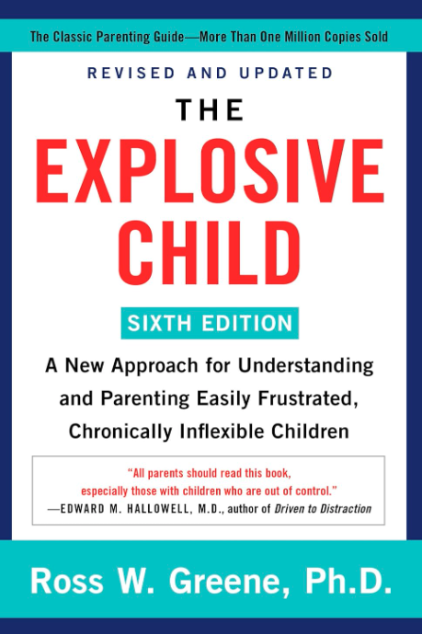

RESOURCE SLIDE: Parenting Books you can read to help the parents of your Patients
Notes:
25
Unit L: Aggressive Behavior

Slide 27
T-MAY Recommendations
Medication Treatments:
Treat the 1º Disorder (underlying condition) first, using recognized guidelines for that disorder.
ONLY IF severe aggression persists after adequate psychosocial & medication treatments for the 1º Disorder, add an AP
  If first AP fails, try another, or consider mood stabilizer
If possible, avoid using more than two psychiatric medications simultaneously
Use recommended titration schedule and deliver adequate doses before adjusting or changing medications
27
Notes:
Updated 8/26/13 by PSJ

Slide 28
Identify and Treat the Primary Issue First
Don’t start a referral, medication, or therapy for “aggression” until we have implemented treatment for the primary problem

Slide 29
Impulsive-Aggressive Spectrum
Severe
Anxiety
Bipolar
spectrum
ADHD
spectrum
Tourette’s
/OCD
PTSD
Cluster B
personality disorders
Impulsivity and Aggression
Developmental
disorders
Antisocial
Borderline
Conduct
Disorder
Substance
abuse
Autism
Spectrum
disorders
Schizophrenia
Spectrum
Impulse
control
disorders
Notes:
RESOURCE
Carlson talks about which of these most common within patients who come in with ‘aggression’ or ‘outbursts’

Slide 30
DSM Diagnoses with Aggression
Anxiety
Autism Spectrum Disorders
ADHD
PTSD
Impulse Control Disorders
Bipolar Disorder
Disruptive Mood Dysregulation Disorder (DMDD)
Conduct Disorder
Substance Use Disorders
Schizophrenia/ Psychotic Disorders
Personality Disorders/ Cluster B/ Antisocial Personality Disorder

Slide 31
What is the Place of Medication in the Management of Aggression?
Treatment of the underlying condition- e.g. ADHD – stimulant, non stimulant such as alpha-2 agonist
Anxiety/Depression – SSRIs- etc.
View aggression
as a symptom,
not a diagnosis!

Slide 32
Methylphenidate in ADHD/CD: Impulsive Aggression
P < 0.001
P < 0.003
Aggression
(Iowa Scale*)
P < 0.03
32
n =
71
35
36
74
37
37
47
24
23
*Sum of 5 items, range 0-15
Klein RG et al. Arch Gen Psychiatry. 1997;54:1073-1080.
Notes:
Updated 8/26/13 by PSJ
74 patients with Conduct Disorder and ADHD. The authors postulated that stimulants such as methylphenidate would NOT improve symptoms of Conduct Disorder. Treatment for 5 weeks. Two thirds met criteria for ADHD!. Results- antisocial behaviors specific to CD improved o methylphenidate. Improvement was independent of severity of ADHD sx.
This slide shows that aggression, NOT JUST ADHD symptoms, benefits by appropriate dosing of stimulants, when ADHD kids have accompanying aggression. So, they need to monitor treatment response for ODD/aggressive symptoms as well, and to not underdose, if the child’s ADHD symptoms are better, but impulsive aggression still is a problem, such as the case with Drew
https://pubmed.ncbi.nlm.nih.gov/9400342/

Slide 33
Before adding medications for aggression, make sure the medications for the primary disorder have been maximized

Slide 34
Optimize meds for the primary disorder first
Don’t add an alpha agonist or an atypical antipsychotic to combat aggression in an ADHD child until we have maximized stimulants.
  If stimulant has been optimized, then consider alpha-2 agonist if sx persist, before adding atypical.
Don’t add an antipsychotic for an aggressive anxious child until SSRI trials have truly failed
Notes:
34

Slide 35
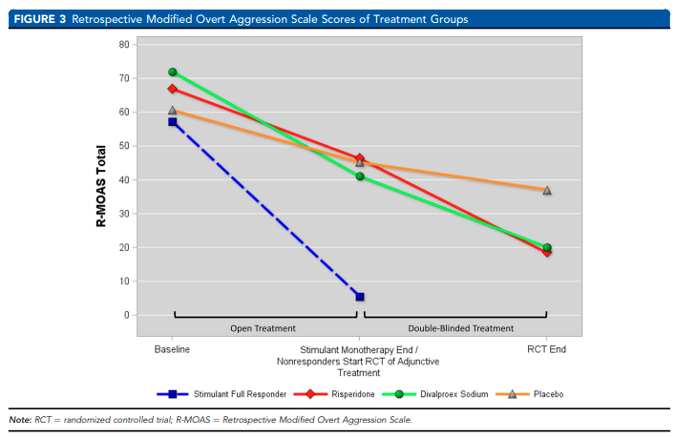
Joseph Blader et al
JAACAP 2021
Stepped Treatment for ADHD and Aggression
Notes:
Joseph Blader et al JAACAP 2021
In this issue of the Journal, Blader et al.1 report the results of a double-blind randomized controlled trial (RCT) aimed at assessing the comparative efficacy and tolerability of adjunctive risperidone (RISP), valproex sodium (DVPX), or placebo for aggressive behaviors in children (aged 6−12 years) with attention-deficit/hyperactivity disorder (ADHD) and comorbid oppositional defiant disorder (ODD) or conduct disorder (CD), as well as a prior history of psychostimulant treatment. Participants with aggressive symptoms persisting after an open-label optimization of psychostimulant medication entered the 8-week randomized phase. Weekly sessions of family-based behavioral treatment were offered during both the optimization and the randomized phases. Among the 151 participants who completed the optimization phase (175 were initially enrolled), an unexpected 63.6% met the study criteria for remission, that is, 3 consecutive weeks with subthreshold scores on the Retrospective−Modified Overt Aggression Scale (R-MOAS). Therefore, only 45 participants were eligible for randomization, and 40 (RISP: n = 17; DVPX: n = 14; placebo: n = 9) were included in the primary analysis. Why did JAACAP publish an inconclusive trial? Because, in our view, the lessons that can be learned from this RCT (in particular, from its optimization phase) are highly relevant for both clinicians and trialists in the field. We are confident that the Blader et al. study will contribute to make clinicians in the field more “optimizers” and trialists more “transparent.”21
Optimization: Concerta 18mg increments titrated up to 72mg but could up to 89mg, if adverge effectives can go to MPH biphasic 60mg max, or mixed amphetamine salts up to 35mg. 104 participants Concerta, 17 MPH BI, 42 mixed amph salts.
63% met met criteria for study’s cirteria for remission after stimulant optimization trial.
Blader, J.C. ∙ Pliszka, S.R. ∙ Kafantaris, V. ...
Stepped treatment for attention-deficit/hyperactivity disorder and aggressive behavior: a randomized, controlled trial of adjunctive risperidone, divalproex sodium, or placebo after stimulant medication optimization
J Am Acad Child Adolesc Psychiatry. 2021; 60:236-251
35

Slide 36
IF severe aggression persists despite,
treatment of the underlying condition has been optimized
psychosocial treatments are not successful
control of the initial level of aggression is urgent
Consider: second generation antipsychotic medication trial

Slide 37
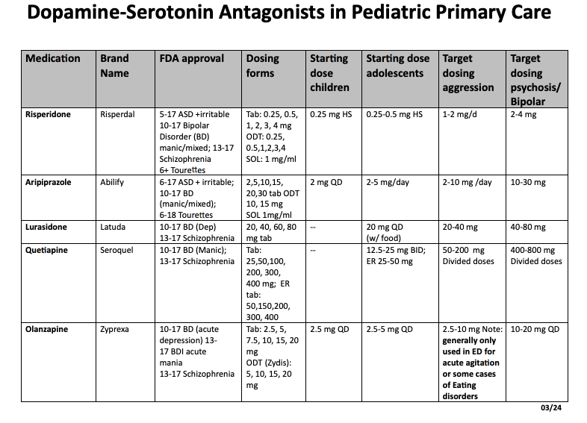

Slide 38
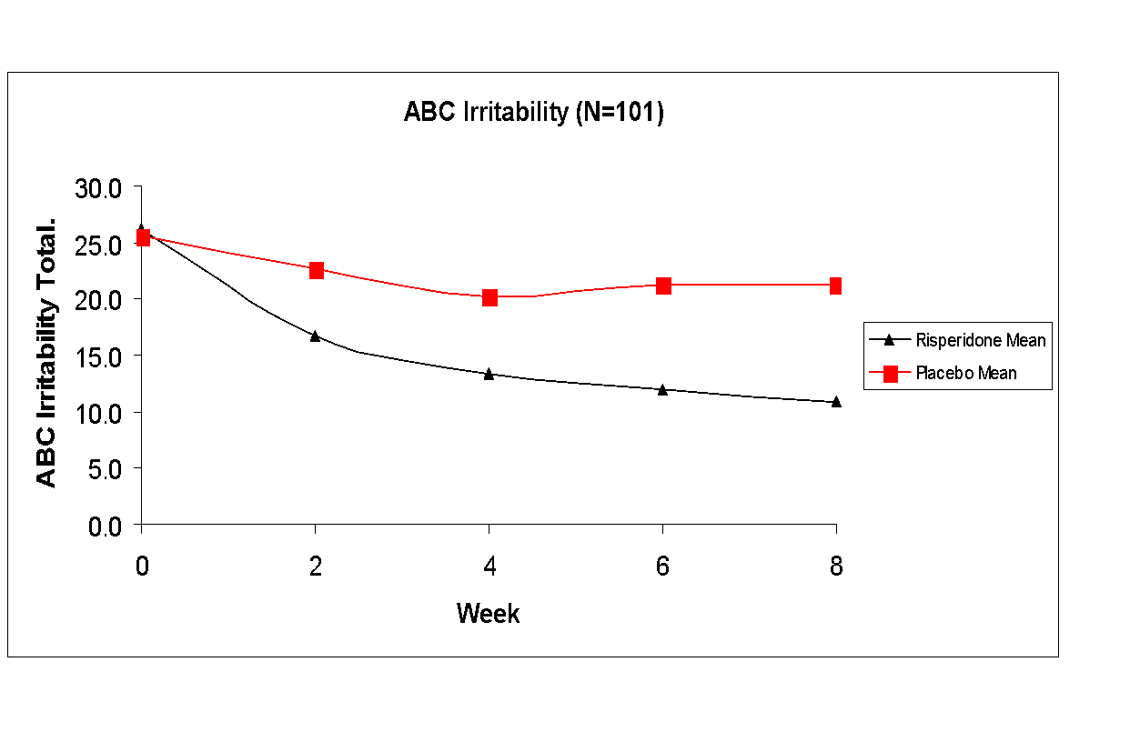
Resource: Risperidone in Autism: Irritability Scale
RUPP Autism Group, NEJM, 2002

Slide 39
Atypical Antipsychotics in Disruptive Behavior Disorders With Aggression: Levels of Evidence
Atypical Antipsychotics | Short-Term Efficacy
Risperidone Aripiprazole Olanzapine Ziprasidone Clozapine Quetiapine | A B* C C C D
39
A = >2 randomized, controlled studies; B = 1 randomized, controlled study; C = clinical experience, eg, open studies, case reports, etc., D = no data or negative outcome.
Studies done with aggression/irritability in autism: Based on all available RCTs thru 8/2013. Adapted from Jobson KO, Potter WZ. Psychopharmacol Bull. 1995;31:457-459.
Notes:
Updated 8/26/13 by PSJ
This table evaluates the levels of evidence for the short-term efficacy of atypical
antipsychotics in disruptive behavior disorders with aggression in children and
adolescents.
A lettering system—A, B, and C—developed as part of the International
Psychopharmacology Algorithm Project report has been used to indicate the current
levels of evidence for a pharmacologic agent. An A rating indicates two or more
randomized, controlled studies; B = 1 randomized, controlled study; C = clinical
experience, eg, open studies, case reports, etc. In addition, a D rating, indicating
either no data or negative outcome has been used.
Risperidone has an A rating; olanzapine, ziprasidone, and clozapine have a C
rating; and quetiapine and aripiprazole have a D rating.
Reference
Jobson KO, Potter WZ. International Psychopharmacology Algorithm Project Report:
Introduction. Psychopharmacol Bull. 1995;31:457-459.

Slide 40
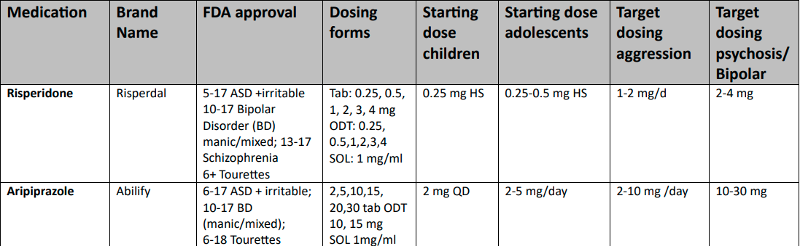

Slide 42
Atypical Antipsychotics: Side Effects
Sedation
Weight gain
Metabolic Syndrome, Diabetes
Gynecomastia/Galactorrhea/Amenorrhea
Cardiac (ziprasidone), orthostatic hypotension
Motor
  Akathisia (Barnes Akathisia Rating Scale)
    inner restlessness and externally observable restlessness
  Extrapyramidal side effects (Simpson Angus Scale)-Parkinsonism
    Shuffling, gait, rigidity, tremor, salivation, head rotation, eye rolling
  Tardive Dyskinesia (Abnormal Involuntary Movement Scale) AIMS
    Special focus on the jaw, tongue, perioral area

Slide 43
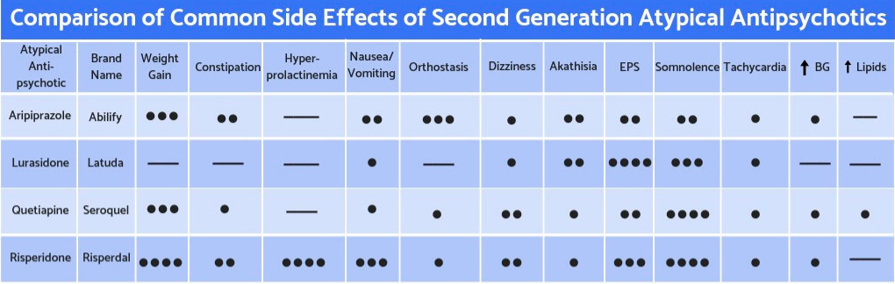
https://projectteachny.org/child-rating-scales. Under “Aggression”

Slide 44
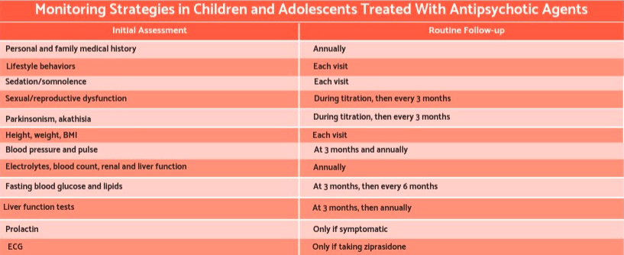
AIMS, Barnes Akathisia scale

Slide 46
Guidelines recommend maintaining an atypical for about 6 months. IMPORTANT TO EDUCATE AT THE OUTSET
The intent is to build self regulation skills that will allow the gradual withdrawal and cessation of meds after 6 months

Slide 47
T-MAY Recommendations
Ongoing Management
Start low, go slow, taper slow (25% dose reduction every 2-4 weeks)
Routinely assess for side effects and drug interactions, including clinically relevant metabolic studies
Provide info to children & parents re: side effects
Collaborate with medical, educational, and/or MH specialists as needed
47
Notes:
Updated 8/26/13 by PSJ

Slide 48
Reassess
Reassess
Reassess
Medications needed for aggression at one time may no longer be needed.
Don’t blindly refill prescriptions or accept another provider’s refills without a reassessment
Notes:
48

Slide 49
Aggression Treatment Pearls
Form a team – Enlist the family in reading (Ross Greene, etc.) and problem-solving
Diagnose and aggressively treat any underlying disorder, especially ADHD/ODD
Encourage use of behavioral strategies, building new skills
If/when all of the above aren’t enough, consider atypical or other agents!
49

Slide 50
We are here to help!
www.projectteachny.org
1-855-227-7272
Notes:
Cori and Rachel
Explain resources
50

Slide 51
Resource: Atypical Toolbox
Atypical Antipsychotic | Start at (mg / day) | Target Dose (mg/day) | Monitor | Watch Out For
Risperidone | 0.25-0.50 | 1-3 | Weight/Height/BMI | EPS/TD
Aripiprazole | 2.5-5 | 5-20 | Weight/Height/BMI | EPS
Quetiapine | 50-100 | 300-600 | Weight/Height/BMI
Ziprasidone | 20-40 | 80-160 | Weight/Height/BMI ECG | Take with food, assess cardiac risk factors
Olanzapine | 5 | 5-20 | Weight/Height/BMI | Choles/FAs

Slide 52
Resource: T-MAY Resources
Complete 38-page Toolkit: go to website to download pdf: www.TheReachInstitute.org (see Footer – “Resources”)
Knapp P, et al., & the T-MAY Steering Group. Treatment of Maladaptive Aggression in Youth (T-MAY) Guidelines I. Family Engagement, Assessment & Diagnosis, and Initial Management. Pediatrics, 129:e1562-1576, 2012
Scotto Rosato N, et al., & the T-MAY Steering Group. Treatment of Maladaptive Aggression in Youth (T-MAY) Guidelines II. Psychosocial Interventions, Medication Treatments, and Side Effects Management. Pediatrics, 129:e1577-1586, 2012
Pappadopulos E, et al. Treatment of Maladaptive Aggression in Youth (T-MAY). Results from a Consensus Survey of Experts-recommended Best Practices. J Child Adol Psychopharm, 21:505-515, 2011
Notes:
Updated 8/26/13 by PSJ
Point out that the toolkit is 38 pages long, so if they want ALL of it, they will have to go to the REACH website and download it. But the workbook does include ½ of it, the most immediately useful pages and tools

