Slide 1
Assessment of Aggression in Children and Adolescents
NY Statewide Intensive Training:
Child and Adolescent Mental Health for Primary Care Clinicians
04/20/25

Slide 2

Jessica Grant, MD, FAAP
Founder, Partner, and Pediatrician,
Manhattan Valley Pediatrics, New York, NY
Project TEACH, Primary Care Champ

Slide 3
Disclosures
Neither I nor my spouse have a relevant financial relationship with a commercial interest to disclose.

Slide 4
Goals and Objectives
Understand aggression as a ”final common pathway” symptom
Recognize the factors that contribute to the vulnerability to aggression
Describe the underlying conditions most frequently associated with aggression in children
Learn how to assess and evaluate children who present with aggressive symptoms

Slide 5
Why Is Aggression Addressed In Intensive Training?
Frequently reason for seeking help from primary care
Most common reason for psychiatric referral
Complicates treatment and leads to poorer outcomes
Frequently leads to use of atypical antipsychotics and multiple medications
Lack of controlled trials to inform physicians’ prescribing practices

Slide 6
Let’s Meet Cliff

Slide 7
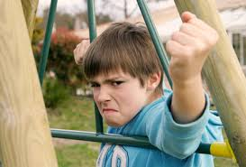

Slide 8
Cliff
Identifying Information:
Cliff is a 9-year-old 4th grader who lives with his parents and 2 siblings.
Chief Concern:
“We’ve had a tough spring and summer with Cliff. He gets his Concerta every morning. His problems with poor attention and hyperactivity have improved and his grades are better. But his temper is a real problem. His after-school program asked us to keep him home until he is better.”

Slide 9
What additional information would you like?

Slide 10
Cliff: History of Present Illness
Difficulties with attention and hyperactivity dating back to preschool.
Started on Concerta 18 mg a year ago.
The dose gradually raised to 54 mg with continued improvement.
In the past few months his parents report increased oppositional behaviors at home
His tantrum episodes occur almost daily at home and out of the house, which is embarrassing for mom and is is getting worse.
Recently he threw a toy at his mother and she needed to go to the emergency room for stitches.
School reports oppositional and aggressive behaviors
Sleeping and eating well; denies sadness, worrying

Slide 11
Cliff: Additional History
Past Psychiatric Illness: Prior history of ADHD treated by PCP
Medical History: Well child
Developmental History: Normal pregnancy and delivery. Walked at 11 months, first words 14 months, phrases by 2 years
Stressors: No maltreatment, recent losses.
Family Medical & Psychiatric History: Mom has been treated for depression. Dad had “behavioral problems as a child”

Slide 12
Cliff’s Vanderbilt

Slide 13
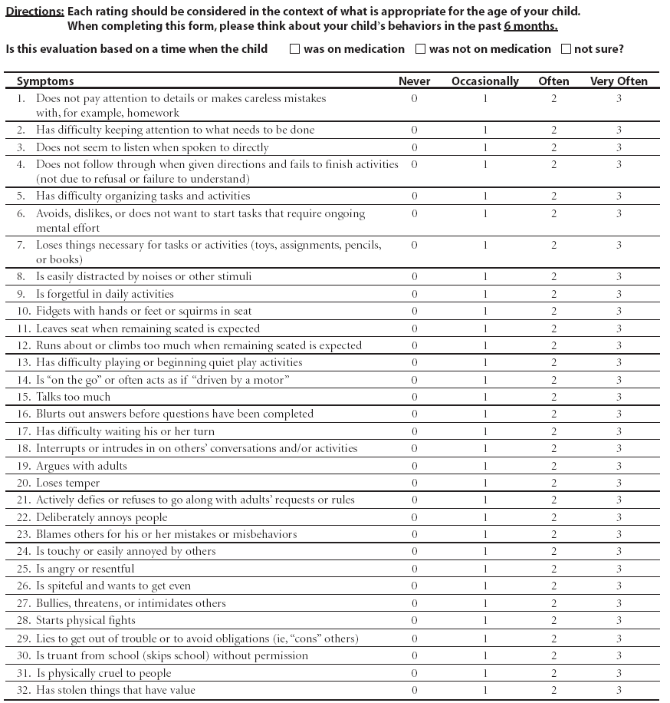
NICHQ Vanderbilt Assessment Scale:
Parent information
Notes:
Updated 8/26/13 by PSJ
THIS SLIDE IS HIDDEN – INCLUDED HERE MOSTLY FOR THE PRESENTER. YOU CAN “UNHIDE” IT IF YOU WISH.

Slide 14
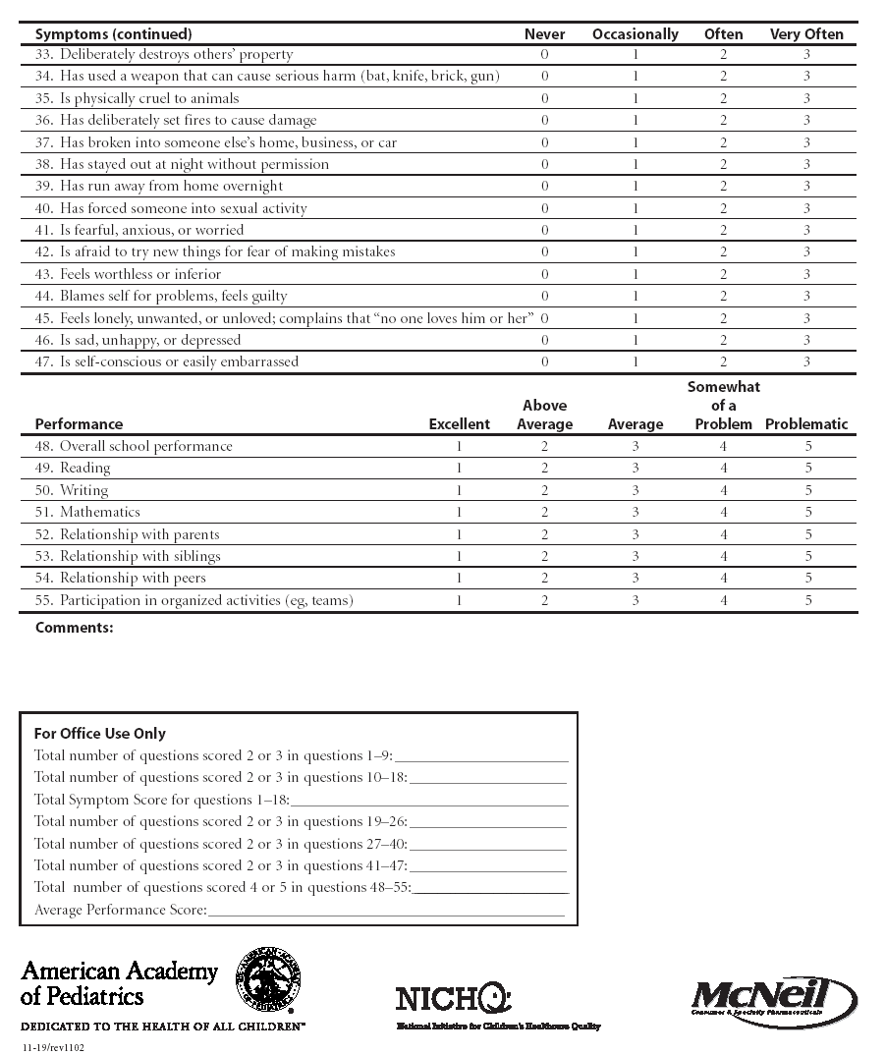
NICHQ Vanderbilt Assessment Scale:
Parent information
Notes:
Updated 8/26/13 by PSJ
THIS SLIDE IS HIDDEN – INCLUDED HERE MOSTLY FOR THE PRESENTER. YOU CAN “UNHIDE” IT IF YOU WISH.

Slide 15
Cliff’s Vanderbilt - Scored
Total number of questions scored 2 or 3 in questions 1-9: Inattention | 2
Total number of questions scored 2 or 3 in questions 10-18: Hyperactivity | 1
Total Symptom Score for questions 1-18: Inattention and hyperactivity | 3
Total number of questions scored 2 or 3 in questions 19-26: Oppositional | 5 > 4 = ODD
Total number of questions scored 2 or 3 in questions 27-40: Conduct | 0
Total number of questions scored 2 or 3 in questions 41-47: Anxiety and depression | 0
Total number of questions scored 2 or 3 in questions 48-55: Performance | 8
Average Performance Score:

Slide 16
What would you do now?
Complete our Assessment!

Slide 17
Understanding Aggression in Children & Adolescents: The “Fever” of Psychiatry
Aggression is not a diagnosis
Aggression IS a “final common pathway” when system overwhelmed
Associated with almost all DSM diagnoses
Occurs when the demands of the world outstrip our resources
Internal (child strengths)
External (family, community, school)

Slide 18
Mindset to bring: Engagement Pearls
Assume kids feel guilty and ashamed (parents too)
Take a “no fault” spirit
Kids do well if they can
Parents do the best they know how
Aggression is a “final common pathway and result of a confluence of factors (not one thing)
Actively involve the parent: “I can’t do it without you. Pills alone won’t give your child the skills he/she needs.”
Actively involve child/youth in recognizing “red zone”, monitoring and controlling aggressive outbursts

Slide 19
Type | Clinical Description | Representative DSM Dx
Impulsive | Unprovoked, brief, rapid, thoughtless, inability to delay reward/recognize consequences; out of proportion and out of the blue | ADHD TBI ID Bipolar
2. Affective Storm/”Hot” | Exaggerated response to affectively provoked or charged (i.e. difficulty modulating arousal), reactive. “Hot blooded” aggression. Extended duration (30+ minutes) | ADHD ASD/ID Substance abuse MDD/DMDD Bipolar
3. Anxious/hyperarousal | Overstimulation, overwehelmed, response to xs anxiety; lash out with relief of tension | PTSD PDD OCD
4. Cognitive/disorganized | Distorted perceptions, impaired reasoning, delusions, paranoia | Psychosis Bipolar Schizophrenia TBI/FASD Substance Abuse
5. Predatory/”Cold” | Premeditated, consciously executed, instrumentally motivated, “cold blooded” | Conduct Disorder Antisocial PD

Slide 20
Evaluation: General Principles
Take the time needed to understand the child and problems!
Bring child back to assure confidence that you understand
Resist the need to prescribe on the first visit!
- Interview family together – observe dynamics
- Interview patient and parent/guardian
separately
HPI, Family History, Psychosocial History and Strengths
Get input directly from school
Use standardized rating scales
Physical examination (as indicated) and labs (typically none)
Notes:
Updated 8/26/13 by PSJ
Comprehensive diagnostic interview with patient and parent/guardian.
Contact prior treating physicians
Review treatment records
Identify other medications being taken
Conduct a physical examination
Order appropriate laboratory studies
Background Information
A psychiatrist should conduct a comprehensive diagnostic interview with children/adolescents and their parents/guardians before initiating or altering treatment regimens. It is important to contact physicians who have previously treated the patient and to obtain all prior treatment records, including prior medications. Since some symptoms may have an organic basis, it is also essential for the patient to have a physical examination and to undergo appropriate laboratory studies.

Slide 21
The Four Questions: Assessment of Children with Aggression
How severe/dangerous is the aggression?
What is underpinning the aggression? (Check for maltreatment)
What changed—what tipped the apple cart over?
How have the parents responded?

Slide 22
1. How Severe: Modified Overt Aggression Scale (MOAS)
- Parent or Teacher Report
- Verbal Incidents
- Incidents involving property
- Incidents towards other people
- Incidents directed towards self
Notes:
PT website

Slide 23
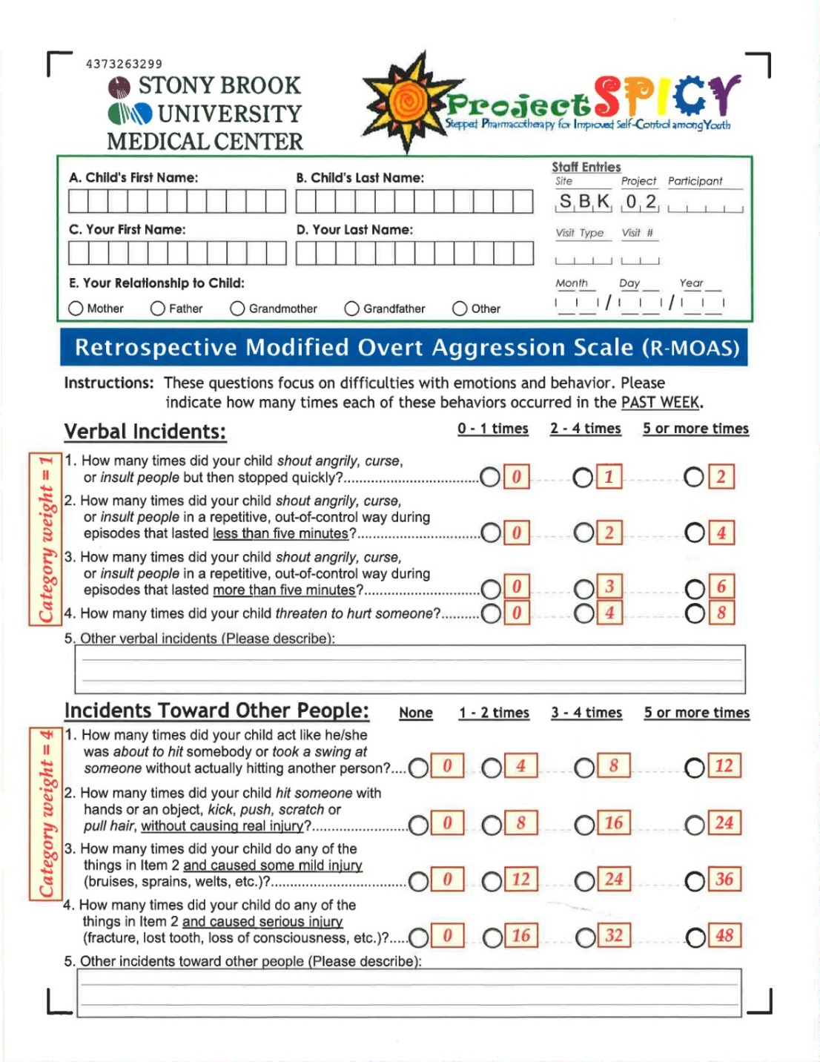

Slide 24
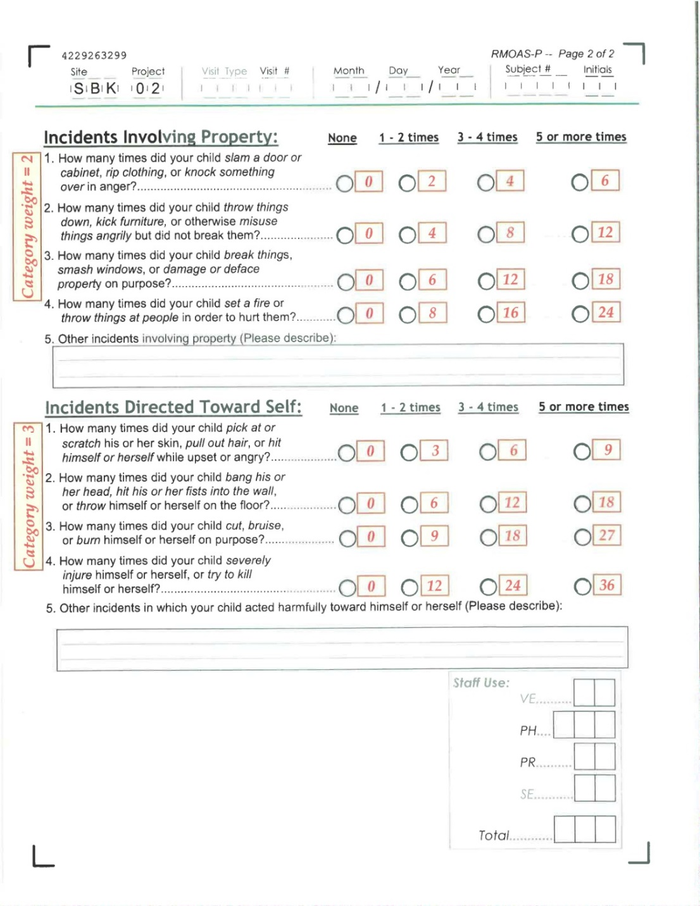

Slide 25
Outburst Monitoring Scale

Slide 27
Scoring MOAS-R
Verbal aggression: 0-2 for each item= 7
Incidents towards other people: 0-3 for each item=7
Incidents towards property: 0-3 for each item=4
Incidents towards self: 0-3 for each item=0
TOTAL: 18
Prepubertal children*: 11 serious concern, 17 major problem
Adolescents: 8 serious concern and 15 major problem
Typical kids < 3
*Rough clinical guide; NOT empirically validated on general population

Slide 28
2. What is underpinning the aggression? Impulsive-Aggressive Spectrum
ADHD spectrum
Severe
Anxiety
Bipolar spectrum
Schizophrenia
Spectrum
Tourette’s
/OCD
Developmental
Disorders
Impulsivity and
Aggression
Autism Spectrum
Disorders
PTSD
Conduct
Disorder
Substance abuse
Cluster B personality
disorders

Slide 29
Clinical Pearl: What’s underpinning the aggression?
In children, first consider trauma and loss, then look for these common condition(s) underpinning aggression:
- ADHD
- Anxiety
- Depression
Use your standardized measures (e.g. Vanderbilt, SCARED, CES-D, PHQ, etc)!

Slide 30
3. What Changed?
When did this start?
Did the demands of life (family, peers, academic, emotional, behavioral, physical) change?
Did the internal resources change?
Onset or worsening of mental illness
Physical illness or medications
Accident
Substance misuse
Did the external circumstances or resources change?
Recent traumatic experience or loss?
Parental availability change?
Extended family changes?
Peers change? Move?
School? Teachers change? Bullying?
Community? Safety?

Slide 31
4. How are Parent(s) Responding: ABC’s Antecedent, Behavior, Consequences
What precipitates the aggressive incidents?
How do the parents respond?
Do they reward/notice good behavior?
What kind of consequences do they use?
What is the interactional cycle that takes place?
Do the parents/adults work together?
Are the consequences reasonable and practical?
Can they be carried out?
Are they carried out?

Slide 32
Cliff’s Parents Response
Parents report that ”nothing stops him!”
Mom usually the disciplinarian as Dad works till later
Mom sharply tells Cliff to stop but when he persists, she often loses her temper and yells at him
Mom at times tells him to take a time out but he refuses
When Dad gets home, he ”talks to Cliff” about his behavior and urges him to stop

Slide 33
Conclusions: Assessment and First Steps
Aggression is a ”final common pathway” symptom; we need to understand what is leaving child vulnerable
Engage the family and child
Conduct a thorough assessment to understand
Severity and dangerousness of the aggression (use rating scales)
Rule out trauma
What is underpinning the aggression?
What changed? Factors relevant to aggression in the child/adolescent (what’s driving the aggression and what tipped over apple cart?)
Parent response
Provide psychoeducation and support

