Slide 1
Treatment of
Anxiety Disorders in Children and Teens
Zoya Popivker, D.O.
Child and Adolescent Psychiatrist
Northwell Health
Notes:
Decide what font you want to use for titles/heading and make them the all same.

Slide 2

Speaker:
Zoya Popivker, D.O.
Northwell Health
zpopivker@northwell.edu
516-927-1630

Slide 3
Disclosures
Neither I nor my spouse/partner has a relevant financial relationship with a commercial interest to disclose.

Slide 4
Anxiety: Objectives for Primary Care
Gain resources for anxiety education
Discuss the role of avoidance in anxiety disorders
Understand the most utilized method of psychotherapy for Anxiety Disorders
Identify the medication class of choice in pediatric Anxiety Disorders

Slide 5

Emily
8 yo girl who is brought in because of stomach aches
Evaluated by GI and no medical condition identified
Difficulties getting her to school since kindergarten
Crying at drop off, clingy to parent
In 2nd grade missed 10 days of school
Now in 3rd grade, has missed 20 days of school to date
Even when she gets to school, she goes to nurse often with stomach aches, sometimes the only resolution is mother picking her up early
No academic issues
If mom unable to pick her up Emily calls frequently to “check in” and make sure that “nothing bad happened”
At home she appears comfortable, pleasant, watches TV
Maintains friendships with small group of girls she has know since pre-K
Does not enjoy play dates or want sleepovers at friend’s homes
During office visit, she is quiet, but smiles easily
PE is unremarkable
No known trauma/loss
SCARED: 38
Notes:
School avoidance
Somatic sxs

Slide 6
What treatment would you recommend ?
a. Write a letter for Home Instruction
b. Refer for therapy and collaborate with the school
c. Start a medication for anxiety
d. Wait and monitor for now

Slide 7
1. Lifelong Anxious Temperament 2. Family History of Anxiety Disorders
Early Intervention
For “At Risk” Kids

Slide 8
Goals of Early Intervention
Parents education about anxiety
Prevent Anxiety Disorders in children with anxious temperament
Reward and model curiosity, exploration
Reduce avoidance and overprotectiveness
Prevent generational transmission of Anxiety
Adapted from Slide courtesy of Dr. Zuckerbrot

Slide 9
Anxiety Education
What is Anxiety?
Anxiety is normal and helpful in small doses
Why me?
Genes and temperament
Life experiences
Development of “thinking traps”
Escape and avoid = more anxiety
Slide courtesy of Drs. Albano and Rynn

Slide 10
100% Accountability
Managing Anxious Children:
100% Accommodation
distress
acting out
impairment
Distress
acting out
impairment
Notes:
If as a parent you say, OK, you don’t have to go to school or soccer then you are over at the 100% accommodating and the acting out will drop off but now the child is really impaired…..
Where is the child? Where are we? Are we as parents or provider/school polarized with others?
Who is the best “nudge” with the child?

Slide 11
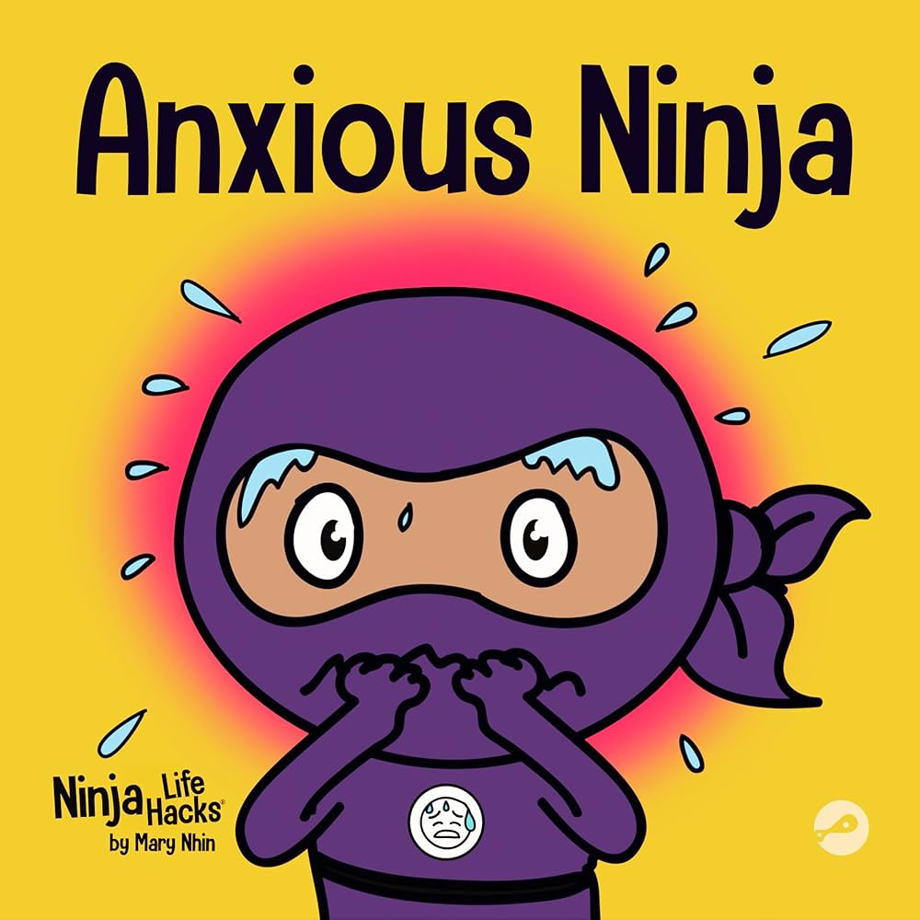
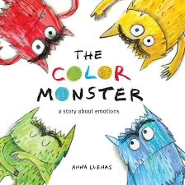
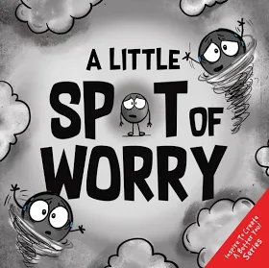
BOOKS FOR PRESCHOOLERS

Slide 12

Books for Parents (and their doctors!)

Slide 13
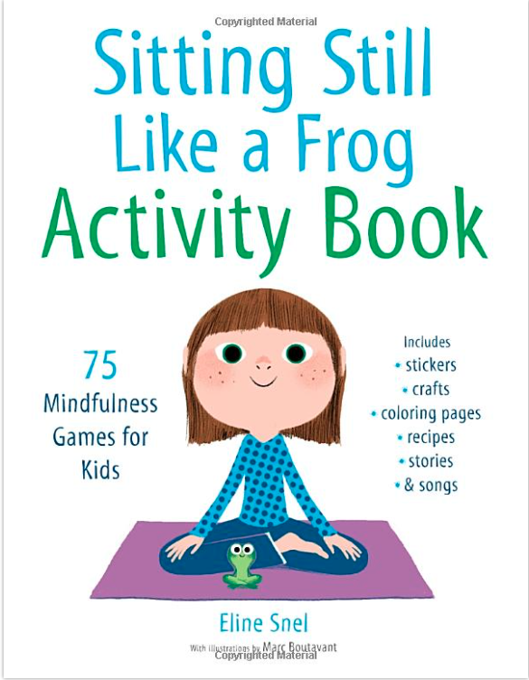



Books for Kids and Teens
https://www.shambhala.com/sittingstilllikeafrog/
Notes:
Again, quick look and list references at the end.

Slide 14
Treatment of Anxiety Disorders: Depends on Severity
Consider the 3 ‘Ps’: Pervasive, Persistent, imPairing
 | SCARED | Distress | Avoidance
Mild | <30 | Some | Minimal
Moderate | 30-40 | Good deal | Some
Severe | 41+ | A lot | A lot

Slide 15
Mild Anxiety

Slide 16
Mild Anxiety Treatment
Educate, support, monitor
Bibliotherapy
Cognitive Behavioral Therapy (CBT) skills in the office

Slide 17
CBT Goals
Extinguish avoidance behavior
Increase healthy problem-solving
Facilitate insight and self-efficacy
Solidify gains and promote generalization
Slide courtesy of Drs. Albano and Rynn
Notes:
From Dr. Foley:
Exposure-based CBT has the most empirical support for the treatment of anxiety disorders in youth
Psychoeducation (educating the patient and the family about the disorder, its course, management and treatment)
Somatic Management Skills training (relaxation, diaphragmatic breathing, self-monitoring) Cognitive restructuring (challenging negative exectations and modifying negative self-talk)
Exposure methods (imaginary and in vivo exposure with gradual desensitization to feared stimuli)
Relapse prevention plans (booster session sna coordination with parents and school)
Coping Cat (Kendall, 1990) –just google

Slide 18
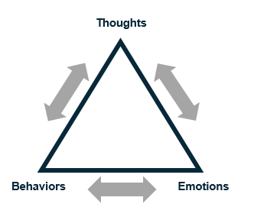
CBT Concepts
Teach self-soothing and somatic management
Identify and change maladaptive thinking
Increase proactive approach behavior (graduated exposure)
Notes:
From Dr. Foley:
Exposure-based CBT has the most empirical support for the treatment of anxiety disorders in youth
Psychoeducation (educating the patient and the family about the disorder, its course, management and treatment)
Somatic Management Skills training (relaxation, diaphragmatic breathing, self-monitoring) Cognitive restructuring (challenging negative exectations and modifying negative self-talk)
Exposure methods (imaginary and in vivo exposure with gradual desensitization to feared stimuli)
Relapse prevention plans (booster session sna coordination with parents and school)
Coping Cat (Kendall, 1990) –just google

Slide 19
Somatic Management
Goals:
Develop tolerance of normal, expected levels of anxiety
Learn & utilize strategies to calm self during stressful/ fear provoking situations or tasks
Methods:
Breathing retraining
Progressive Muscle Relaxation
Slide courtesy of Drs. Albano and Rynn

Slide 20
Breathing Retraining
Calms the nervous system
Stimulate the vagus nerve
Lowers heart rate and blood pressure
Reduces stress hormones

Slide 21
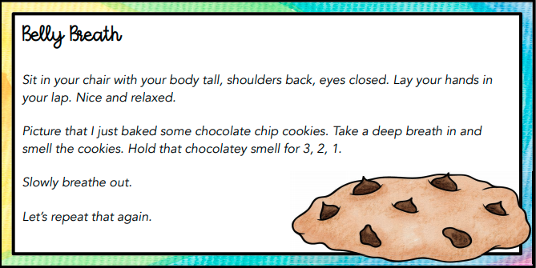
Notes:
I would describe these a quick examples that can be done in pcp office.
Consider the Ollendick Chocolate Cookie deep breathing example – easily done in the office

Slide 22
Progressive Muscle Relaxation
Two step technique: tension and relaxation
Pay attention to the feeling of relaxation when releasing the contracted muscle
Practice daily, bedtime is often ideal
Takes as little as 10 minutes per day to practice
Younger child: parent reads the script, can use fewer body parts
Can then utilize in other stressful situations

Slide 23

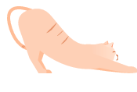
Relaxation Script Grades K-4 (Ollendick, 1978)
To begin the relaxation session, have the children sit comfortable in their chair and close their eyes. Soft, slow music can be playing in the background. When reading the script, speak in a soft, even tone. Pause between sentences.
Hands and Arms
Pretend you have a whole lemon in your left hand. Now squeeze all the juice out. Feel the tightness in your hand and arm as you squeeze. Now drop the lemon. Notice how your muscles feel when they are relaxed. Take another lemon and squeeze it. Try to squeeze. Try to squeeze it harder than you did the first one. That's right. Real hard. Now drop your lemon and relax. See how much better your hand and arm feel when they are relaxed. Once again, take a lemon in your left hand and squeeze all the juice out. Don't leave a single drop. Squeeze hard. Now relax and let the lemon fall from your hand. (repeat this process with the right hand and arm.)
Arms and Shoulders
Pretend you are a furry, lazy cat. You want to stretch. Stretch your arms out in front of you. Place them up high over your head, way back. Feel the pull in your shoulders. Stretch higher. Now just let your arms drop back to your side. Okay, kittens, let's stretch again. Stretch your arms out in front of you. Raise them over your head. Put them back, way back. Pull hard. Now let them drop quickly. This time let's have a great big stretch. Try to touch the ceiling. Stretch your arms way out in front of you. Raise them way up high over your head. Push them way, way back. Notice the tension and pull in your arms and shoulders. Hold tight now. Great. Let them drop very quickly and feel how good it is to be relaxed. It feels good and warm and lazy.

Slide 24
Muscle Relaxation: Script Conclusion
Stay as relaxed as you can.
Let your whole body go limp and feel all your muscles relaxed.
As you go through the day, remember how good it feels to be relaxed.
Sometimes you have to make yourself tighter before you can be relaxed, just as we did in these exercises.
Practice these exercises every night to get more relaxed.
When you are a really good relaxer, you can help yourself relax at school.
Just remember the turtle, or the jawbreaker, or the mud puddle, and you can do these exercises and nobody will know.
You've done a good job. You're going to be a super relaxer.

Slide 25
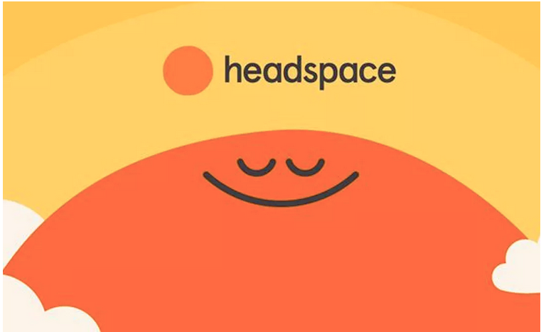


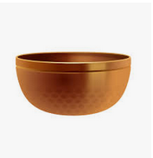
Apps
Headspace
Calm
Insight Timer
Stop, Breathe and Think
Notes:
Some are available for free for medical professionals

Slide 26
Q: What part of CBT is known to have the most powerful impact in lowering anxiety?
a. Psychoeducation – understanding anxiety
b. Relaxation Strategies – deep breathing, meditation
c. Exposure – doing what makes the patient anxious
d. Identify and change maladaptive thinking

Slide 27
Anxiety Fear Hierarchy
Fear Thermometer (SUDS)
Separation Anxiety Fear Hierarchy
Most Anxiety
Situation SUDS
Spending night at friend’s house 10
Spending 2 hours at friend’s– w/o mom 8
Spending 30 mins at friend’s– w/o mom 7
Mom leaving home for 30 minutes 6
Mom leaving home for 15 minutes 5
Mom going out to get mail 3
Mom going in a different room–nighttime 2
10
9
8
7
6
5
4
3
2
1
0
Least Anxiety
Slide courtesy of Drs. Albano and Rynn
Notes:
I might say quickly that this is an example of graduated exposure. JW
IS BOX ON RIGHT FORMATTED CORRECTLY?

Slide 28
Moderate Anxiety
Exposure-based CBT
or
Psychopharmacology

Slide 29
CAMS- Child Anxiety Multimodal Study Overview
Separation Anxiety DO, Social Phobia, Generalized Anxiety DO
N = 488, ages 7-17
12-week acute trial: CBT, Sertraline, Comb, Pill PBO
Pills-only double blinded
Random assignment, blind Independent Evaluators
Phase II: 6 month maintenance for treatment responders
Slide courtesy of Drs. Albano and Rynn

Slide 30
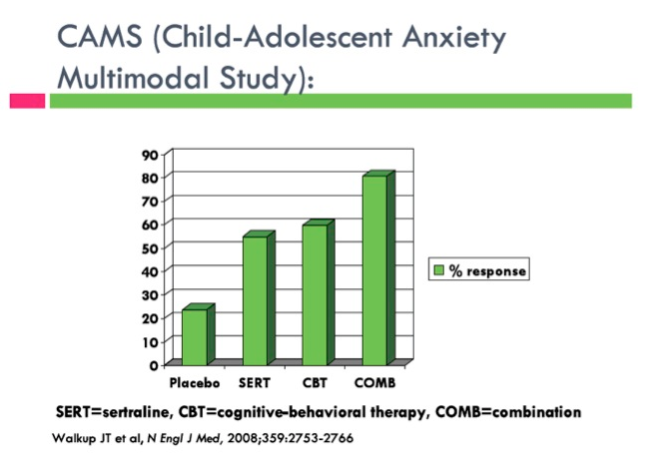
Child Anxiety Multimodal Study CAMS
COMB > CBT = SRT > PBO
81%
55%
60%
24%
CGI-I 1 and 2 (ITT, LOCF)
Walkup et al., 2008

Slide 31
Child–Adolescent Anxiety Multimodal Study
Mean dose of SER/PBO at final visit:
COMB: 134 mg/day
SER: 146 mg/day
PBO: 176mg/day
Walkup JT, Albano AM, Piacentini J, Birmaher B, Compton SN, Sherrill J, Ginsburg GS, Rynn MA, McCracken J, Waslick B, Iyengar S, March JS, Kendall PC. Cognitive-behavioral therapy, sertraline and their combination for children and adolescents with anxiety disorders: acute phase efficacy and safety. New England Journal of Medicine. Dec 25, 2008.
Notes:
Last updated 8/20/2013 – PSJ
Note high doses of medication used

Slide 32
Q: What medication have you prescribed for anxiety?
a. SSRI (sertraline, fluoxetine, escitalopram)
b. SNRI (duloxetine, venlafaxine)
c. Benzodiazepine (lorazepam, alprazolam, clonazepam)
d. Buspirone
e. None

Slide 33
Serotonin Reuptake Inhibitors with FDA Approval
Approved for OCD
Sertraline > 6 yrs (SSRI)
Fluoxetine > 7 yrs (SSRI)
Fluvoxamine > 8 yrs (SSRI)
Clomipramine > 10 yrs (TCA)
Approved for Depression
Fluoxetine > 8 yrs (SSRI)
Escitalopram > 12 yrs (SSRI)
Approved for Non-OCD Anxiety
Escitalopram > 7 yrs GAD (SSRI)
Duloxetine > 7 yrs GAD (SNRI)
Slide courtesy of Dr. Walkup
Notes:
21
How about for GAD, Social Anxiety and Social Phobia? None and Duloxetine only lately.

Slide 34
SRI Efficacy for Anxiety Disorders
Social Anxiety DO, Generalized Anxiety DO and Social Phobia
Fluvoxamine – RUPP, 2001
Fluoxetine – Birmaher et al, 2003
Sertraline (CAMS) – Walkup et al, 2009
Social Phobia
Paroxetine - Wagner et al, 2004
Fluoxetine - Beidel et al 2007
Venlafaxine - March et al, 2007-
Generalized Anxiety DO
Sertraline - Rynn et al., 2001
Venlafaxine, Rynn et al., 2007
Duloxetine, Strawn et al 2015
Buspirone in GAD, unpublished negative trial
Slide courtesy of Dr. Walkup

Slide 35
When to Choose SSRI Treatment with Moderate Anxiety
Patient and Parent preference
Too anxious to start CBT
CBT not available
CBT has failed or only partially resolved symptoms

Slide 36
Severe Anxiety
Exposure-based CBT
and
Psychopharmacology

Slide 37
SSRI
Brand (off-label for non-OCD anxiety) | Generic | Target Dose | Starting Dose
Zoloft | Sertraline | 25-200 for kids and adolescents | Start at 12.5-25 mg
Prozac | Fluoxetine | 10-60 for kids and adolescents | Start at 5-10 mg
Lexapro | Escitalopram | 10-20 for adolescent | Start at 5 or 10 mg
Notes:
Start kids even lower!

Slide 38
SSRI How-To: Part I
Start at a dose lower than the expected therapeutic dose (fluoxetine 10 mg instead of 20 mg or sertraline 12.5mg instead of 25mg)
If there are no side effects, go up in a week.
Warn families that the early doses are to acclimate and test the waters.
Get to a therapeutic dose in 2-4 weeks (clinical judgement).
Patients should respond somewhat to therapeutic dose in 2-3 weeks.
If no response, increase dose.
If some response, wait 4-6 weeks (for full response to take effect) to decide if dose should be increased.

Slide 39
SSRIs
Anxiety often needs higher doses
Start with lower doses due to hypervigilance for side effects
Warn about side effects
Start low BUT do not forget to go up—Most treatment failure is just a failure to raise the dose enough!
Younger kids respond well to all treatments but also have more side effects from meds
Continue for 12 months of remission before tapering
Plan taper around expected stressors

Slide 40
SSRI Side Effects
Common Side effects of SSRI’s:
Dry mouth
GI: Constipation, Diarrhea
Sweating, rashes
Sleep disturbance
Sexual dysfunction
Irritability
“Disinhibition” (risk-taking behaviors, increased impulsivity)
Agitation or jitteriness
Headache
Appetite changes

Slide 41
Side Effects
More serious side effects
Serotonin syndrome (fever, hyperthermia, restlessness, confusion, etc)
Hypomania
Discontinuation syndrome (dizziness, drowsiness, nausea, lethargy, headache)
Suicidality

Slide 42
Other Meds for Anxiety
SNRI—(Duloxetine) when failed SSRIs
Evidence is not there to use the following as first or second line treatments:
Antihistamines
Beta blockers
Benzodiazepines
Buspirone
Notes:
The referenced article refers to possible treatments for anxiety in adults…the take home message is that these are unproven in pediatric anxiety disorders.
Last updated 8/20/2013 - PSJ

Slide 43


Slide 44
Take-aways
Early intervention with anxiety makes a difference.
The pediatrician has a unique opportunity to identify anxious children.
The pediatrician’s office is an ideal setting to start treatment for anxiety.
Medication and psychological approaches are effective for anxiety management. Medication should not be a last resort.
Tools for management of anxiety can empower children and their parents.

Slide 45
Call Us
Thank You!
1-855-227-7272

