Slide 1
Assessment and Diagnosis of Anxiety Disorders in Children and Teens
Fall 2025

Slide 2
Kim Dobson-Callahan, MD
Assistant Professor Department of Psychiatry
Course Director: Art of Medicine, Jacobs School of Medicine and Biomedical Sciences University at Buffalo
kmdobson@buffalo.edu

Slide 3
Disclosures
Dr. Jason Herrick serves as consultant to MVP Health on the Pharmacy and Therapeutics Review Committee

Slide 4
Goals and Objectives
Distinguish between anxiety and an anxiety disorder
Review the epidemiology of pediatric anxiety disorders
To recognize the signs and symptoms of anxiety disorders in children and adolescents at different ages
To know how to screen and assess for these conditions
Notes:
USPTF just receommended screening for anxiety over 8 yo

Slide 5
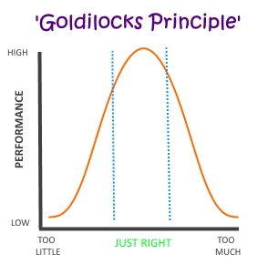
What is Anxiety?
Feeling of apprehension, “nervous”, “worry”, or unease
Anticipation of danger
May be experienced somatically as well as emotionally/cognitively
Normal
Adaptive: helps us focus and prepare
Temporary

Slide 6
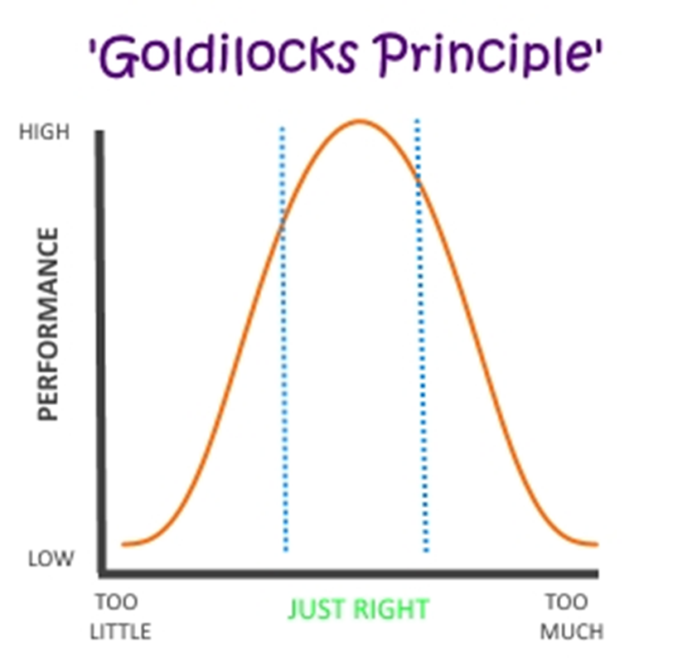
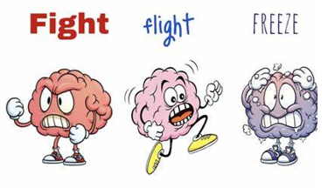
When is Anxiety a Disorder?
“Hijacked” autonomic nervous system
Frequent and persistent (6 months)
Avoidance
Restriction/resistance of activity
Impairment
Need for parental accommodations
“Missing out”
Tantums/Aggression

Slide 7
Subtypes of Anxiety Disorders
Younger children:
Selective Mutism (cousin of Social Anxiety)
Separation Anxiety Disorder
Older school aged and Adolescents:
Phobias
Generalized Anxiety Disorder
Social Anxiety Disorder
Panic Disorder
Note:
OCD and PTSD were included as Anxiety Disorders in DSM-IV.
In DSM-V they are better classified as obsessive-compulsive or trauma and stressor related disorders respectively

Slide 8
A couple questions before we jump into assessment….

Slide 9
Poll Question #1
Does your practice routinely screen for depression using a validated tool?
YES
NO
I am not sure

Slide 10
Poll Question #2
Does our practice routinely screen for anxiety using a validated tool?
YES
NO
I am not sure

Slide 11
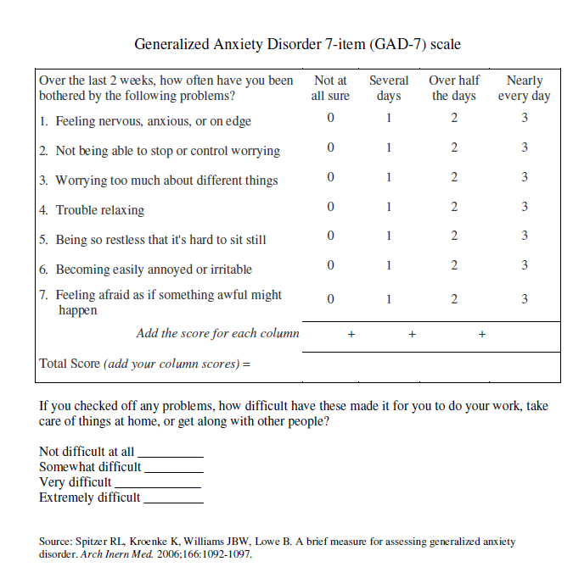
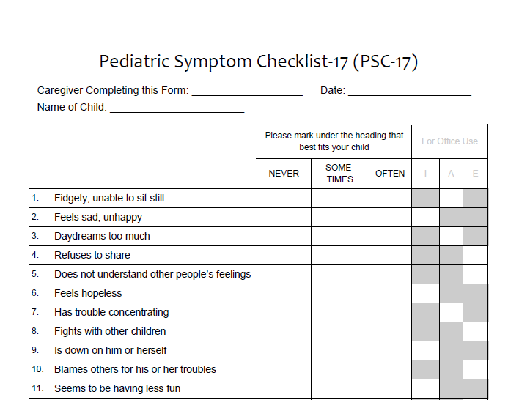
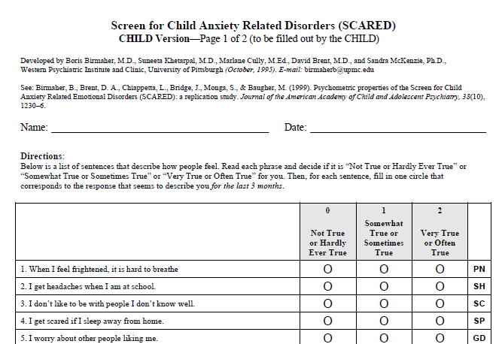
Why Should We Screen for Anxiety?
High prevalence
Up to 20% lifetime – increasing in youth
High morbidity
Highly treatable
Low detection
<25% identified
As many as 50% never receive treatment
USPTF recommends @ 8yo

Slide 12
Anxiety Ignored Can Derail Development
Family difficulties
Undermines development of independence (avoidance vs. overprotection)
Increased family conflict (parents, sibs) as others feel “controlled”
At risk for substance abuse
School absence
Academic delays/loss
Underdeveloped social-emotional skills (“muscles”)
Restricted range of activities
Lack of development of social-emotional skills
Loss/lack of development of peer relationships
Decreased opportunities for pleasure and skill development

Slide 13
How Does Anxiety Present?
Emotional/Cognitive:
Thoughts and feelings of apprehension in anticipation of danger (internal or external); need for excessive reassurance
Commonly experienced as “worry” or “nervousness” but some kids don’t have words for and/or don’t recognize
Behavioral:
Avoidance, absence, tantrums, aggression
Physical symptoms:
Headaches, stomach aches, difficulty breathing, swallowing (often without insight)
4. Sleep disturbance
Notes:
Note differences across age groups:
Elementary School - Developmental regression, Crying, Somatic sxs, Clingy, Triggered by separations, Fear based oppositionality, Sleep problems
Middle School - Somatic sx, School refusal, Performance based, Poor concentration, Sleep problems, Irritability, Defiance, Avoidance
Adolescent/High School - All sx seen in middle school…plus…Impaired socialization, Restriction of life activities, Substance abuse

Slide 14

Emily
8 yo girl who is brought in because of stomach aches
Evaluated by GI and no medical condition identified
Difficulties getting her to school since kindergarten
Crying at drop off, clingy to parent
In 2nd grade missed 10 days of school
Now in 3rd grade, has missed 20 days of school to date
Even when she gets to school, she goes to nurse often with stomach aches, sometimes the only resolution is mother picking her up early
No academic issues
If mom unable to pick her up Emily calls frequently to “check in” and make sure that “nothing bad happened”
At home she appears comfortable, pleasant, watches TV
Maintains friendships with small group of girls she has know since pre-K
Does not enjoy play dates or want sleepovers at friend’s homes
During office visit, she is quiet, but smiles easily
PE is unremarkable
No known trauma/loss
Notes:
School avoidance
Somatic sxs

Slide 15
Assessment
Interview child/adolescent alone
Interview parent(s) with/without child as indicated
Use validated screening tools – i.e. SCARED
Assess for any acute stressors (trauma, loss, moved, etc.)
Consider known developmental history
Consider other psychiatric causes
Targeted PE
Guided by somatic complaints
Work up and rule out medical causes/related issues as indicated
Thyroid dysfunction
Inflammatory bowl
Asthma
Migraine
Note: physical health causes rarely present with anxiety in isolation
Notes:
Trauma – <1-month acute stress or adjustment, > 1 month PTSD or adjustment
Anxiety – 6+ months (<6 months adjustment)

Slide 16
Screening
Pediatric Symptom Checklist (PSC): Broad universal screener assessing 3 domains - attention, externalizing and internalizing
GAD-7: 13+, anxiety specific, youth self report; 0-21 scores
5-9 mild anxiety
10-14 moderate anxiety
15-21 severe anxiety
SCARED: 8y+, anxiety specific, parent and self report measures
>25 is positive screen
>30 almost always reflects an anxiety disorder

Slide 17
www.projectteachny.org

Slide 18
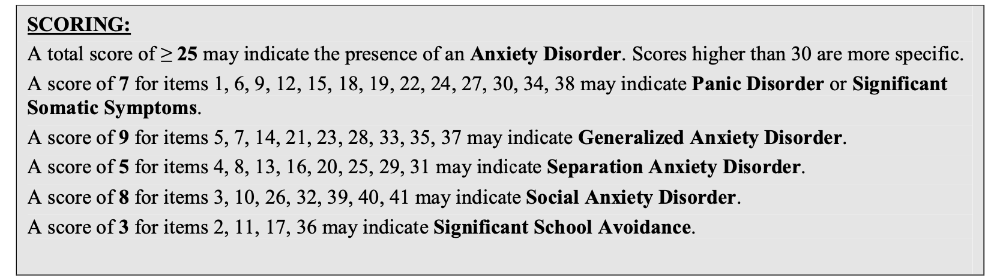
Scoring the SCARED
Separate Parent, Child forms (8-18 yo)
10 minutes
Subscales differentiate types of anxiety
Score of 25+ suggestive of anxiety

Slide 19
Psychiatric Differential
Dx | Overlaps
ADHD | Restless, inattentiveness
Depression | Inattention, sleep problems, somatic
Bipolar | Restless, irritable, sleep problems
Learning Disorder | Generate worries about academics
Psychosis | Restless, social withdrawal
Autism spectrum | Social withdrawal/avoidance, repetitive behaviors, need for routine

Slide 20
Medications/Substances that Cause/Worsen Anxiety
Prescribed medications
Albuterol, steroids, SSRI’s, stimulants, thyroid medications, antipsychotics
Caffeine – carbonated beverages, energy drinks
OTC medications – cold medications, decongestants, diet pills, antihistamines, CAM
Nicotine/vaping
Substance intoxication/abuse (pot, cocaine, methamphetamine, PCP, LSD) and/or withdrawal

Slide 21
Diagnosis
Potentially some urgency, very unlikely an emergency
Use DSM-V criteria as guide
Allow for complete work-up of potential physical health causes
Remember avoidance is hallmark
Establish the diagnosis with confidence
Assess severity/level of impairment
Provide psychoeducation
Screen for common comorbidity (i.e. MDD, ADHD)

Slide 22
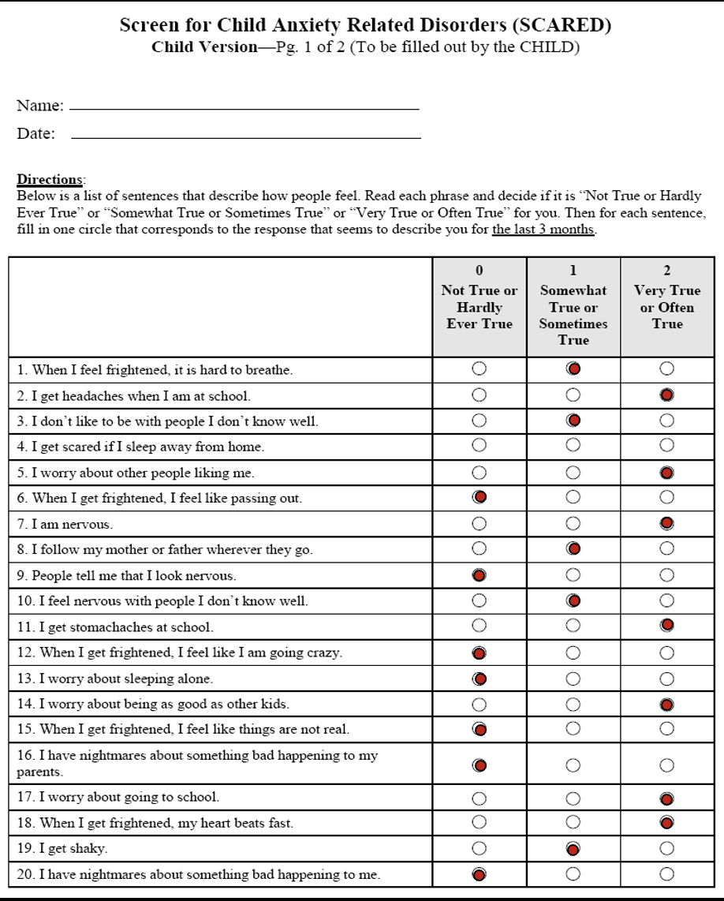
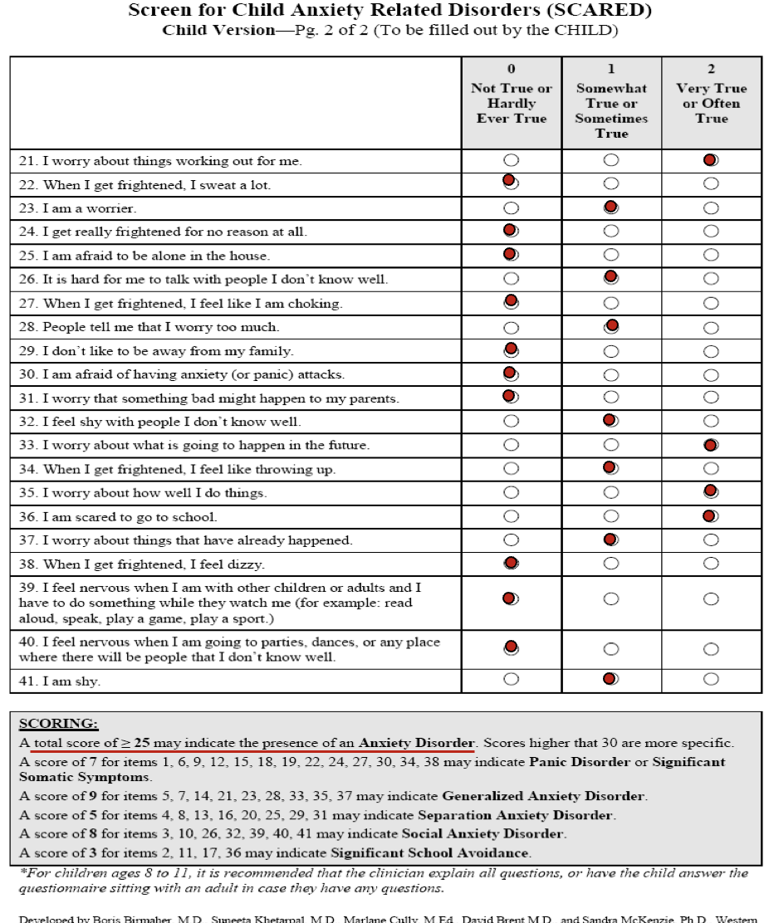
Emily
8 yo girl who is brought in because of stomach aches, GI w/u (-), increase in school avoidance, maintaining grades, frequent reassurance seeking, okay at home and with small group of friends.
During office visit, she is quiet, but smiles easily, PE is unremarkable, no known trauma/loss
Notes:
School avoidance
Somatic sxs

Slide 23
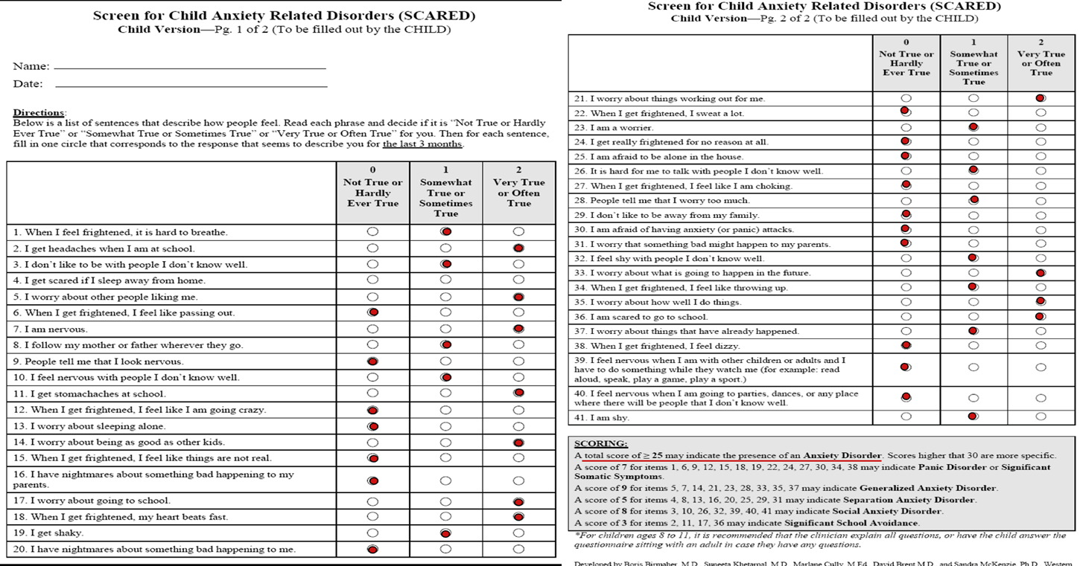
POLL #3 –
What is Emily’s total SCARED Score?

Slide 24
SCARED Scoring
Total – 34 (++)
Panic – 5 (-)
GAD – 15 (++)
SepAnxD – 1 (-)
SocAnxD – 5 (-)
SchoolAvo- 8 (++)

Slide 25
Poll Question #4
Do we think Emily has an
Anxiety Disorder?
Yes
No
I want more information
I’m not sure

Slide 26
Poll Question #5
How would you rate the severity of Emily’s GAD w/ school avoidance?
Mild
Moderate
Severe

Slide 27
Severity
 | SCARED | Distress | Avoidance
Mild | <30 | Some | Minimal
Moderate | 30-40 | Good deal | Some
Severe | 41+ | A lot | A lot
 | SCARED | Distress | Avoidance
Mild | <30 | Some | Minimal
Moderate | 30-40 | Good deal | Some
Severe | 41+ | A lot | A lot
SCARED = 38
Distress = ???
Avoidance = 20+ school days missed

Slide 28
Summary
Anxiety disorders as a category are the most common mental health condition in adolescents
Commonly goes undiagnosed (akin to ADHD:IT; “quiet”, “good” kids)
Universal screening recommended by USPTF for 8-18
i.e. (+) PSC/YPSC and signs of anxiety -> SCARED
When work up is suggestive of anxiety, make the diagnosis!
R/O Trauma/loss
Consider medical/medication/substance contributions
Severity assessment supports medical decision making/treatment planning
Assess for comorbid conditions

Slide 29
Appendix

Slide 30
GAD DSM5 Criteria
Excessive anxiety and worry (apprehensive expectation)
occurring more days than not
for at least six months,
about several events or activities
The person finds it difficult to control the worry.
Associated with three or more of the following six symptoms:
Restlessness or feeling keyed up or on edge
Being easily fatigued
Difficulty concentrating or mind going blank
Irritability
Muscle tension
Sleep disturbance (difficulty falling or staying asleep, or restless unsatisfying sleep)
Not attributable to the physiological effects (e.g., a drug of abuse, a medication) or another medical condition (e.g., hyperthyroidism).
Notes:
Not focused on ONE issue (e.g. social, weight, health, separation, panics)

Slide 31
Separation Anxiety Disorder DSM5
Inappropriate and excessive fear or anxiety concerning separation from attachment figures, as evidenced by persistent anxiety in at least 3 of the following:
Anticipating or experiencing separation from home or from major attachment figures.
Losing major attachment figures or about possible harm to them, such as illness, injury, disasters or death.
Untoward event that causes separation from a major attachment figure.
Persistent reluctance or refusal to go out, be away from home, go to school, go to work, or elsewhere because of fear of separation.
Being alone or without major attachment figures at home or In other settings.
Sleep away from home or to go to sleep without being near a major attachment figure.
Nightmares involving the theme of separation
Physical symptoms (e.g. headaches, stomach aches, nausea, vomiting) when separation from major attachment figures occurs or is anticipated.
Lasting at least 4 weeks in children and adolescents and typically >6 months in adults.
Notes:
Casuses impairment of functioiing

Slide 32
Social Anxiety Disorder DSM5
Intense fear of one or more social or performance situations in which the person is exposed to unfamiliar people or to possible scrutiny by others. The individual fears that he or she will act in a way (or show anxiety symptoms) that will be embarrassing and humiliating.
Exposure almost invariably provokes anxiety
The person recognizes that this fear is unreasonable or excessive.
The feared situations are avoided or else are endured with intense anxiety and distress.
Interferes significantly with the person's normal routine, or there is marked distress about having the phobia.
Persistent, lasting 6 or more months.
Not due to direct physiological effects of a substance (e.g., drugs, medications) or a general medical condition
NOTE: Selective Mutism separate diagnosis but thought of as variant of Social Anxiety Disorder

Slide 33
Gen Medical Differential Diagnosis: Uncommon
Hyperthyroidism
Migraine
Asthma
Seizure disorders
Lead intoxication
Even less Common: Hypoglycemia, arrhythmias
Rare: Pheochromocytoma, CNS disorders (ex delirium/brain tumor)

Slide 34
Presentation of Anxiety at Different Ages
Elementary School | Middle School | Adolescent/High School
Developmental regression Crying Somatic sxs Clingy Triggered by separations Fear based oppositionality Sleep problems | Somatic sx School refusal Performance based Poor concentration Sleep problems Irritability Defiance Avoidance | All sx seen in middle school…plus… Impaired socialization Restriction of life activities Substance abuse

Slide 35
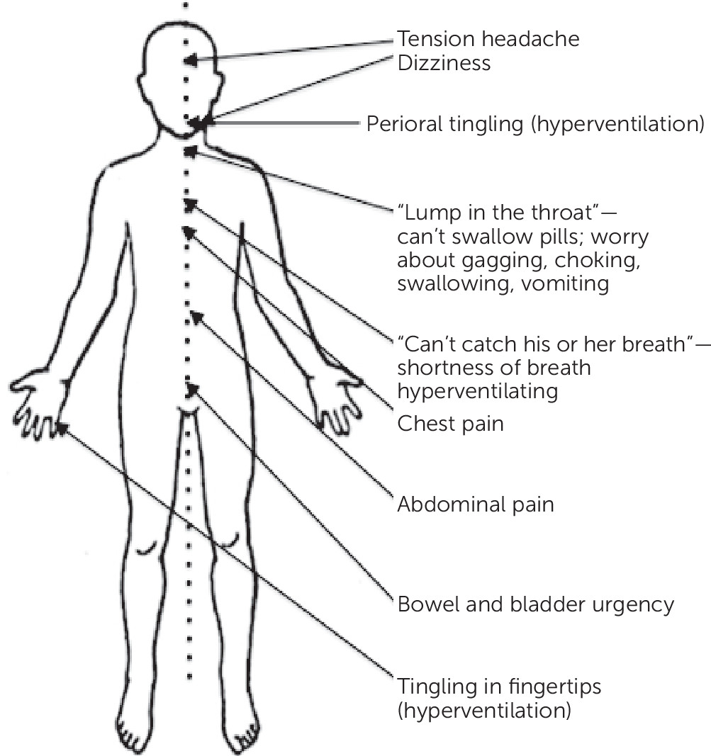
Midline Physical Symptoms

