Slide 1
Trauma Informed Care: Incorporating into Your Practice
Spring, 2025

Slide 2
Presenter:
,
Mary DeGuardi, MD
Medical Director UHS Pediatrics
Binghamton, NY
Associate Clinical Professor
SUNY Upstate Medical University
Syracuse, NY

Slide 3
Disclosures
“Neither I nor my spouse/partner has a relevant financial relationship with a commercial interest to disclose.”

Slide 4
WHY is trauma informed care important in primary care?

Slide 5
Trauma-Informed Care in Practice
SAMHSA (2015) concept of a trauma-informed approach - A program, organization, or system that is trauma-informed:
Realizes the widespread impact of trauma and understands potential paths for recovery
Recognizes the signs and symptoms of trauma in clients, families, staff, and others involved with the system
Responds by fully integrating knowledge about trauma into policies, procedures, and practices
Seeks to actively resist re-traumatization
Notes:
****clinic- have to say practice TIC
Movement- w cynical- if message doesn’t ring true to practice- important things
Just focus on symptoms miss cause and opportunity
Prevent retraumatization- strength and resilience--

Slide 6
Trauma is COMMON (estimates that more than 50% of children have had exposure to a traumatic event)
Many children/families who have experienced trauma are UNDIAGNOSED and UNTREATED
Providers who use a trauma informed approach in ALL patient encounters are providing a UNIVERSAL PRECAUTION to prevent retraumatizing a child/family

Slide 7
Rationale
Why become trauma informed?
Trauma is pervasive
Impact is far-reaching
Affects how people approach health care and other services
Helping services can be inadvertently re-traumatizing
Focus on:
Recovery and healing are possible
Protective factors facilitate healing and resilience
Healing takes place in the context of safe and supportive relationships

Slide 8
What are challenges incorporating trauma informed care into practice?

Slide 9
Incorporation into practice - challenges
Office culture (readiness for change)
Knowledge
Time/scheduling/workflow issues
Resources - educational, emotional, psychosocial, community
Ongoing staff support/team building
Financial barriers

Slide 10

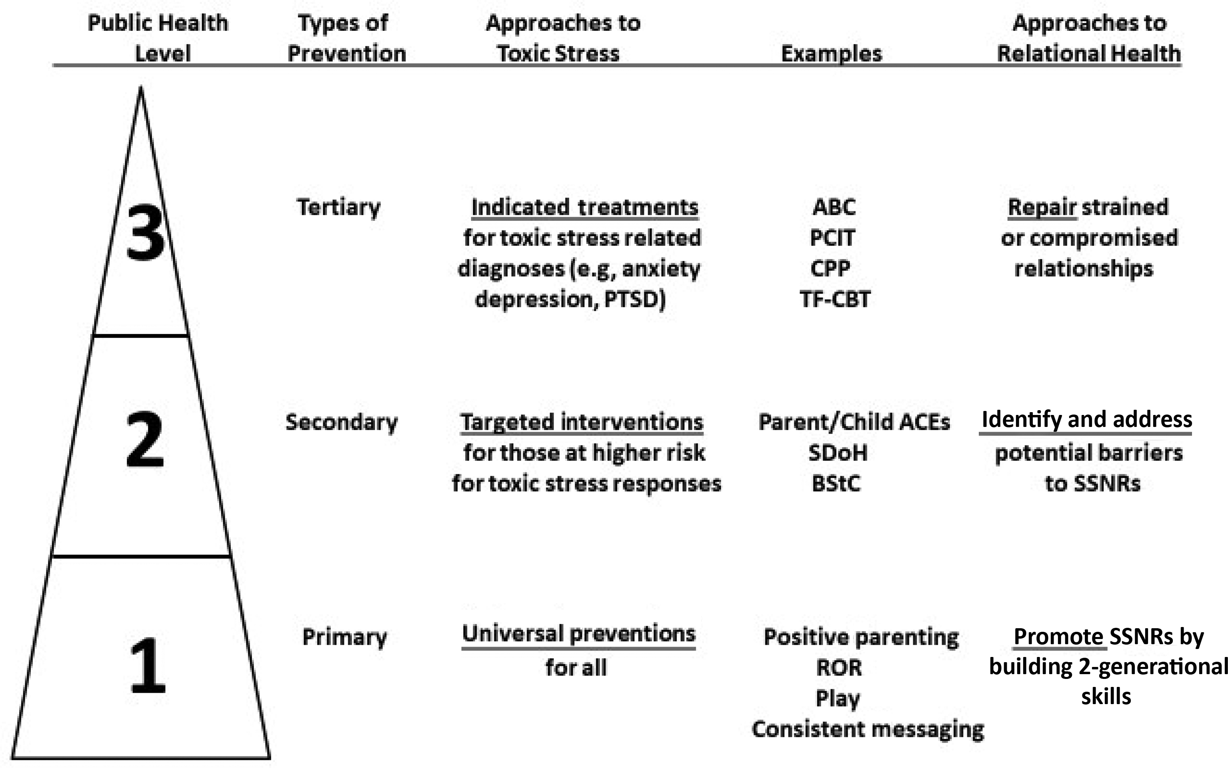
From: Preventing Childhood Toxic Stress: Partnering With Families and Communities to Promote Relational Health
Pediatrics. 2021;148(2). doi:10.1542/peds.2021-052582
Figure Legend:
A public health approach to prevent childhood toxic stress is a public health approach to promote relational health. Many of the components of a public health approach to prevent, mitigate, and treat toxic stress responses (see examples) are also components of a public health approach to promote, identify barriers to, and repair SSNRs. The examples provided are illustrative and not intended to be comprehensive or exhaustive. See the Appendix for full descriptions of the abbreviations. BStC, biological sensitivity to context; PTSD, posttraumatic stress disorder. Adapted with permission from Garner AS, Saul RA. Thinking Developmentally: Nurturing Wellness in Childhood to Promote Lifelong Health. Itasca, IL: American Academy of Pediatrics; 2018
Date of Download: 4/1/2025
Copyright © 2025 American Academy of Pediatrics. All rights reserved.

Slide 11
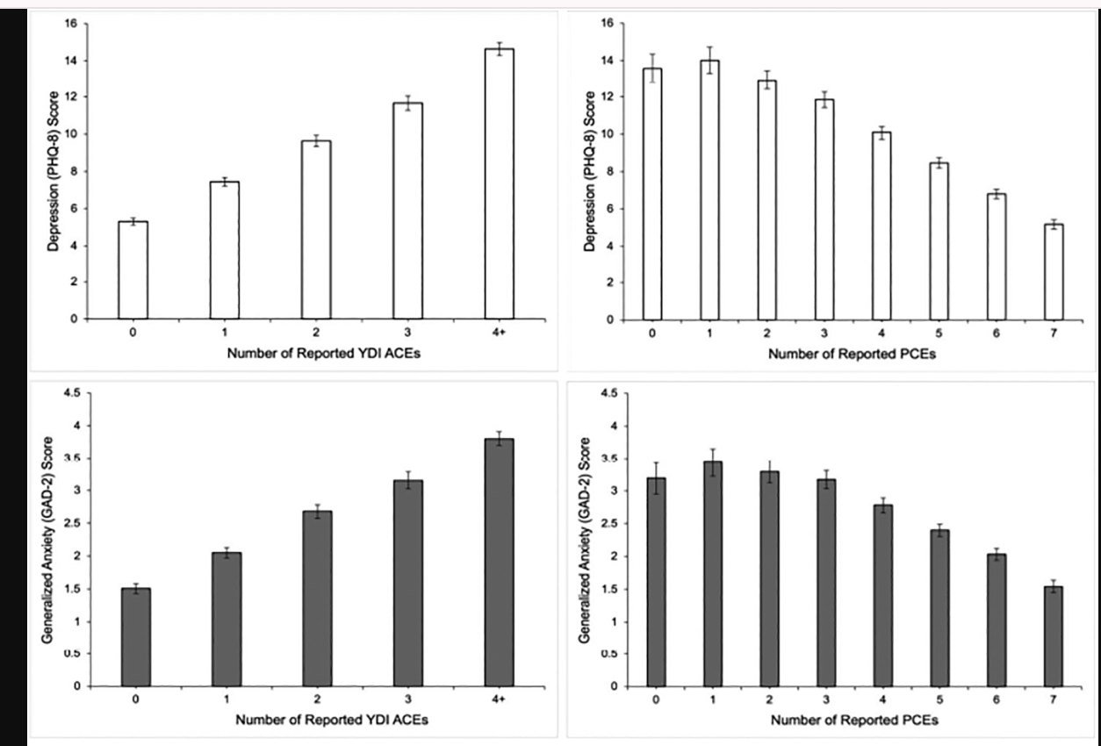
Positive Childhood Experiences Protective
Samji, et.al. Child Abuse and Neglect, Oct 2025
Notes:
https://www.sciencedirect.com/science/article/pii/S0145213424000097#f0010

Slide 12
Surveillance - trauma is common
“Has anything bad or scary or upsetting happened since our last visit?”
“Has anyone come or gone from your family recently?”

Slide 13
Initial Steps
Consider the diagnosis of trauma in patients with
Somatic complaints
Symptoms of emotional dysregulation/distress
Children living in “high risk” situations
Sleeping/eating difficulties
Academic/social difficulties
Regression, behavioral changes

Slide 14
Rule out co-morbidities (full assessment)
Utilize
Utilize Standardized Screening Tools
Assess
Assess degree of impairment
Address
Address safety issues
Perform a good assessment

Slide 15
Screening
ACEs for parent and/or child
Domestic violence screening
SEEK (Safe Environment for Every Kid)

Slide 16
PCPs play a crucial role in trauma treatment
Childhood exposure to traumatic events is common
PCP offices can be the first place it is identified
PCP can learn to recognize and treat acute symptoms in their offices
Successful treatment is built upon a strong and caring relationship with at least one adult

Slide 17
Office based intervention - psychoeducation
Emphasize the role of a single nurturing relationship in recovery from trauma
Discuss the biological basis of fear and its manifestations (fight/flight)
Relationships, routine and regulation
Offer some practical tips on ways to integrate these concepts into family life now
Introduce role of therapy for ongoing trauma treatment, and provide linkage and warm hand-off (if possible)

Slide 18
TIC goals in primary care
Convey
Convey hope
Build
Build resilience
Engage
Engage learning/thinking brain
Develop
Develop child’s self-efficacy
Teach
Teach skills of self-regulation

Slide 19
Case: Eli, 8 years old
CC: “angry and moody whenever I ask him to do anything”
Comes with stepmother. He lived with birth mother until he was 7. Removed by CPS for neglect
Initially eager to please and easygoing. Loving towards 2-year-old stepsister.
Now gets angry and yells at his stepmother when she tells him to do things
Some nights hears him crying softly in his room
Above average grades and likes to read. One friend in his class.
Father works 12-hour days
On exam: Well groomed, down cast eyes, sad affect, shame when stepmother speaks, only smiles when step sib brings him a toy.
Notes:
his homework, or clear the table, or get ready for bed.
When she asks him what is wrong, he will either yell to leave him alone or tell her that she won’t understand.

Slide 20
Initial Observations
Mom looks frustrated, overwhelmed, and angry
Child - sad, ashamed, quiet
What else do you want to know?
Notes:
*** what is the what else? Shouldn’t get to other qs to use?
Table exercise part- answer
Initial observations what do we know and want to know-
95 participants—
Can turn in to table
Concrete
Look at total time-

Slide 21
Table Exercise: Assessment and Differential Diagnosis
What else do you want to know?
What would you ask the stepmother?
What would you ask Eli?
How would you phrase the questions?
What is on your differential diagnosis?

Slide 22
Differential diagnosis?
Depression
Anxiety
Trauma
Adhd
ODD
Aggression

Slide 23

Next step?

Slide 24
Interview Eli
Notes:
How would you ask the qs--

Slide 25
Interview with Eli
Safety
Calm voice, eye contact, warmth
Convey hope, empathy, “helper”
Gentle questioning
Recognize, compliment strengths
Be alert for s/s of distress
Notes:
Ear for safety

Slide 26
Interview with Eli
Admits he has nightmares about being sent back to his birth mother
Describes times when his birthmother or her friends hurt him.
Admits he has thought of running away from home.
CATS 2 score - 25

Slide 27
Initial Assessment: Eli
Child’s trauma screen positive
Safety concerns
Maternal distress
Child - mood and sleep impairments
Impairment of parent/child relationship
Additional screens pending

Slide 28

Next step?

Slide 29
Psychoeducation: How to discuss trauma with mom and child

Slide 30
What is toxic stress and how does the body react

Slide 31
Message to parents
Distinguish between normal stress and toxic stress
Occurs when a child feels unsafe over a long time and lacks the buffering effect of being loved and cared for by a supportive adult
Children who experience this level of stress have difficulty with managing their emotions, regulating sleep and appetite and developing relationships
Treatment is available and effective. The strongest predictor of recovery is the development of a supportive, loving relationship with at least one caring adult.
Positive experiences mitigate adverse experiences

Slide 32
Talking with families about trauma
Describe
Describe signs and symptoms of childhood trauma (fight/flight/freeze response)
Convey
Convey support and hope for recovery, and assure collaboration and partnership
Offer
Offer practical suggestions for help NOW with difficult symptoms
Plant
Plant the seed of psychotherapy (begin linkage if family is ready)

Slide 33
What might you recommend for Eli’s anger/mood issues?
Might

Slide 34
Self- regulation strategies
Parent helps child to label emotions, feelings, thoughts, and expand emotional vocabulary
Teach child about his brain - feeling, thoughts, behavior triangle
“Feelings thermometer”
Positive self-talk
Breathing exercises (box breathing)
Mindful meditation

Slide 35
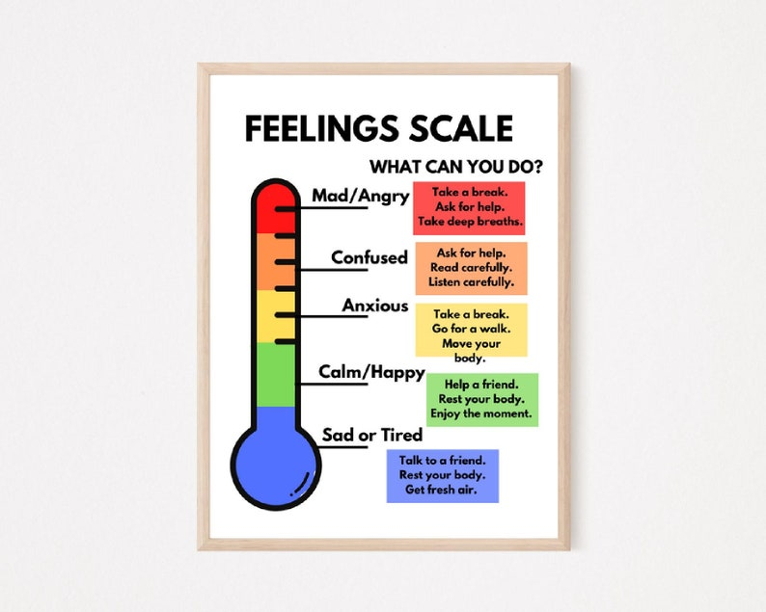

Slide 36

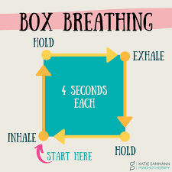

Slide 37
What office-based interventions would be helpful for Eli?
Sleep strategies
Self-regulation techniques
Relationship building/mom and child

Slide 38
Sleep Interventions
Consistent Schedule
Bedtime routine
Limit screen time
Create relaxing sleep environment –quite/limited light
Avoid frightening digital content
Meditation
? Medication

Slide 39
Collaboration
School – social worker, teacher
Community support – peer mentor, after school activities
Support for family
What supports are in your office – social worker, care coordinator

Slide 40

Summary
-relationship with child/family important part of healing
-frequent follow ups essential
-use of screen tools
-HOPE is important!
-Call PROJECT TEACH

Slide 41
Interventions for “strong emotions”
Reassurance - verbal and nonverbal messages to buffer child’s fears
1
Routines - predictability, eg. school mornings, after school, bedtime
2
Regulation - Help child label emotions/ thoughts, “Time-in” activities, help with household tasks, play and co-regulation activities with parent
3

Slide 42
Resources
Aap.org:The Trauma-Informed Pediatric Practice. Paperback 2024
Aap.org: Childhood Trauma and Resilience : A practical guide. e-book. 2021

Slide 43
Thank you!

