Slide 1
Trauma Informed Care: Working with families & youth
Notes:
nayla Intro comments
the different types of trauma
how to diagnose
how to treat.

Slide 2
Speaker:
Nayla M. Khoury, MD
Associate Professor
SUNY Upstate Norton School of Medicine
Psychiatry
Notes:
nk

Slide 3
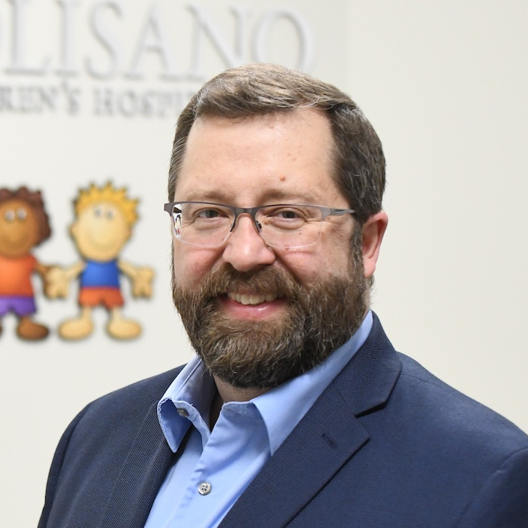
Speaker:
Mike Scharf, MD
Mark and Maureen Davitt Professor and Director of Child and Adolescent Psychiatry,
Psychiatrist-in-Chief, Golisano Children’s Hospital
Associate Chair for Children and Youth
Department of Psychiatry, University of Rochester
Notes:
mike

Slide 4
Disclosures
Neither we nor our spouses/partners has a relevant financial relationship with a commercial interest to disclose.
Notes:
Victor

Slide 5
Learning Objectives
Learn trauma informed care principles & strategies for applying to your practice.
Identify developmentally appropriate strategies for assessing and diagnosing trauma and trauma-related disorders.
Understand evidence based treatments for treating trauma and trauma-related disorders and strategies for supporting resilience.
Notes:
Victor

Slide 6

A call to action:
Increase funding for mental health access
Continue telehealth options
Increase school based mental health options
Accelerate integrated mental health in primary care
Strengthen prevention programs
Promote and pay for trauma informed care to support resilience
Address acute care needs and staff shortages
Advance mental health parity laws
Notes:
Victor
Before pandemic, suicide was a problem affecting young ppl, being second leading cause of death in the us 10—25 yrs of age and rising rates for young black youth which is thought to be multifactorial, health care disparities being one of them.
Unexpectedly, however, our hospital did not observe this increase during the early months of the pandemic and the number of adolescents presenting for acute mental health emergencies dropped precipitously. This radical shift in numbers raised many concerns regarding the state of adolescent mental health and wellbeing. Many of us worried that youth needing mental health support were not seeking help due to fear of COVID-19. These concerns have been substantiated; over the past month, the number of youth seeking emergent mental health care in our hospital and emergency department is twice normal for this time of year.
Cloutier RL, Marshaall R. A dangerous pandemic pair: Covid19 and adolescent mental health emergencies. Am J Emerg Med. 2021;46:776-777. https://libezproxy.syr.edu/login?url=https://www.proquest.com/scholarly-journals/dangerous-pandemic-pair-covid19-adolescent-mental/docview/2555958068/se-2?accountid=14214. doi: http://dx.doi.org/10.1016/j.ajem.2020.09.008.
More than 140,000 children in the United States lost a primary and/or secondary caregiver, with youth of color disproportionately impacted. We are caring for young people with soaring rates of depression, anxiety, trauma, loneliness, and suicidality that will have lasting impacts on them, their families, and their communities.
for more context, Suicide among our youth has always been a major problem as the second leading cause of death and continues to be a problem now, particularly for young female teens who have been visiting theh EDD due to suicide attempts more than pre pandemic.
We also know that the rates among black youth have risen faster than any other racial/ethnic group, particularly among latency age kids, highlighting the intereactions between our dual pandemics of covid19 infection and structural racism in this country.
While the reasons are not completely known, our discussion of ACES today or adverse childhood experiences, are thought to be part of these disparities, as well as important disparities regarding access and treatment.

Slide 7
What is the Differential?
ADHD
Adjustment reaction/trauma/loss
Anxiety
Learning disability/disorder
Depression (crying)
Sleep disorder
Notes:
victor

Slide 8
Trauma informed community begins with ourselves
Be mindful of your own responses.
Find care practices that work for you and are sustainable.
Know you are not alone in this work.
Get to know your resources (internal and local).
Advocate for the team you need to do this work.
Notes:
Victor

Slide 9
The cure for burnout isn’t and can’t be self care.
It has to be all of us caring for each other.
~Emily & Amelia Nagoski
Dare to lead Podcast with Brene Brown
Notes:
nayla

Slide 10
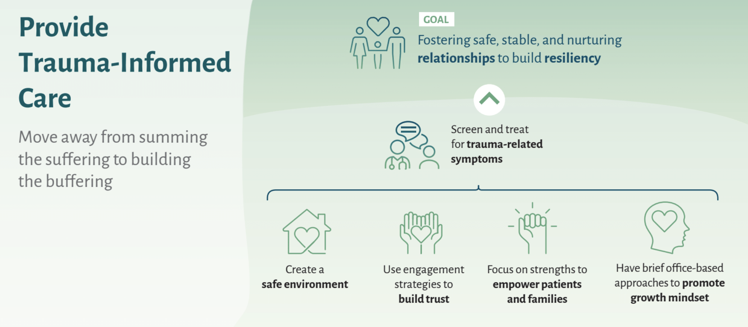
Notes:
nk

Slide 11
What is resiliency?
Notes:
nk

Slide 12
Resiliency
Withstanding and rebounding from adversity.
Regaining the ability to thrive, with the potential for transformation and positive growth forged through the searing experience.
(Walsh, 2020)
Fostered by shared beliefs
To make meaning of the crisis and challenges.
To (re)gain a positive, hopeful outlook that supports active agency.
Notes:
Nk
: Walsh, Froma. (2020). Family Process. 59(3): 883-897. Loss and Resilience in the Time of COVID‐19: Meaning Making, Hope, and Transcendence.
Heart rate variability is a promising biomarker of mental health resilience.
•Heart rate variability is an index of flexibility and ability to adapt to stress.

Slide 13
Protective factors
School engagement.
Family & neighborhood.
Participation in after school activities.
Community:
Relationships:
Relationships with one supportive adult
Friends
Positive thoughts of self
Self-regulation
Social competence
Flexible thinking
Individual:
Notes:
nk

Slide 14
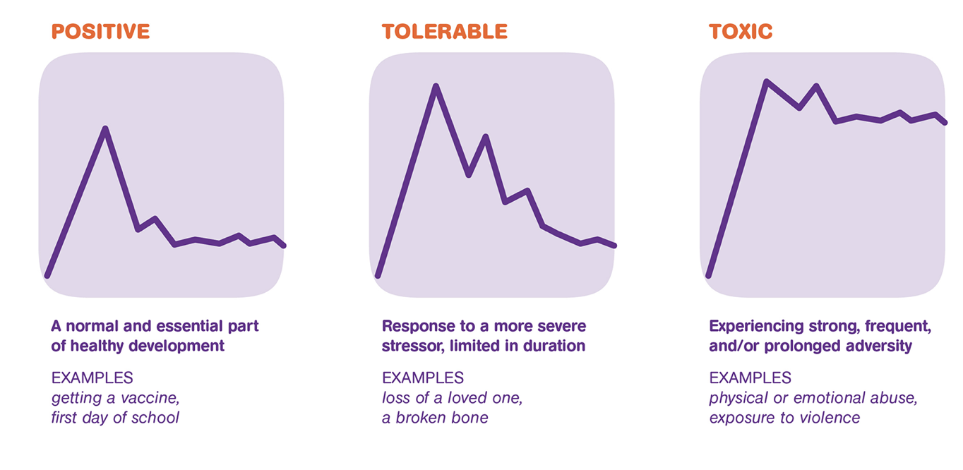
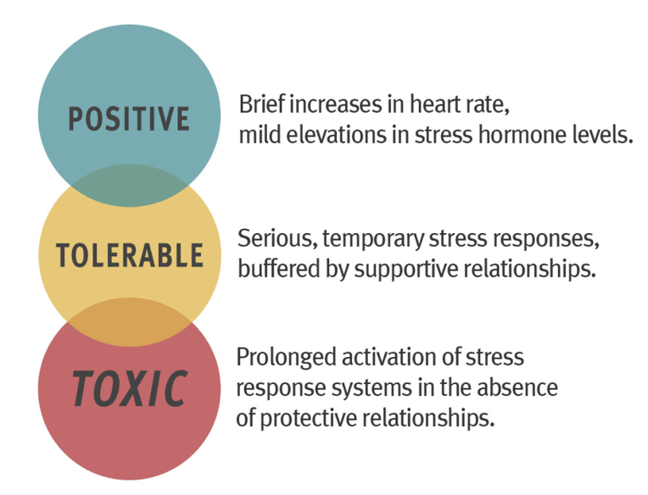
When is stress “Toxic”?
Stress is a normal and necessary part of development.
Toxic when prolonged; in absence of protective relationships.
Notes:
nk
Stress can categorized as:
Positive: promoting growth
Tolerable: not helpful, but not damaging
Toxic: overwhelming a child’s coping mechanisms and leading to long term impairment
In absence of protective relationships.. Supportive relationships can make the difference.
http://developingchild.Harvard.edu

Slide 15
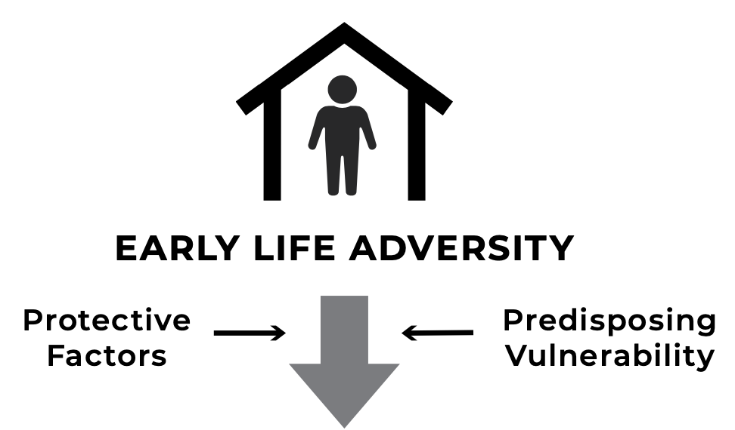

Role of primary care
Supportive relationship over time.
A safe place:
Patient centered medical home.
Targeting modifiable/preventable ACES.
Leveraging resilience factors.
Notes:
Nk
You can make a difference.

Slide 16
Trauma informed care (TIC): Framework
Understanding the prevalence of trauma & adversity & its impacts.
Recognizing the effects of trauma & adversity on health and behavior.
Training leadership, providers, and staff on responding with TIC best practices.
Integrating knowledge about trauma into policies, procedures, practices.
Resisting re-traumatization by approaching patients with non-judgmental support.
Notes:
nk

Slide 17
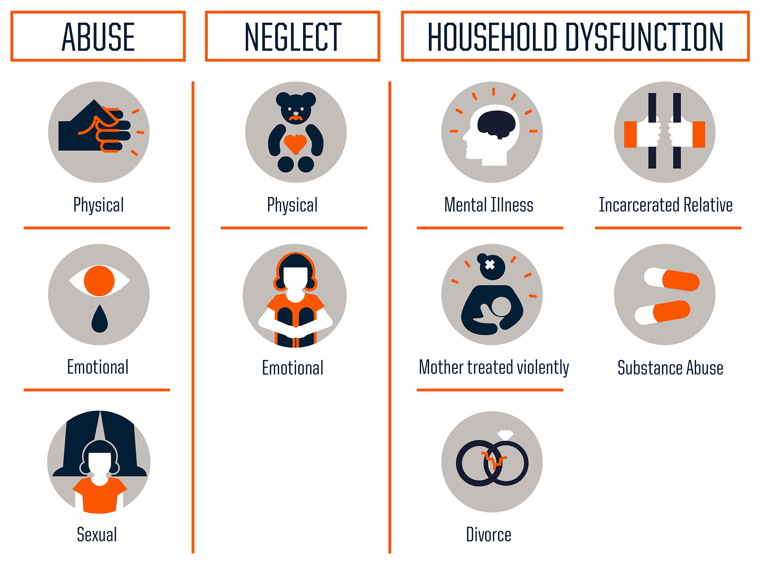
Childhood adversity common pre pandemic
Adverse childhood experiences
Community Violence
Bullying
Disasters
Medical trauma
Refugee trauma
Terrorism
Traumatic Grief
Historic & Racial trauma
Notes:
nk
We will focus on whats known about the effects of ttrauma andWe also know that childhood adveersitty is common pre pnadmeic. Oon the left here are thee typese of abusee, neglect and hoouseehold dysfunction which areee known as the aces – adveersee childhood expeerienees, studied retroospectiveeley in a largeee sample of middle class americans in the 90s by Kaiser permanenteee. The results showed us howo common childhood adversity is and the risks it is associated with, psychiatrically and medically. We now know that trauma ooutsidee of the home can also impact young ppl, trauma such as community violence, bullying or the trauma tha tmany have experienced as a result of covid, such as medical trauma ro traumatic grief. For underrepresented minorities, this mayb eompounded by hihstoric trauma, trauma that is transmitted socially and genetticaly across generations and racial trauma of everyday life.
Extended ACES – adversity outside of homes and embedded in low-resource communities affects communities of color disproportionately.
Trauma + loss. Experience matters.
Up to 80% children experience at least one traumatic experience in childhood; minority children are disproportionately impacted by trauma and continue to have high rates of contact with the health care system.
In times of pandemic, ptsd/trauma related sx being seen for kids and adults alike
Historical – impacts entire communities, cumulative and transmitted across generations
Mechanisms include social as well as biologic transmission
Ex. African American communities and legacy of slavery, displacement of Native Americans and boarding schools
Racial - trauma due to witnessing or experiencing racism, discrimination or structural prejudice
Increased vigilance, suspicion, sensitivity to threat, sense of foreshortened future
Potential maladaptive response to stress, particularly for youth in low-income communities with increased risk for community violence and victimization

Slide 18
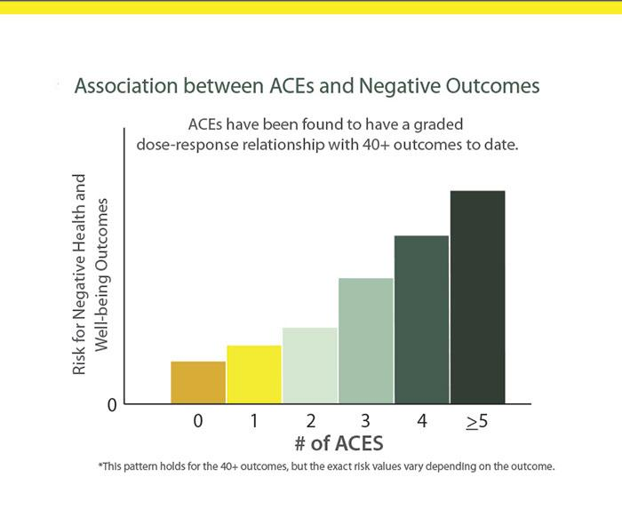
Known risk between adversity and wellbeing
Notes:
nk
https://vetoviolence.cdc.gov/apps/phl/resource_center_infographic.html
Adult Alcoholism/Liver Disease
Chronic Depression/Suicide Attempts
Perpetrating Domestic Violence/Being raped
Difficulty Parenting
As the number of ACEs increases so does the risk for the following:
Myocardial infarction
Asthma
Mental distress
Depression
Smoking
Disability
Reported income
Unemployment
Lowered educational attainment
Coronary heart disease
Stroke
Diabetes

Slide 19
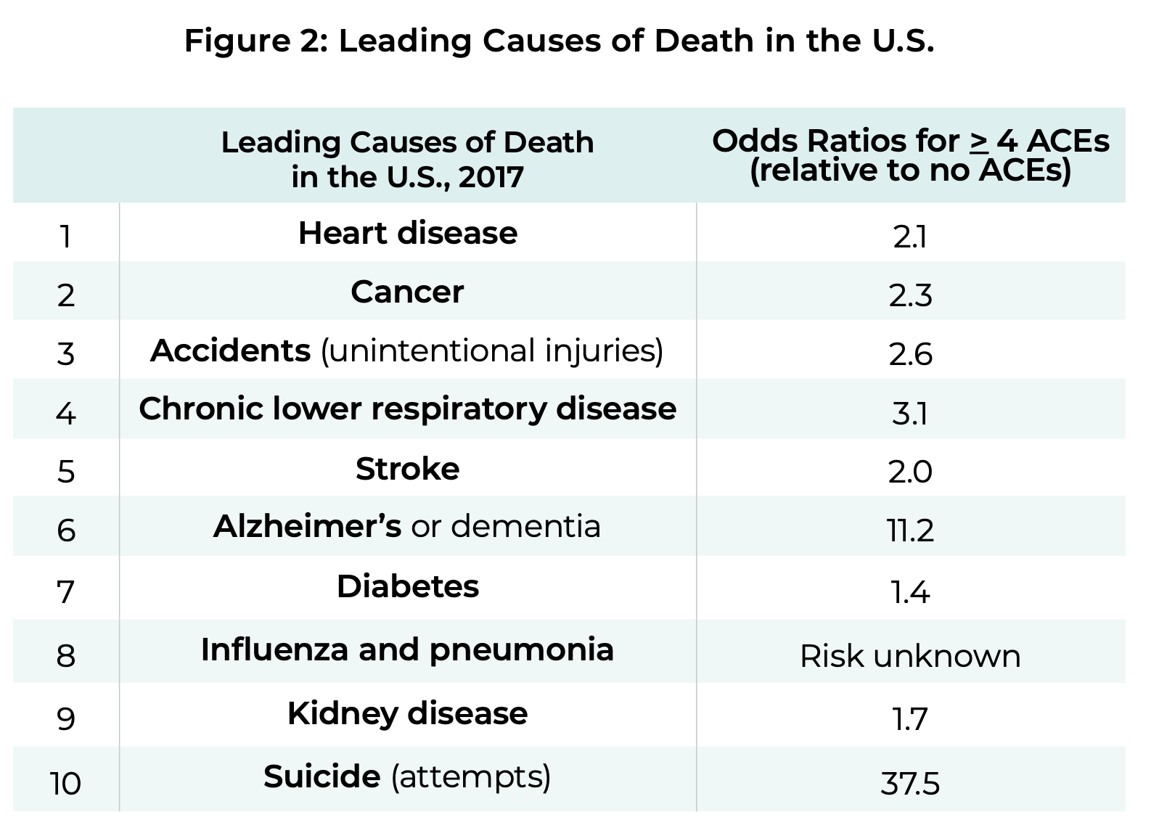
Notes:
nk
The long term effects of trauma and aces are remarkable.
https://www.cdc.gov/violenceprevention/aces/about.html

Slide 20
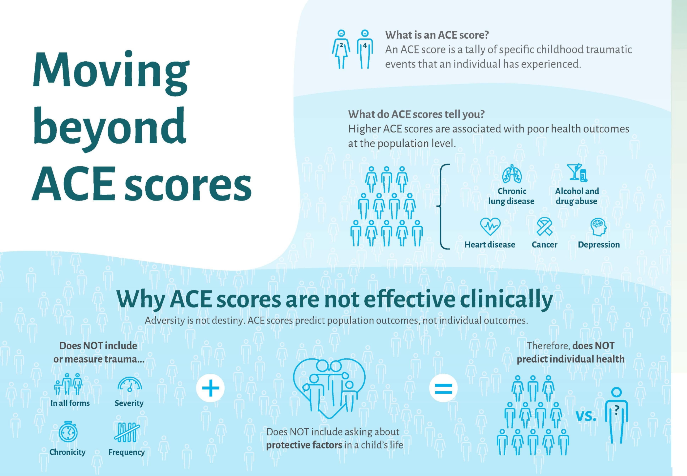

Slide 21
Who goes on to experience trauma sequelae?
All Kids who experience childhood trauma develop PTSD.
True.
False.
Notes:
Victor
: All Kids who experience Childhood trauma develop PTSD- True or False.
Answer: false!

Slide 22
Who goes on to experience trauma sequelae?
All Kids who experience childhood trauma develop PTSD.
True.
False.
Notes:
Victor
: All Kids who experience Childhood trauma develop PTSD- True or False.
Answer: false!

Slide 23
Exposure doesn’t equal trauma disorder
Keep in mind the three e’s of trauma:
Exposure
Experience
Effects
Not everyone with a trauma history needs extensive trauma therapy.
Careful assessment Is helpful.
Notes:
Victor

Slide 24
Post Traumatic Stress Disorder
Traumatic event (Criterion A) + 4 clusters + impairment x one month
Clusters:
B: Intrusive symptoms
For kids – repetitive play with trauma themes
Frightening dreams without recognizable content
Trauma reenactments during play
C: Persistence avoidance
D: Negative changes in cognition and mood
E: Hyperarousal and reactivity changes
Notes:
Victor
Exposure to actual or threatened death, serious injury, or sexual violence in one (or more) of the following ways:
Directly experiencing the traumatic event(s).
Witnessing, in person, the event(s) as it occurred to others.
Learning that the traumatic event(s) occurred to a close family member or close friend. In cases of actual or threatened death of a family member or friend, the event(s) must have been violent or accidental.
Experiencing repeated or extreme exposure to aversive details of the traumatic event(s) (e.g., first responders collecting human remains; police officers repeatedly exposed to details of child abuse). Note: Criterion A4 does not apply to exposure through electronic media, television, movies, or pictures, unless this exposure is work related.
§Tightening of the A1 Criterion
§Eliminating the A2 Criterion (fear, horror, helplessness)
§4 (rather than 3) Symptom Clusters
§Special Criteria for Preschool Children (children 6 and younger)
§Addition of a Dissociative Subtype

Slide 25
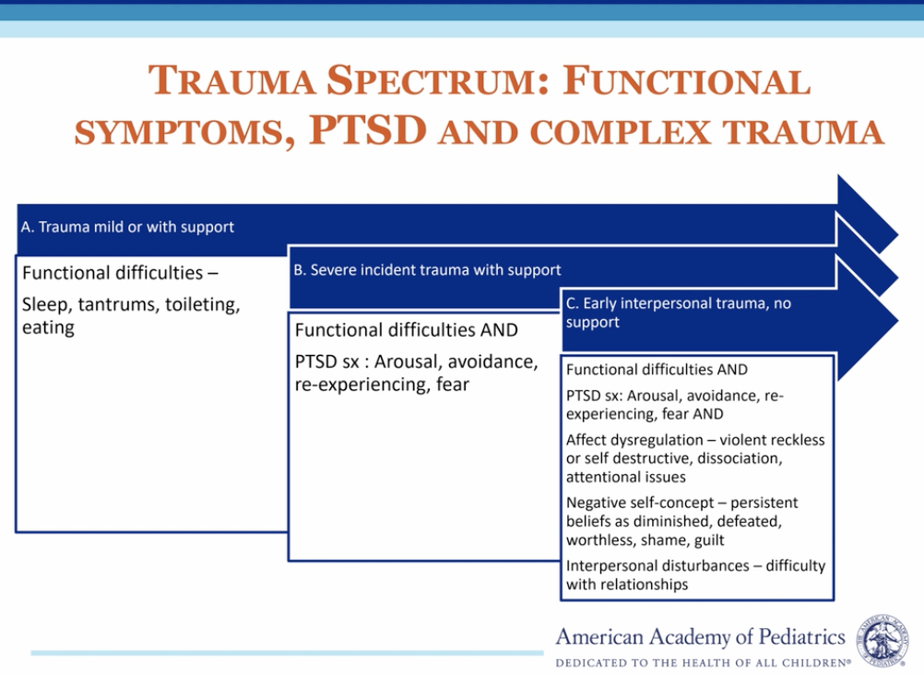
Notes:
Victor
Pediatricians and pcp care for many children at riskf or traumatic s tress
Type I
A single, unexpected event
Examples: one time assault, natural disaster, car accident, or witnessing a horrible event.
May lead to “typical”DSM PTSD or depression.
Type II
Chronic, repetitive events, which become an expected part of life.
Examples: chronic physical or sexual abuse, living in a severely chaotic/unpredictable environment.
Clinical sequela more complicated, may lead to “atypical” PTSD or personality disorders.
(Lenore Terr)
Dyadic model – so much of complex aces and traumas are relational and multigenerational. PCP observational skills – transform observation into clinical description. What did you see? What did it feel like in the room? Foundations of attachment and attachment relationships.

Slide 26
Most Kids who experience Trauma are resilient:
True
False
Notes:
nk
POLLL?
Most Kids who experience Trauma are resilient- True or False
Answer: true!

Slide 27
Most Kids who experience Trauma are resilient:
True
False
Notes:
nk
POLL
Most Kids who experience Trauma are resilient- True or False
Answer: true!

Slide 28
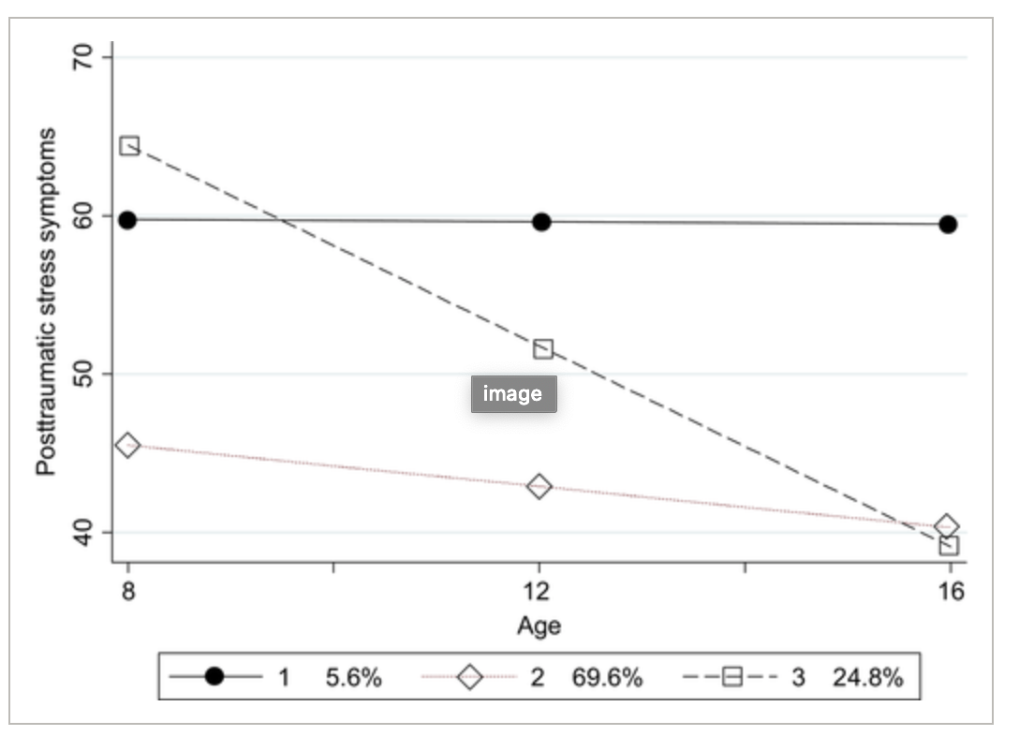
PTSD patterns over time: Fortunately, most improve with support
3 patterns of symptoms:
70 % Resilient
25 % Clinical-Improving
5 % Borderline-Stable
From longitudinal Study of Child Abuse & Neglect
N = 1,178 at-risk children
Multiple evals between 4-18 years of age.
(Miller-Graff & Howell, 2017).
Borderline‐Stable
Clinical‐Improving
Resilient
Notes:
nk
N = 1,178 at-risk children living in High-Risk environments
Child Protective Services (CPS)
Clinical-Improving group differs from Resilient
1. More likely to have CPS reports of
physical abuse
2. More likely witness violence at home and
community
3. Less likely to report homes were safe
4. More likely to report anger
Van der kolk 2003:
Because infants and toddlers who have been traumatized multiple times often experience developmental delays across a broad spectrum, including cognitive, language, motor, and socialization skills [36], they tend to display complex disturbances with various, often fluctuating, presentations. They generally meet numerous clinical diagnoses. In one study of 364 abused children in the United States [35], 58% met criteria for separation anxiety/overanxious disorder, 36% for phobic disorder, 35% for PTSD, 22% for attention deficit hyperactivity disorder, and 22% for oppositional defiant disorder. In prospective study by Putnam [37] of a group of sexually abused girls, anxiety, oppositional disorder, and phobia were clustered in one group, whereas depression, suicidality, PTSD, attention deficit hyperactivity disorder, and conduct disorder represented another cluster [37]. The spectrum of biologic, emotional, and cognitive abnormalities is ex- pressed in a multitude of psychological, somatic, and behavioral problems that range from learning disabilities to aggression against self and others [38–42]. ~~~
Remnants of trauma makes these youth vulnerable to subsequent trauma.
Traumatic remnants.

Slide 29
Trauma informed care: Principles
Recognize the signs and symptoms of trauma exposure on physical and mental health.
Establish physical and emotional safety of patients and staff.
Build trust between providers and patients.
Ensure collaboration by bringing patients into process of goal-setting, treatment-planning.
Promote patient-centered, evidence-based care.
Provide culturally sensitive care.
Notes:
nk
The principles!
Patient-centered
How to make time and space for mom and Dan, together and separate?
Team-based approach
Who screens? Which screens?
Who follows up if positive?
What do you need to assess and treat this family?
Collaboration
Take time for introductions, getting to know values, goal setting.
Build trust & recognize sx of trauma
Balancing safety screening with building resiliency

Slide 30
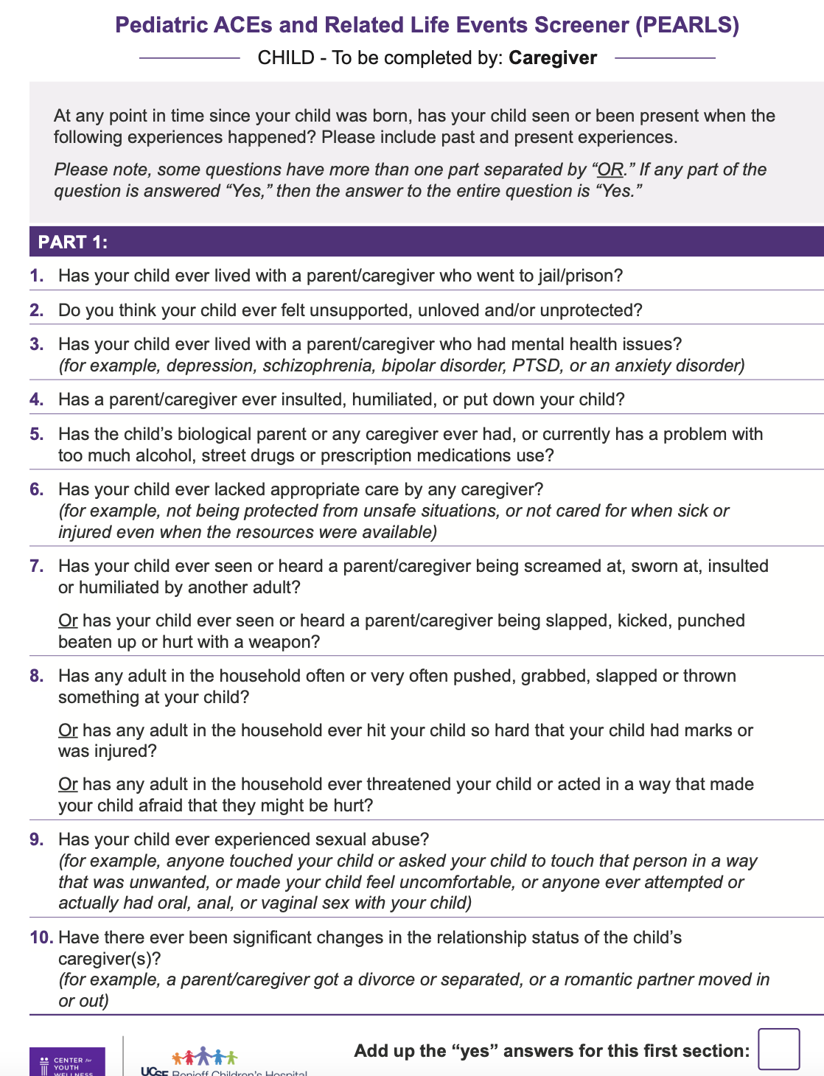
Universal Screening tools
ACES/PEARLS& BCES
parents
youth
SEEK for 0-5 youth
Notes:
Nk
https://intermountainhealthcare.org/ckr-ext/Dcmnt?ncid=529796906

Slide 31

Open ended trauma inquiry
“Stressful and scary events sometimes happen. Has there been a time where you felt really scared for your safety or someone else’s at home or in the community?”
“Has anything bad or scary happened to you or your child since I last saw you?”
Notes:
nk
Avoidance of discussing trauma is typically rooted in one or more of the following:
The belief that bringing it up will cause painful recollection or worsening of symptoms.
One’s own avoidance of painful discussions.
Fear of tainting the child’s description of the trauma (e.g. upcoming court testimony.)
Solutions:
Listen more than talk.
Be careful not to ask leading questions.
Be clear as to your role: e.g. Clinical vs. Forensic

Slide 32
Resilience inquiry
Tell me a little bit about yourself:
What are some things you are really proud of?
What are your parents really proud of?
If something difficult were to happen, who would be available to help you?
If something good were to happen, who would be cheering for you?
All of us have somethings from our childhood that are so wonderful. All of us have things that we hope to protect our children because they were hard. What do you want your children to get from you and what would you want to protect them from?
Notes:
nk
Avoidance of discussing trauma is typically rooted in one or more of the following:
The belief that bringing it up will cause painful recollection or worsening of symptoms.
One’s own avoidance of painful discussions.
Fear of tainting the child’s description of the trauma (e.g. upcoming court testimony.)
Solutions:
Listen more than talk.
Be careful not to ask leading questions.
Be clear as to your role: e.g. Clinical vs. Forensic

Slide 33
Rating scales for PTSD
Child and Adolescent Trauma Screen (CATS)
Self report, children 7-17
Caregiver report 3-17
Score >12 suggests need to refer and possibly treat
Child PTSD Symptom Scale (CPSS)
Self report, 8-18
Score >15 suggests PTSD highly likely.
Notes:
Victor– how a rating scale eventually helped her feel ready to share.

Slide 34
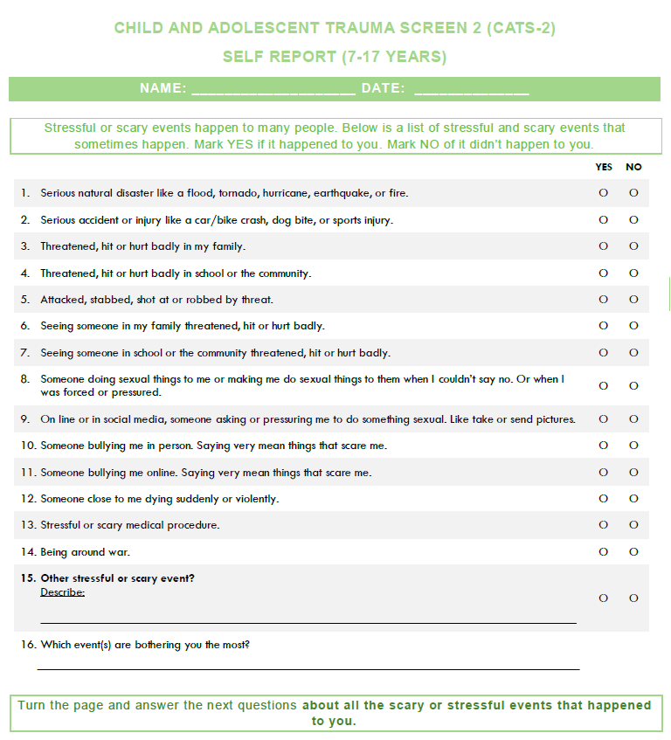
Notes:
Victor

Slide 35
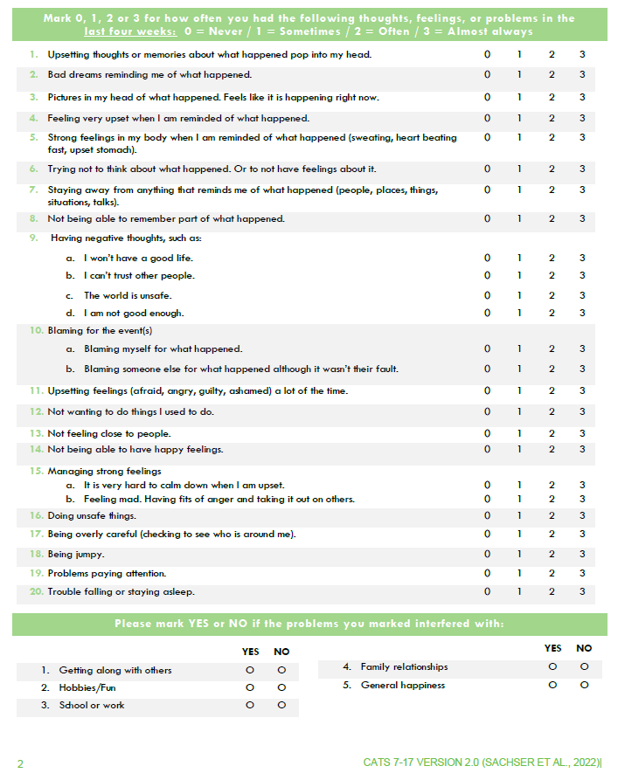
Notes:
Victor

Slide 36

Notes:
Victor

Slide 37
Evidence-based tx
At-risk youth
Multiple ACES/At-risk youth
Parent-child interactive therapy
Child parent psychotherapy to help child & parent attune
PTSD & Complex trauma
Complex trauma
ARC: Attachment, regulation, competency
ITCT: Integrative treatment of complex trauma
PTSD
Trauma focused CBT (ages 3+)
Child and family traumatic stress intervention
EMDR
Notes:
Victor
PCIT or CPP attunement thnx – to help child and parent attune.
Tf-cbt for trauma and ptsd –
Complex trauma – arc; itct-c, itct-a
Primary and secondary preventin
Brazelton touch points

Slide 38
PTSD Essential TX components
Direct exploration of trauma – building narrative, exposure
Stress management techniques
Exploration and correction of inaccurate attributions regarding trauma (cognitive reprocessing)
Parental inclusion if possible, to help understand and validate trauma narrative
Notes:
Victor
Involves encouraging a child, through relaxation and desensitization procedures, to describe the event with diminished hyperarousal and negative affective states (“reprocessing.”)
Many experts believe this to be the most critical component of PTSD treatment.
Example: With Ron, help him tell his story of what happened when his father went to jail and use coping skills when he notices anxiety or other strong emotions.
Stress management techniques
Sense of control over thoughts and feelings
Relieve acute distress when sx occur
Techniques:
Mindfulness exercise
Progressive muscle relaxation
Thought stopping
Positive imagery
Deep breathing
Examples:
Square breathing
5-4-3-2-1
Holding Ice or putting cold washcloth over temples
Rumination vs reprocessing
Reprocessing (Good)
Thinking of an experience in a new way, or having new feelings when remembering.
What happens in good psychotherapy.
Data suggesting biologic changes occur.
Repeating the same story or experience again and again in exactly the same way.
NOT associated with any sort of improvement and may make some feel worse.
🡪 Re-traumatizing

Slide 39
PTSD Tx Components in Primary Care
Understanding a person’s reaction to the trauma, without necessarily going into the trauma itself.
Stress management techniques
Planting psychoeducation seeds.
Meeting families where they are in regards to acknowledgement.
Notes:
Victor

Slide 40
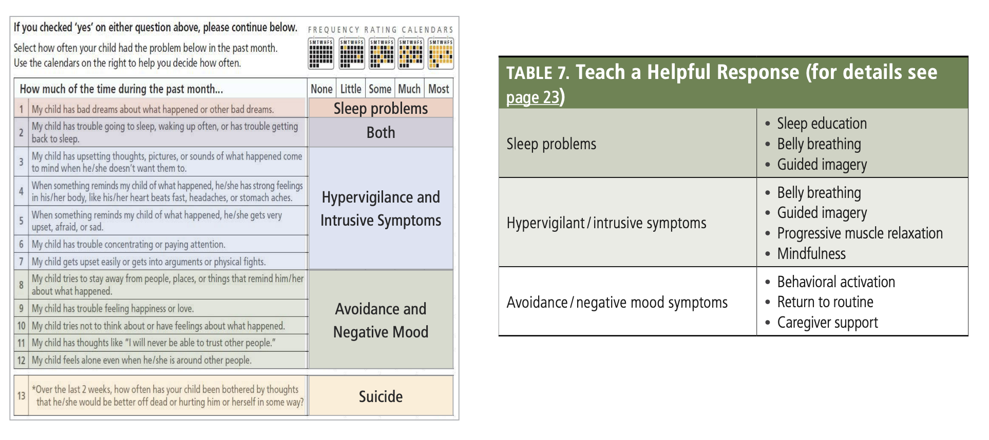
Brief interventions
Notes:
Victor

Slide 41
Psychopharmacology
Adjunctive - NOT one of the established elements of treatment
Theories; some reports of med efficacy; no randomized trials.
Medications used to treat prominent symptoms or co-morbid psychiatric conditions.
Core PTSD sx
Hyperarousal & nightmares- alpha agonistst
Notes:
Victor

Slide 42
Take aways
Trauma is ubiquitous & most youth are resilient.
Most severe trauma sequalae occurs in the absence of protective relationships.
You can have an important role in promoting resilience in a child & family's life.
What changes are needed to embody and integrate TIC into your practice?
Notes:
Victor

