Slide 1
Treatment of
Eating Disorders

Slide 2
Victor Fornari MD MS
Vice Chair & Director, Division of Child & Adolescent Psychiatry
(Cohen Children’s Medical Center & The Zucker Hillside Hospital)
Professor of Psychiatry & Pediatrics
Donald & Barbara Zucker School of Medicine
At Hofstra/Northwell

Slide 3
Rachel Kaufman, MD
Primary Care Champion

Slide 4
Disclosures
PCORI- START - Salary support
Advisory Board- AGB-Pharma AB
New York State Office of Mental Health (OMH) -
Project TEACH- Salary support

Slide 5
?
Poll #1 True or False
Anorexia Nervosa may have the highest mortality rate of all psychiatric disorders

Slide 6
?
Poll #2 Anorexia Nervosa
A. Amenorrhea is a diagnostic criteria
B. 15 % weight deficit is required to meet criteria
C. Is rarely found in males
D. A, B & C
E. None of the above

Slide 7
?
Poll #3: Avoidant/Restrictive Food Intake Disorder (ARFID)
A. Is not an eating disorder
B. Is a feeding disorder
C. Can be associated with Autism Spectrum Disorder
D. A & C
E None of the above

Slide 8
Disclaimers
If humor is used during this talk, it by no means is to suggest that there is anything humorous about these disorders, but rather, it is used as a vehicle for transmitting information in a palatable fashion
Eating Disorders may have one of the highest mortality rates of all psychiatric disorders

Slide 9
Is there a way to prevent eating disorders?
How can we raise our children not to worry about whether they are thin enough?
How can we feel good about ourselves without worrying about whether we are thin enough?

Slide 10
Ambivalence towards treatment

Slide 11
Treatment resistance

Slide 12
Persuasion

Slide 13
Perceived Coercion

Slide 14
Compulsion

Slide 15
What is often the first thing people say to one another when they meet after a period of time? (when they wish to be nice)

Slide 16
You look terrific!

Slide 17
Have you lost weight?

Slide 18
Personal Impact
Given the prevalence of these disorders, it is likely that most people in this room either know a close family member or friend who has had an eating disorder, or has had one him or herself

Slide 19


Slide 20
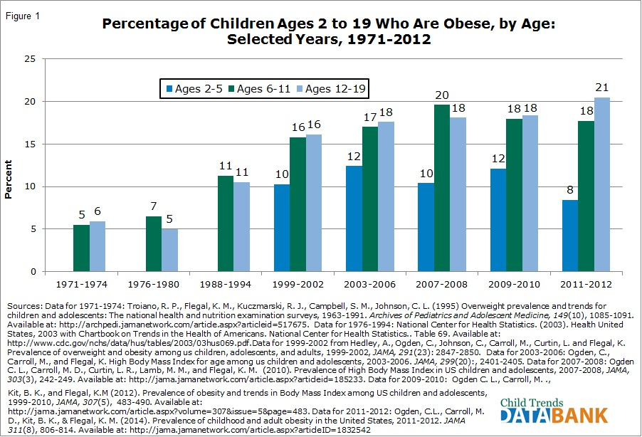

Slide 21


Slide 22
Levels of care to consider
Treatment
  Begin with medical assessment to determine the needed level of care
  Hypokalemia, bradycardia & orthostatic hypotension may determine need for inpatient medical level of care
-Inpatient Medical
-Inpatient Pediatric
-Inpatient Adolescent Psychiatric
-Inpatient Adult Psychiatric
-Inpatient Psychiatric Eating Disorder
-Day Treatment
-Intensive Outpatient Program
-Outpatient Treatment

Slide 23
EATING DISORDERS: Characteristics of levels of care
Levels of care
  Specialized pediatric or medical inpatient
  General pediatric or medical inpatient
  Specialized psychiatric inpatient
  General psychiatric
  Residential programs
  Partial hospital
  Intensive outpatient
  Outpatient
Characteristics of different settings
  Unit security
  Patient legal status
  Physician on-site 24/7
  Nursing on-site 24/7
  Medical monitoring
  Hours of operation
  Able to maintain work/school
Available interventions
  Option for IV hydration
  Option for nasogastric tube feedings
  Option for treatment over objection
  Medical management
  Psychiatric management
  Psychological management
  Group-based therapies
  Individual psychotherapies
  Family psychotherapies
  Meal supervision and support
  Milieu therapy
  Nutritional management
  Multidisciplinary team-based management

Slide 24
APA Practice guideline for THE treatment of eating disorders https://www.psychiatry.org/psychiatrists/practice/clinical-practice-guidelines
2023
Notes:
Full practice guideline citation
Online and pdf versions available at: https://www.psychiatry.org/psychiatrists/practice/clinical-practice-guidelines
Executive Summary available at: XXX

Slide 25
EATING DISORDERS: Screening
Statement 1 - APA recommends (1C) screening for the presence of an eating disorder as part of an initial psychiatric evaluation.
Rationale: Risk to health if present; estimated prevalence
Prevalence rates have wide range of estimates based on the study design and country. Rates for eating disorders that do not meet full criteria are even higher.
 | 12-month prevalence | Lifetime prevalence
Anorexia nervosa | 0.5% ♀ 0.1% ♂ | 1.4% ♀ 0.2% ♂
Bulimia nervosa | 0.7% ♀ 0.4% ♂ | 1.9% ♀ 0.6% ♂
Binge eating disorder | 1.4% ♀ 0.6% ♂ | 2.8% ♀ 1.0% ♂

Slide 26
EATING DISORDERS: Quantitative Measures
Statement 3 - APA recommends (1C) that the initial psychiatric evaluation of a patient with a possible eating disorder include weighing the patient and quantifying eating and weight control behaviors (e.g., frequency, intensity, or time spent on dietary restriction, binge eating, purging, exercise, and other compensatory behaviors).
Rationale:
Establishes level of severity, in part aligning with DSM criteria.
Permits tracking of relative changes in symptoms over time with greater reliability than retrospective recall.
Consistent with suggestion in psychiatric evaluation guidelines and other guidelines to use quantitative measures.

Slide 27
EATING DISORDERS: Physical Examination and other signs
Abnormal vital signs
Height, weight, and BMI
- Possible indication of medical instability that warrants a higher-level care
e.g., heart rate <50 bpm, systolic blood pressure <90 mmHg, or temperature <36°C (96.8°F)
- Normal results may not exclude an eating disorder
Evaluate initially, with weight obtained, ideally, at all visits (www.cdc.gov/healthyweight/assessing/bmi/adult_bmi/english_bmi_calculator/bmi_calculator.html)
Notes:
Freeman R, Wieling W, Axelrod FB, et al: Consensus statement on the definition of orthostatic hypotension, neurally mediated syncope and the postural tachycardia syndrome. Auton Neurosci 161(1–2):46–48, 2011 21393070
Raj SR, Guzman JC, Harvey P, et al: Canadian Cardiovascular Society position statement on postural orthostatic tachycardia syndrome (POTS) and related disorders of chronic orthostatic intolerance. Can J Cardiol 36(3):357–372, 2020 32145864
Singer W, Sletten DM, Opfer-Gehrking TL, et al: Postural tachycardia in children and adolescents: what is abnormal? J Pediatr 160(2):222–226, 2012 21996154

Slide 28
EATING DISORDERS: Identification of Co-occurring Conditions
Statement 4 - APA recommends (1C) that the initial psychiatric evaluation of a patient with a possible eating disorder identify co-occurring health conditions, including co-occurring psychiatric disorders.
Rationale:
Physical health conditions can confound diagnosis, be associated with higher rates of eating disorders, and contribute to complications of eating disorders.
Rates of psychiatric comorbidity are high (e.g., depression, anxiety, trauma-related disorders, ADHD, misuse of substances such as stimulants).

Slide 29
EATING DISORDERS: Identification of Co-occurring Conditions (continued)
Substance use history such as…
the use of caffeine, tobacco, alcohol, cannabinoids, and other substances
cigarette smoking (including electronic cigarettes or vaping) to suppress appetite
the use or misuse of prescribed or non-prescribed meds that suppress appetite (e.g., OTC weight loss products, stimulants) or enhance muscularity (e.g., supplements, androgens)
Trauma and suicide history such as…
physical, emotional, or sexual abuse; bullying (including cyberbullying); neglect (including food insecurity); symptoms related to PTSD
suicide risk, including current suicidal ideas, plans, or intentions, prior suicidal plans or attempts, and the presence of non-suicidal self-injury
Notes:
Ferrell EL, Russin SE, Flint DD: Prevalence estimates of comorbid eating disorders and posttraumatic stress disorder: a quantitative synthesis. J Aggress Maltreat Trauma 31(2):264–282, 2020
Mason TB, Tackett AP, Smith CE, et al: Tobacco product use for weight control as an eating disorder behavior: recommendations for future clinical and public health research. Int J Eat Disord 55(3):313–317, 2021 34866222
Naveed A, Dang N, Gonzalez P, et al: E-cigarette dependence and weight-related attitudes/behaviors associated with eating disorders in adolescent girls. Front Psychiatry 12:713094, 2021 34526923

Slide 30
ANOREXIA NERVOSA: Family-Based Treatment in Adolescents and Emerging Adults
Statement 12 - APA recommends (1B) that adolescents and emerging adults with anorexia nervosa who have an involved caregiver be treated with eating disorder-focused family-based treatment, which should include caregiver education aimed at normalizing eating and weight control behaviors and restoring weight.
Rationale:
Support from the expert opinion and from a NMA of studies of psychotherapies in AN
FBTs (with family in charge of the patients’ eating) led to greater changes in BMI than no treatment and greater changes in %IBW than TAU.

Slide 31
Treatment
  Perform a comprehensive psychiatric evaluation to determine the diagnosis and whether there is co-morbidity
  Rarely, do eating disorders present as the sole form of psychopathology
  Assess for safety and whether there is any suicidal or non-suicidal self injury (NSSI)

Slide 32
High Risk
How does the evidence
support the treatment
  Begin with medical stabilization
  Food is the mainstay of treatment
  Family Based Treatment (FBT) is the evidence based approach for the younger patient
This population requires close medical monitoring due to the risk of sudden death from hypokalemia and bradycardia

Slide 33
Psychopharmacology of
Eating Disorders
There is no clear psychopharmacology for anorexia or bulimia nervosa
Co-morbid conditions are often addressed (anxiety, depression, inattention, mood fluctuations, psychosis)
SSRI may be helpful to reduce binge frequency in BN, however, CBT is the treatment of choice

Slide 34
Psychotherapy of
Eating Disorders
FBT is the treatment of choice for AN, however, requires the capacity of the family to be engaged and cooperative
CBT is the treatment of choice for BN
DBT may be helpful to reduce suicidal thoughts, behavior as well as NSSI in individuals with an eating disorder (often with a trauma history)

Slide 35
Psychotherapy of
Eating Disorders
Individual psychotherapy is important once there is medical stabilization, however, the evidence does not support that it is the treatment of choice for medical recovery
Family Therapy is important, regardless of the age of the patient, however, in families with suspected abuse or neglect, it may be contra-indicated

Slide 36
Nutritional Rehabilitation
No meaningful psychotherapy can occur with the malnourished brain
Food is the mainstay of treatment

Slide 37
Historical perspective
Anorexia Nervosa
Medieval times- Fasting Saints
1873 - Sir William Gull – Anorexia Nervosa
1980 – DSM-III – Anorexia Nervosa (25 % weight deficit)
1987 – DSM-IV – Anorexia Nervosa (15 % weight deficit)
2013 – DSM-5 – Anorexia Nervosa
(elimination of amenorrhea criterion & percentage weight cut-off )

Slide 38
DSM 5 criteria for
Anorexia Nervosa
Food restriction with low weight
Intense fear of gaining weight or becoming fat
Disturbance in body experience

Slide 39
Historical perspective
Bulimia Nervosa
Gerald Russell, 1979 –
“an ominous variant of anorexia nervosa”
1980 – DSM-III Bulimia Nervosa
1987 – DSM-III-R Bulimia Nervosa
1990 – DSM-IV Bulimia Nervosa
2013 – DSM-5 Bulimia Nervosa

Slide 40
DSM 5 criteria of
Bulimia Nervosa
Recurrent episodes of binge eating
A sense of lack of control over eating
Recurrent inappropriate compensatory behaviors
At least on average once per week for 3 months
Self evaluation unduly influenced by shape or weight

Slide 41
New: Avoidant/Restrictive Food Intake Disorder
ARFID
Apparent lack of interest in eating, avoidance based on sensory characteristics of food, or concern about aversive consequences of eating
The avoidance or restricted eating failure to gain as expected

Slide 42
Course of illness
Prognosis
Mortality rates

Slide 43
Eating Disorders
A Primary Care perspective
Dr. Rachel Kaufman

Slide 44
Disclosures
Project TEACH
-I am a PCP Champion for Project TEACH
-I receive Salary support for my work with Project TEACH

Slide 45
EATING DISORDER BIAS
-Whether we want to admit it or not, the majority of providers have a mental image of a thin, white, female patient
-Not all eating disorder patients are thin!
-Not all eating disorder patients are female (trans patients are at higher risk)
-People from ALL ethnic backgrounds can develop eating disorders

Slide 46
These disorders develop over time
Patients do not wake up one day and suddenly meet all the DSM5 criteria for an eating disorder
We sometimes have the opportunity to identify and support patients who are developing disordered patterns BEFORE they are underweight and/or Purging regularly and in medical danger
Even in patients who never will meet DSM5 criteria, disordered eating patterns are harmful to them, and we can support better relationships with food

Slide 47
How and When to start this Conversation
Rigorous screening of every patient is likely impractical, but I have gotten traction with asking just one or two open ended questions:
“Tell me about how you feel about food”
“Do you feel like you have a good relationship with food?”
“Will you let yourself eat when you are hungry?”
“When you look in the Mirror, what do you see?”

Slide 48
Be Mindful of Eating Disorders when you see weight loss
Don’t automatically congratulate the patient! Start with some neutral fact finding
“I see you have lost weight in the past 6 months, why do you think your weight changed?”
“You say you are just More Healthy, but what does that mean for you?”

Slide 49
Messy Realities when Specialist care is difficult to access
First, Make sure your patient does not require hospitalization, then..
Don’t be afraid to bring the patient back! You don’t have to do it all in one visit
Establish clear lines of communication with your staff to have patient face away from the scale at visits
Picking up the phone is a Superpower: Counselors (if your patient is already in counseling) and Schools nurses and school guidance counselors can be valuable partners
Focus on the most practical and essential health goals

Slide 50
?
True or False
Anorexia Nervosa may have the highest mortality rate of all psychiatric disorders

Slide 51
?
Anorexia Nervosa
A. Amenorrhea is a diagnostic criteria
B. 15 % weight deficit is required to meet criteria
C. Is rarely found in males
D. A, B & C
E. None of the above

Slide 52
?
Avoidant/Restrictive Food Intake Disorder (ARFID)
A. Is not an eating disorder
B. Is a feeding disorder
C. Can be associated with Autism Spectrum Disorder
D. A & C
E None of the above

Slide 53
Minnesota Experiment of
Human Starvation
https://www.youtube.com/watch?v=8iH5htWIwo0

Slide 54
Acknowledgements
Collaborative effort, Division of Child & Adolescent Psychiatry, Department of Psychiatry, The Zucker Hillside Hospital (ZHH) & the Division of Adolescent Medicine, Department of Pediatrics, Cohen Children’s Medical Center (CCMC)
New York State Center of Excellence –
Columbia, Cornell and LIJ (CCMC & ZHH)

Slide 55
Thank you

