Slide 1
Assessing and Managing
Adolescent Suicide Risk In Primary Care
Fall, 2024

Slide 2
Welcome!
Molly Scharf, MD
Family Physician
Rochester Institute of Technology
Student Health Center
Michele Phillips
Michele Phillips
Sr. Project Director, Project TEACH
Sr. Project Director, Project TEACH
mp246@buffalo.edu
MP246@Buffalo.edu

Slide 3
Disclosure
I have no relevant financial relationships with ineligible companies
Notes:
DAVID

Slide 4

The way through it is by talking about it……….
Suicide risk grows in shame and silence

Slide 5
The Starfish Story
One day an old man was walking along the beach when he noticed a young man picking up and gently throwing things into the ocean.
Approaching the young man he asked, “Good morning! May I ask what it is that you are doing?”
The young man paused and looked up and replied: “Throwing starfish back into the ocean.” The old man then said “Well I must ask why are you doing that? The young man responded: “The surf is up and the tide is going out. If I don’t throw them back, they’ll die,”
Upon hearing this, the old man commented, "But, young man, do you not realize that there are miles and miles of beach and there are starfish all along every mile? You can't possibly make a difference!"
After listening politely, the young man bent down to pick up another starfish and threw it into the surf. Then, he smiled at the old man and said:
“It made a difference to that one.”

Slide 6
Why Screen?

Slide 7
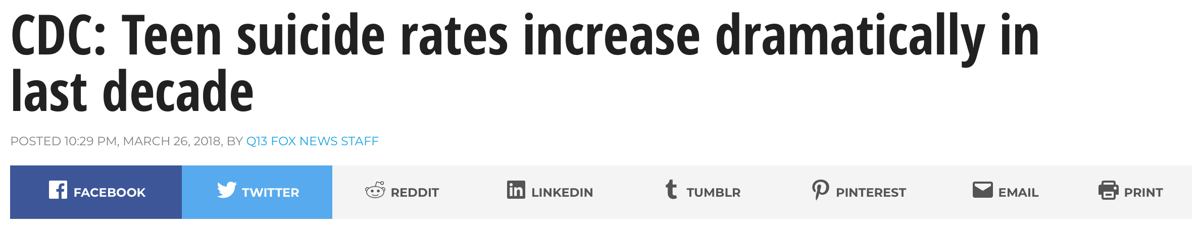
Notes:
Increase 56%! OVERALL RATE 13/100,000; 10-14: tripled over this time period, now 3/100,000; 15-19 6.8 to 10.6. DECREAED SMALL AMOUNT FROM 2021 TO 2022

Slide 8
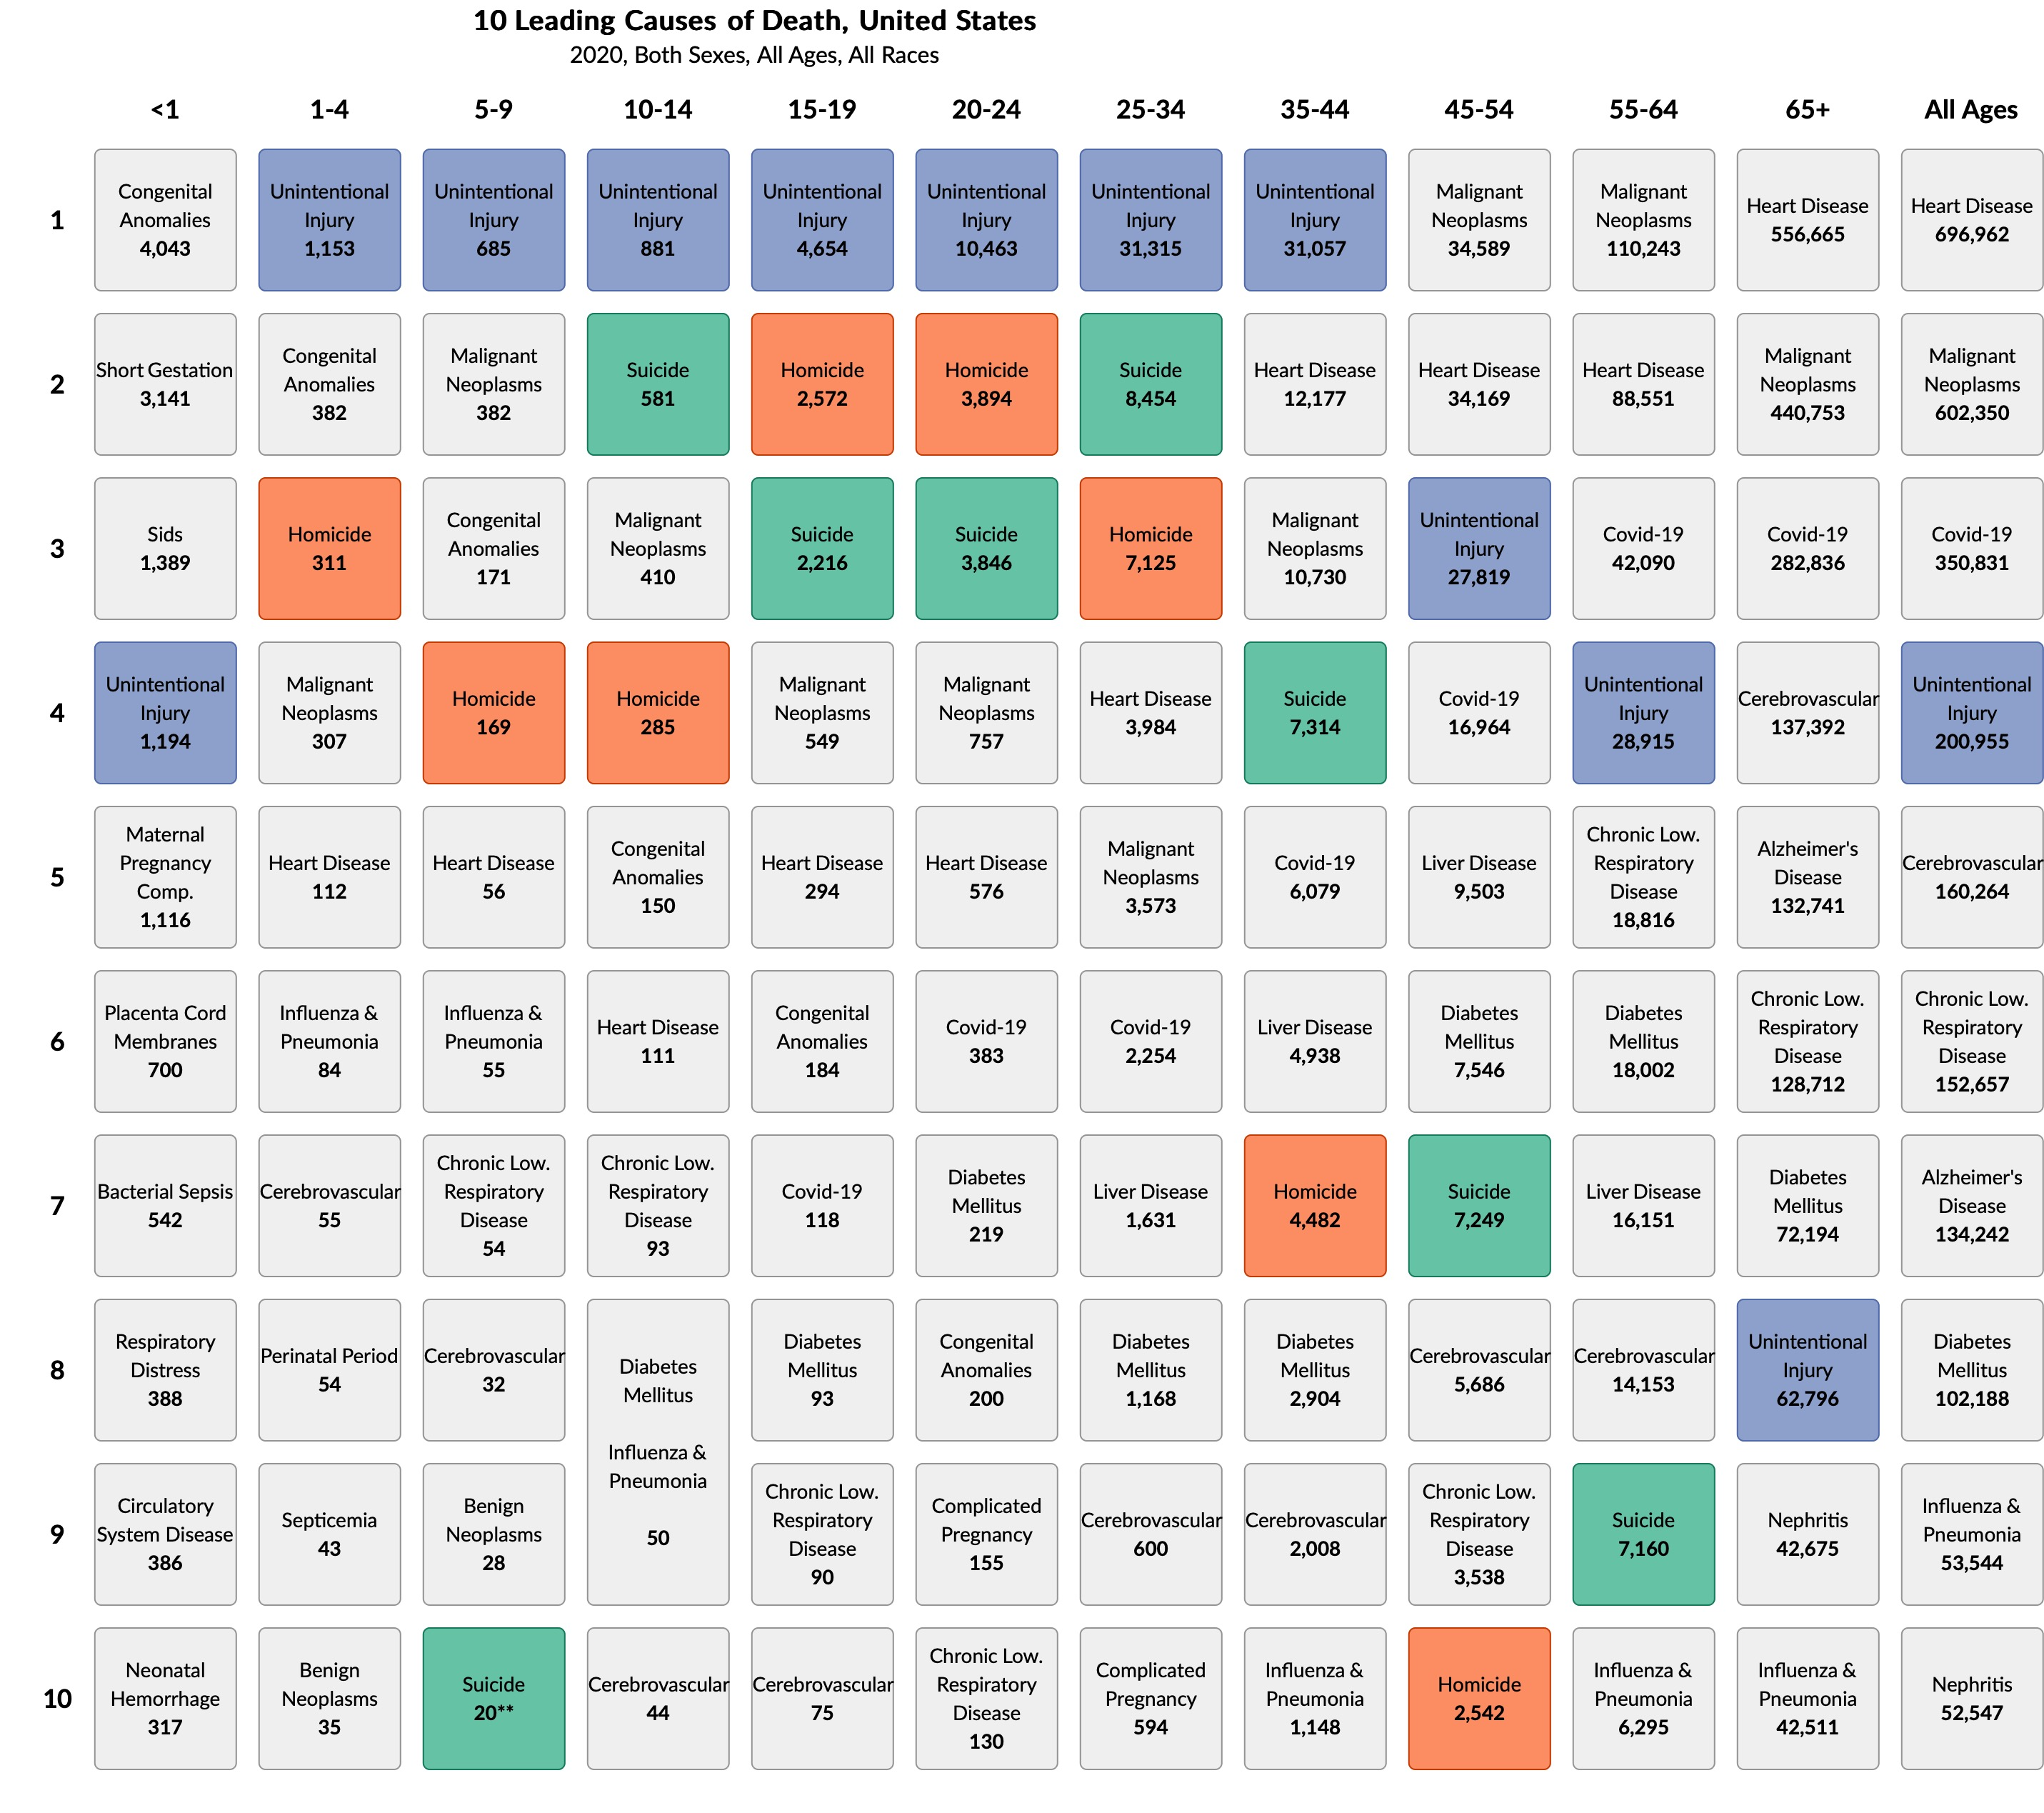
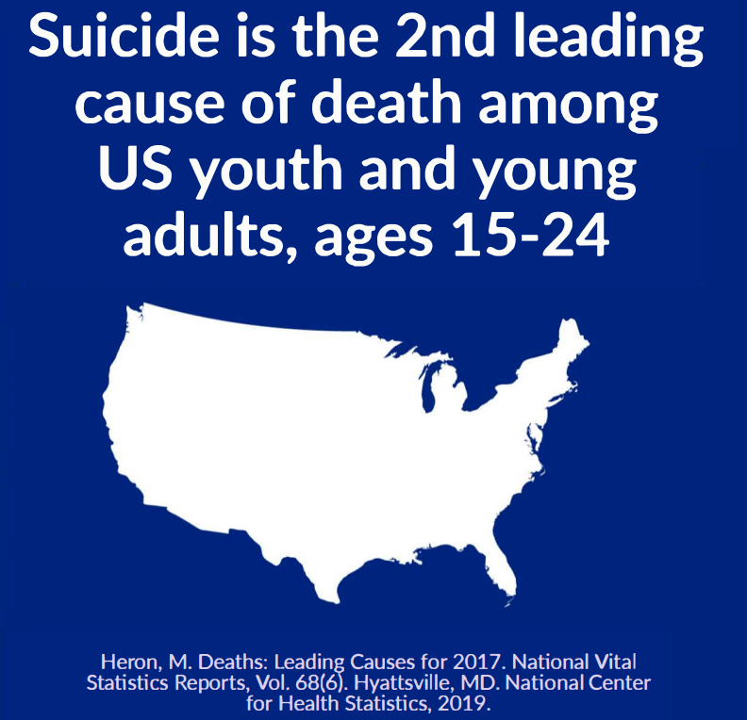

Slide 9
40% of youth who died by suicide visited a primary care medical setting within the month prior
Why Screen in Primary Care?

Slide 10
Why screen universally?
Decreases bias
Systematic
Destigmatizes so opens up discussion, decreases isolation

Slide 11
Sidebar: Firearms #1 Cause, 15-19 yo
Notes:
Girls suffocation 52%, firearms 23%, 14% OD; 10-14:

Slide 12
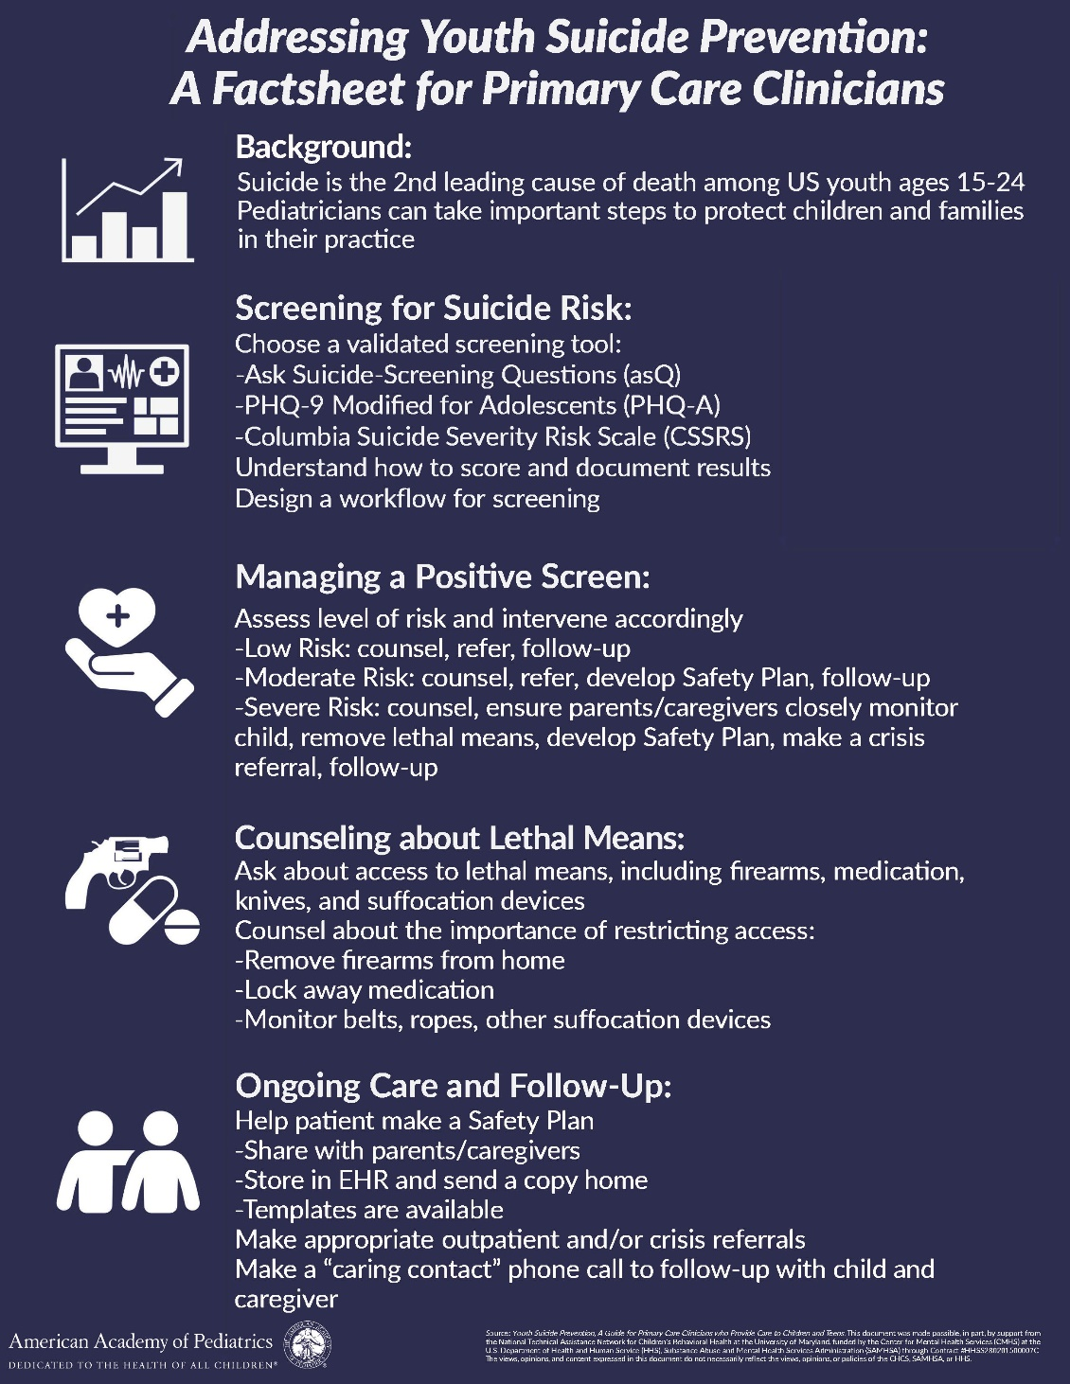
AAP Blueprint for
Youth Suicide Prevention
https://www.aap.org/en/patient-care/blueprint-for-youth-suicide-prevention/

Slide 13
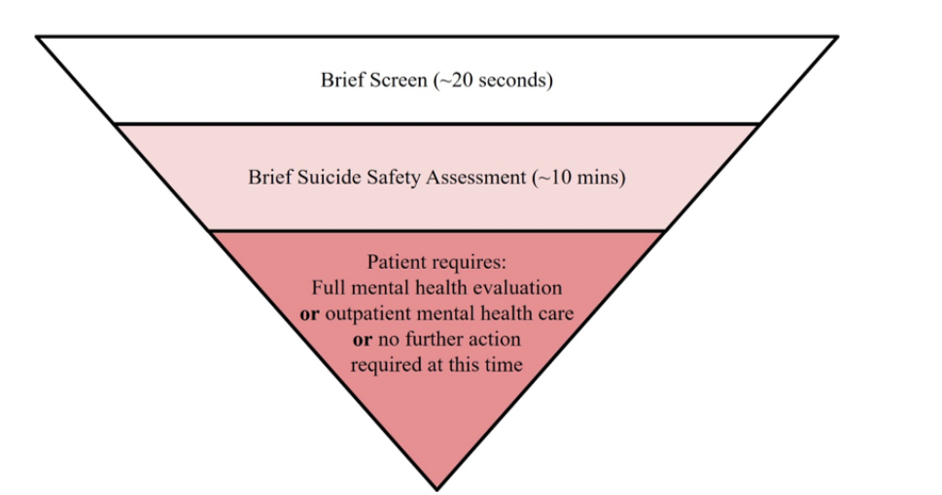
3-Step Approach
Brief Screen (universal)
<1 minute
Ages 12 +
8-11 if at risk
Brief Suicide Safety Assessment
If identified to be at risk
10-15 minutes
Stratify Risk (to determine disposition)
Imminent
Further evaluation needed
Low Risk
https://www.aap.org/en/patient-care/blueprint-for-youth-suicide-prevention/strategies-for-clinical-settings-for-youth-suicide-prevention/clinical-pathways-for-suicide-prevention/

Slide 14
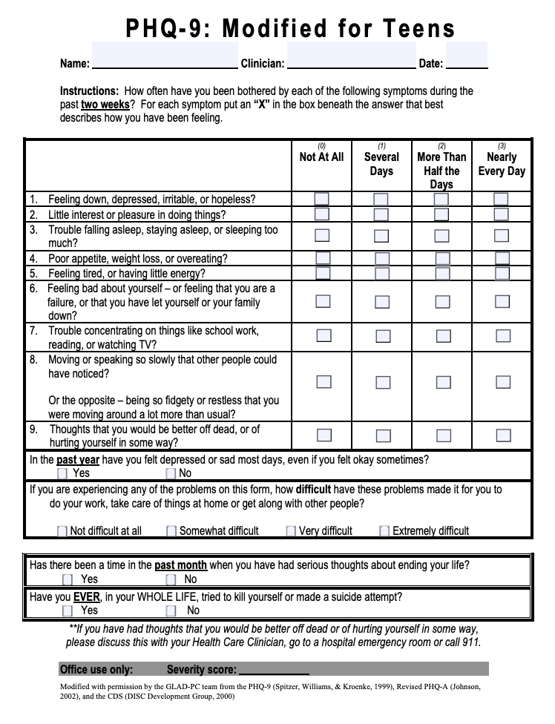
Identifying
Suicide Risk:
Depression
Screening Tools
Caution: PHQ9 MT commonly used but not considered evidence based!
Notes:
Choose a validated screening tool
Options include ASQ, PHQ-9, CSSRS
Understand how to score and document results
Identify screening workflow
Discuss differences between standardized depressive symptoms screening tools (i.e. PHQ-9) vs standardized suicide-specific screening tools (i.e. ASQ, C-SSRS)
Phq9 > passive suicidality , and history of suicide attempt
CSSRS > active suicidality

Slide 15
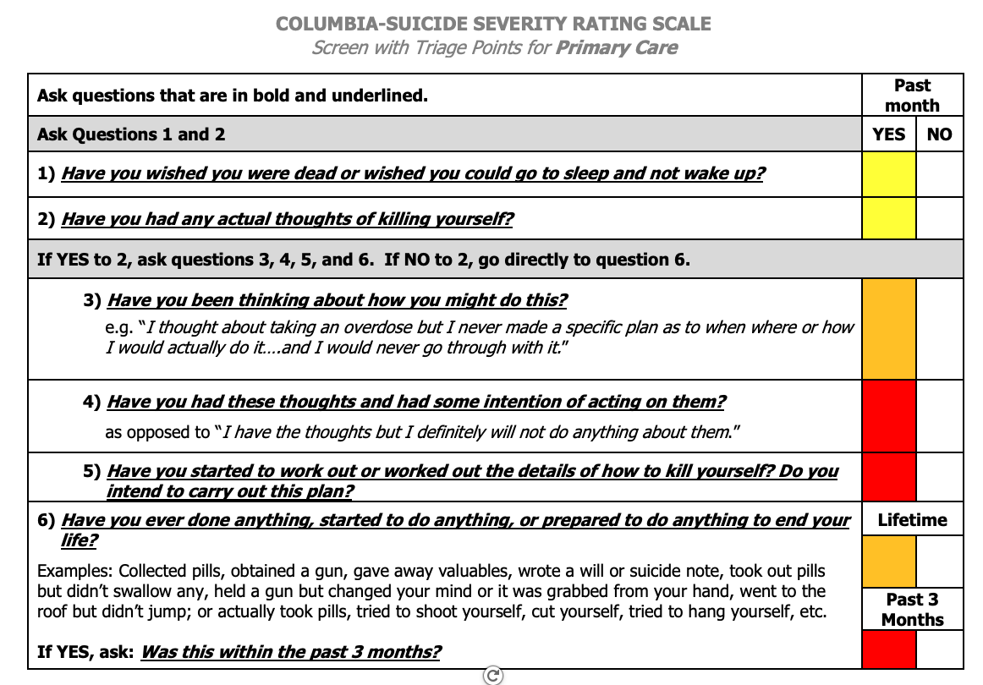
Identifying Suicide Risk:
Suicide Brief Screen
Notes:
Management of a positive screen begins with assessing the level of risk in order to intervene accordingly
When using the C-SSRS, triage works the same in most settings -The only thing that changes are next steps, which are setting specific.
The most worrisome answers are a recent (past month) “yes” to items 4 or 5 for suicidal ideation and/or any recent (3 months) behavior
Once you have identified someone at risk for suicide you want to determine what is that level of risk
Phq9 > passive suicidality , and history of suicide attempt
CSSRS > active suicidality
** NYP Guidelines include: C-SSRS screening tool will be completed in Ambulatory Care as follows:
-Adolescent patients(12 and older): Pre-screening with PHQ9 modified for teens will be completed at every visit that will prompt a C-SSRSif suicide/self-harm responses are positive.
-Youth 11years and under will receive the screening based on clinician’s judgment

Slide 16
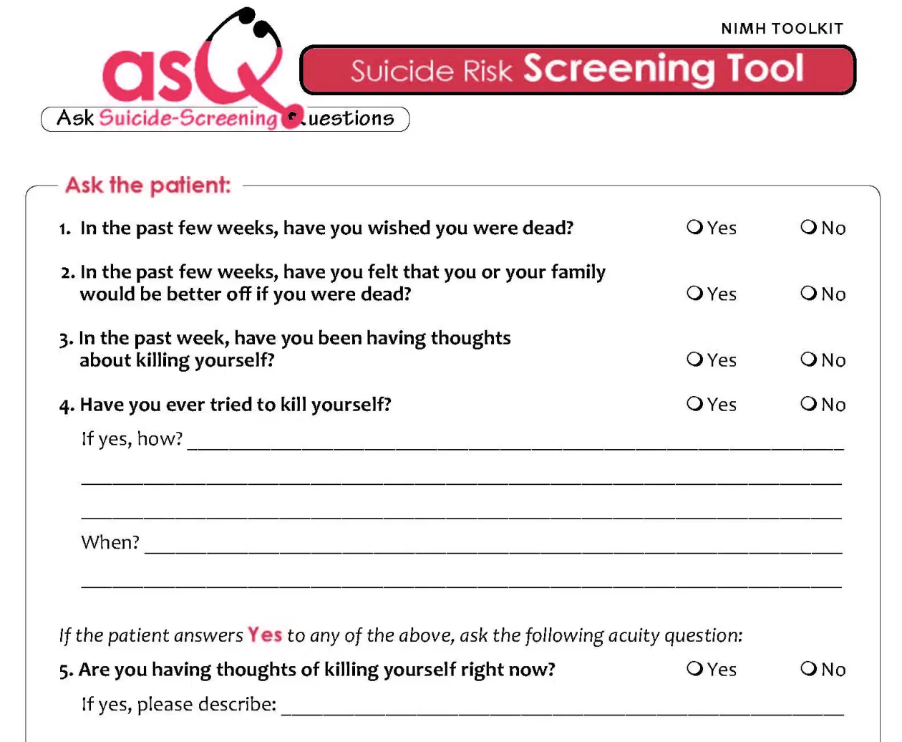
Identifying Suicide Risk:
Suicide Brief Screen
Integrated with PHQ9
https://www.nimh.nih.gov/sites/default/files/documents/PHQ-A_with_depression_questions_and_ASQ_PDF.pdf
https://www.nimh.nih.gov/sites/default/files/documents/research/research-conducted-at-nimh/asq-toolkit-materials/youth-outpatient/suicide_risk_screening_pathway_outpatient_youth.pdf
Notes:
Choose a validated screening tool
Options include ASQ, PHQ-9, CSSRS
Understand how to score and document results
Identify screening workflow
Discuss differences between standardized depressive symptoms screening tools (i.e. PHQ-9) vs standardized suicide-specific screening tools (i.e. ASQ, C-SSRS)
Phq9 > passive suicidality , and history of suicide attempt
CSSRS > active suicidality

Slide 17
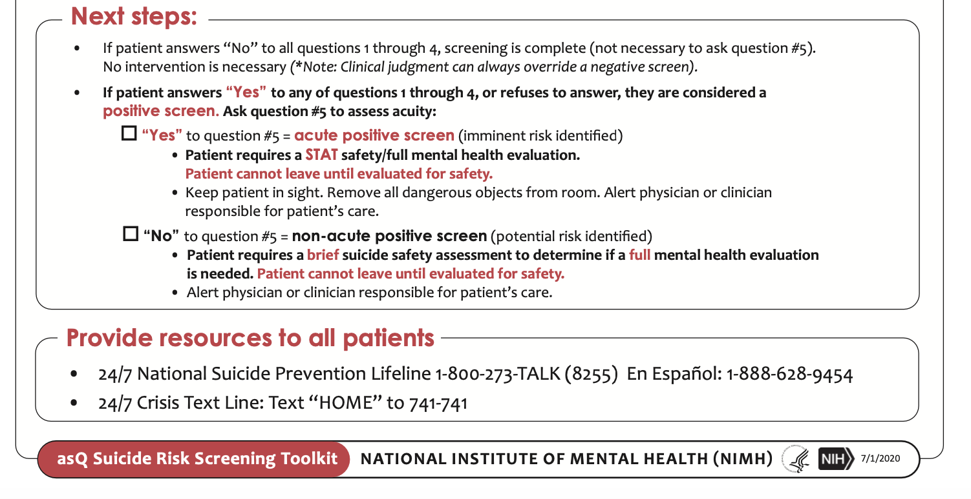
If Q1-4 “Yes” then it is a positive screen……

Slide 18
If the AsQ Positive then…
Brief Suicide Safety Assessment
1. Recognize, convey respect for the patient (feel valued)
2. Assess the patient – frequency; plan; past behavior; symptoms , social support& stressors
3. Interview patient and parent together, alone
4. Determine a disposition
5. Make a safety plan (including means restriction)
6. Provide resources

Slide 19
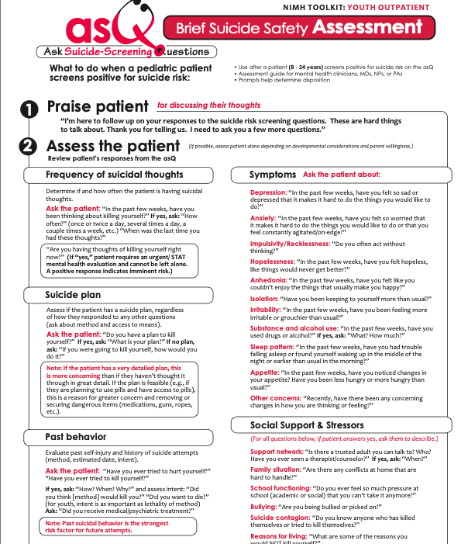
ASQ BSSA
Notes:
EXPLICIT WORDING

Slide 20
Further Questions to Assess (ideally alone)
Have you had thoughts of killing yourself?
How often do you have thoughts of killing yourself or that you wished you were dead?
Do you have a plan of how you would kill yourself? What have you thought about?
When was last time?
How long do these thoughts stay with you?
Are they hard to get out of your mind? Does it interfere with functioning?
At those times Is there anything you do that helps? Makes it better?
Is there anyone you can talk to when you feel like that?
On a scale of 0-10 (0=none, 10=actually doing something) how close have you come to actually doing something to hurt or kill yourself?
What stopped you from doing anything? What keeps you wanting to be alive?

Slide 21
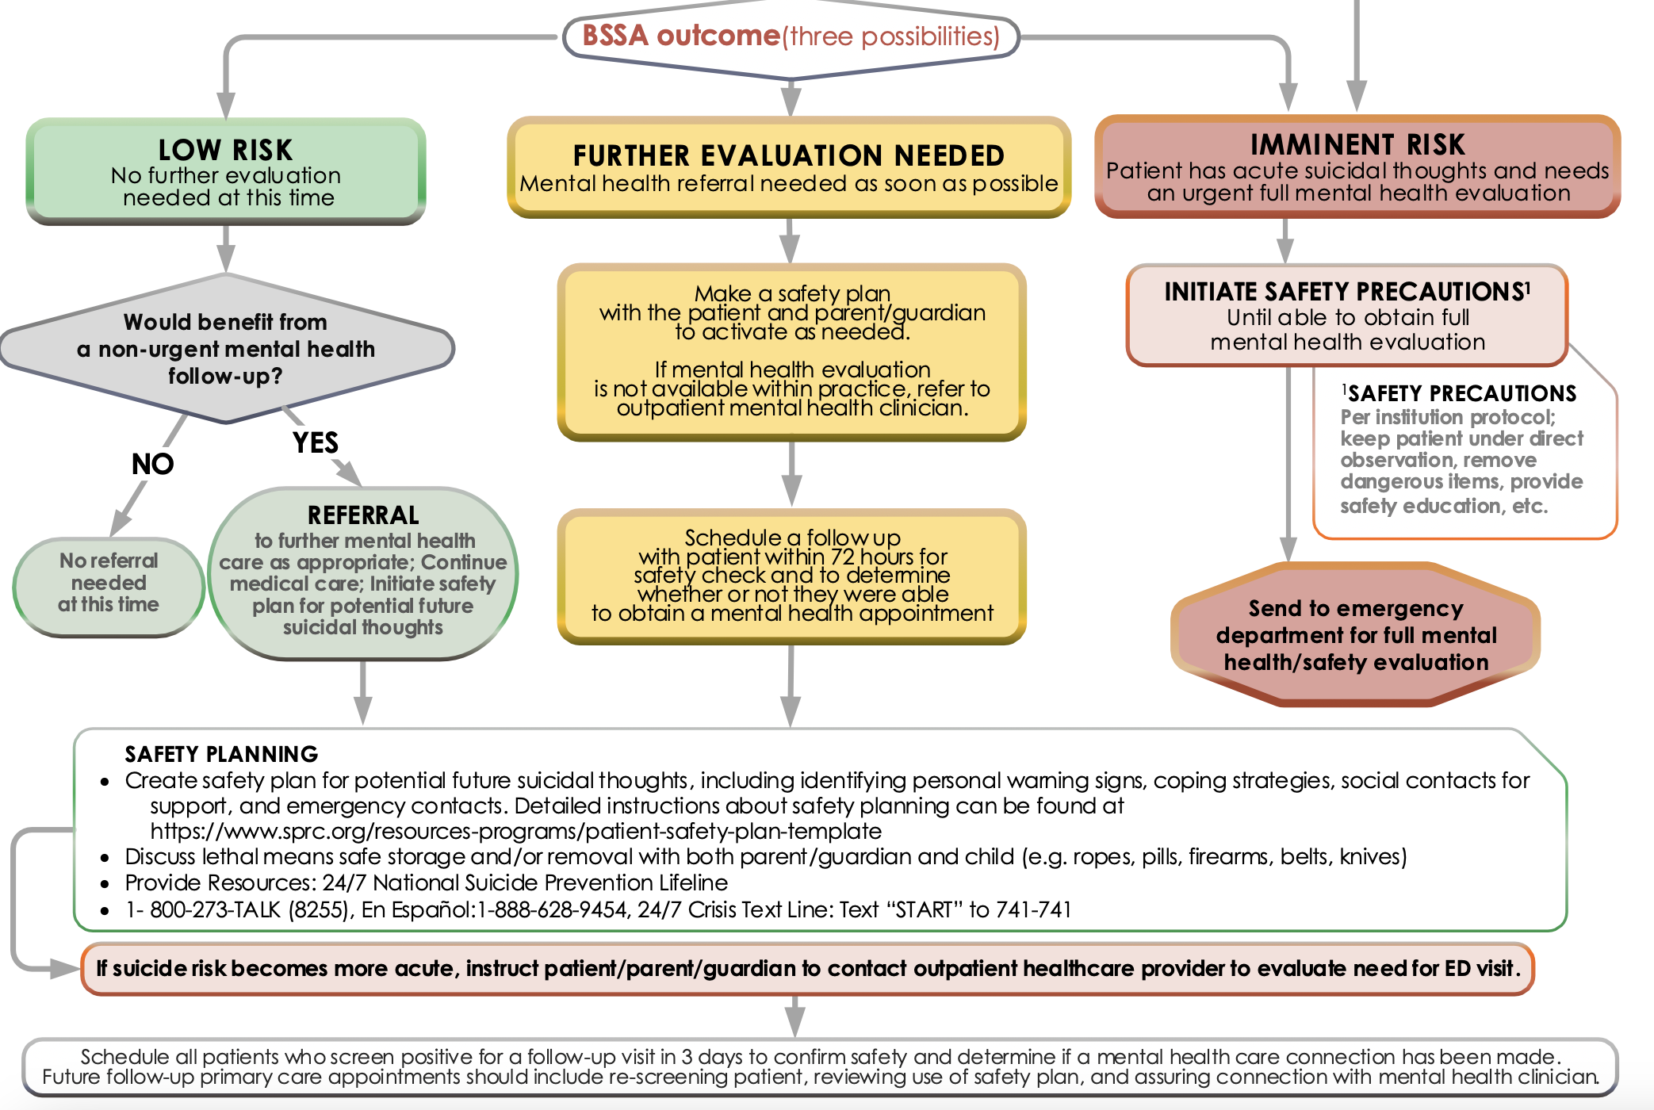
Disposition Based On BSS Assessment

Slide 22
Safety Plan Intervention
A brief intervention to mitigate risk for mild-moderate risk.
NOT A NO SUICIDE CONTRACT
Intent is to collaboratively help individuals lower their imminent risk by constructing
  a predetermined set of personal coping strategies and
  a list of individuals and/or agencies they can contact.
Results in a one page document to use when suicide risk is emerging.
Suicide risk fluctuates over time, SPI is for staying safe when these feelings emerge.
Notes:
SPI – determined best practice by Suicide prevention resource center

Slide 23

Best Safety Plans: for staying safe when these feelings emerge.
Brief, Feasible
Collaborative: include the
patient’s own words,
Done Side by side
Done BEFORE imminent risk
Involve family members

Slide 24
https://projectteachny.org/app/uploads/2023/10/safety-plan-stanley-template.pdf

Slide 25
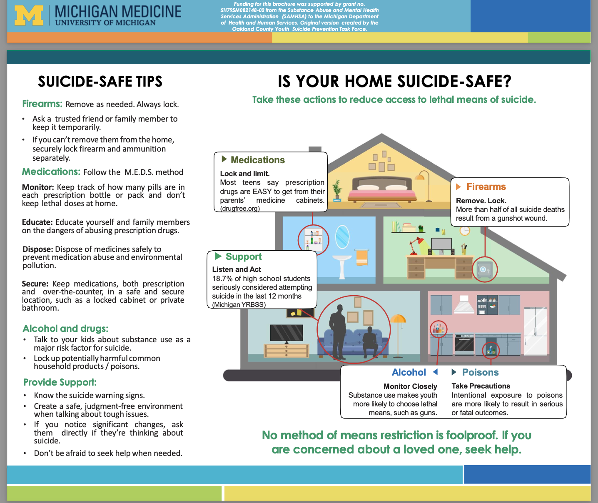
Means Restriction

Slide 26
Resources for Parents and Teens
Phone/chat resources
  Know your local/regional crisis services
  988
  1-800 273-Talk
  Text Got5 (AYUDA for Spanish) to 741-741
Trevor Project https://www.thetrevorproject.org/get-help-now/ (LGBTQ)
  1-866-488-7386
  Text START to 678-678
Trans Lifeline https://translifeline.org/hotline/ 1-877-565-8860
Now Matters Now (peer based DBT skills) https://www.nowmattersnow.org/
JED Foundation https://www.jedfoundation.org/
UPMC STAR Center (for adolescents and families) https://www.starcenter.pitt.edu

Slide 27
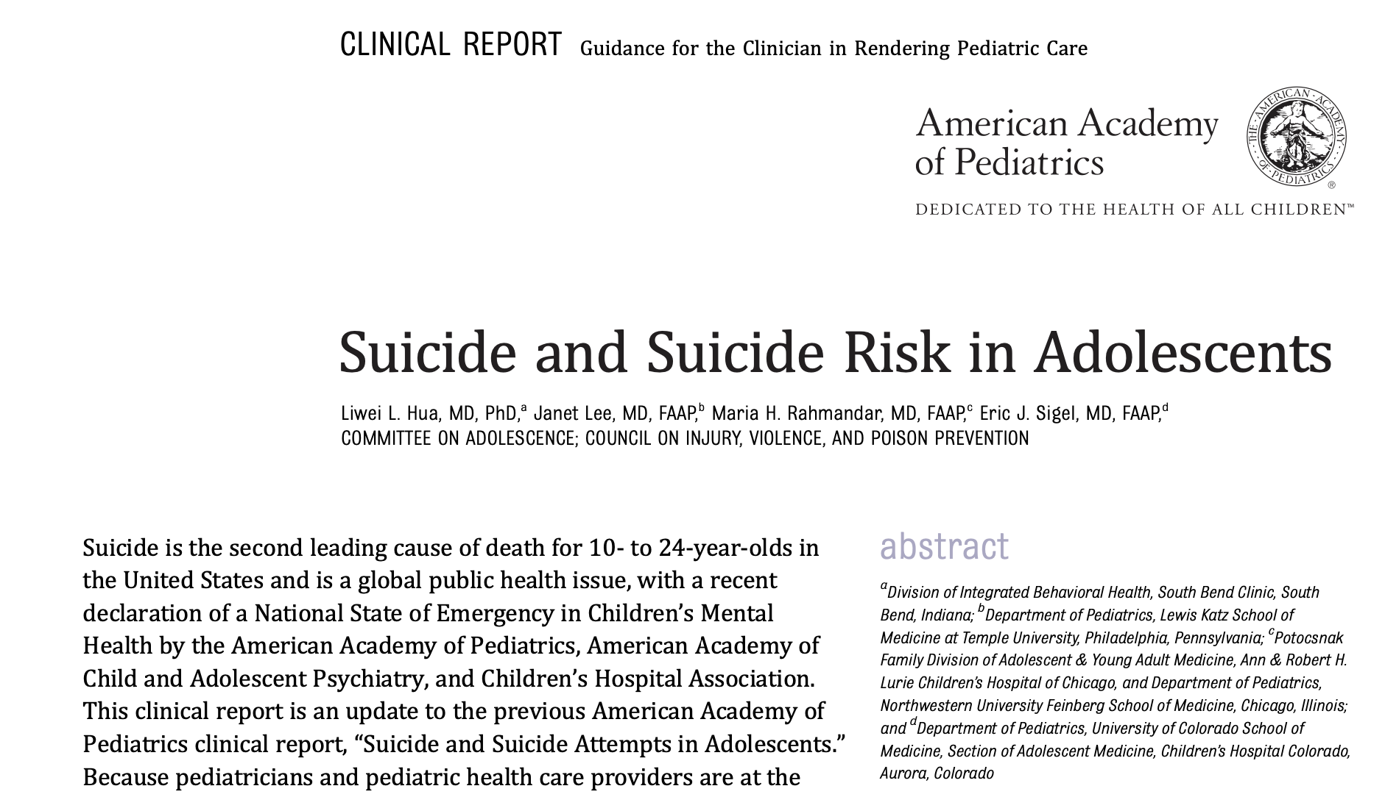
Pediatrics. 2024;153(1): e2023064800

Slide 28
Resources for Professionals
AAP Blueprint for Suicide Prevention Strategies for Clinical Settings
https://www.aap.org/en/patient-care/blueprint-for-youth-suicide-prevention/strategies-for-clinical-settings-for-youth-suicide-prevention/
Ask Suicide Screening Toolkit (ASQ) https://www.nimh.nih.gov/research/research-conducted-at-nimh/asq-toolkit-materials/index.shtml
Counseling on Access to Lethal Means (CALM) Free online course https://zerosuicidetraining.edc.org/enrol/index.php?id=20
Pediatric Meltdown Podcast Episodes 8, 37, 38, 96

Slide 29
Conclusions: Suicide is preventable
Suicide in adolescents is a major public health problem
and tragedy when it occurs
Suicide risk grows in silence—talking saves lives
Universal screening opens up the conversation
Suicidal ideation is often linked with depression; depression can be treated..…if it’s recognized!
Suicide is often impulsive
  promote limiting access to means and
  Promote bridging relationships:
  Pediatric clinicians CAN BE THAT BRIDGE, Caring Connection

Slide 30
2022 AAAP/Bright Futures Recommendations for Preventive Pediatric Care
Youth ages 12+: Universal screening
Youth ages 8-11: Screen when clinically indicated
Youth under age 8: Screening not indicated. Assess for suicidal thoughts/behaviors if warning signs are present

