Slide 1
Assessment and Diagnosis of Adolescent Depression
Diane Bloomfield, MD, FAAP
Associate Professor of Pediatrics,
Albert Einstein College of Medicine
Medical Director, Family Care Center at Montefiore
Associate Division Chief for Clinical Affairs

Slide 2
Speaker:
Medical Director, Comprehensive Family Care Center, Attending Pediatrician, Children’s Hospital at Montefiore
Diane Bloomfield, MD, FAAP
Associate Professor of Pediatrics,
Albert Einstein College of Medicine
Medical Director, Family Care Center at Montefiore
Associate Division Chief for Clinical Affairs
Academic General Pediatrics, CHAM
Project TEACH Primary Care Champ

Slide 3
Disclosures
Neither we nor our spouses/partners have a relevant financial relationship with a commercial interest to disclose.

Slide 4
Why talk about adolescent depression?

Slide 6
Depression is Common in Teens
Major Depressive Disorder
1-2% for children (boys: girls-1:1)
4-8% for adolescents (boys:girls-1:2)
By the end of adolescence: 11-20% lifetime
Dysthymia
1% for children
5% for adolescents
Sub-syndromal Depressive Symptoms
5-10%
Notes:
Stress that we are focusing on adolescent depression because childhood depression is uncommon. As the teen gets older, risk rises greatly, as more common even after age 15. If a primary care provider suspects pre-pubertal depression, first look again for something else (anxiety is more likely…). Get help if you think it is prepubertal depression.

Slide 7
Depression Derails Kids’ Lives Now
Poor Self-Image: negative view of self → hopeless view of one’s future → suicidality
School: decreased concentration, lack of motivation, poor energy → bad grades, school absences → school drop-out or decreased level of achievement
Peers: irritable mood & decreased energy/motivation→ conflict, drama, & decreased involvement in activities → loss of meaningful interpersonal relationships & a supportive social circle
Family: irritable mood → conflict, drama → dismissed as bad kid, help not provided
Community: irritable mood & decreased energy/motivation→ arguments with coaches/instructors, quitting activities → social isolation

Slide 8
Depression Derails Kids’ Lives Later
Psychosocial problems persist as deficits never gained
Recurrent Depressions
Recurrent Suicidality
Substance abuse
Poor employment if education disrupted
Hospitalizations

Slide 9
How to Recognize the Moods of an Adolescent
HAPPY
DEPRESSED
EXCITED
ANXIOUS
MANIC
SUICIDAL
Notes:
(Slide courtesy of Amy Cheung. MD) Not so easy. Some think it is obvious but it Is not. It is hard. All of depression management is hard. So..

Slide 10
Raise Hands: Have you heard of GLAD-PC?

Slide 11
GLAD-PC: Part I, Part II, and a Toolkit
Pediatrics. 2018 Feb;
Guidelines for Adolescent Depression in Primary Care (GLAD-PC): I. Practice Preparation, Identification, Assessment, and Initial management.
Guidelines for Adolescent Depression in Primary Care (GLAD-PC): II. Treatment and ongoing management.
www.gladpc.org
Guidelines for Adolescent Depression in Primary Care Toolkit

Slide 12
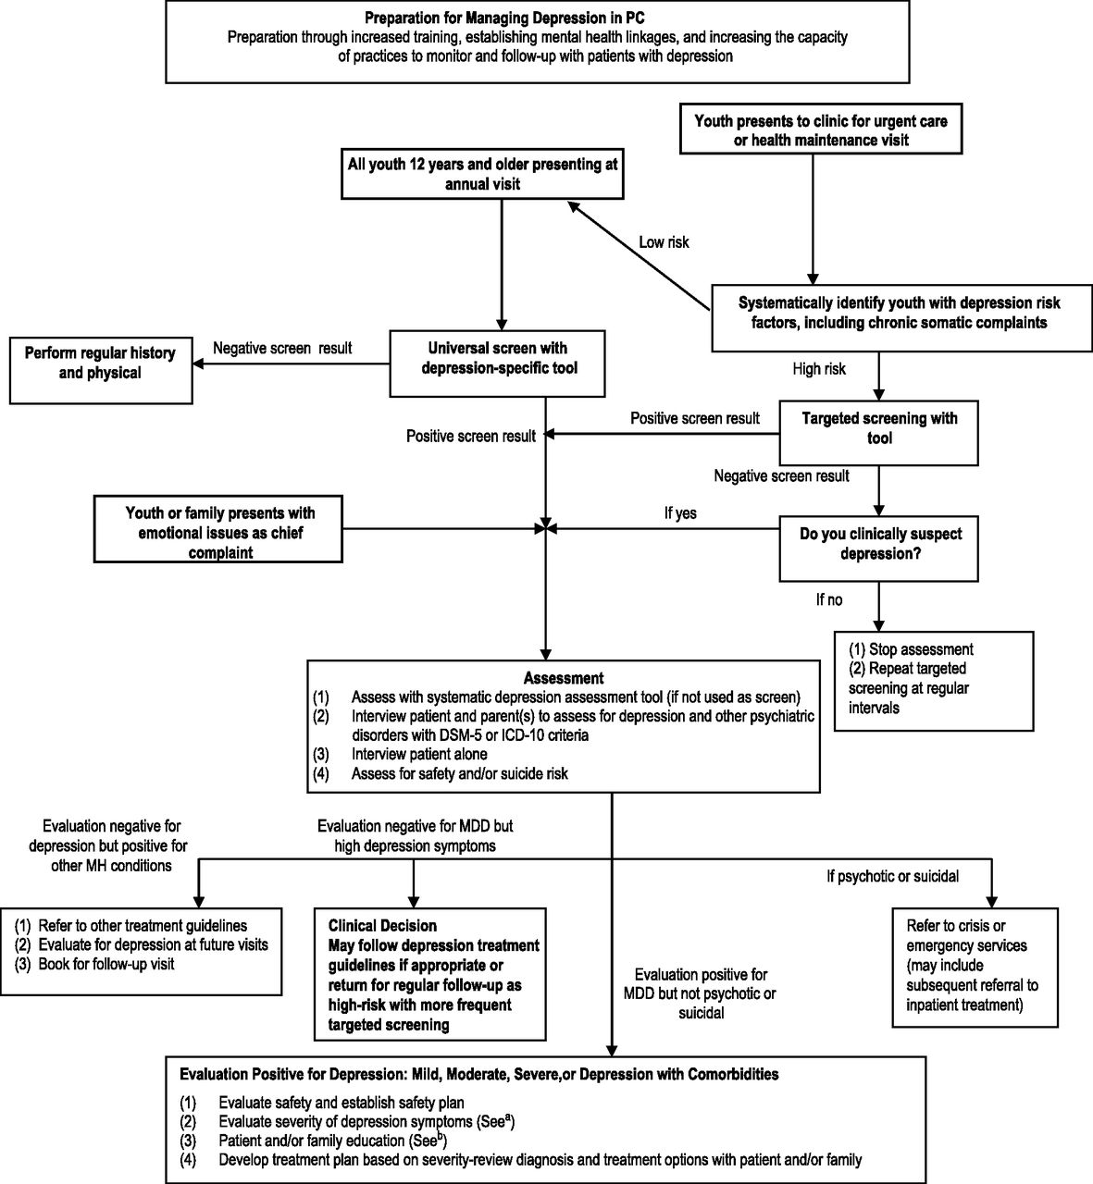
Clinical assessment flowchart.
Rachel A. Zuckerbrot et al. Pediatrics doi:10.1542/peds.2017-4081
©2018 by American Academy of Pedatrics
Notes:
Walk group through different ways to identify (universal screening is only one pathway in!)

Slide 13
Other Advocates for Universal Screening
The USPSTF recommends screening for major depressive disorder (MDD) in adolescents aged 12 to 18 years. Screening should be implemented with adequate systems in place to ensure accurate diagnosis, effective treatment, and appropriate follow-up. (2016, 2009).

Slide 14
Other Advocates for Universal Screening (AAP, 2016, 2014)

Slide 15
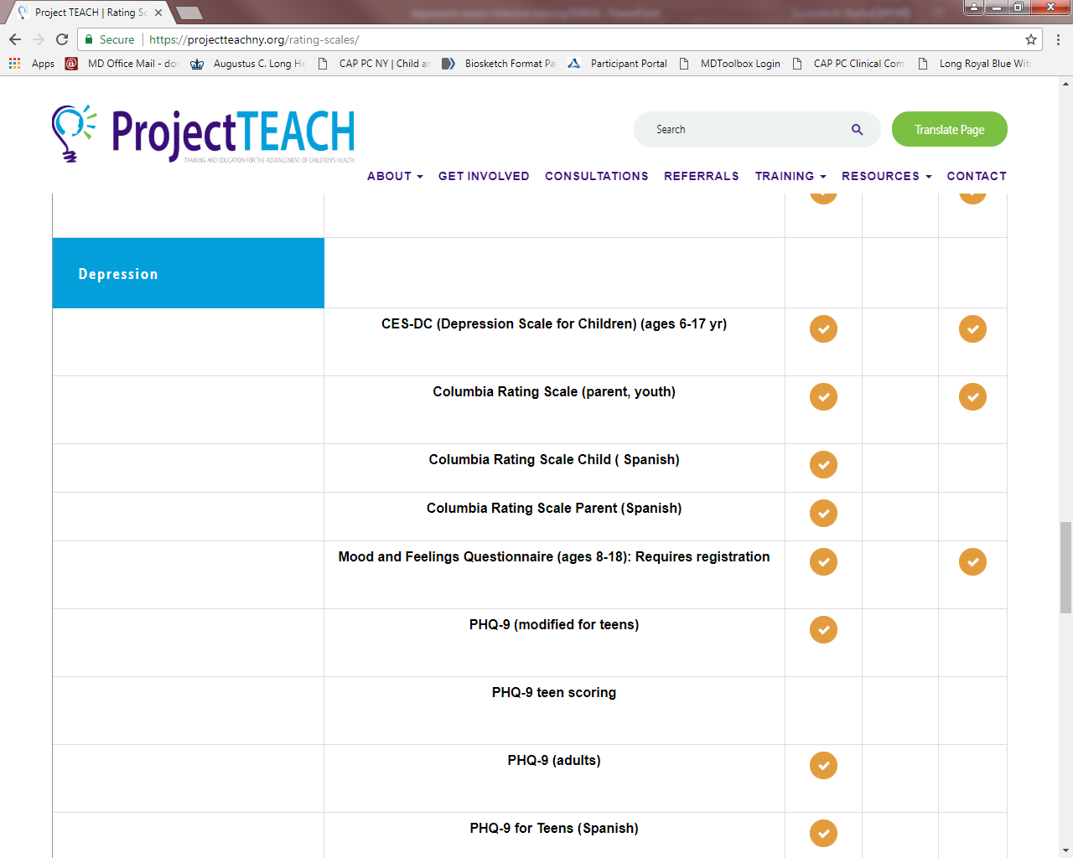

Slide 16
Notes:
In your folder

Slide 17
Parent Screens

Slide 18
CASE: Danielle
Danielle’s mother books a sick visit appointment saying to the front desk that Danielle is “not right.”
You have known Danielle all of her life and there has never been any issues.
Danielle is 15 years old.
When you come into the exam room, Danielle appears “angry” at her mom.
Her mom says Danielle has quit basketball and is angry at her mom and dad.
Notes:
Explain how Danielle fits into the algorithm. She did not get a screen as this is an urgent visit and the staff did not realize it was a mental health appointment. What would you do with Danielle at this point?

Slide 19
CASE: Danielle
Danielle appears irritable.
With her mom in the room, Danielle says basketball was boring.
Danielle says she happily plays video games and watches Stranger Things.
She says her parents annoy her and are on her case because she does not do as well in school as her brother. She says she gets Bs.
Her mom says Danielle’s grades have dropped from B plus to B minus but she does not bother Danielle about that.
Danielle stays up late in her room.
Danielle no longer hangs out with her basketball friend group.
Notes:
Explain how Danielle fits into the algorithm. She did not get a screen as this is an urgent visit and the staff did not realize it was a mental health appointment. What would you do with Danielle at this point?

Slide 20
Clinical assessment flowchart.
Rachel A. Zuckerbrot et al. Pediatrics doi:10.1542/peds.2017-4081
©2018 by American Academy of Pedatrics
Notes:
Go through assessment

Slide 21
DSM 5 Diagnostic Criteria for MDD
Five (or more) of the following symptoms have been present during the same 2-week period and represent a change from previous functioning; at least one of the symptoms is either (1) depressed mood or (2) loss of interest or pleasure.
(1) Depressed mood - or irritable mood in kids!
(2) Diminished interest or pleasure in all, or almost all, activities
(3) Significant weight loss or weight gain, or decrease or increase in appetite
(4) Insomnia or hypersomnia
(5) Psychomotor agitation or retardation
(6) Fatigue or loss of energy
(7) Feelings of worthlessness or excessive or inappropriate guilt
(8) Diminished ability to think or concentrate, or indecisiveness
(9) Recurrent thoughts of death (not just fear of dying), recurrent suicidal ideation without a specific plan, or a suicide attempt or a specific plan for committing suicide
Notes:
SAME AS IN ADULTS WITH FEW MODS; 5 OR MORE; ONE MUST BE 1 OR 2; IRRITABILITY IN KIDS

Slide 22
DSM 5 Depressive Disorders
Disruptive Mood Dysregulation Disorder
Major Depressive Disorder
Persistent Depressive Disorder (Dysthymia)
Premenstrual Dysphoric Disorder
Substance/Medication-Induced Depressive Disorder
Depressive Disorder Due to Another Medical Condition
Other Specified Depressive Disorder
Unspecified Depressive Disorder
Specifiers for Depressive Disorders

Slide 23
Depression in Adolescents:
May appear less depressed than pre-pubertal counterparts
Express more helplessness and hopelessness
Experience greater anhedonia
Begin to endorse excess sleep
More apt to experience weight changes
Somatic complaints
Academic Difficulties
Suicidality
Behavioral Problems, Hostility
Notes:
23

Slide 24
Interview Patient With Parent and Alone
Follow up with further questions to determine coherence of story:
Is it persistent? How long? Interfering with function?
Confirm positives on written screens and clarify:
Nature, duration, onset, precipitants, what’s been tried?
Targeted Physical Exam
Labs only as indicated by history, physical exam

Slide 25
Assess for Comorbidity
A child or adolescent with a depressive disorder will have a 20-33% chance of having another disorder
Most commonly: anxiety disorders, conduct and oppositional disorders and dysthymic disorder
MDD often precedes the onset of substance use disorders
Notes:
25

Slide 26
Assess Psychosocial Functioning
How impaired is this teen?
Is he missing class?
Is she getting good grades?
Has the school noticed a problem?
Is he still playing basketball on the team?
Has she continued to paint?
Are his friends still coming to visit?
Is she still going out to parties?
Does he participate in family outings?

Slide 27
Assess for Protective Factors
Positive parent-child relationship
Connection to school
Prosocial peer group
Sports
Higher IQ

Slide 28
Assess for Genetic/family risk factors
Genetic loading: Single most predictive factor associated with the risk of developing MDD
Twin studies: 50% heritability; greater in adolescent-onset depression (Rice, 2009)

Slide 29
Investigate for Suicide
Ask adolescent directly about ideation, impulses, and acts
Ask parents directly about statements or behaviors suggesting suicidal ideation/feelings

Slide 30
CASE: Danielle
Alone in the room, Danielle is a little more talkative but still somewhat hostile and closed off.
Danielle mentions that the coach benched her, and she felt disrespected.
Danielle denies drug use.
She says she is tired during the day after staying up late playing video games and streaming shows.
She says suicidal thinking is stupid.
She does say nobody would care if she were not around.
Notes:
Does Danielle have MDD?

Slide 31
Points to Remember
Familiarize yourself and practice with the GLAD-PC Guidelines
Prepare yourself and your office to undertake the identification and management of adolescent depression
Screen all adolescents ages 12 and up with a formal depression self-report tool
Always be on the lookout for kids with risk factors for depression
Remember that kids who come in with ANY behavioral chief complaint should be assessed for depression as well

Slide 32
Points to Remember
Talk with teens alone
Get information from Parents and Caregivers
Remember the DSM-5 criteria
Functioning, functioning, functioning!
Assess for safety
Can this patient go home today?

