Slide 1
Aggression Management in Primary Care

Slide 2
Speaker:
Maureen Montgomery MD
Assistant Clinical Professor of Pediatrics,
SUNY Buffalo, School of Medicine
Contact: memontgomery163@gmail.com

Slide 3
Disclosures
“Neither I nor my spouse/partner has a relevant financial relationship with a commercial interest to disclose.”

Slide 4

Remember Cliff?

Slide 5
NICHQ Vanderbilt Assessment Scale:
Parent information
Notes:
Updated 8/26/13 by PSJ
THIS SLIDE IS HIDDEN – INCLUDED HERE MOSTLY FOR THE PRESENTER. YOU CAN “UNHIDE” IT IF YOU WISH.

Slide 6
NICHQ Vanderbilt Assessment Scale:
Parent information
Notes:
Updated 8/26/13 by PSJ
THIS SLIDE IS HIDDEN – INCLUDED HERE MOSTLY FOR THE PRESENTER. YOU CAN “UNHIDE” IT IF YOU WISH.

Slide 7
Cliff is back: Vanderbilt
Total number of questions scored 2 or 3 in questions 1-9: Inattention | 2
Total number of questions scored 2 or 3 in questions 10-18: Hyperactivity | 1
Total Symptom Score for questions 1-18: Inattention and hyperactivity | 3
Total number of questions scored 2 or 3 in questions 19-26: Oppositional | 5 > 4 = ODD
Total number of questions scored 2 or 3 in questions 27-40: Conduct | 0
Total number of questions scored 2 or 3 in questions 41-47: Anxiety and depression | 0
Total number of questions scored 2 or 3 in questions 48-55: Performance | 8
Average Performance Score:

Slide 8
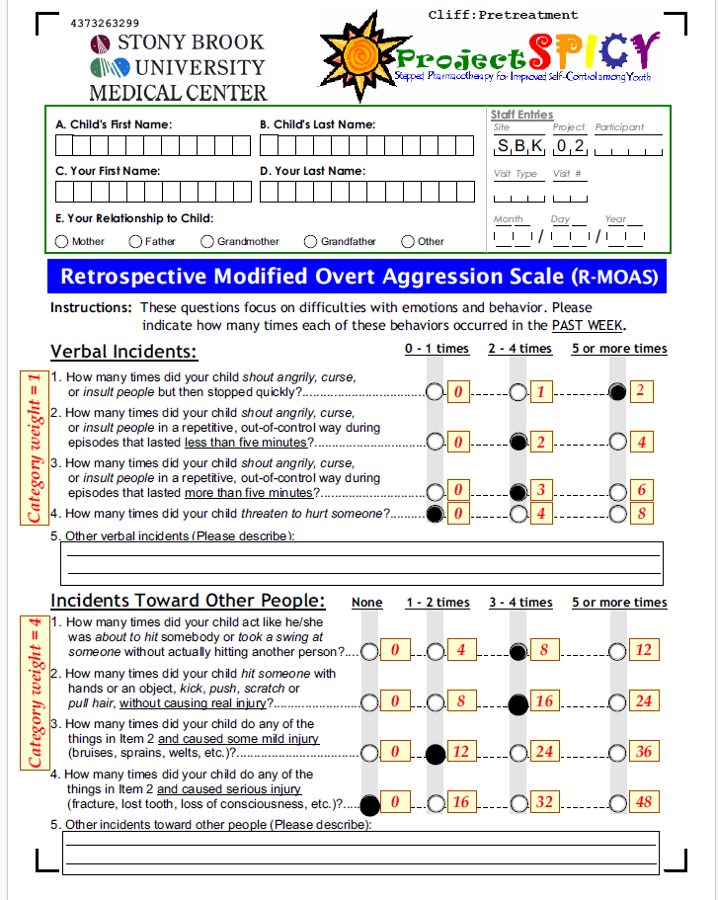

Slide 9
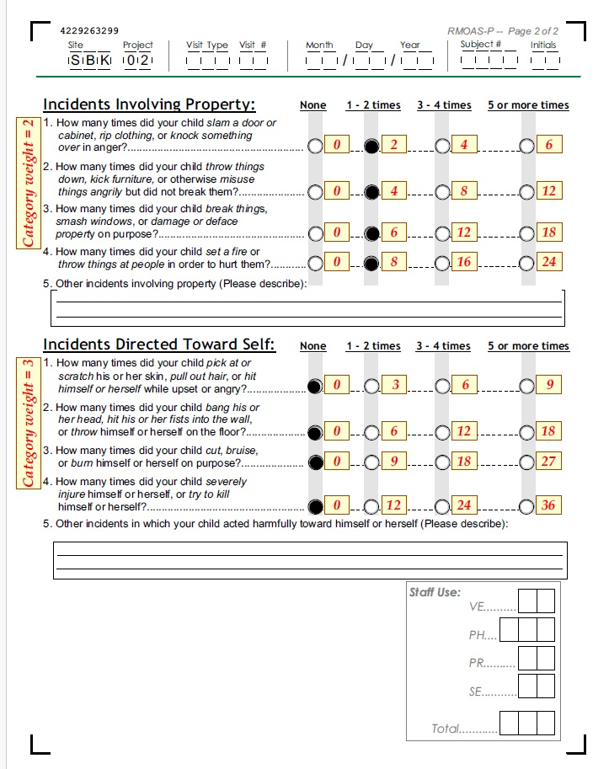

Slide 10
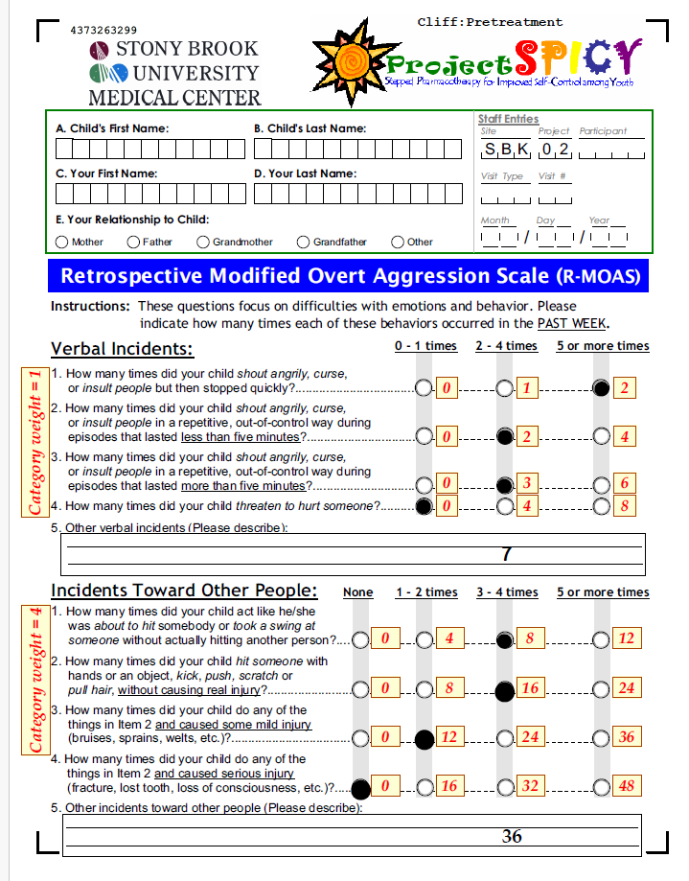

Slide 11
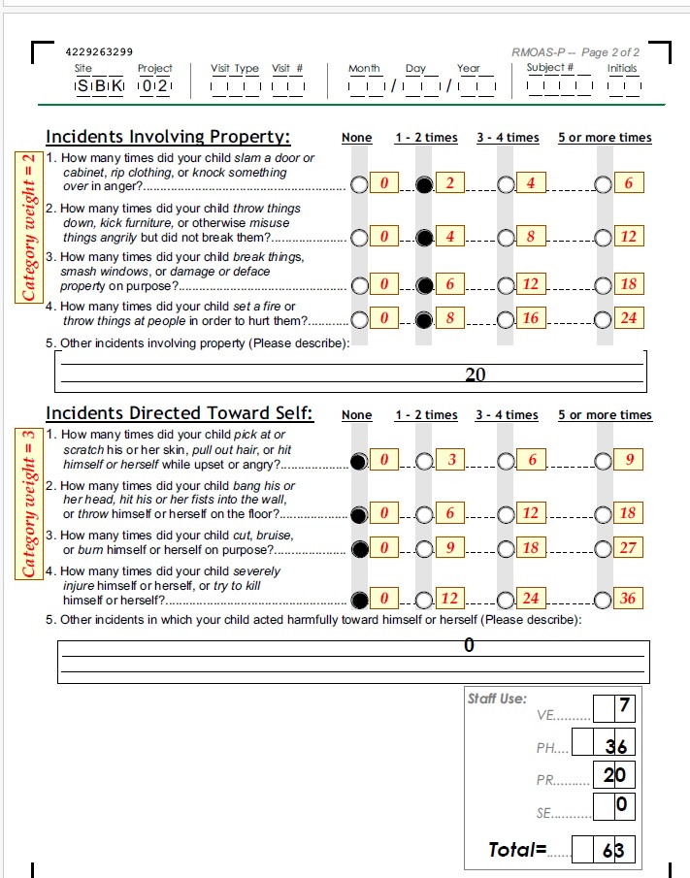

Slide 12
Cliff - clinical summary
assessment completed, including standardized rating scales
Diagnosis: ADHD with severe aggression
No additional co-morbidities
No history of trauma, bullying or substance use
ADHD symptoms are well controlled on stimulant medication but remaining ODD symptoms

Slide 13
What would you do next?

Slide 14
Psychoeducation Pearls
Present your understanding that the child’s “system is on overload” and what is underpinning the aggression
“No fault” position with parents and child
Parents need support but also strategies
Tension often builds up to a “red zone”: encourage observing the precipitants, evolution, places of detouring
Positive approach
  Positive reinforcement
  “Catch the child being good”
  Don’t reward negative behaviors unwittingly

Slide 15
School
Make contact (or ensure parents do) with school point person
Obtain information and identify resources that school may be able to provide
504 or IEP

Slide 16
Psychosocial Treatment First Line: Connect before you Correct!
Provide or assist the family in obtaining evidence based psychotherapy (first line).
Assist and support in maintaining consistent behavioral strategies
Generally referred to as
  parent management training or behavior management
  Coping skills for child
For severe situations consider more intensive or “wraparound” services

Slide 17
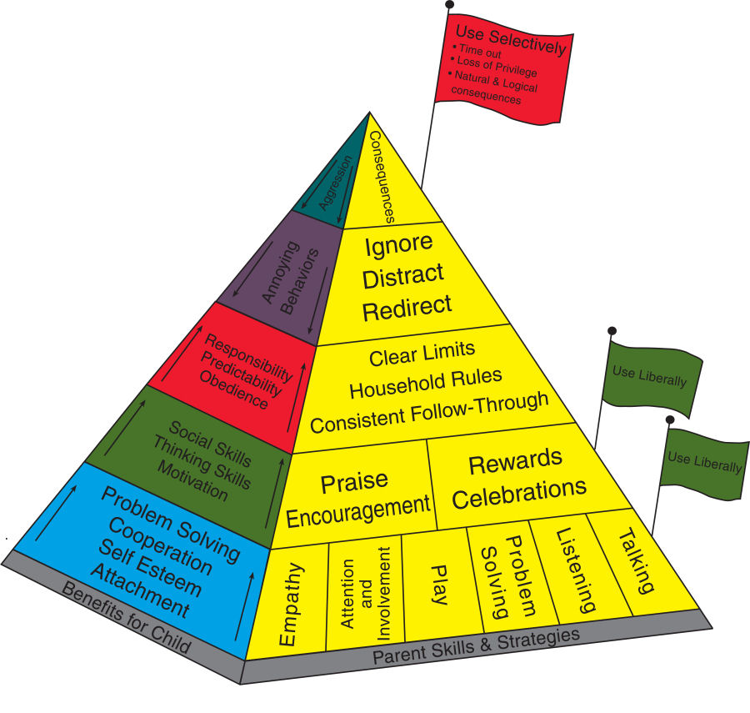
Incredible Years Parenting Pyramid

Slide 18
Now We Get to Medication Management:
Treat the Underlying Condition First
Cliff’s ADHD symptoms well managed
No other comorbidities
Level of aggression severe and major life consequences appear likely
  Injured mother
  Frequent episodes of verbal and physical aggression at home, school
  Removed from after school program

Slide 19
What would you do next?
A) Switch to a different class of stimulant
B) Add an alpha agonist
C) Start Risperidone
D) Increase dose of Concerta
E) Call Project Teach

Slide 20
Optimize Stimulant
MTA showed that ODD symptoms often responded to higher doses of stimulants
Concerta increased to 72 mg
Parents called 3 days later to report that he had become much more irritable and aggression worse

Slide 21
Poll #2 :Now what would you do?
A) Switch to a different class of stimulant
B) Add an alpha agonist
C) Start Risperidone
D) Call Project Teach

Slide 22
Clinical Judgment
Switch stimulant class
  Pros: lower side effect burden, will see response immediately (or not)
  Con: has responded well to MPH prep and low likelihood that the aggression will respond better to an AMP preparation
Start alpha agonist
  Pros: lower side effect burden
  Con: less likely to be effective, may take weeks to see effect
Start Risperidone
  Pros: more likely to be effective, quickly
  Cons: higher side effect burden, especially weight gain, need lab monitoring

Slide 23
Cliff was prescribed a low dose of Risperdal, initially 0.25 mg hs and later increased to 0.25 mg bid

Slide 24
Cliff 2 weeks later

Slide 25
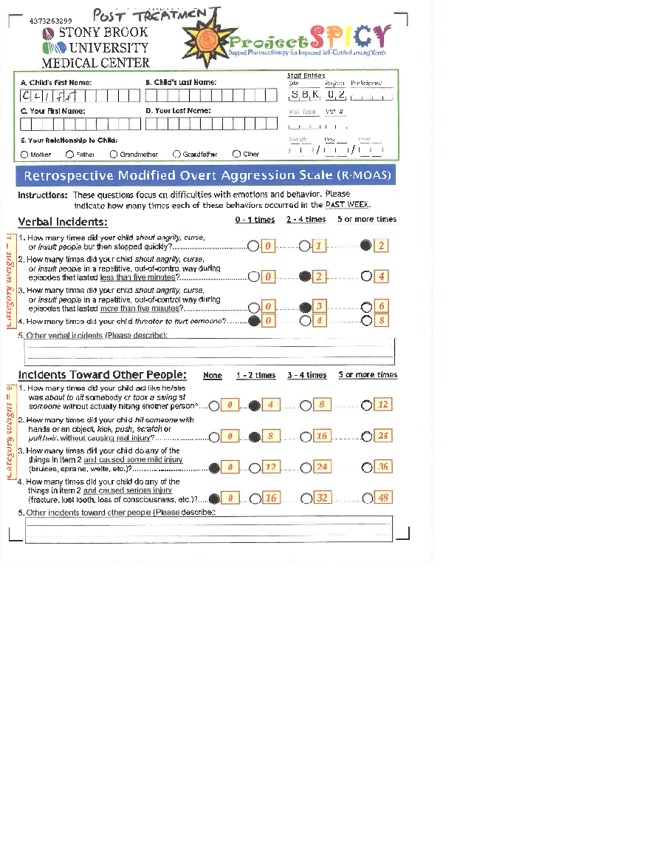

Slide 26
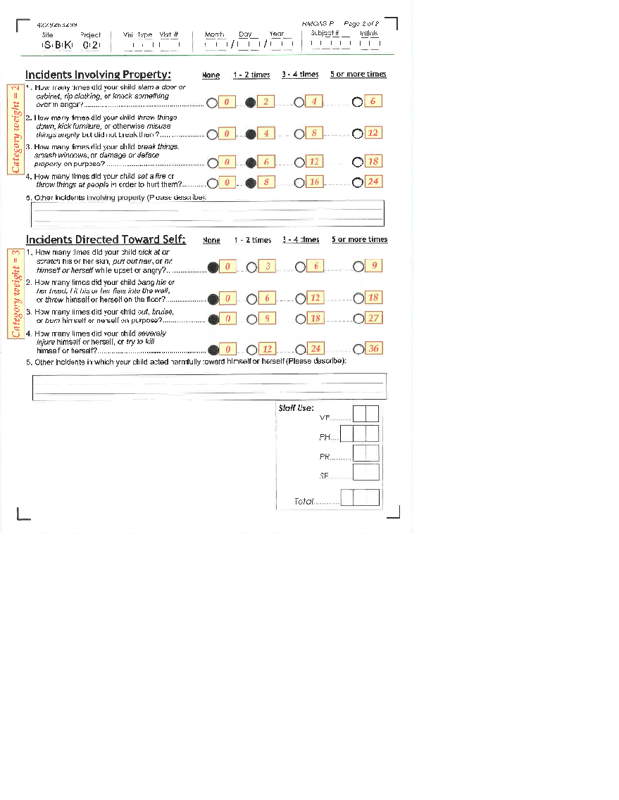

Slide 27
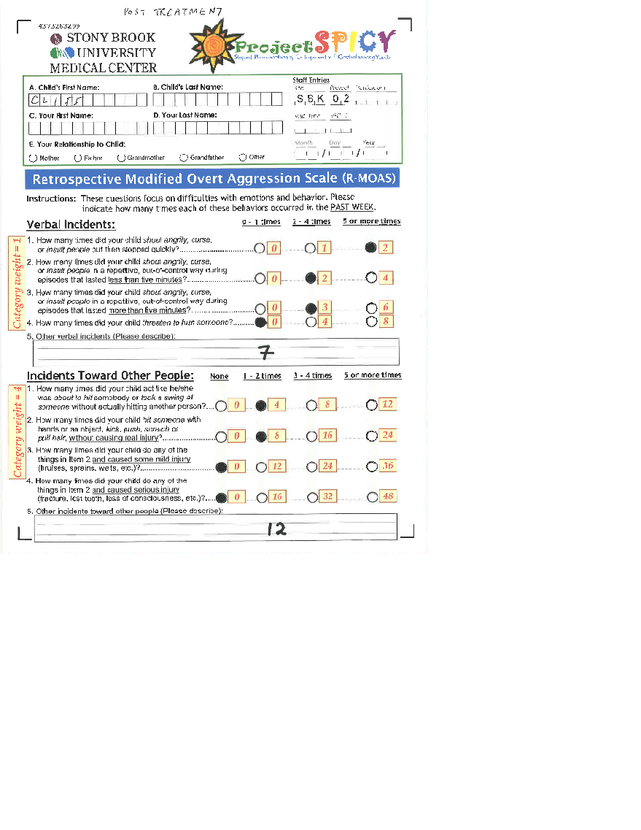

Slide 28


Slide 29
What would you do next?

Slide 30
Poll #3
A) Switch from Concerta to an amphetamine based stimulant
B) Add an alpha agonist
C) Increase Risperidone to 0.5 mg BID
D) Call Project Teach

Slide 31
Cliff’s Risperdal was increased to 0.5 BID

Slide 32
Cliff 1 month later
Much improved, doing well at home, school
Continues in therapy.
MOAS score has dropped further to 8
Continue risperidone 0.5 BID

Slide 33
Cliff 6 months later
Doing well.
Continues in therapy.
MOAS score 3
Self esteem has improved
Consider tapering Risperdal by .25 mg Q1-2 months
Follow-up and discontinue Risperdal if appropriate

Slide 34
Summary: Aggression management in primary care
Aggression - common symptom in primary care
Multifactorial - associated with many mental health dx
STEP 1 - Thorough assessment (identify primary diagnosis and co-morbidities, severity, ABCs)
STEP 2 – Link for E/B psychosocial treatment
STEP 3 – Medications: treat primary diagnosis to remission if possible
STEP 4 -If aggression persists and is severe (safety), consider SHORT TERM use of atypical antipsychotic
Call Project Teach for assistance

Slide 35
QUESTIONS?

