Slide 1
Treatment of
Anxiety Disorders in Children and Teens
Notes:
Decide what font you want to use for titles/heading and make them the all same.

Slide 2
PCP CHAMP:
Jessica Grant, MD, FAAP
Founder, Partner, and Pediatrician, Manhattan Valley Pediatrics, New York, NY
Project TEACH, Primary Care Champ

Slide 3
Disclosures
Neither we nor our spouses/partners have a relevant financial relationship with a commercial interest to disclose.

Slide 4
Anxiety: Objectives for Primary Care
Identify books to help mildly anxious children and their families
Name and understand the psychotherapy with the most evidence for anxiety
Learn CBT skills the general practitioner can implement in the office
Understand the medication class of choice in pediatric anxiety disorders

Slide 5
Early Intervention: Anxious Temperament

Slide 6
Goals of Early Intervention
Education of parents/teachers/doctors/others about all forms of anxiety
Prevent the development of Anxiety Disorders in children with anxious temperament
Prevent generational transmission of Anxiety symptoms and impairment

Slide 7
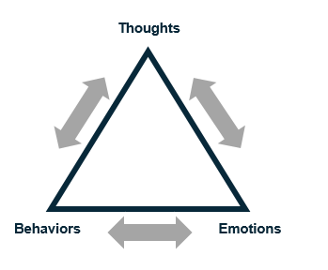
Psychoeducation for Children
What is Anxiety?
Anxiety is normal and helpful in small doses
3 component model: Think, Feel, Do
Why me?
Genes and temperament
Experience in the world
Development of “thinking traps”
Escape and avoid = More and more anxiety
Slide courtesy of Drs. Albano and Rynn

Slide 8
100% Accountability
Psychoeducation for Parents
100% Accommodation
Distress
Acting out
Impairment
Distress
Acting out
Impairment
Notes:
If as a parent you say, OK, you don’t have to go to school or soccer then you are over at the 100% accommodating and the acting out will drop off but now the child is really impaired…..
Where is the child? Where are we? Are we as parents or provider/school polarized with others?
Who is the best “nudge” with the child?

Slide 9
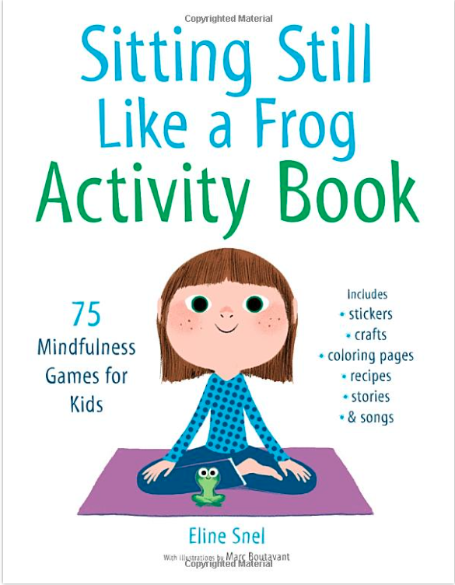
Books for Kids and Teens
https://www.shambhala.com/sittingstilllikeafrog/
Notes:
Again, quick look and list references at the end.

Slide 10
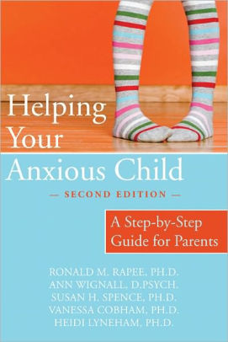
Books for Parents and PCPs

Slide 11
Treatment of Anxiety Disorders: Depends on Severity
Consider the 3 ‘Ps’: Pervasive, Persistent, imPairing
 | SCARED | Distress | Avoidance
Mild | <30 | Some | Minimal
Moderate | 30-40 | Good deal | Some
Severe | 41+ | A lot | A lot

Slide 12
Mild Anxiety

Slide 13
Mild Anxiety Treatment
Educate, support, monitor
Bibliotherapy
Cognitive Behavioral Therapy (CBT) skills in the office

Slide 14
CBT Goals
Extinguish avoidance behavior
Increase healthy problem-solving
Facilitate insight and self-efficacy
Solidify gains and promote generalization
Slide courtesy of Drs. Albano and Rynn
Notes:
From Dr. Foley:
Exposure-based CBT has the most empirical support for the treatment of anxiety disorders in youth
Psychoeducation (educating the patient and the family about the disorder, its course, management and treatment)
Somatic Management Skills training (relaxation, diaphragmatic breathing, self-monitoring) Cognitive restructuring (challenging negative exectations and modifying negative self-talk)
Exposure methods (imaginary and in vivo exposure with gradual desensitization to feared stimuli)
Relapse prevention plans (booster session sna coordination with parents and school)
Coping Cat (Kendall, 1990) –just google

Slide 15
CBT Concepts
Teach self-soothing and somatic management
Identify and change maladaptive thinking
Increase proactive approach behavior (graduated exposure)
Notes:
From Dr. Foley:
Exposure-based CBT has the most empirical support for the treatment of anxiety disorders in youth
Psychoeducation (educating the patient and the family about the disorder, its course, management and treatment)
Somatic Management Skills training (relaxation, diaphragmatic breathing, self-monitoring) Cognitive restructuring (challenging negative exectations and modifying negative self-talk)
Exposure methods (imaginary and in vivo exposure with gradual desensitization to feared stimuli)
Relapse prevention plans (booster session sna coordination with parents and school)
Coping Cat (Kendall, 1990) –just google

Slide 16
Somatic Management
Goals:
Develop tolerance of normal, expected levels of anxiety
Learn & utilize strategies to calm self during stressful/ fear provoking situations or tasks
Methods:
Breathing retraining
Progressive Muscle Relaxation
Slide courtesy of Drs. Albano and Rynn

Slide 17
Breathing Retraining
Calms the nervous system
Stimulate the vagus nerve
Lowers heart rate and blood pressure
Reduces stress hormones

Slide 18
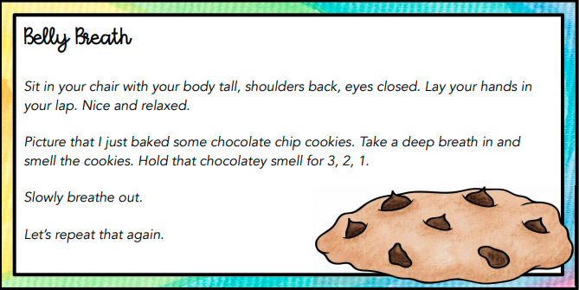
Notes:
I would describe these a quick examples that can be done in pcp office.
Consider the Ollendick Chocolate Cookie deep breathing example – easily done in the office

Slide 19
Square Breathing

Slide 20
Progressive Muscle Relaxation
Two step technique: tension and relaxation
Pay attention to the feeling of relaxation when releasing the contracted muscle
Practice daily, bedtime is often ideal
Takes as little as 10 minutes per day to practice
Younger child: parent reads the script, can use fewer body parts
Can then utilize in other stressful situations

Slide 21
Relaxation Script Grades K-4 (Ollendick, 1978)
To begin the relaxation session, have the children sit comfortable in their chair and close their eyes. Soft, slow music can be playing in the background. When reading the script, speak in a soft, even tone. Pause between sentences.
Hands and Arms
Pretend you have a whole lemon in your left hand. Now squeeze all the juice out. Feel the tightness in your hand and arm as you squeeze. Now drop the lemon. Notice how your muscles feel when they are relaxed. Take another lemon and squeeze it. Try to squeeze. Try to squeeze it harder than you did the first one. That's right. Real hard. Now drop your lemon and relax. See how much better your hand and arm feel when they are relaxed. Once again, take a lemon in your left hand and squeeze all the juice out. Don't leave a single drop. Squeeze hard. Now relax and let the lemon fall from your hand. (repeat this process with the right hand and arm.)
Arms and Shoulders
Pretend you are a furry, lazy cat. You want to stretch. Stretch your arms out in front of you. Place them up high over your head, way back. Feel the pull in your shoulders. Stretch higher. Now just let your arms drop back to your side. Okay, kittens, let's stretch again. Stretch your arms out in front of you. Raise them over your head. Put them back, way back. Pull hard. Now let them drop quickly. This time let's have a great big stretch. Try to touch the ceiling. Stretch your arms way out in front of you. Raise them way up high over your head. Push them way, way back. Notice the tension and pull in your arms and shoulders. Hold tight now. Great. Let them drop very quickly and feel how good it is to be relaxed. It feels good and warm and lazy.

Slide 22
Muscle Relaxation: Script Conclusion
Stay as relaxed as you can.
Let your whole body go limp and feel all your muscles relaxed.
As you go through the day, remember how good it feels to be relaxed.
Sometimes you have to make yourself tighter before you can be relaxed, just as we did in these exercises.
Practice these exercises every night to get more relaxed.
When you are a really good relaxer, you can help yourself relax at school.
Just remember the turtle, or the jawbreaker, or the mud puddle, and you can do these exercises and nobody will know.
You've done a good job. You're going to be a super relaxer.

Slide 23
Challenging Maladaptive Thinking
A belief that is false and rationally unsupported
Thought traps (catastrophizing, fortune telling, black and white thinking)
If you change the thoughts → You change the emotions

Slide 24
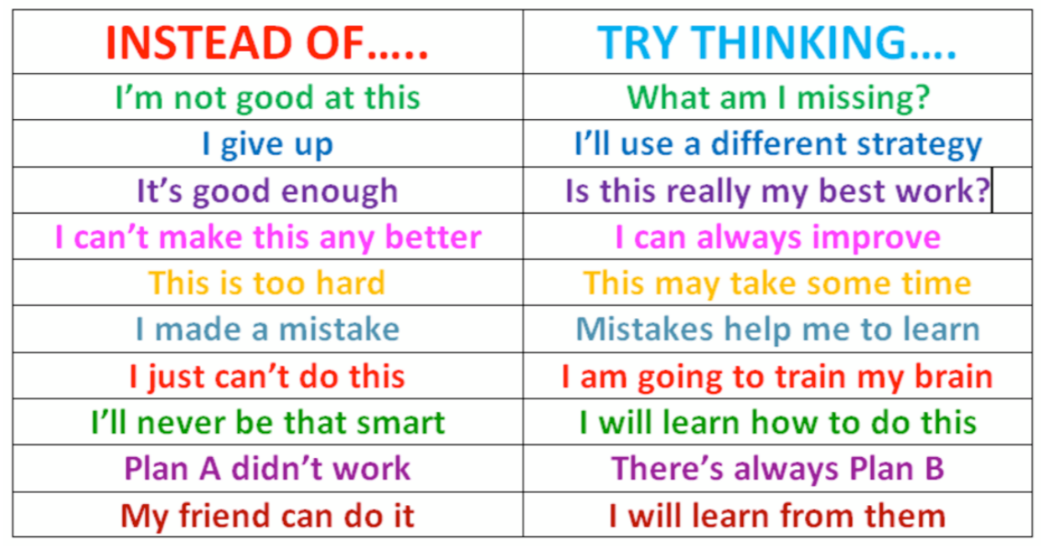
Thinking through negative thoughts
What thought might be more helpful?

Slide 25
Graduated Exposure
Helps people build confidence and coping skills while reducing anxiety

Slide 26
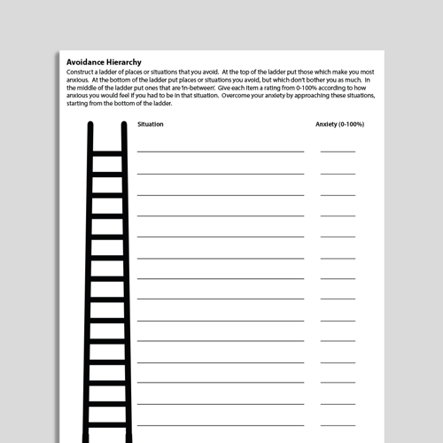
Fear Ladder
Build a separate ladder for each fear
Start with steps that cause mild anxiety and work towards steps that cause more anxiety
For middle steps consider length of time, environment, who is with you
-
Notes:
This can be developed in the pediatricians office.
Steps in the middle (not the low fear or the high fear goal but the in-between steps) can be hard to identify- vary factors such as length of time, envirorment, supports

Slide 27
Fear Ladder: Phobia of Needles
10 Get a shot
9 Slightly prick skin with a needle
8 Clear skin with alcohol pad (step prior to getting a needle)
7 Watch someone get a needle in real life
6 Rest a needle on your skin
5 Stick a needle into a doll
4 Hold a needle
3 Watch a needle be stuck into a doll
2 Watch video of someone getting a needle
1 Look at a picture of a needle
Notes:
This comes up in the pediatrician’s office all the time and is a great chance to open the door to an anxiety discussion

Slide 28
Fear Ladder: Social Anxiety
10 Sit in a restaurant and order meal alone
9 Call the waiter over to get the check
8 Ask for modifications or add additional parts to the meal
7 Sit in a restaurant and order the meal with family present
6 Sit in a restaurant and order water with family present
5 Sit in a restaurant and greet the waiter with eye contact
4 Sit in a restaurant while parent orders food
3 Practice ordering food with a parent in the kitchen
2 Practice ordering food at home alone
1 Look at a menu at home
Notes:
When asking about anxiety, I specifically ask about this as this will affect function later in life. Many adolescents consider it normal to not be able to order food or ask for help at a store, but when I draw this to their attention, they acknowledge this creates difficulties.

Slide 29
Moderate Anxiety

Slide 30
Child–Adolescent Anxiety Multimodal Study (CAMS)
Federally funded, multi-site RCT in 488 youth (7-17 Y/O) with a primary diagnosis of non-OCD anxiety disorder (separation anxiety disorder, generalized anxiety disorder, or social phobia)
Randomized to 12 weeks of
CBT
Sertraline (SER)
Combination of CBT + SER (COMB)
Placebo (PBO)
Walkup JT, Albano AM, Piacentini J, Birmaher B, Compton SN, Sherrill J, Ginsburg GS, Rynn MA, McCracken J, Waslick B, Iyengar S, March JS, Kendall PC. Cognitive-behavioral therapy, sertraline and their combination for children and adolescents with anxiety disorders: acute phase efficacy and safety. New England Journal of Medicine. Dec 25, 2008.
Notes:
Last updated 8/20/2013 - PSJ

Slide 31
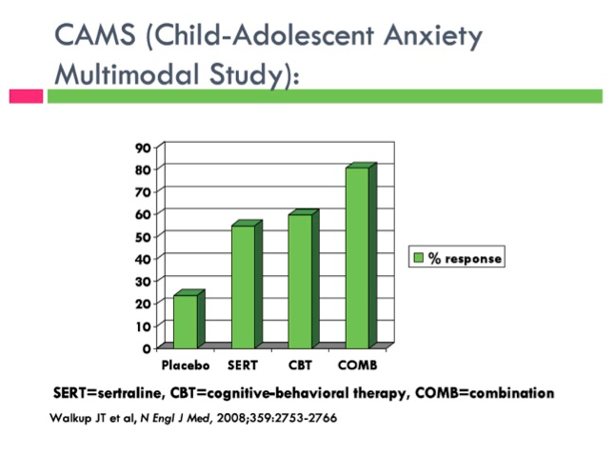
Child Anxiety Multimodal Study CAMS
COMB > CBT = SRT > PBO
81%
55%
60%
24%
CGI-I 1 and 2 (ITT, LOCF)
Walkup et al., 2008

Slide 32
Child–Adolescent Anxiety Multimodal Study
Mean dose of SER/PBO at final visit:
COMB: 134 mg/day
SER: 146 mg/day
PBO: 176mg/day
Walkup JT, Albano AM, Piacentini J, Birmaher B, Compton SN, Sherrill J, Ginsburg GS, Rynn MA, McCracken J, Waslick B, Iyengar S, March JS, Kendall PC. Cognitive-behavioral therapy, sertraline and their combination for children and adolescents with anxiety disorders: acute phase efficacy and safety. New England Journal of Medicine. Dec 25, 2008.
Notes:
Last updated 8/20/2013 - PSJ

Slide 33
FDA approved SSRI Meds for the Pediatric Anxiety Triad
NONE

Slide 34
Serotonin Reuptake Inhibitors FDA Approvals
Approved for OCD
Clomipramine > 10 yrs (TCA)
Fluvoxamine > 8 yrs (SSRI)
Sertraline > 6 yrs (SSRI)
Fluoxetine > 7 yrs (SSRI)
Approved for Depression
Fluoxetine > 8 yrs (SSRI)
Escitalopram > 12 yrs (SSRI)
Approved for Non-OCD Anxiety
Duloxetine > 7 yrs GAD (SNRI)
Slide courtesy of Dr. Walkup
Notes:
21

Slide 35
SSRI Efficacy for Non-OCD Anxiety Disorders
SAD, GAD and SoP
Fluvoxamine - RUPP, 2001
Fluoxetine - Birmaher et al, 2003
Sertraline (CAMS) - Walkup et al, 2009
SoP
Paroxetine - Wagner et al, 2004
Fluoxetine - Beidel et al, 2007
Venlafaxine - March et al, 2007
GAD
Sertraline - Rynn et al, 2001
Venlafaxine - Rynn et al, 2007
Duloxetine - Strawn et al, 2015
Buspirone in GAD, unpublished negative trial
Slide courtesy of Dr. Walkup

Slide 36
SSRI TREATMENT - Moderate Anxiety
Patient and parent preference
Too anxious to start CBT
CBT not available
CBT has failed or only partially resolved symptoms

Slide 37
Severe Anxiety
Exposure-based CBT
and
Psychopharmacology

Slide 38
SSRI
Brand (off-label for non-OCD anxiety) | Generic | Target Dose | Starting Dose
Zoloft | Sertraline | 25-200 for kids and adolescents | Start at 12.5-25 mg
Prozac | Fluoxetine | 10-60 for kids and adolescents | Start at 5-10 mg
Lexapro | Escitalopram | 10-20 for adolescent | Start at 5 or 10 mg
Notes:
Start kids even lower!

Slide 39
SSRIs
Anxiety often needs higher doses in the end
Start with a lower doses to start as anxious people are hypervigilant for side effects
WARN about side effects
Start low BUT do not forget to go up—Most treatment failure is just a failure to raise the dose enough!
Younger kids respond well to all treatments but also have more side effects from meds

Slide 40
Other Meds for Anxiety
SNRI—(Duloxetine) when failed SSRIs
Evidence is not there to use the following as first or second line treatments:
Antihistamines
Beta blockers
Benzodiazepines
Buspirone
Notes:
The referenced article refers to possible treatments for anxiety in adults…the take home message is that these are unproven in pediatric anxiety disorders.
Last updated 8/20/2013 - PSJ

Slide 41
Sleep Hygiene
Wind down period before bed
Consistent bedtime schedule
Physical activity during the day
Limit caffeine and alcohol
Create restful environment
Nothing but sleep on the bed
No napping
No screens in the room
Manage stress before bed
If unable to sleep:
Change position
Read for 20 minutes
Muscle relaxation
Can do short trial of melatonin
Notes:
Anxiety and sleep difficulties often go hand in hand...
If we can help sleep, we can help anxiety. If we can help anxiety, we can help sleep. Rarely do children have “insomnia”, they have anxiety.

Slide 42
Take-aways
Early intervention with anxiety makes a difference.
The pediatrician has a unique opportunity to identify anxious children.
The pediatrician’s office is an ideal setting to start treatment for anxiety.
Medication and psychological approaches are effective for anxiety management. Medication should not be a last resort.
Tools for management of anxiety can empower children and their parents.

Slide 43
The Pay-Off

Slide 44
1-855-227-7272

