Slide 1
What’s Next?
ADHD Treatment when Medication is not “Working”

Slide 2
Speaker:
Viki Katsetos, MD
Child and Adolescent Psychiatry Divsion
University of Rochester

Slide 3
Disclosures
None

Slide 4
Meet Percy, a 9-year-old with ADHD. Over the next 20-30 minutes we will work together to help Percy and his family navigate common issues that we encounter especially when we get that call… “This is not working!”

Slide 5
Percy - ADHD: Combined Type - Parents sought behavioral intervention initially - School reporting concerns prompted motivation for medication - Started Concerta 18 mg, increased to 27 mg during last 5 weeks of school a/w improvement, but residual symptoms. - Held medication over summer - Restarted at 27mg a week before school started

Slide 6
The medication is not helpful!
His grades are even worse than they were at this time last year!
School says he’s behaving, but you should see him at home!
I think we need to try something else!

Slide 7
What are most common reasons a medication may “not be working”?
Adherence
Insufficient dose
Observation time
Diagnostic question
Comorbidity

Slide 8
What are reasons a medication may not “work”?
Adherence
Insufficient dose
Observation time
Diagnostic question
Comorbidity
Is medication being TAKEN?
Who administers?
What prompts taking of medication?
Diversion?

Slide 9
What are reasons a medication may not “work”?
Adherence
Insufficient dose
Observation time
Diagnostic question
Comorbidity
Has dose been increased?
Has patient grown?
Is there an increase in demands on patient?

Slide 10
What are reasons a medication may not “work”?
Adherence
Insufficient dose
Observation time
Diagnostic question
Comorbidity
When is it not working?
Could medication be wearing off?
Is onset of action delayed?
Rebound phenomenon?

Slide 11
What are reasons a medication may not “work”?
Adherence
Insufficient dose
Observation time
Diagnostic question
Comorbidity
Are we sure we are treating the right thing?
Review differential?
Additional work-up?

Slide 12
Percy - Mother gives medication (Concerta 27mg) after breakfast every morning - Behaving fine in school, “at least not getting calls at work,” mornings may be little worse - “Terrible” when he gets home; “won’t listen”, “all over the place”, “cannot get him to do any homework”, “it’s exhausting” - He really has hard time settling down to go to bed, but this is “not new”
Notes:
Taking medication!
Wears off or rebound - booster
Delayed onset – consider taking before meal
Sleep disruption – booster vs clonidine

Slide 13
Percy - Repeat Vanderbilt Screens - Teacher screen, comment notes “he seems to do better around 10am, but has hard time by end of day” - Both teacher and parent note difficulties in reading - Remains “bright and cheerful” with peers and sibling - Mother was promoted and is now working later more frequently and not home for most of after school routine
Notes:
CSE need?
Depression less likely
Change in afternoon routine?

Slide 14
What is the next step?
Give medication earlier in the morning
Increase the dose to 36 mg
Optimize sleep
All of the above…

Slide 15
Percy - Dose increased to 36mg and parents instructed to give before breakfast - Associated with improved behavior in school, both in the morning and through the end of school day - Father continues to express frustration with Percy’s focus with homework and increased activity after school - Sleep hygiene addressed as per recommendations, but onset of sleep remains problematic - Falling further behind in reading
Notes:
Rebound vs wear off -> Booster? Alpha or stimulant
CSE?

Slide 16
What do we do next?
Additional Information that could be gathered
Medication Steps to Consider

Slide 17
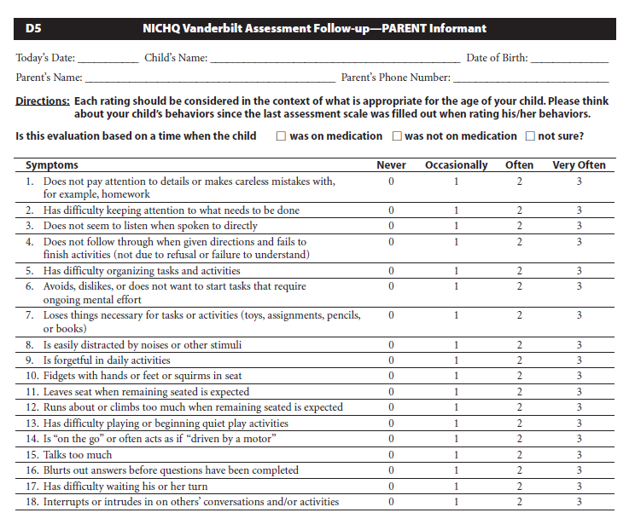
Titration Considerations:
Start low and go slow holds…but not too slow!
Goal to optimize response vs. settling for improvement
If child is a PARTIAL responder on the imum dose of stimulant, switch to another stimulant OR consider augmentation (usually with an alpha agonist)
Treat to remission!

Slide 18
Dose has been Optimized, But Side-Effects…
Switch to the alternative stimulant type
There is no absolute equivalency
Can use web-based calculators as guide:
https://www.adhdmedcalc.com/
Also helpful in world of stimulant shortages

Slide 19
If there is a good “daytime” stimulant response and later day coverage is the issue?
Can a “booster” of a short acting version of the AM stimulant be added without impact on sleep?
Timing of second dose depends on wear off time of morning medicine
If hyperactivity/impulsivity is most problematic later in the day an alpha agonist like Guanfacine (Tenex, Intuniv) or Clonidine (Catapres, Capvay) may be suitable
This may also be preferred if stimulant is already significantly impacting food intake/weight

Slide 20
Considerations when adding an Alpha Agonist
Hyperactivity/Impulsivity > Attention
Sedation
What amount is tolerable? Is it advantageous?
Clonidine > Guanfacine
Heart Rate and Blood Pressure
Adherence
Rebound hypertension
Notes:
Clonidine start 0.1mg
Guanfacine 0.5mg

Slide 21
Other Things to Consider If Stimulants Are Not Working: Comorbidity/Diagnostic Issue
Other Comorbidity?
What about co-occurring Anxiety/Depression
Is it mild/moderate enough for CBT
Remember your screening tools - PHQ-9, SCARED
Does this require an SSRI trial?
Learning Disorder
CSE evaluation for IEP need
Neuropsychiatric Testing
ODD
Parenting-based intervention recommended -> Parent Behavior Management Training
Notes:
Again highlight need to understand why not working?

Slide 22
Percy - Titrated to 54 mg with improved behavior and academic performance in school, however continued symptoms on Vanderbilt, with teacher’s also noticing worry - Despite implementation of reward plan for after school to improve behavior, father continues to express frustration with Percy’s focus and increased activity after school - Sleep hygiene addressed as per recommendations, but onset of sleep remains problematic, now he is also frequently asking to sleep with his parents - Falling further behind in reading - Appetite reduced
Notes:
Rebound vs wear off -> Booster? Alpha or stimulant
CSE?

Slide 23
What do we do next?
Could something else beyond ADHD be occurring?
Medication considerations

Slide 24
When Might A Stimulant’s “Failure” Be More Predictable?
Existing Tic Disorder –
May consider atomoxetine which is less associated with tic exacerbation
If tic causes impairment, could target both tic and ADHD symptoms with Alpha-Agonist

Slide 25
When Might A Stimulant’s “Failure” Be More Predictable?
Significant Anxiety
Treat anxiety – CBT, SSRI
Atomoxetine – less likely to exacerbate anxiety in comparison to stimulant

Slide 26
When Might A Stimulant’s “Failure” Be More Predictable?
Children with ASD
Generally more sensitive to side effects though stimulants can still provide benefit
With ADHD: hyperactive/impulsive type and/or with aggression consider alpha agonist

Slide 27
Take homes…when medication doesn’t seem to “work”
There is not a SINGLE “right way”
Dosing:
Adherence
Treat to remission
Use Vanderbilt and other collateral information to guide treatment
If partial response to max dose, consider switching to alternative vs augmenting with alpha
Booster medication if wear off is likely
Comorbidity vs. Misdiagnosis
Consider learning disorders – CSE evaluation
Use screens to help rule out (PHQ9, SCARED, GAD7, CRAFFT, CPSS-V)
Life circumstances

Slide 28
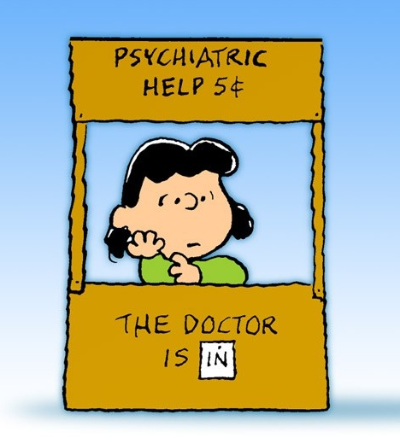
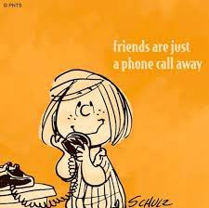
Whenever in doubt, always remember, with Project Teach….

Slide 29
ADHD
4. Alternate Class (MPH or AMP)
1. Diagnostic Assessment
3. MPH or AMP (plus parent management usually)
7. Bupropion (not FDA approved)
2. Multimodal treatment plan with family and child
6. Atomoxetine alone or as add on
5. Alpha agonist alone or as add on

Slide 30
ADHD + Anxiety/Depression
Comorbidities and ADHD
4. Alternate Class (MPH or AMP)
1. Diagnostic Assessment
3. Psychosocial treatment + MPH or AMP
2. Multimodal treatment plan with family and child
6. If residual anxiety, add SSRI
5. Atomoxetine alternate as first line
Notes:
This is same for any comorbidity—start the psychosocial tx for that comorbidity and if after treating ADHD with good meds and after good psychosocial tx, there is residual sx of comorbidity, tx it with another rmed

Slide 31
Toolkit Published by AAP 2020

