Slide 1
Behavioral Health Care in an Obstetric-Gynecology practice
Ellen Tourtelot MD
Ellen Poleshuck PhD
Notes:
Do we want to restrict this to depression

Slide 2
Provider Focus Groups
Over 50% of providers (Nurse Practitioners and OB/GYN residents) were not confident with prescribing antidepressant medication to pregnant patients.

Slide 3
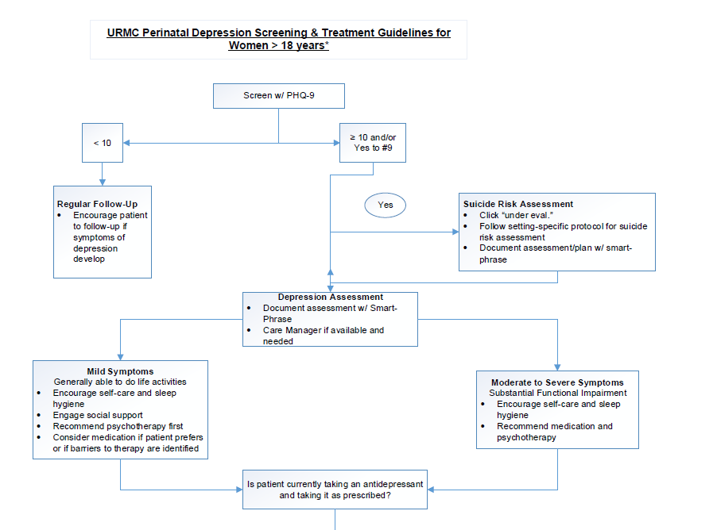

Slide 4
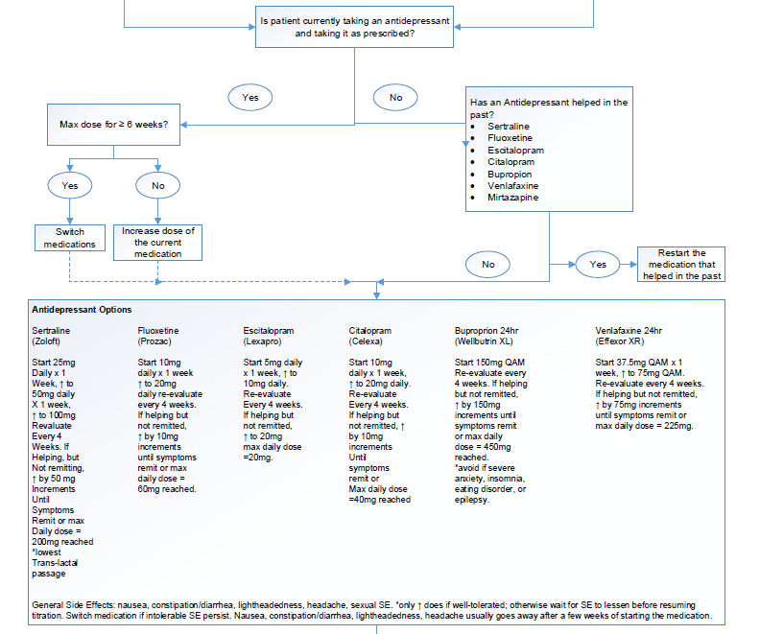
Notes:
I am no going to go into this in detail, but you will have the slide deck to reference. Main point is go up on the dose until in therapeutic range before adding a second medication or switching medication.

Slide 5
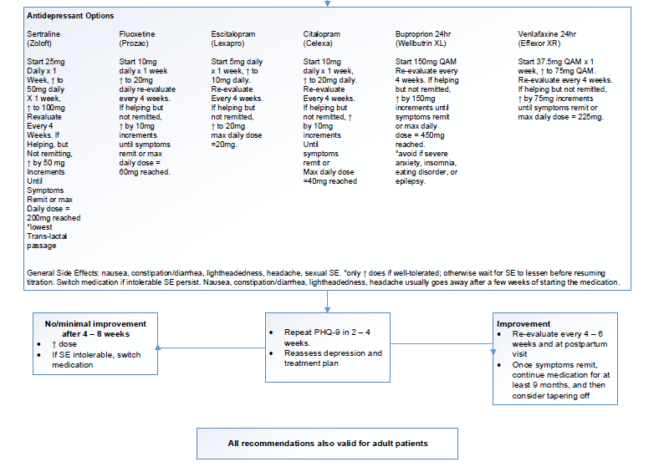
Notes:
Switching to different medication carries more risk than going up on the dose until therapeutic or max dose reached.

Slide 6
Documentation Template: Initial Assessment
Current PHQ-9 score: ***
Positive for the following symptoms of depression: (anhedonia, depressed mood, lack of sleep/too much sleep, fatigue, poor appetite or overeating, feeling bad about yourself, trouble concentrating, psychomotor agitation or retardation)
Recent precipitants/stressors: ***
Domains of greatest functional impairment
Patient currently prescribed *** by *** and is taking medication as prescribed
Patient actively attending psychotherapy (With *** Where ***ROI Y/N)
Prior treatments (outpatient, inpatient, pharmacotherapy, none)
Other medical conditions ruled out (TSH ***, other***)
Concurrent substance abuse addressed (none reported, alcohol, THC, opiates, other ***)
Fup plan: ***

Slide 7
RESPONSE
Provider education on suicide assessment included an in-service and a grand rounds.
Template (smart phrase) was developed and sent to all providers and available in EHR to use in assisting with suicide evaluation.
Track all screens with a positive answer to question 9 on PHQ and check documentation in the chart. Give feedback to providers. Safety initiative for 2019.

Slide 8
Contact Information
Ellen Tourtelot, MD
Associate Professor
Medical Director, UR Medicine Gender Wellness Obstetrics and Gynecology
Ellen_Tourtelot@urmc.Rochester.edu
Ellen Poleshuck, PhD
Associate Professor
Director, UR Medicine Program for Women’s Mental Health and Wellness
Ellen_Poleshuck@urmc.Rochester.edu

