Slide 1
ADHD Treatment in Perinatal Patients
Jeffrey Iler, MD
Assistant Professor of Psychiatry
Medical Director, Program for Mental Health and Gender Wellness
University of Rochester Medical Center, Rochester NY

Slide 2
Speaker:
Jeffrey Iler, MD
Assistant Professor of Psychiatry
Medical Director, Program for Mental Health and Gender Wellness
University of Rochester Medical Center
Rochester, NY
Contact:
jeffrey_iler@urmc.rochester.edu

Slide 3
Disclosures
I have no relevant financial relationship with a commercial interest to disclose.

Slide 4
Objectives
Review known the risks associated with untreated ADHD in perinatal patients
Overview non-pharmacological options for perinatal patients with ADHD
Discuss known risks associated with pharmacological treatments for ADHD during the perinatal period

Slide 5
Scope:
ADHD estimated to affect 4.4% of American adults¹
Estimated ratio in adults is 1.6:1 male to female²
No longer viewed as “just a childhood illness”
An estimated 60% of children with ADHD will continue to have clinically relevant symptoms as adults³
Inattentive symptoms in particular frequently persist, although hyperactive symptoms may also persist in some cases

Slide 6
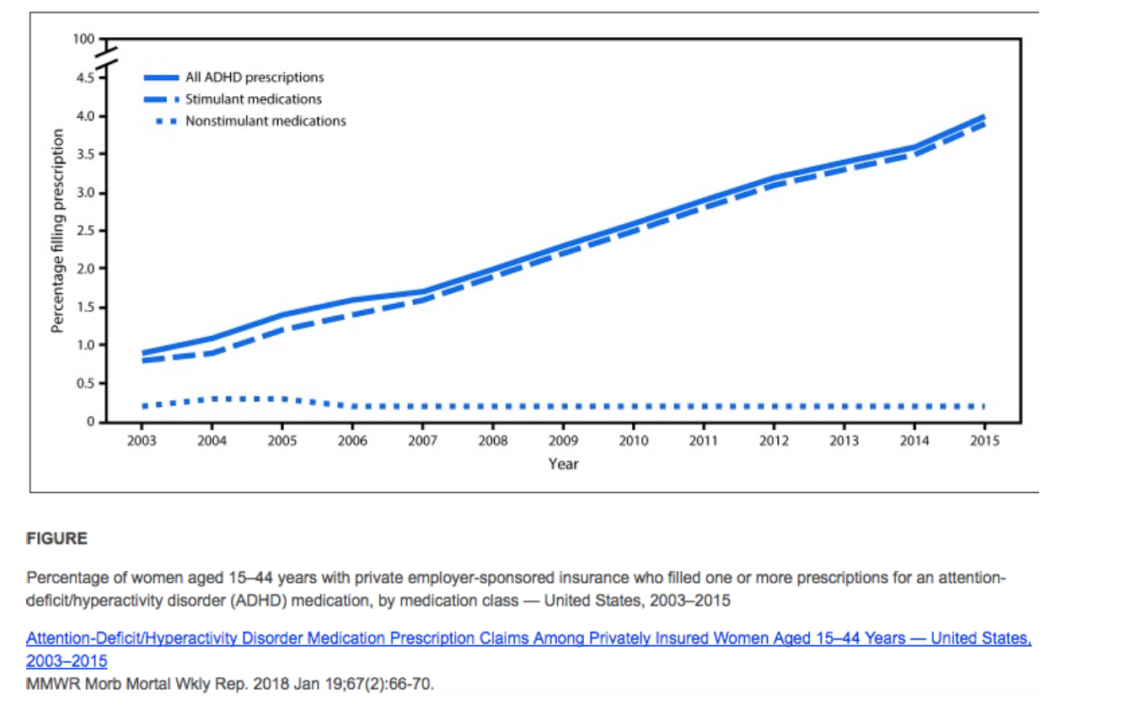
Treatment for ADHD in adults is increasing
The increase in prescriptions is largely being driven by stimulants

Slide 7
Impact of ADHD on pregnancy outcomes
Limited studies have shown some specific perinatal risks
Murray et al reported higher risk for maternal stress, comorbid depressive symptoms, and significant negative impact on social supports
They also found significantly higher rates of tobacco use and preterm birth, but this lost significance when adjusted for confounding factors⁵
Poulton et al found an increased risk of multiple negative outcomes including pre-eclampsia, pre-term labor/birth, higher incidence of surgical delivery, and higher need for neonatal resuscitation and higher likelihood of neonatal admission, although they were unable to confidently ascribe these outcomes to parental ADHD, use of psychostimulants, or other correlated factors⁶

Slide 8
More broadly, untreated ADHD in adults is associated with numerous negative outcomes1, 4, 5, 7, 8, 9, 20, 21, 22, 23
Elevated risk of multiple medical comorbidities, especially neurological, metabolic, musculoskeletal and respiratory illnesses
Elevated risk of all cause mortality, especially non-natural mortality (e.g. accidental death, suicide)
Higher rates of serious motor vehicle crashes
Elevated rates of substance misuse
Elevated risk of mood disorders and anxiety disorders
Heightened impulsivity/increased risk-taking behaviors
Elevated rates of criminal behavior/legal system involvement
Decreased academic and vocational success, higher rates of financial stress
Decreased social supports, higher rates of relational conflict/divorce

Slide 9
Why treat during pregnancy?
Treatment of ADHD has been shown to reduce rates of morbidity/mortality⁷ (including decreasing risk of motor vehicle crashes²¹), reduce substance abuse²², and reduce symptoms of emotional dysregulation and impulsivity⁴
Treatment of ADHD also has positive impact on²³:
Successful employment and improved financial resources
Social connection and support
Engagement in health-promoting behaviors
Parenting

Slide 10
Non-pharmacological interventions
Psychoeducation
CBT
Neurofeedback
Peer support
Coaching
Environmental modifications (e.g. prioritizing public transport over driving, accommodations in school/work, etc.)

Slide 11
Risks associated with pharmacological treatment of ADHD in pregnancy: Stimulants
The most convincing data of adverse effects from stimulant exposure exists from studies of pregnant individuals abusing psychostimulants (in particular methamphetamine)
See higher rates of fetal demise, hypertensive disorders, in utero growth restriction, preterm birth, postpartum hemorrhage in this group
Cannot automatically extrapolate these risks to therapeutic use
Notes:
With the exception of in cases of stimulant abuse abuse, no firm evidence of harm from exposure to psychostimulants exists at this time

Slide 12
Risks associated with pharmacological treatment of ADHD in pregnancy: Stimulants
Increased risk of birth defects
Possible small increase in cardiac malformations with methylphenidate
No known risk with amphetamine exposure¹⁰
Other studies have found no association between stimulant exposure and birth defects¹¹
In utero growth effects
Some evidence of growth acceleration and being large for gestational age¹¹
However, other studies have shown growth restriction¹³

Slide 13
Risks associated with pharmacological treatment of ADHD in pregnancy: Stimulants
Hypertensive disorders^{6, 12, 14}
Data are conflicted on risk of pre-eclampsia with therapeutic stimulant exposure
Increased risk of preterm birth^{11, 14}
Increased rates of neonatal morbidity
More likely to require NICU care, and more likely to experience CNS disorders (e.g. seizures)¹¹
More likely to require caesarian delivery, have low APGAR scores, require NICU care⁶
No study has found stimulant associated increase in neonatal death

Slide 14
Risks associated with pharmacological treatment of ADHD in pregnancy: Bupropion
Increased risk of birth defects?
Early studies said maybe, but more recent data are reassuring^{15, 16}
Few other reported negative pregnancy outcomes
Low risk for postnatal adaptation
Less effective than stimulants, but may be a reasonable option for patients with comorbid depression and/or nicotine use disorder

Slide 15
Risks associated with pharmacological treatment of ADHD in pregnancy: Atomoxetine
Limited data available
No evidence of increased risk of birth defects^{17, 18}
No evidence of increased risk of pre-eclampsia or preterm birth¹⁴
No evidence of increased risk of long-term developmental problems including growth problems or autism¹⁸

Slide 16
Risks associated with pharmacological treatment of ADHD in pregnancy: α2 agonists
Very little published data and what is known is confounded – most studies are from patients being treated for severe hypertension, which can have significant effects on pregnancy outcomes
Clonidine was not associated with impairments in development or growth¹⁸
Guanfacine was similarly not associated with development or growth impairments after exposure during pregnancy¹⁹

Slide 17
References
Kessler, R. C., Adler, L., Barkley, R., Biederman, J., Conners, C. K., Demler, O., Faraone, S. V., Greenhill, L. L., Howes, M. J., Secnik, K., Spencer, T., Ustun, T. B., Walters, E. E., & Zaslavsky, A. M. (2006). The prevalence and correlates of adult ADHD in the United States: results from the National Comorbidity Survey Replication. The American journal of psychiatry, 163(4), 716–723.
Quinn PO, Madhoo M. A review of attention-deficit/hyperactivity disorder in women and girls: uncovering this hidden diagnosis. Prim Care Companion CNS Disord. 2014;16(3):PCC.13r01596
Young, J. L., & Goodman, D. W. (2016). Adult attention-deficit/hyperactivity disorder diagnosis, management, and treatment in the dsm-5 era. The Primary Care Companion For CNS Disorders.
Reimherr, F. W., Marchant, B. K., Gift, T. E., Steans, T. A., & Wender, P. H. (2015). Types of adult attention-deficit hyperactivity disorder (ADHD): baseline characteristics, initial response, and long-term response to treatment with methylphenidate. Attention deficit and hyperactivity disorders, 7(2), 115–128.
Murray, A. L., Taut, D., Baban, A., Hemady, C. L., Walker, S., Osafo, J., Sikander, S., Tomlinson, M., Toit, S. D., Marlow, M., Ward, C. L., Fernando, A., Madrid, B., Van Thang, V., Tuyen, H. D., Dunne, M., Hughes, C., Fearon, P., Valdebenito, S., & Eisner, M. (2022). Associations Between ADHD Symptoms and Maternal and Birth Outcomes: An Exploratory Analysis in a Multi-Country Cohort of Expectant Mothers. Journal of attention disorders, 26(14), 1882–1894.
Poulton, A. S., Armstrong, B., & Nanan, R. K. (2018). Perinatal Outcomes of Women Diagnosed with Attention-Deficit/Hyperactivity Disorder: An Australian Population-Based Cohort Study. CNS drugs, 32(4), 377–386.

Slide 18
References
Du Rietz, E., Brikell, I., Butwicka, A., Leone, M., Chang, Z., Cortese, S., D'Onofrio, B. M., Hartman, C. A., Lichtenstein, P., Faraone, S. V., Kuja-Halkola, R., & Larsson, H. (2021). Mapping phenotypic and aetiological associations between ADHD and physical conditions in adulthood in Sweden: a genetically informed register study. The lancet. Psychiatry, 8(9), 774–783.
Li, L., Zhu, N., Zhang, L., Kuja-Halkola, R., D'Onofrio, B. M., Brikell, I., Lichtenstein, P., Cortese, S., Larsson, H., & Chang, Z. (2024). ADHD Pharmacotherapy and Mortality in Individuals With ADHD. JAMA, 331(10), 850–860.
Chang, Z., D'Onofrio, B. M., Quinn, P. D., Lichtenstein, P., & Larsson, H. (2016). Medication for Attention-Deficit/Hyperactivity Disorder and Risk for Depression: A Nationwide Longitudinal Cohort Study. Biological psychiatry, 80(12), 916–922.
Huybrechts, K. F., Bröms, G., Christensen, L. B., Einarsdóttir, K., Engeland, A., Furu, K., Gissler, M., Hernandez-Diaz, S., Karlsson, P., Karlstad, Ø., Kieler, H., Lahesmaa-Korpinen, A. M., Mogun, H., Nørgaard, M., Reutfors, J., Sørensen, H. T., Zoega, H., & Bateman, B. T. (2018). Association Between Methylphenidate and Amphetamine Use in Pregnancy and Risk of Congenital Malformations: A Cohort Study From the International Pregnancy Safety Study Consortium. JAMA psychiatry, 75(2), 167–175.
Nörby, U., Winbladh, B., & Källén, K. (2017). Perinatal Outcomes After Treatment With ADHD Medication During Pregnancy. Pediatrics, 140(6), e20170747.
Newport, D. J., Hostetter, A. L., Juul, S. H., Porterfield, S. M., Knight, B. T., & Stowe, Z. N. (2016). Prenatal Psychostimulant and Antidepressant Exposure and Risk of Hypertensive Disorders of Pregnancy. The Journal of clinical psychiatry, 77(11), 1538–1545. https://doi.org/10.4088/JCP.15m10506chiatry, 75(2), 167–175.

Slide 19
References
Wright, T. E., Schuetter, R., Tellei, J., & Sauvage, L. (2015). Methamphetamines and pregnancy outcomes. Journal of addiction medicine, 9(2), 111–117.
Cohen, J. M., Hernández-Díaz, S., Bateman, B. T., Park, Y., Desai, R. J., Gray, K. J., Patorno, E., Mogun, H., & Huybrechts, K. F. (2017). Placental Complications Associated With Psychostimulant Use in Pregnancy. Obstetrics and gynecology, 130(6), 1192–1201.
Turner, E., Jones, M., Vaz, L. R., & Coleman, T. (2019). Systematic Review and Meta-Analysis to Assess the Safety of Bupropion and Varenicline in Pregnancy. Nicotine & tobacco research : official journal of the Society for Research on Nicotine and Tobacco, 21(8), 1001–1010.
Cole, J. A., Modell, J. G., Haight, B. R., Cosmatos, I. S., Stoler, J. M., & Walker, A. M. (2007). Bupropion in pregnancy and the prevalence of congenital malformations. Pharmacoepidemiology and drug safety, 16(5), 474–484.
Bröms, G., Hernandez-Diaz, S., Huybrechts, K. F., Bateman, B. T., Kristiansen, E. B., Einarsdóttir, K., Engeland, A., Furu, K., Gissler, M., Karlsson, P., Klungsøyr, K., Lahesmaa-Korpinen, A. M., Mogun, H., Nørgaard, M., Reutfors, J., Sørensen, H. T., Zoega, H., & Kieler, H. (2023). Atomoxetine in Early Pregnancy and the Prevalence of Major Congenital Malformations: A Multinational Study. The Journal of clinical psychiatry, 84(1), 22m14430.
Bang Madsen, K., Robakis, T. K., Liu, X., Momen, N., Larsson, H., Dreier, J. W., Kildegaard, H., Groth, J. B., Newcorn, J. H., Hove Thomsen, P., Munk-Olsen, T., & Bergink, V. (2023). In utero exposure to ADHD medication and long-term offspring outcomes. Molecular psychiatry, 28(4), 1739–1746.
Philipp E. (1980). Guanfacine in the treatment of hypertension due to pre-eclamptic toxaemia in thirty women. British journal of clinical pharmacology, 10 Suppl 1(Suppl 1), 137S–140S.
Klein, R. G., Mannuzza, S., Olazagasti, M. A., Roizen, E., Hutchison, J. A., Lashua, E. C., & Castellanos, F. X. (2012). Clinical and functional outcome of childhood attention-deficit/hyperactivity disorder 33 years later. Archives of general psychiatry, 69(12), 1295–1303. https://doi.org/10.1001/archgenpsychiatry.2012.271

Slide 20
References
Chang, Z., Lichtenstein, P., D'Onofrio, B. M., Sjölander, A., & Larsson, H. (2014). Serious transport accidents in adults with attention-deficit/hyperactivity disorder and the effect of medication: a population-based study. JAMA psychiatry, 71(3), 319–325. https://doi.org/10.1001/jamapsychiatry.2013.4174
Faraone, S. V., & Wilens, T. E. (2007). Effect of stimulant medications for attention-deficit/hyperactivity disorder on later substance use and the potential for stimulant misuse, abuse, and diversion. The Journal of clinical psychiatry, 68 Suppl 11, 15–22.
Kosheleff, A. R., Mason, O., Jain, R., Koch, J., & Rubin, J. (2023). Functional Impairments Associated With ADHD in Adulthood and the Impact of Pharmacological Treatment. Journal of attention disorders, 27(7), 669–697. https://doi.org/10.1177/10870547231158572

