Slide 1
Speaker:
Elizabeth Fitelson, M.D.
Associate Professor of Psychiatry at CUIMC
Director, The Women’s Program
Columbia University Department of Psychiatry
Contact:
eem36@cumc.columbia.edu

Slide 2
Bipolar Disorder:
What Obstetric Clinicians Need to Know

Slide 3
Disclosures
No relevant disclosures
Notes:
If you have disclosures, state:
“My spouse/partner and I have the following relevant financial relationship with a commercial interest to disclose:” followed by disclosures
or
If you do not have disclosures, state:
“Neither I nor my spouse/partner has a relevant financial relationship with a commercial interest to disclose.”
(Note: Your Disclosures must match the information provided on your disclosure form.)

Slide 4
Outline:
What is Bipolar Disorder?
How do we distinguish it from other psychiatric disorders?
Why is it important for obstetric clinicians to know about Bipolar Disorder?
Pre-pregnancy medications and interactions with birth control
Risks in pregnancy
Risks postpartum
Posptartum Psychosis: A Psychiatric Emergency
Brief Overview of Mood Stabilizers in Pregnancy
Managing the Postpartum Bipolar Patient
Acute Management
Beyond the “Fourth Trimester”

Slide 5
Case: 24yo woman with Bipolar 1 Disorder
24yo married woman presented for consultation about managing Bipolar 1 Disorder in pregnancy. She had been hospitalized twice for mania with psychosis. Her first episode was right after she graduated from college. She demonstrated pressured speech, was only sleeping 2 hours a night, was agitated, and had a delusion that one of her teachers was sending her telepathic signals. She was stabilized on valproate and olanzapine. Tapered off of both after one year with her psychiatrist, but within 2 months became acutely agitated and paranoid, and was physically aggressive. Stabilized on lithium and olanzapine. Olanzapine was tapered off after several months due to weight gain. Became depressed, and citalopram was added. At the time of presentation she had been stable for 3 years on the combination of lithium 1200mg daily and citalopram 20mg daily. She and her husband planned to start a family within the next year.

Slide 6
What is Bipolar Disorder?
Diagnostic Criteria
Screening tools
Distinguishing from other psychiatric and medical illness

Slide 7
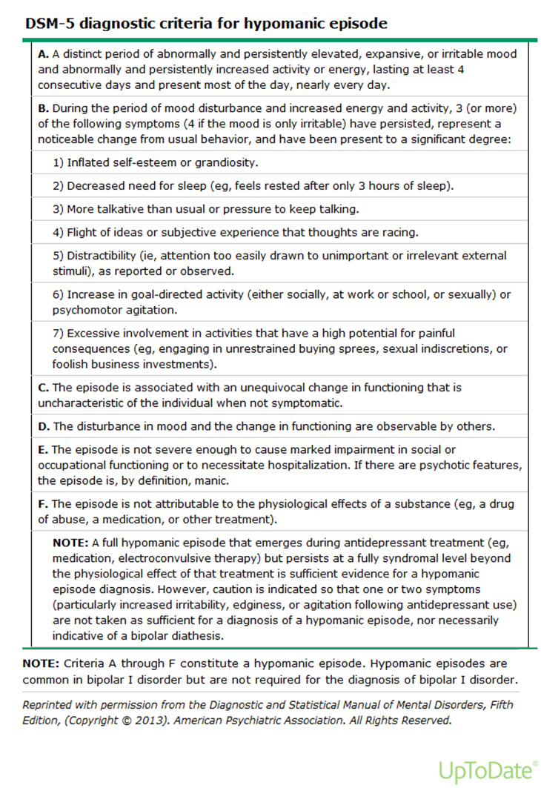
Notes:
Manic or hypomanic episodes with mixed features are characterized by episodes that meet full criteria for mania (table 1) or hypomania (table 2), and at least three of the following symptoms during most days of the episode [1]:
●Depressed mood
●Diminished interest or pleasure in most activities
●Psychomotor retardation
●Low energy
●Excessive guilt or thoughts of worthlessness
●Recurrent thoughts about death or suicide, or suicide attempt

Slide 8
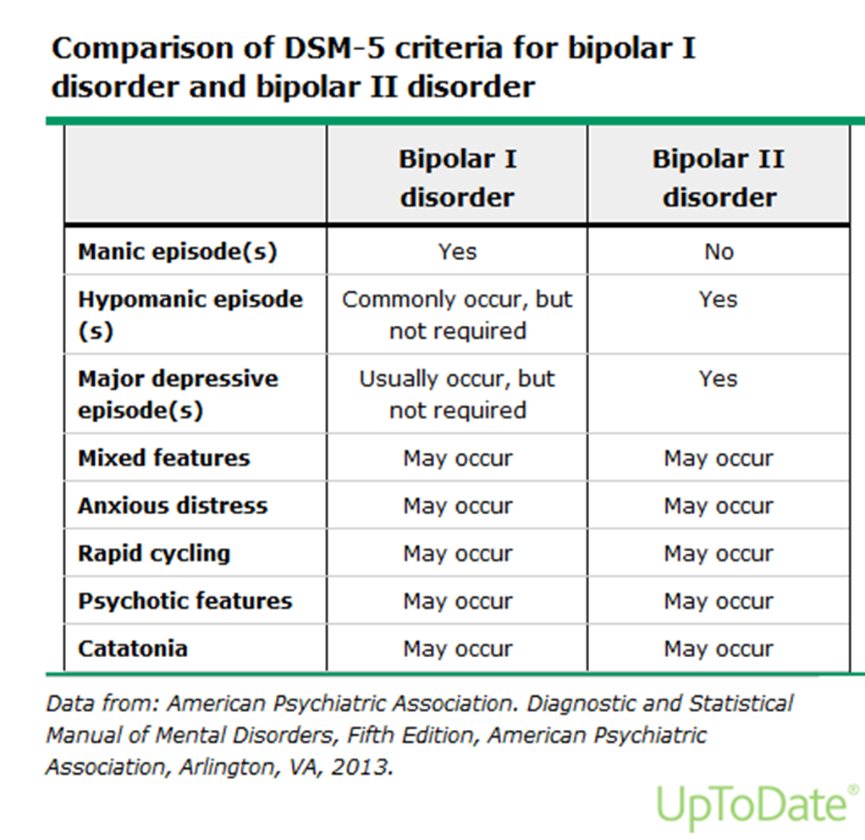
Bipolar Disorder DSM-V

Slide 9
Bipolar Epidemiology and Course
1-3% lifetime prevalence (bipolar 1 and 2)
Age of onset (diagnosis or 1st manic) in women early to mid 20’s (late teens men), later dx possible
Chronic, relapsing remitting course
Depression is more frequent than mania (bipolar patients spend more time depressed than manic or hypomanic)
Antidepressants without mood stabilizers can precipitate mania, mixed states, and more mood cycling
Lifetime suicide risk is 15x general population
Treatment mainstay is mood stabilizing medication, psychosocial support and attention to sleep and health

Slide 10
Differential and Comorbidity
Differential Dx:
Schizophrenia/schizoaffective
Trauma/PTSD
Substance Use Disorders
Severe Anxiety D/o
Thyroid Disorders
Cushing’s Dx
Delirium (in medically ill)
Iatrogenic (ie steroids)
Comorbidity:
Trauma/PTSD
Substance Use Disorders
Anxiety Disorders
Obesity
DM2
Hyperlipidemia
Obstructive Sleep Apnea
Thyroid, other immune disorders

Slide 11
Screening:
EDPS or PHQ for Depression
Screen for Substance and Alcohol Use
Mood Disorders Questionnaire screens for mood elevation (but low specificity)
If you have concerns based on:
Family history of bipolar
Past diagnosis or medications suggestive of bipolar dx
Presentation of mania/hypomania, mixed symptoms, or psychotic sx
Unusual response to antidepressants (escalating agitation e.g.)
Call Project TEACH to discuss before initiating treatment or for management

Slide 12
What is important to know about Bipolar Disorder in reproductive age women?
Pre-pregnancy medications and interactions with birth control
Risks in pregnancy
Risks postpartum

Slide 13
50% of Pregnancies are Unplanned!
Likely higher in bipolar patients
Mood stabilizers have important interactions with hormonal birth control
Bipolar disorder has high morbidity in the perinatal period for mom, fetus, and family

Slide 14
Interactions Between Mood Stabilizers and Reproductive Health
Drug | Menstrual/Hormonal Interactions | Pregnancy
Valproic Acid (Depakote) | Can cause PCOS OCP’s lower VPA levels | Teratogenic in every trimester *should not be 1st line in reproductive age women!*
Lamotrigine | OCP’s lower LMG levels 50% | No clear teratogenicity
Antipsychotics | Can elevate prolactin levels (impact on menses, fertility, bone health) | No clear teratogenicity; weight gain and metabolic monitoring; neonatal EPS (rare)
Carbamazepine/Oxcarbazepine | Lowers OCP effectiveness | First trimester NTD’s, craniofacial abnormalities, low VitK
Lithium | None | Cardiac defects (slt), polyhydramnios, neonatal effects
Topiramate | Lowers OCP effectiveness | Some signal of teratogenic risk >200mg

Slide 15
Risks of BD and Pregnancy
Poor self-care, poor nutrition, prenatal care, risks of substance use, poor judgment, fetal abuse/injury
Effects on family system
Adverse effects on fetal growth (premature birth, low birth weight, pre-eclampsia)
Postpartum psychosis
Suicide, infanticide
Wadhwa, 1993; Kurki 2000; Jablensky 2005
Notes:
The authors retrospectively compared recurrence rates and survival functions for 101 women with DSM-IV bipolar disorder (68 type I, 33 type II) during pregnancy and postpartum (N=42) or during equivalent periods (weeks 1–40 and 41–64) for age-matched nonpregnant subjects (N=59) after either rapid (1–14 days) or gradual (15–30 days) discontinuation of lithium. Recurrence rates also were obtained for the year before discontinuing lithium. RESULTS: Rates of recurrence during the first 40 weeks after lithium discontinuation were similar for pregnant (52%) and nonpregnant women (58%) but had been much lower for both in the year before treatment was discontinued (21%). Among subjects who remained stable over the first 40 weeks after lithium discontinuation, postpartum recurrences were 2.9 times more frequent than recurrences in nonpregnant women during weeks 41–64 (70% versus 24

Slide 16
Bipolar Disorder and Pregnancy
Viguera et al, 2000
Notes:
Depressive or dysphoric-mixed episodes were more prevalent in pregnant than nonpregnant women (63% versus 38% of recurrences).
Recurrence risk was greater after rapid than after gradual discontinuation, and for patients with more prior affective episodes, but was similar for diagnostic types I and II.
CONCLUSIONS: Rates of recurrence during the first 40 weeks after lithium discontinuation were similar for pregnant and nonpregnant women but then sharply increased postpartum. Risk was much lower during preceding treatment and less with gradual discontinuation. Treatment planning for potentially pregnant women with bipolar disorder should consider the relative risks of fetal exposure to mood stabilizers versus the high recurrence risks after discontinuing lithium.

Slide 17
Postpartum Period is Particularly High Risk for Women with Bipolar Illness
Lack of sleep
Infant temperament
Family stressors, role transition
Sudden change in hormone levels
Breastfeeding
Immunological factors?

Slide 18
Postpartum Psychosis
A Psychiatric Emergency

Slide 19
Postpartum Psychosis
Women with BD have highest risk for PPP
Baseline rate 1-2/1000
Bipolar women significantly higher risk (up to 20%)
72-88% women with PPP have dx BD
Onset 2 days to 4 weeks, waxing/waning course
Paranoid, grandiose, or bizarre delusions,
Mood swings, grossly disorganized behavior, confusion, cognitive disruption
Risk for suicide, infanticide
Psychiatric Emergency
Sit et al 2006; Chaudron 2003
Notes:
Among patients who develop PP immediately after childbirth, 72%–88% have bipolar illness or schizoaffective disorder, wheras only 12% have schizophrenia.

Slide 20
Postpartum Psychosis (cont’d)
Distinguish from pre-existing stable psychotic disorder
Patient needs immediate psychiatric evaluation and cannot be alone with the infant (usually needs psych ER)
If in doubt, call Project TEACH
Medical workup: look for other causes of delirium, intoxication, immune dysfunction
CBC, LFTs, TFTs, BMP, B12, Folate, Utox
Consider imaging if focal findings

Slide 21
Brief Overview of Mood Stabilizers in Pregnancy

Slide 22
Treatment Principals for Prescribing Psychotropics in Pregnancy
Know what you are treating
There are no risk-free decisions. Where there is illness, there is risk.
Cases by case, “risk of no/under treatment vs risks of treatment”
Maximize non-medication therapeutic options even when meds indicated
The best medication is usually the one that works for the patient
Avoid polypharmacy when possible
Use the lowest EFFECTIVE dose of medications
Re-screen, monitor effectiveness, changes across puerperium
Involve family/partner when possible, consider family system in risk
Communication and education with patient, supports, treatment team

Slide 23
Non-pharmacologic approaches
Psychotherapy (IPSRT, CBT, supportive, etc)
ECT, TMS
Bright Light Therapy
Support groups, peer support, telephone
Acupuncture, yoga, meditation
Exercise
Sleep regulation
Postpartum: Focus on practical and emotional supports

Slide 24
Use of Mood Stabilizers in Pregnancy
*All mood stabilizers
cross the placenta;
folate supplementation
(5 mg/day)
pre-conception and
throughout pregnancy
*mothertobaby.org; Adapted from Moore 1993, and the National Organization of Fetal Alcohol Syndrome (NOFAS) 2009.

Slide 25
Lithium
First line for treatment of bipolar 1: reduces rates of suicide and postpartum psychosis
MFM consult/monitoring indicated for women on lithium in pregnancy
Teratogenicity
Ebstein’s anomaly: abnormalities of tricuspid valve and right ventricle; risk increased from 1:20,000 to 1:2,000
Prevalence cardiac defects increased from ~1% -> 2%
Risk ratio proportional to dose (3x>900 mg)
Patorno 2017

Slide 26
Lithium
Obstetric Complications
Hypothyroidism
Polyhydramnios
Nephrogenic diabetes insipidus
Neonatal complications
Apnea, cyanosis
Hyperbilirubinemia
Muscle flaccidity and hypotonia
Hypothyroidism/hypoglycemia
Cardiac rhythm abnormalities
Seizures
Neurodevelopmental outcomes
Data are limited but 3 small studies have not demonstrated negative outcomes
Jacobson 1992, Schou 1976, Forsberg 2018, Menon 2008

Slide 27
Lithium Management in Pregnancy
Obtain preconception level and monthly in pregnancy
Lithium levels *will decrease* in 2nd/3rd trimester (blood volume, renal metabolism)
Close management with psychiatrist for mood monitoring
Monitor fluid levels after 24 weeks
Check more frequently in women at risk for dehydration, ie hyperemesis gravidarum
No NSAIDS
Fetal echocardiogram and high resolution ultrasound at 18-20 weeks
Maintain hydration
Wesseloo 2017

Slide 28
Lithium
Management postpartum (levels increase)
Decrease dose postpartum to preconception dose
Check level 24 hours postpartum and 1-2x weekly first 2 weeks postpartum
Consider higher target serum lithium level in first postpartum months
Breastfeeding
Only recommended after careful consideration in certain reliable/adherent patients of fullt erm infants who are able to monitor their babies
Monitor infant TSH/BUN/Cr

Slide 29
Lamotrigine
FDA approved for maintenance of bipolar disorder but not effective for treatment of acute mania
2008 study found that 30% of women taking lamotrigine had postpartum bipolar disorder relapses versus 100% of women not taking mood stabilizing medications
Teratogenicity:
Single study found an increased risk of oral cleft defects (2.5/1000 births) but this has not been replicated in later larger studies
Rate orofacial clefts in general population ~0.7/1,000
Pregnancy complications
No significant differences found in birthweight
Neurodevelopmental outcomes
No significant differences found in IQ
Newport 2008, Dolk 2008

Slide 30
Lamotrigine
Management during pregnancy:
Obtain preconception level
Levels q 4 weeks
Estradiol upregulates UGT1A4 which increases lamotrigine clearance
Requires dose increase as early as 8 weeks gestation
Management postpartum
Taper to preconception dose postpartum(over 3-4 weeks)
Reduction 25% PPD 1
Lamotrigine clearance normal 4 weeks postpartum
Signs of toxicity: diplopia/ataxia/nausea/dizziness
Breastfeeding
Infant serum levels reported 18- 50% maternal serum
No reports of neonatal Stevens Johnson Syndrome
No evidence of neurobehavioral toxicity

Slide 31
First generation antipsychotics
Teratogenicity
No evidence of teratogenic risk in high potency typical AP (Haldol/Fluphenazine)
Possible teratogenic risk in low potency typical AP (Chlorpromazine)
Neonatal outcomes
Risk of neonatal EPS with late fetal exposure
Neurodevelopmental outcomes
No known neurobehavioral effects
Lactation
Low transmission
No adverse effects reported
Gentile 2010, Yaeger 2006

Slide 32
Second generation antipsychotics
Teratogenicity
Data does not support increased risk of malformations (*risperidone)
Polypharmacy more likely associated with congenital malformations
Pregnancy outcomes
Higher baseline weight, but not increased weight gain antepartum
Metabolic risks, both SGA and LGA reported, ?preterm birth
Neurodevelopmental outcomes
Few studies
Breastfeeding
Lactation: Seroquel preferred (lowest transmission)
Monitor for sedation
Huybrechts 2016, Sadowski 2013

Slide 33
Second generation antipsychotics: Clozapine
Cessation of clozapine more likely to result in severe relapses
2X risk of gestational diabetes
Risks of neonatal seizures, agranulocytosis, floppy baby syndrome
Lactation: not recommended due to risk of agranulocytosis (monitoring required)
Mehta 2017

Slide 34
Depakote
Teratogenicity
Neural tube defects (1-9%)-dose-response relationship
Neural tube development begins in early weeks of gestation before many women know they are pregnant
Increased risks hypospadias, polydactyly, facial clefts, cardiac defects, abnormal facial features
Neonatal outcomes
Irritability/low apgar/hypertonia/feeding problems/hepatotoxicity/hypoglycemia/low fibrinogen
Neurodevelopmental outcomes
Low IQ
Increased risk of autism
Increased risk ADHD
Breastfeeding: Considered safe in lactation

Slide 35
Carbamazepine
Teratogenicity
Risk of neural tube defects 0.5-1%
Risk of Craniofacial abnormalities, microcephaly, IUGR
Neonatal abnormalities
Fetal vitamin K deficiency
Neonatal bleeding
Rec: 20mg/d oral vit K last month of pg, 1mg IM to neonate
Neurodevelopmental outcomes
No association with cognitive dysfunction
Breastfeeding
Case reports of transient hepatic dysfunction
OK with monitoring

Slide 36
Supporting Bipolar Women through the Postpartum

Slide 37
Patient and Family Support PP
Frequent outreach
Emphasize sleep: “Sleep is a mood stabilizer!”
Discuss breastfeeding, bottle feeding, combination, in non-judgmental, supportive way
Involve partner and all other support system
Plan in advance for relapse: “plan for the worst, hope for the best”

Slide 38
Patient and Family Support PP (cont’d)
Most mental-health related maternal death occurs beyond the “fourth trimester”
Linkage to ongoing psychiatric care is critical
Pay attention to comorbidities (ie substances, medical)
Support resources for families (ie NAMI)

Slide 39
When to Consider Medication Treatment for PMADS (severity)
Mild-Moderate | Moderate-Severe
No suicidal ideation Able to access psychotherapy and/or other nonmedication treatments Prior good response to psychotherapy Good social supports Able to care for self/baby Sleep disruption responsive to more support | Suicidal ideation** Difficulty functioning caring for self/baby History of severe depression and/or suicide attempts Severe sleep disruption despite behavioral interventions and support Comorbid anxiety disorder, panic attacks Obsessional thoughts about harm Subjective distress, impact on family systems Psychotic symptoms**
**Needs immediate assessment, consider activating emergency response

Slide 40
Staying Up to Date: Resources
Project TEACH: https://projectteachny.org/
Mothertobaby.org (free resources including fact sheets for patients)
Reprotox.org (subscription site)
Lactmed: https://toxnet.nlm.nih.gov/newtoxnet/lactmed.htm
Postpartum Support International: www.postpartum.net
MGH Center for Women’s Mental Health www.womensmentalhealth.org

