Slide 1
Psychotherapy and pharmacologic approaches to
perinatal depression and anxiety
  Nevena Radonjic, MD PhD
  Assistant Professor
Norton College of Medicine at SUNY Upstate Medical University
  September 30th, 2024

Slide 2
Speaker:
Nevena Radonjic, MD PhD
Department of Psychiatry
Norton College of Medicine at SUNY Upstate Medical University
Syracuse, New York
Contact:
(315) 464-3445, radonjin@upstate.edu

Slide 3
Disclosures
No relevant financial relationship with a commercial interest to disclose.

Slide 4
Treatment of perinatal mood and anxiety disorders
Mild to moderate severity
Moderate to severe severity
Psychotherapy
Antidepressants
Psychotherapy

Slide 5
Prevention: Reach-out, Stay Strong, Essentials for mothers of newborns (ROSE)
Psychotherapy in the treatment of perinatal depression and anxiety
An evidence-based intervention to prevent postpartum depression (Phipps et al., 2013).
Showed to reduce cases of postpartum depression by half among low-income women in a series of randomized control trials.
Cited in the U.S. Preventive Services Task Force recommendation regarding the prevention of perinatal depression.
Includes 4- or 8- prenatal sessions and one post-natal booster
Highly structured, easy to learn, and can be provided by nurses or health educators

Slide 6
Prevention: Mother to Babies
Psychotherapy in the treatment of perinatal depression and anxiety
An evidence-based intervention to prevent postpartum depression (Tandon et al., 2016).
Based on principles of cognitive behavioral therapy, attachment theory and psychoeducation
Designed to be delivered by clinic or community-based providers
Individual: includes nine brief sessions (20-25 min)
Group format: six 90 min to 2 hrs group sessions

Slide 7
Psychotherapy in the treatment of perinatal depression and anxiety
  Psychological interventions are effective in the treatment of perinatal depression and considered to be first-line treatment for mild to moderate depression.
  Cognitive behavioral therapy (CBT), a therapy that focuses on helping patients identify and change unhealthy thoughts and behaviors, has the most data on effectiveness in the treatment of perinatal depression (Branquinho et al., 2021).
  Interpersonal therapy (IPT), a modality that focuses on role transitions and interpersonal distress in the perinatal period, also proved effective in the treatment of perinatal depression (Sockol et al., 2011).

Slide 8
Psychotherapy in the treatment of perinatal depression and anxiety
  Other studied psychological interventions with possible benefits:
    Behavioral activation
    Mindfulness
    Psychological or social support
    Psychoeducation or education-based interventions
Reviewed in Branquinho et al., 2021.

Slide 9
Non-pharmacologic treatments of perinatal depression and anxiety
Complementary and alternative medicine (CAM) treatments:
  Often preferred by patients.
  Hence, clinicians need to be familiar with CAM therapies and systematically inquire about their use.
  May be reasonable to consider for women in the perinatal period, but the safety and efficacy of these relative to standard treatments are still to be systematically determined.
Deligiannidis and Freeman, 2014.

Slide 10
Non-pharmacologic treatments of perinatal depression and anxiety
The most commonly used CAM treatments:
  Omega-3- fatty acids (1 gram EPA + DHA daily)
  Folate (0.4-1mg folic acid daily)
  S-adenosyl-methionine (SAM) (RCTs 200-1600mg per day)
  St. John’s wort (200-1600mg per day)
  Bright light therapy (30 minutes beginning within ten minutes of awakening 10,000 lux illumination)
  Exercise (for general health, 30 minutes a day of exercise most days of the week in absence of medical contraindications)
  Massage (massage therapy consisting of weekly sessions of 20 minutes, may be a reasonable consideration)
  Acupuncture
Deligiannidis and Freeman, 2014.

Slide 11
Non-pharmacologic treatments of perinatal depression and anxiety
CAM treatments – practice points:
  Evidence for augmentation with omega-3 fatty acids, exercise, or folate with standard treatments for perinatal depression
  Bright light therapy may be a reasonable therapeutic option for some individuals who prefer non-pharmacologic interventions
  Acupuncture and massage may provide benefits in the treatment of perinatal depression at this time, but should not replace more standard therapies
Deligiannidis and Freeman, 2014.

Slide 12
Risks of prescribing antidepressants during pregnancy
Limitations:
  Lack of randomized clinical trials
  Limited information on medication efficacy, alternative treatments, or dosage alterations given pharmacokinetic changes in pregnancy
  Treatment decisions based only on observational studies
  Previous studies compared outcomes of depressed women on antidepressants with healthy women, with incomplete adjustment for confounding factors

Slide 13
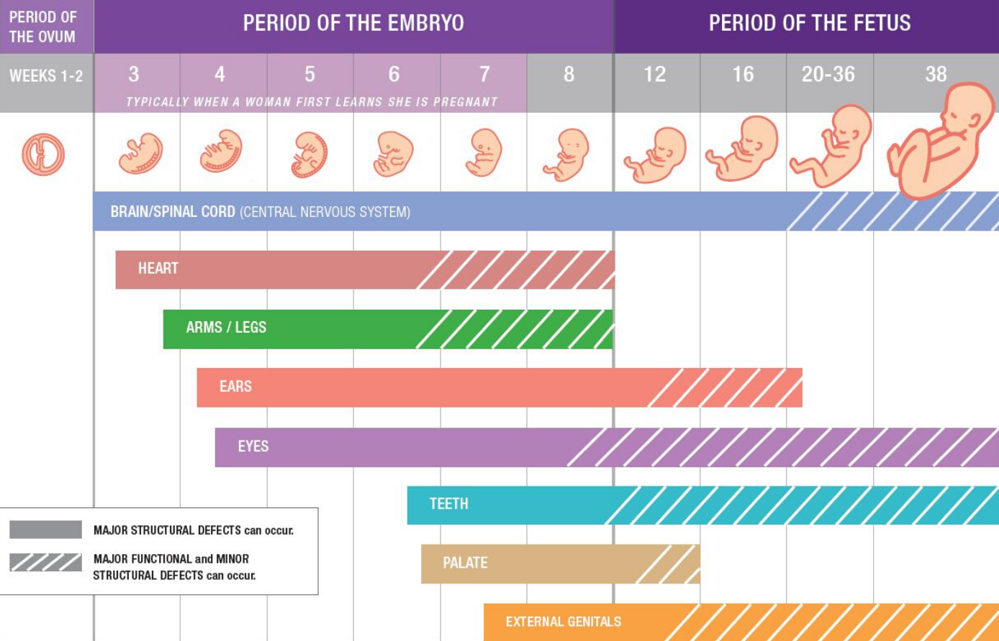
Critical periods of development
Source Mothertobaby.com: Adapted from Moore 1993, and the National Organization of Fetal Alcohol Syndrome (NOFAS) 2009.

Slide 14
Risks of prescribing psychotropic medications during pregnancy and lactation
The potential risks of untreated mental health for both the mother and infant need to be balanced against the risks and benefits of medication
No decision is without a risk
Individualized approach

Slide 15
How to choose the medication?
SSRIs and SNRIs are the main groups of medications used in the treatment of perinatal depression and anxiety
If the patient has never been on the medication, the medication with a short half-life, and low concentration in the breastmilk such as sertraline should be recommended
If the patient has a history of previous medication trials, it is recommended to use medications that were helpful in the past and resulted in remission of symptoms

Slide 16
How to start and monitor treatment?
Start low and discuss with the patient the most common side effects such as gastrointestinal distress, headache, and possible activation
Discuss with a patient that it usually takes 4-6 weeks for the medication to give the full effect
Use screening tools at each visit to help you monitor the response
Increase the dose based on clinical presentation, the goal of the treatment is complete remission of symptoms
Given pharmacokinetic changes in pregnancy, patients in the third trimester might need an increase in the dose of medication

Slide 17
The most commonly used medications in the treatment of perinatal depression and anxiety
Medication | Indication | Starting dose | Usual dosage range
Fluoxetine | MDD, GAD | 10 mg | 10 – 80 mg daily
Sertraline | MDD, GAD | 25 mg | 50 – 200 mg daily
Escitalopram | MDD, GAD | 5 mg | 5-20 mg daily
Citalopram | MDD, GAD | 10 mg | 10-40 mg daily
Paroxetine | MDD, GAD | 10 mg | 10 – 50 mg daily
Venlafaxine | MDD, GAD | 37.5 mg | 75-225 mg daily
Bupropion XL | MDD w/o anxious distress Nicotine dependence | 150 mg | 150 – 450 mg daily
Mirtazapine | MDD with nausea | 7.5 mg | 15 -45 mg nightly

Slide 18
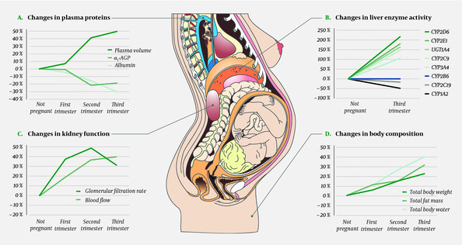
Key physiological changes during pregnancy
Westin AA et al., 2018.
Notes:
Figure 1 Some key physiological changes in pregnant women that affect the absorption, distribution, metabolism and excretion of drugs. Panel A shows how pregnancy leads to increased plasma volume and a similar fall in the concentration of drug-binding plasma proteins. Panel B shows activity changes for important drug-metabolising enzymes. Cardiac output increases during pregnancy, which in turn leads to increased renal (panel C), hepatic and pulmonary blood flow. Panel C also shows the changes in glomerular filtration rate. Panel D shows pregnancy-dependent changes in body composition that may affect the volume of distribution for drugs. Data adjusted from references (2, 6, 7, 8). α1-AGP = α1-acid glycoprotein (orosomucoid), CYP = cytochrome P-450, UGT = uridine diphosphate glucuronosyltransferase. Illustration: p6 m5/stock.adobe.com.

Slide 19
Risks of preterm birth with antenatal serotonergic antidepressant use
  Per CDC, the US preterm birth rate is 10.4%
Prenatal antidepressant use was associated with an increased risk of moderate-to-late preterm birth (Rommel at al., 2022):
    Gestational age: A 2.3 day decrease in gestational age
    Birthweight: A 51 g decrease in birthweight
    Other outcomes: A higher risk of moderately low birthweight, postnatal adaptation syndrome, and neonatal admission
    No differences were found for persistent pulmonary hypertension or birth defects
.

Slide 20
Risks of birth defects with antenatal serotonergic antidepressant use
  Some studies (DeVries et al, 2021) raised concerns related to a small increased risk of cardiac malformations with OR of 1.28 (CI: 1.17-1.41) for any antidepressant, with OR for SNRI being 1.69 and for SSRIs 1.25.
  A large, population-based cohort study of 949,504 pregnant women suggested no substantial increase in the risk of cardiac malformations attributable to antidepressant use during the first trimester (Huybrecht et al., 2014)
.

Slide 21
Risks of persistent pulmonary hypertension with antenatal serotonergic antidepressant use
  FDA issued a public health advisory in 2006
  Huybrecht et al., 2015: a potential increased risk of PPHN associated with maternal use of SSRIs in late pregnancy. However, the absolute risk was small, and the risk increase appears more modest than suggested in previous studies.
  Infants exposed to SSRIs in late pregnancy compared with early pregnancy had a higher risk of persistent pulmonary hypertension (number needed to harm: 285) (Norby er al., 2016)
.

Slide 22
Risks of postnatal adaptation syndrome with antenatal serotonergic antidepressant use
Neonatal adaptation syndrome encompasses a wide range of different clinical presentations: infant irritability, abnormal crying, tremor, lethargy, hypoactivity, decreased feeding, tachypnea, respiratory distress, irritability, tachypnea, hypothermia, and hypoglycemia
No evidence supporting tapering of antidepressants in 3rd trimester (Byatt et al, 2014)
Cornet et al. 2024: Delayed neonatal adaptation occurred in 11.2% of exposed vs 4.4% of unexposed infants RR 2.52 (CI 2.36 to 2.70).
After multivariable adjustment, there was an association between SSRI exposure and delayed neonatal adaptation OR 2.14 (CI 1.96 to 2.32).
This association was dose-dependent:
  Escitalopram and fluoxetine were associated with the highest risk of delayed neonatal adaptation
.

Slide 23
Risks to long-term child neurodevelopment with antenatal serotonergic antidepressant use
Concern raised based on animal studies and previous studies.
Antidepressant exposure compared with no exposure was not associated with an increased risk of autism spectrum disorder or ADHD (Brown et al., 2017; Malm H et al, 2016; Rommel AS et al, 2020; Vega ML et al, 2020)
Women with depression during pregnancy have an increased risk of having a child with ASD, regardless of antidepressant use (Wilcox Hagberg et al, 2018).
.

Slide 24
Treatment of postpartum depression
Brexanolone
FDA approved for the treatment of postpartum depression (F53.0) in 2019
Schedule IV drug
An intravenous formulation allopregnanolone
Administered as a continuous intravenous infusion over 60 hours, titrated from 30 mcg/kg/hr up to 90 mcg/kg/hr and back down to 30 mcg/kg/hr
Patients must be monitored for hypoxia using continuous pulse oximetry equipped with an alarm
Only available through Risk Evaluation and Mitigation Strategy (REMS) due to risk of loss of consciousness and excessive sedation reported during clinical trials
Adverse effects: sedation, dizziness, dry mouth, flushing
Boxed warning for excessive sedation and loss of consciousness

Slide 25
Treatment of postpartum depression
Zuranolone
A synthetic modification of allopregnanolone that can be administered orally
FDA approved for treatment of PPD in 2023
Schedule IV drug
Capsules; dosage 20 mg, 25 mg and 30 mg
Administered at bedtime 50 mg with fat-containing food
If sedating, consider reducing to 40 mg
May be used alone or as an adjunct to oral antidepressant therapy
Boxed warning for impaired ability to drive or engage in other hazardous activities due to CNS depressant effects

Slide 26
The perinatal use of benzodiazepines
Generally, for short-term use, with medications with short half-life being preferred (LactMed)
Lorazepam is often considered the drug of choice in this category of medications due to short half-life and low relative infant dose of 2.5%
Not recommended in patients with a history of substance use disorders
Need to be gradually stopped
Discuss the risks and benefits of its use with the patient
Notes:
Importance Understanding the safety profile of medications used in pregnancy is crucial for clinical decision-making. Few studies exist on the associations of exposure to benzodiazepines and benzodiazepine-like hypnotic drugs (z-hypnotics) in pregnancy with pregnancy outcomes.
Objective To determine whether exposure to benzodiazepines or z-hypnotics in pregnancy is associated with greater risk of negative immediate pregnancy outcomes compared with nonexposure.
Design, Setting, and Participants This questionnaire-based cohort study used data from the Norwegian Mother, Father and Child cohort study (MoBa), which also includes data from the Medical Birth Registry of Norway. Pregnant women were recruited from all over Norway from 1999 and 2008. The first child was born in October 1999 and the last in July 2009. This analysis included women who completed 3 questionnaires, twice during pregnancy and once 6 months after delivery. Data analyses were conducted from September to November 2019.
Exposures Self-reported exposure to benzodiazepines or z-hypnotics during pregnancy, characterized in terms of any exposure, timing (ie, early, middle, or late), and duration of exposure.
Main Outcomes and Measures The main outcomes were gestational age at delivery, risk of preterm delivery, birth weight, birth weight relative to gestational age and sex, risk of being small for gestational age, head circumference, Apgar score less than 7 at 5 minutes, and risk of neonatal respiratory distress. Continuous outcomes are reported using effect estimates as mean differences, and binary outcomes are reported using risk ratios.
Results The MoBa study included 114 234 mother-child dyads. This analysis of MoBa data includes 82 038 singleton pregnancies among 69 434 unique women. Mean (SD) maternal age was 30.2 (4.5) years, and 37 641 pregnancies (45.9%) were in primiparous women. Exposure to benzodiazepines or z-hypnotics was reported in 679 pregnancies (0.8%). After adjusting for all measured baseline and postbaseline confounders, benzodiazepine or z-hypnotic use during pregnancy was associated with lower birth weight (mean difference, −79.3 [95% CI, −126.7 to −31.9] g), lower gestational age at birth (mean difference, −2.1 [95% CI, −3.3 to −0.9] days), and higher risk of preterm birth (risk ratio, 1.41 [95% CI, 1.03 to 1.94]). We found no significant association of exposure to benzodiazepines or z-hypnotics with the child’s birth weight relative to gestational age and sex (z score), or any of the other immediate birth outcomes.
Conclusions and Relevance These findings suggest that the magnitude of the association of exposure to benzodiazepines or z-hypnotics with gestational age is not necessarily clinically significant. The absence of an association of exposure to benzodiazepines or z-hypnotics with z score for birth weight relative to gestational age and sex suggests that association of exposure to benzodiazepines or z-hypnotics with birth weight could be explained by earlier delivery rather than impaired intrauterine growth.

Slide 27
The perinatal use of benzodiazepines
Prenatal use not associated with increased risk of congenital malformation or cardiac malformation
Antenatal SSRI and benzo use in combination was associated with an increased risk of congenital malformation
Frequent and daily dosing in late pregnancy associated with risk of neonatal intoxication or neonatal withdrawal syndrome
Increased risk of small head circumference and Neonatal ICU care
Data for breastfeeding with short-acting BZD is reassuring
Data on longer-term neurodevelopmental outcomes is relatively reassuring
Iqbal 2002 , Oberlander Et al 2008, Grigoriadis et al 2019 Grigoriadis 2020, Kelly 2012, Lupatelli 2019
Notes:
Importance Understanding the safety profile of medications used in pregnancy is crucial for clinical decision-making. Few studies exist on the associations of exposure to benzodiazepines and benzodiazepine-like hypnotic drugs (z-hypnotics) in pregnancy with pregnancy outcomes.
Objective To determine whether exposure to benzodiazepines or z-hypnotics in pregnancy is associated with greater risk of negative immediate pregnancy outcomes compared with nonexposure.
Design, Setting, and Participants This questionnaire-based cohort study used data from the Norwegian Mother, Father and Child cohort study (MoBa), which also includes data from the Medical Birth Registry of Norway. Pregnant women were recruited from all over Norway from 1999 and 2008. The first child was born in October 1999 and the last in July 2009. This analysis included women who completed 3 questionnaires, twice during pregnancy and once 6 months after delivery. Data analyses were conducted from September to November 2019.
Exposures Self-reported exposure to benzodiazepines or z-hypnotics during pregnancy, characterized in terms of any exposure, timing (ie, early, middle, or late), and duration of exposure.
Main Outcomes and Measures The main outcomes were gestational age at delivery, risk of preterm delivery, birth weight, birth weight relative to gestational age and sex, risk of being small for gestational age, head circumference, Apgar score less than 7 at 5 minutes, and risk of neonatal respiratory distress. Continuous outcomes are reported using effect estimates as mean differences, and binary outcomes are reported using risk ratios.
Results The MoBa study included 114 234 mother-child dyads. This analysis of MoBa data includes 82 038 singleton pregnancies among 69 434 unique women. Mean (SD) maternal age was 30.2 (4.5) years, and 37 641 pregnancies (45.9%) were in primiparous women. Exposure to benzodiazepines or z-hypnotics was reported in 679 pregnancies (0.8%). After adjusting for all measured baseline and postbaseline confounders, benzodiazepine or z-hypnotic use during pregnancy was associated with lower birth weight (mean difference, −79.3 [95% CI, −126.7 to −31.9] g), lower gestational age at birth (mean difference, −2.1 [95% CI, −3.3 to −0.9] days), and higher risk of preterm birth (risk ratio, 1.41 [95% CI, 1.03 to 1.94]). We found no significant association of exposure to benzodiazepines or z-hypnotics with the child’s birth weight relative to gestational age and sex (z score), or any of the other immediate birth outcomes.
Conclusions and Relevance These findings suggest that the magnitude of the association of exposure to benzodiazepines or z-hypnotics with gestational age is not necessarily clinically significant. The absence of an association of exposure to benzodiazepines or z-hypnotics with z score for birth weight relative to gestational age and sex suggests that association of exposure to benzodiazepines or z-hypnotics with birth weight could be explained by earlier delivery rather than impaired intrauterine growth.

Slide 28
Use of antidepressants during lactation
All psychotropic medications readily pass into breast milk and the amount of medication secreted into breast milk is usually significantly lower than the amount of medication that passes through the placenta during pregnancy
If an infant was exposed in utero to psychiatric medication, it is reasonable to continue with the same medication while breastfeeding
Exceptions:
  The mother’s psychiatric illness has relapsed and the current medication regimen is not working
  The infant appears to be having side effects or medical complications related to the medication exposure during breastfeeding
Payne, 2019.

Slide 29
LactMed
The National Library of Medicine at the NIH maintains the Drugs and Lactation Database (LactMed) found at: https://www.ncbi.nlm.nih.gov/books/NBK501922/
Database maintained by a peer review panel that reviews scientific data to assure validity and currency.
It includes information on levels of drugs in breastmilk and infant blood and the possible adverse effects in the nursing infant.

Slide 30
Relative infant dose (RID)
A valuable tool and practical guide to indicate the extent of drug exposure to the infant while breastfeeding
The RID calculates the weight-adjusted dose in the infant relative to the weight-adjusted dose in the mother

Slide 31
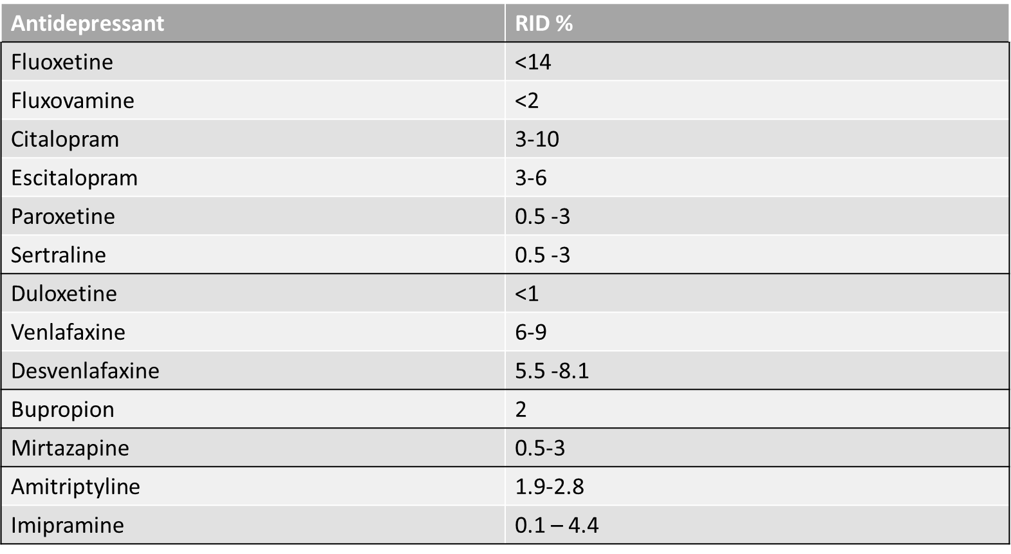
RID of commonly used antidepressants
RID: <1% for zuranolone, 1-2% for brexanolone (see LactMed)
Adapted from Chad et al., 2013

Slide 32
General recommendations
Encourage patient to have psychiatric care during and after pregnancy
Ideally, all medication changes should be done before pregnancy and the patient should be psychiatrically stable
Consider breastfeeding when discussing possible medications during pregnancy

Slide 33
General recommendations
Frequently the best option is a medication that the patient found helpful in the past, due to known efficacy and tolerability
When possible, monotherapy in adequate dose is preferred over polypharmacy
The goal of treatment is full symptom remission, and medications should be adjusted to the lowest efficacious and fully therapeutic dose

Slide 34

Postpartum Resource Center of New York
A state-wide non-profit organization providing since 1998 free emotional support, educational information, and healthcare and support group resources.
Moms on Call and Family Telephone Support
State-wide Perinatal Mood and Anxiety Disorders Resource Directory www.postpartumny.org/resourcedirectory
Postpartum Resource Center of New York’s Training Institute
NYS Lead Coordinator for PSI postpartum.net
Notes:
Patient-facing resource

Slide 35
Patient-facing resources: National Maternal Mental Health Hotline
•National MMH Hotline is an HRSA service –PSI is a Contractor
•Funding passed by Congress in December 2021
•Launched Spring 2022
•24 hours a day, 7 days a week, 365 days a year
•Staffed by licensed mental health clinicians, healthcare, certified peer specialists and childbirth professionals
•Counselors speak English and Spanish and interpreter services available for 60 languages
•Collaborates with Suicide Prevention Lifeline, Domestic Violence Hotline and National Disaster Distress Hotline
• >12,000 calls and texts in its first year
"Counselors shall provide immediate psychosocial support, evidence-based information, brief intervention, resources and referrals via telephone and text to pregnant or postpartum persons experiencing symptoms of perinatal mental health conditions and their support persons/loved ones“
https://mchb.hrsa.gov/national-maternal-mental-health-hotline
CALL or TEXT: 1-833-TLC-MAMA (1-833-852-6262)

Slide 36

Patient-facing resources:
Suicide and Crisis Lifeline 988
CALL or TEXT 988
For Spanish: 1-888-628-9454
free, confidential, available for everyone, 24/7 across the US
23,044,100 calls during 2005-2021
Funded by SAMHSA

Slide 37
Online resources for providers
Mother to Baby: mothertobaby.org
  a service of the non-profit Organization of Teratology Information Specialists (OTIS)
  a suggested resource by many agencies including the Centers for Disease Control and Prevention (CDC) and the Food and Drug Administration’s Office of Women’s Health.
  LactMed: contains information on drugs and other chemicals to which
  breastfeeding mothers may be exposed. It includes information on the
  levels of such substances in breast milk and infant blood, and the possible
  adverse effects in the nursing infant.

Slide 38
Local Resources
SUNY Upstate Dept of Psychiatry – WMH division 315 464 3225
SUNY Upstate Dept of Psychiatry – Reproductive Psychopharmacology clinic 315 464 3445
The Hutchings PC Madison Street Clinic – Healthy Moms, Healthy Babies 315 426 7783
Crouse Perinatal Family Support Program – 315 470 7940
Helio Health 315 471 1564
Psychological Healthcare 315 670 4177

Slide 39
Thank you

