Slide 1
Suicide Risk Assessment and Management in Obstetric and Family Medicine Practices
Joshna Singh, M.D
Assistant Professor of Clinical Psychiatry,
Jacobs School of Medicine and Biomedical Sciences, University at Buffalo

Slide 2
Disclosures
“Neither I nor my spouse/partner has a relevant financial relationship with a commercial interest to disclose.”

Slide 3
Risk
Perinatal suicide rates ≈1.6 to 4.5 per 100,000 live births (5.3 -
5.5 in non perinatal women)
Completed suicide account for 20% of post partum deaths
Prevalence of suicidal ideation ≈ 16.4% from early pregnancy to 6 weeks postpartum(12.1 percent in pregnancy, 7.8 % postpartum)
Rates of attempted or completed suicide are lower in periparatum
Subgroups at elevated risk: severe psychiatric illness, young age
More likely to use more lethal or violent means
Maternal suicide often occur in later in post partum period(6 months)
Ref: Chin et al 2022, Lindhal et al 2005,Grigoriadias et al 2017,Thortonet al 2013, Xiao et al 2023
Notes:
1Suicide and Maternal Mortality https://www.ncbi.nlm.nih.gov/pmc/articles/PMC8976222/#CR22
2. Prevalence of suicidality during pregnancy and the postpartum https://pubmed.ncbi.nlm.nih.gov/15883651/
3. 2. Perinatal suicide in Ontario, Canada: a 15-year population-based study https://pubmed.ncbi.nlm.nih.gov/28847780/ giorgis 2017
Thorton 2013 Maternal deaths in NSW (2000-2006) from nonmedical causes (suicide and trauma) in the first year following birth
4. Trajectories of perinatal suicidal ideation from early pregnancy to six weeks postpartum and their influencing factors: A prospective longitudinal study - PubMed (nih.gov)
Perinatal suicide rates in the USA are estimated at 1.6 to 4.5 per 100,000 live births as compared to 5.3 to 5.5 5 in non perinatal wormen
Suicidal ideation or thoughts of self harm range from 5-14% 2
Completed suicide account for 20% of post partum deaths 2
Althiugh rates of attempted or completed syuide are lower in periparatum then other times certai subgroups of women are at elevated risk esp with sever psychiatric illness
More likely to use more lethal or violent means then non peripartum women suhgesting higer intent ans higher riks of completed suidiee 3
Maternal suicide often occur in later in post parum period more frequwnty in six months post partum 3
Prevalence of suicidal ideation was 16.4% from early preganancy to six weeks postpartum , 12.1 percent in preganancy ans 7.8 % postpartum :4

Slide 4
Suicide and Psychiatric Illness
Suicide risk ≈ 300 times higher with postpartum psychiatric illness
Suicidal behavior incident rate 5.62 /1000 person /year in PND
Suicidal behavior risk is 3 times higher in women with PND
Risk remains doubled 5 or more years later
No data for risk of suicide in bipolar d/o and postpartum psychosis
Most women who die by suicide have affective or anxiety d/o
Less likely in any pharmacological or non pharmacological treatment
ref: Hang Yu et al 2024,Johannsen et al 2016,khalief 2016
Notes:
1,2 ,3 reference https://jamanetwork.com/journals/jamanetworkopen/fullarticle/2813745
4. All-Cause Mortality in Women With Severe Postpartum Psychiatric Disorders - PubMed (nih.gov)
. Perinatal suicide in Ontario, Canada: a 15-year population-based study https://pubmed.ncbi.nlm.nih.gov/28847780/ giorgis 2017
Suicide behavior is suicide attempt or completed suicide
Half of women who died by suicide in perinatal period were diagnosed with depression , as compared with non –peripartum women were less liklet to be receiving aharamcologicla or non phramcological care Suicide in perinatal and non-perinatal women in contact with psychiatric services: 15 year findings from a UK national inquiry - PubMed (nih.gov)

Slide 5
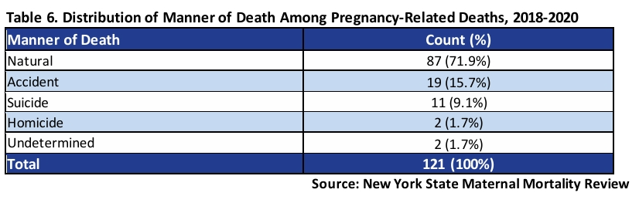
NYS Maternal Mortality Review 2018-2020

Slide 6
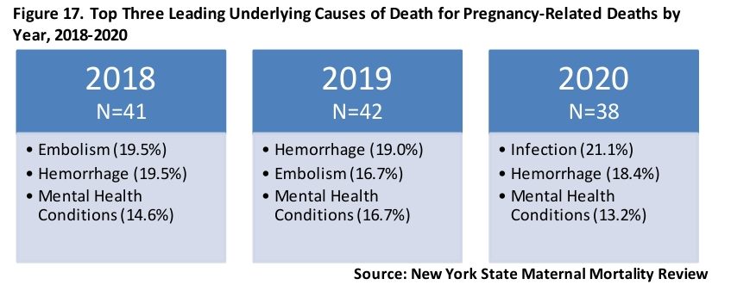
NYS Maternal Mortality Review 2018-2020

Slide 7
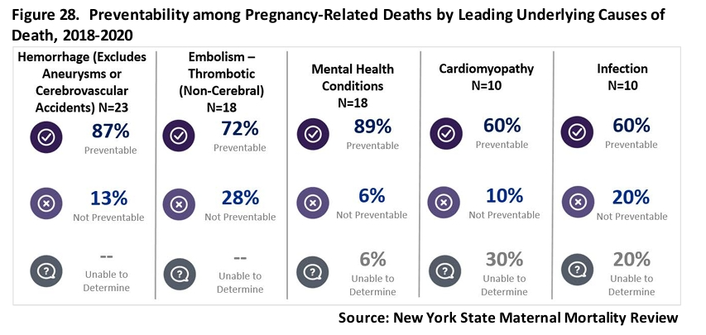
NYS Maternal Mortality Review 2018-2020

Slide 8
Risk Factors
Individual | Pregnancy related | Socioeconomic
H/O of self harm or prior suicide attempts | Obstetrical or neonatal complications | Younger age
Prior or current psychiatric illness/substance use | Unwanted unintended pregnancy | Intimate partner violence
H/O of trauma | Avoidance of health services from fear of losing custody | Lack of social support,
F/H of psychiatric illness, suicide ideations, suicide attempt |  | Social, racial gender discrimination, inequalities
Notes:
Metz et al¹⁸ and Khalifeh et al.²
Reference
T.D. Metz, P. Rovner, M.C. Hoffman, A.A. Allshouse, K.M. Beckwith, I.A. Binswanger
Maternal deaths from suicide and overdose in Colorado, 2004–2012
Obstet Gynecol, 128 (2016), pp. 1233-1240
H. Khalifeh, I.M. Hunt, L. Appleby, L.M. Howard
Suicide in perinatal and non-perinatal women in contact with psychiatric services: 15 year findings from a UK national inquiry
Lancet Psychiatry, 3 (2016), pp. 233-242
Mangla K, Hoffman MC, Trumpff C, O'Grady S, Monk C. Maternal self-harm deaths: an unrecognized and preventable outcome. Am J Obstet Gynecol. 2019 Oct;221(4):295-303. doi: 10.1016/j.ajog.2019.02.056. Epub 2019 Mar 5. PMID: 30849358.
Orsolini L, Valchera A, Vecchiotti R, Tomasetti C, Iasevoli F, Fornaro M, De Berardis D, Perna G, Pompili M, Bellantuono C. Suicide during Perinatal Period: Epidemiology, Risk Factors, and Clinical Correlates. Front Psychiatry. 2016 Aug 12;7:138. doi: 10.3389/fpsyt.2016.00138. PMID: 27570512; PMCID: PMC4981602.

Slide 9
Don’t Ask, Don’t Tell, Don't Know
Heighten suicidality
Make patient uncomfortable
Practitioner’s confidence/ comfort
Bias
Inadequate expertise/ training
Insufficient time
More likely to enquire if patient was depressed

Slide 10
Differential Diagnosis
Post Partum Psychosis
Ego-dystonic intrusive thoughts
Non suicidal self in jury
Passive suicidal ideation
Notes:
Widely used health system in the peripartum period
Trust, long-term relationships - FPs

Slide 11
Suicide Risk Assessment
There are a lot of tools available to help guide the conversation
Both the PHQ-9 and the EPDS include questions which can identify the presence of suicidal ideations, but need follow up
P4 screener
Ask Suicide Screening Questions (ASQ)
Columbia Suicide Severity Rating Scale (CSSRS)
Notes:
They are just screening tools and riks is subkective report from patient. What is biggestfear for a patuent in apsychiatrist office , invlunartry inpatient admission

Slide 12
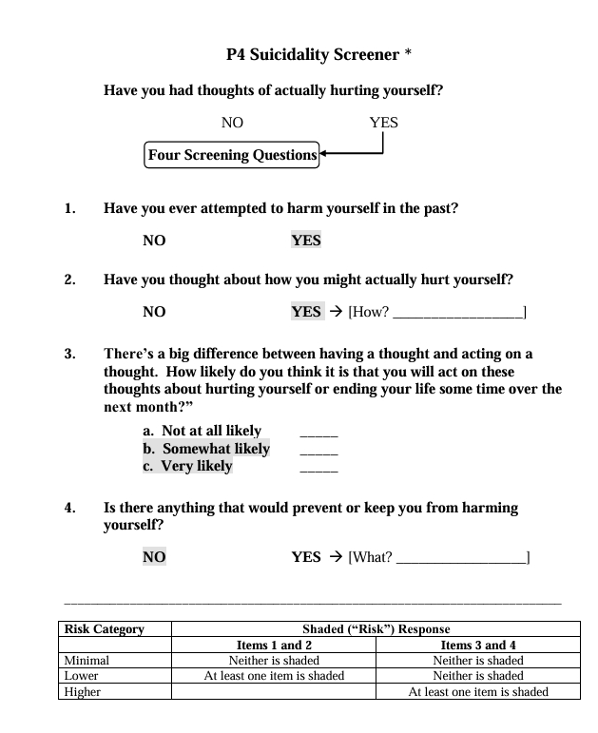
P4 Suicidality Screener
Notes:
P4 (aka Suicidal Ideation Screening Questionnaire) (Cooper-Patrick et al, 1994)
Elicits the 4 “P”s
Past suicidal ideation
Suicide plan
Probability of suicidal action
Preventative factors
Based on responses, provides a basic risk level of minimal, lower, or higher

Slide 13
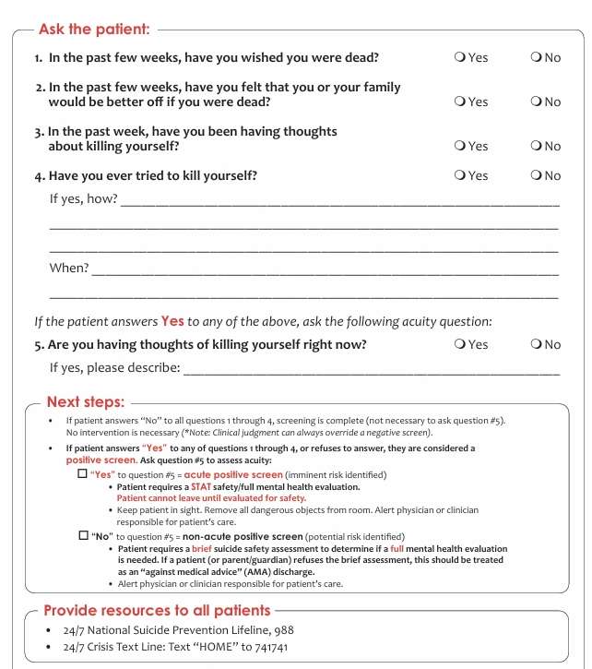
ASQ Screening Tool

Slide 14
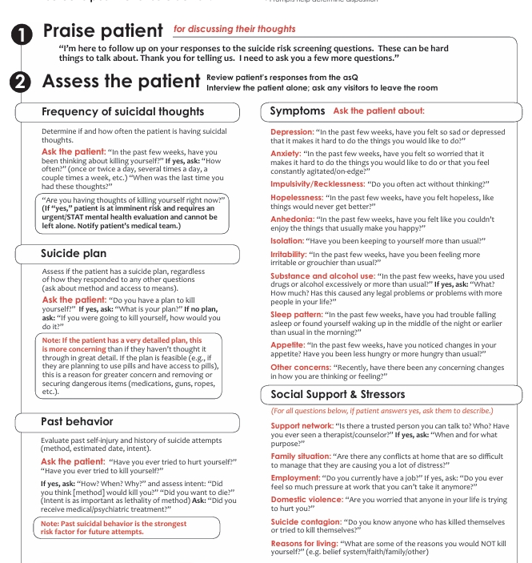
ASQ Brief Suicide Assessment

Slide 15
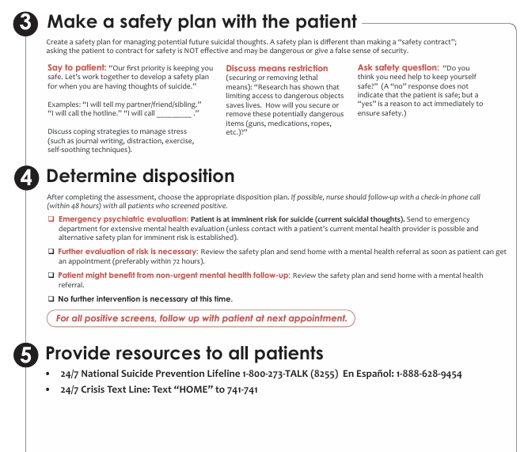
ASQ Brief Suicide Assessment

Slide 16
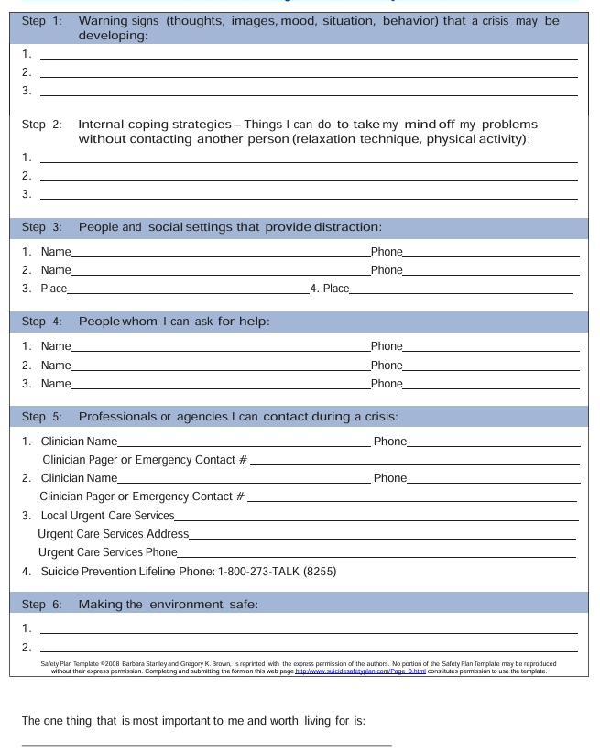
Patient Safety Plan Template

Slide 17
Safety Planning: Suicide Risk is Dynamic
Steps to limit access to lethal means
List of concrete warning signs of a developing crisis
Available coping strategies the patient can utilize
Social supports patient can reach out to
Professional contact information's for use during crisis
Notes:
Also education of how to recognize that using using coping coping skills / or

Slide 18
Protective Factors
Social Support; Belongingness | Strong Therapeutic Relationship with a Trusted Provider
Life Satisfaction | Problem-Solving Skills, Cognitive Flexibility
Sense of responsibility to family | Reality Testing Ability
Coping Skills | Religious Faith

Slide 19
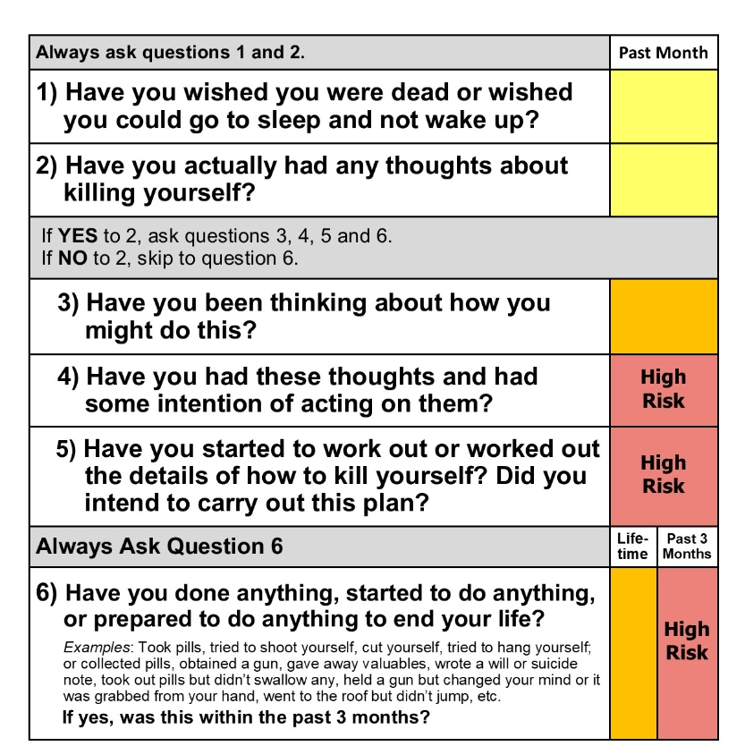
Columbia Suicide Severity Rating Scale
Notes:
Columbia Suicide Severity Rating Scale
The CSSRS is an evidence based tool widely used in research as well as clinical settings
Assesses risk and protective factors, presence of suicidal ideations, the nature of the suicidal ideations, and any suicidal behaviors
The CSSRS is a clinician administered instrument and more detailed than other commonly used assessment tools
Provider training is recommended prior to use

Slide 20
Suicide Risk Assessment
Remember that asking about SI does not increase the risk of suicide attempts or “give people ideas”
Normalize the process: the more uncomfortable you appear, the less forthcoming your patient is likely to be
Don’t assume a negative response and don’t use vague language/euphemisms
Follow up and be thorough – adequate risk assessment (and management) requires details
Notes:
J

Slide 21
What We Would Like To Know
Current suicidal thoughts(nature, timing, intent)
Current suicidal plan (access to means, details, preparation )
Current treatment (accessibility to treatment, current
Previous attempt (timing, intent, method, consequences)
Current substance abuse
Current psychiatric diagnosis and severity of symptoms
Current medications
Ongoing substance use
Current stressors and social supports
Impulsivity
Protective factors
Collateral information
Notes:
Details important for risk assessment include:
Past attempts – perhaps the strongest predictor of future attempts
Means – both access to means, and the lethality of the means
Preparation – has the patient taken steps to enact a plan, or to wrap up “loose ends” in their life (e.g. giving away belongings)
Timing – is the SI fleeting or ruminative?
Impulsivity – historically impulsive patients are at higher risk
Substance use – an independent risk factor for suicide (especially alcohol)
Current stressors and psychosocial environment
Protective factors –why hasn’t the patient acted on SI so far?
Current

Slide 22
Management
  Imminent Risk: Seek a higher level of care
  This is appropriate whenever a patent is felt to represent an imminent risk of harm, or is unable/unwilling to engage in safety planning
  Mild to Moderate Risk
  Monitor and re-assess
  Safety Plan
  Treatment of underlying psychiatric illness
  Linkage to therapy
  Optimize social supports
Notes:
J

Slide 23
Suicide Risk Resources
988 Suicide and Crisis Lifeline
https://projectteachny.org/maternal-rating-scales/
Home - Suicide Prévention Center NY (preventsuicideny.org)
Alliance of Hope For Suicide Loss Survivors | Home

