Slide 1
Epidemiology, Screening and Assessment of Perinatal Mood and Anxiety Disorders (PMADs)
Yardana Kaufman, MD
Project TEACH NY Faculty, Reproductive Psychiatry
Reproductive Psychiatrist, Perinatal Psychiatry Center, Zucker Hillside Hospital, Northwell Health
Assistant Professor of Psychiatry, Zucker School of Medicine at Hofstra/Northwell
ykaufman@northwell.edu
Notes:
Epidemiology, screening and assessment of perinatal mood and anxiety disorders (PMADs)

Slide 2
Objectives:
Describe the epidemiology, risk factors, and complications of PMADs.
Use structured tools to aid in screening and diagnosing patients with PMADs.
Notes:
E

Slide 3
Disclosures
“Neither I nor my spouse has a relevant financial relationship with a commercial interest to disclose.”

Slide 4
Defining PMADs
PMADs are a leading complication associated with childbirth
Perinatal
  Present during conception to first year after giving birth
Mood
  major depressive disorder, bipolar disorder, psychotic symptoms secondary to mood disorder, postpartum psychosis
Anxiety
  generalized anxiety disorder (GAD), panic disorder, obsessive compulsive disorder (OCD), post-traumatic stress disorder (PTSD)
Disorders
  impairment of daily functioning
Notes:
Can include any psychiatric disorders that are present before conception

Slide 5
Learning & understanding the stats
Estimated PMAD prevalence is about 20-25% (Vesga-lopez et al 2008)
PMAD rates have increased (Mckee et all 2020)
Up to 23% of PMADs start during pregnancy (Viguera et al 2011)
PMADs are both underdiagnosed and undertreated (Cox et al 2016)
  Up to 70% of birthing individuals with PMADs go undetected
  Up to 85% of birthing individuals with PMADs go untreated
Notes:
PMADs are the most common complication of pregnancy, affecting 1 in 4-5 childbearing women. These rates get higher when looking at certain minoritized populations, for example it is estimated that rates of PMADs for black women is closer to 1 in 2 with similar rate seen for Hispanic immigrant women.
Of note, not only are risk for PMADs higher in these minoritized group, there is significant evidence that these populations are diagnosed and treated at much lower rates as well, affecting outcomes of PMADs
Higher rates seen during COVID-19 Pandemic
High rates seen for marginalized populations including black birthing parents and immigrant Hispanic populations
PMAD rates have increased in last decade
PMADs under detected – has lead to changes in ACOGs recommendations around screening
PMADs go untreated or undertreated – lack of identification, patient concerns, poor access to healthcare, provider discomfort
Though a significant portion of PMADs start during or even before pregnancy – the postpartum period continues to be a time of elevated symptom onset/exacerbation – likely multifactorial as it relates to rapid hormonal shifts and sudden change in responsibilities and self identity
Will not discuss significantly here but also want to note that substance use disorders is a common co-occurring illness that we see along PMADs.
Arnaudo et al 2017:
- up to 44% of pregnant women with opioud use disorder have a psychiatric co-morbidity
Acog
- Opioid use in pregnancy has been increasing in recent years
------
Perinatal mood and anxiety disorders, serious mental illness, and delivery related health outcomes, United Sttaes 2006 – 20015. Mckee et all 2020 (https://link.springer.com/article/10.1186/s12905-020-00996-6)
- included estimated 39,025,974 delivery hospitlizations from 2006 to 2015
- PMAD increased from 18.4 to 40.4 per 1000 deliveries during this time
Psychiatric disorders in pregnant and postpartum women in the united states
https://cdn.jamanetwork.com/ama/content_public/journal/psych/11865/yoa80012t2.png?Expires=1698762259&Signature=g9KxR~3knsRElZVDkqqVVnqpuQrvVo3MleoqMrlQLus8lStxkeym~mCOf9WG81OQoVmKpbfRtnsTBhvi5TP1KAP-i82d42Ue1Dcfra7SDbEDibxwyJx1VbN19el31VOaCaKbtKARu0zDFE2PzoVU6RShXi9HUAqARF0ieLVTfJeaimflHKrh~59E9Gr0HLZ84aoEu4us5MGNUS3epoQ2GFJV9cxbhKaN84skcPVJ3HbMrxigkRpTQMx3BJohzNiN5tNe88H2glLS4NlEB3z71J8B6mWPrRL2DRTFBMUS7JCnCxgUc101NoVLLWR470EOF5k6SVUyMeVQ8b0VBQyhDQ__&Key-Pair-Id=APKAIE5G5CRDK6RD3PGA
Perinatal Depression Treatment Cascade: Baby steps toward improving outcomes
https://www.psychiatrist.com/jcp/delivery/the-perinatal-depression-treatment-cascade/
Mental Health in Obstrectic Patients and Providers during Covid-19 Pandemic
https://www.ncbi.nlm.nih.gov/pmc/articles/PMC8767924/
- quarantine restrictions, high rates of unemployment, economic decline
Episodes of Mood Disorders in 2,252 pregnancies and postpartum periods (Viguera et al 2011)

Slide 6
(Risk) factors correlated with perinatal psychiatric disorders
Lifetime personal or family history of psychiatric disorder
History of PMAD
History of PMDD (premenstrual dysphoric disorder)
Discontinuation of psychotropic medication proximate to conception
Lower educational level attainment
Inadequate social support; marital/partner dissatisfaction
<12 weeks of parental leave
High life stress
Current or past abuse/trauma including domestic violence and traumatic birth experience
Perinatal smoking, EtOH or other substance use
Unplanned or undesired pregnancy
Co-morbid sleep disorders
Co-morbid medical conditions/high-risk pregnancy
Infant/fetus with significant medical comorbidities or stay in NICU
Biologic
Psychological
Social/
Environmental
Yang, K et al, 2022; Furtado M et al 2018; Hutchens & Kearney 2020
Notes:
Women with a history of PPD are 27 to 46 times more likely to experience PPD during subsequent pregnancies⁻⁻Rasmussen MLH et al. PLoS Medicine. 2017
<12 weeks of parental leave is associated with higher rates of PPD

Slide 7
PMADs associated with adverse health behaviors & outcomes for the entire family system
Birthing Individual
Child
Family
Notes:
Why does this matter?
Untreated perinatal mental illness can have broad implications for the entire family system from the birthing individual (with impact on social/occupational and functioning impact) to the child with affects on social emotional learning as well as impacts on other members of the family or support system including other children and parents
CDC 2018 data US rate of preterm birth (<37 weeks gestation) = 10%

Slide 8
Birthing Individual
Maternal/Birthing individual associated adverse health outcomes/behaviors with PMADs
Psychosocial associations | Suicide Illness suffering Decreased perinatal care Impaired nutritional intake Increase of substance use Impaired work functioning Impaired bonding with infant Adverse effect on family dynamics including relationship with partner Lactation failure or unplanned weaning (Dennis CL et al 2009; Stuebe AM et al, 2014)
Obstetrical associations | Miscarriage preeclampsia/PIH, Preterm labor (Bansil P et al 2010) Increased # of surgical delivery interventions (Wang SY & Chen CH, 2010) Cesarean delivery (Bansil P et al 2010) Maternal gestational weight retention (Herring SJ et al, 2008) Increased # of hospital transfers (Mckee et al 2020)
Bonari et al., 2004; Kimmel MC, et al, 2018
Notes:
This slide should serve as a reminder to screen all birthing individuals but also to make sure to treat to euthymia

Slide 9
Suicidal ideation during the perinatal period
Pregnant women are more likely than the general population to endorse suicidal ideation (Gelaye B et al 2017)
Maternal suicide is the leading cause of direct maternal mortality in the first postpartum year (MBRRACE, 2018)
The prevalence of suicidal ideation was 16.4% from early pregnancy to six weeks postpartum, with 12.1% in pregnancy and 7.8% in postpartum (Xiao M et al 2023)
Suicide accounted for 12.2% of all pregnancy-related deaths in NYS in 2018
New York State Department of Health. New York State Maternal Mortality Review Report on Pregnancy-Associated Deaths in 2018. Albany, NY: New York State Department of Health. 2022
Notes:
Pregnant women are more likely than the general population to endorse suicidal ideation (Gelaye B et al 2017)
Maternal suicide is the leading cause of direct maternal mortality in the first postpartum year (MBRRACE, 2018)
A 2004 review of 17 studies in high- and low-income countries found the prevalence of suicidal ideation among pregnant and postpartum women to range between 5 and 18% with low-income countries presenting higher prevalence rates (Lindahl et al. 2005).
Suicide accounted for 12.2% of all pregnancy-related deaths in NYS in 2018

Slide 10
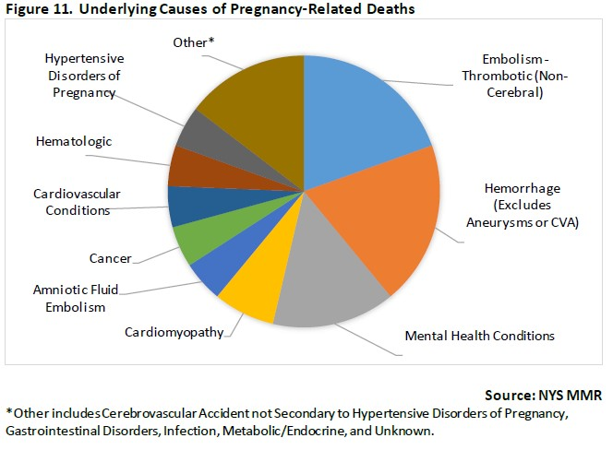
Mental health conditions were the 3rd most common underlying cause of pregnancy-related deaths
Among 41 pregnancy-related deaths in NYS in 2018, the most common underlying causes of death were embolism-thrombotic (non-cerebral) and hemorrhage (excluding aneurysms or CVA), followed by mental health conditions.
8, 20%
8, 20%
6, 15%
Notes:
Pregnancy-related death: A death during pregnancy or within one year of the end of pregnancy from a pregnancy complication, a chain of events initiated by pregnancy, or the aggravation of an unrelated condition by the physiologic effects of pregnancy.
In 2018, there were 117 pregnancy-associated deaths in NYS
41 were pregnancy-related
56 were pregnancy-associated but not related
20 were pregnancy-associated but unable to determine relatedness
Mental health conditions included suicide and substance use related deaths?

Slide 11
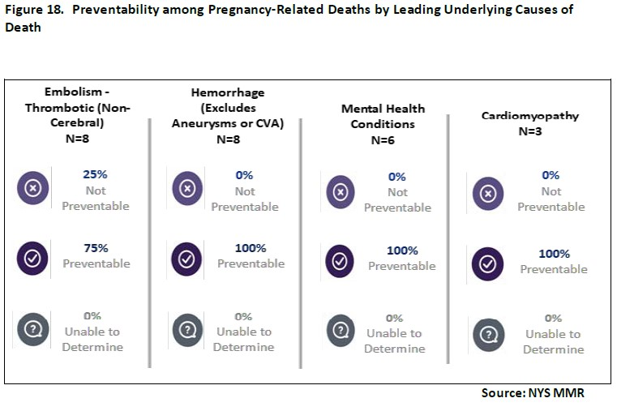
100% of deaths due to mental health conditions were judged preventable
Preventability varied across underlying causes of death.
Among the leading causes of death, 100% of deaths due to hemorrhage, mental health conditions, and cardiomyopathy were judged preventable.
Notes:
Preventable death: a death is considered preventable if the Board determines that there was at least some chance of the death being averted by one or more reasonable changes to patient, family, provider, facility, system and/or community factors.
- screening is an opportunity intervene

Slide 12
Child
Fetal/Child associated adverse health outcomes/behaviors with PMADs
Intrauterine growth restriction Low birth weight Infanticide Decreased fetal reactivity Altered infant brain development (Rifkin-Graboi A., 2013 & 2015 et al; Qiu A. et al, 2013; Scheinost et al, 2016) Postpartum maternal-infant attachment difficulties (Perry DF et al, 2011) Maternal PPD predicts delay in non-verbal communication in 14 mo old infants (Kawai E et al, 2016) Increased risk of hyperactivity and conduct disorder (MacKinnon N et al, 2017) Increased risk for depression by 16 years of age (Murray L, et.al., 2011)
Bonari et al., 2004; Kimmel MC, et al, 2018

Slide 13
Screening in Peripartum:
How often does you or your practice perinatal psychiatric screening?
Never
At the initial pregnancy or postpartum visits only
Several times during the perinatal period
At every visit
Notes:
E

Slide 14
Screening: ACOG 2023 Updated Guidelines
ACOG JUNE 2023 Guideline Summary Recommendations: Screening and Diagnosis of Mental Health Conditions During Pregnancy and Postpartum
Everyone receiving well-women pre-pregnancy, prenatal, and postpartum care be screened for depression and anxiety using standardized instruments. Screening for perinatal depression and anxiety should occur at the initial prenatal visit, later in pregnancy, and at the postpartum visits. Mental health screening should be implemented with systems in place to ensure timely access to assessment and diagnosis, effective treatment, appropriate monitoring, and follow-up based on severity. Screening for bipolar disorder should be performed before initiating pharmacotherapy for anxiety or depression, if not previously done.
Notes:
ACOG = American College of Obstetricians and Gynecologists
PMADs under detected – has lead to changes in ACOGs recommendations around screening

Slide 15
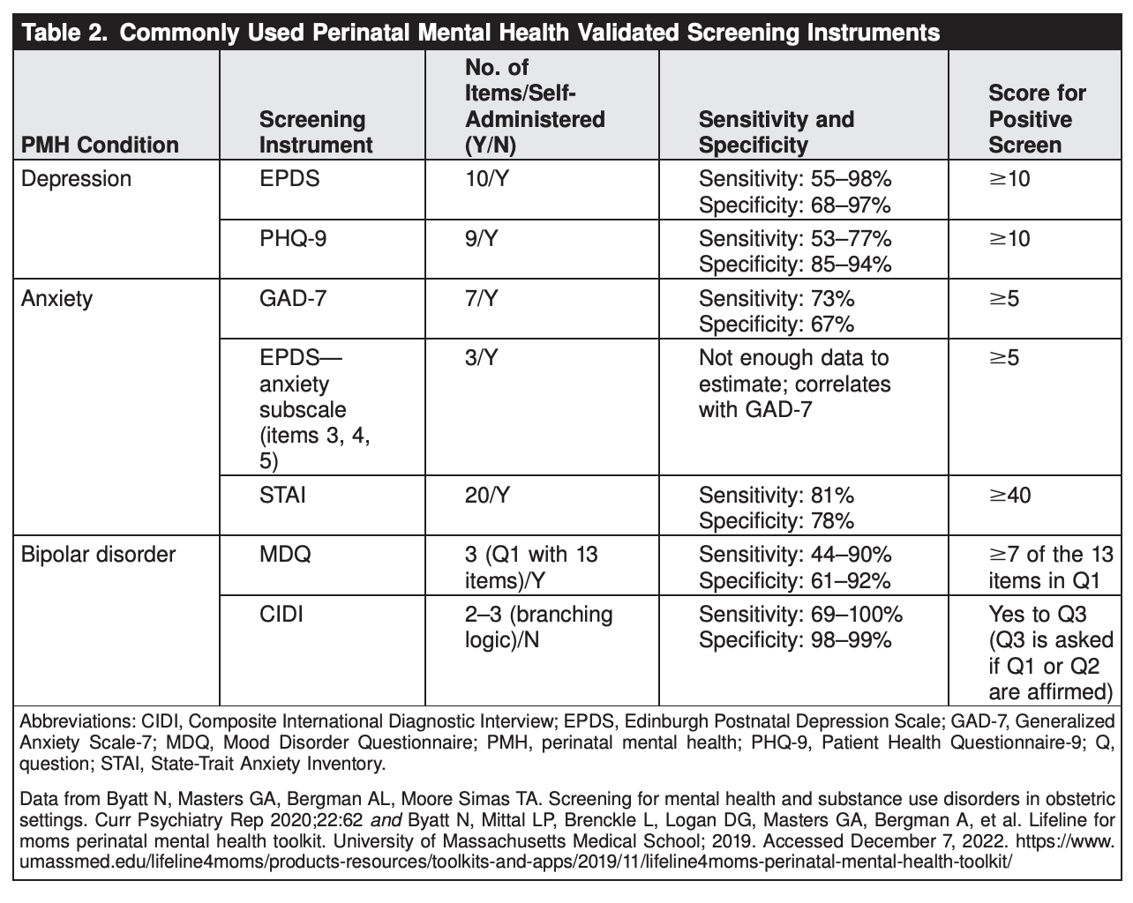
Common Screening tools
Visit projectteachny.org/maternal-rating-scales for additional scales/screeners
ACOG JUNE 2023 Guideline Summary Recommendations

Slide 16
Depression Screens
Edinburgh Postnatal Depression Scale (EPDS)
First tool developed specifically to screen for depression in peripartum people
Can screen for other psychiatric disorders (e.g. GAD) as well as depression
Consists of a 10 item self-rated questionnaire
A score of 10 is the most commonly used cutoff
Question 10 addresses the presence/absence of suicidal ideation
PHQ-9 (Patient Health Questionnaire - 9)
One of the most widely used depression screening tools
It has been studied in peripartum populations and found to be valid, comparable to the EPDS (Wang et al, 2021)
Translated into various languages
Like the EPDS, the PHQ-9 is a self-report questionnaire (consisting of 9 questions)
Similarly, a score of 10 is the most commonly used cutoff for a positive screen for depression
Question 9 specifically addresses suicidal ideation
Notes:
Edinburgh Postnatal Depression Scale (EPDS)
As compared to the pHQ-9 which a commonly used scale for depressive symptoms, this scale has less focus on somatic symptoms which very common in the perinatal period - allowing for more specific screening
• 10-item self-report questionnaire validated for use in pregnancy and postpartum for depression screening ^{[i]}
• Useful for screening, distinguishing symptom severity and monitoring treatment progress;
• Suicidality: item 10 screens for suicidal ideation – positive scores merit immediate discussion and referral to mental health specialist
First too developed to specifically screen for depression peripartum
PHQ-9 (Patient Health Questionnaire)
- useful in that it is widely used, has multiple language translations, and embedded into many hospitial systems
- question 9 specifically addresses suicidal ideation
Less senstivie/specific but still useful: has more of a focus on somatic symptoms

Slide 17
Anxiety Screening
EPDS
  EPDS contains 3 questions which assess anxiety (EPDS 3A)
  A cutoff of 5 or more on this subscale yields a sensitivity of around 70%, specificity of around 92% (Smith-Nielson et al, 2021)
Perinatal Anxiety Screening Scale (PASS)
  31 self report questionnaire
  Validated in pregnancy and postpartum
  Assess four categories of anxiety
GAD (Generalized Anxiety Disorder) – 7
  Widely used across many settings to screen GAD, and has some evidence for validity in pregnant populations
  Consists of a self-report questionnaire made up of 7 questions
  The typical cutoff score used is 10

Slide 18
Bipolar Screening
CIDI (Composite International Diagnostic Interview) CIDI
  Provider instrument
  Total of 12 questions
  Has a euphoria and irritability stem questions
  Moderate risk for bipolar disorder is 6 or more questions with positive endorsement
MDQ (Mood Disorders Questionnaire)
  Self-report questionnaire assessing 13 symptoms with yes/no questions, as well as a question assessing timing of symptoms, and a question assessing the degree of impairment caused by the symptoms
  A score of 7 or more is typically used as the cutoff for a positive screen
  Must answer positive to question 2 (assessing the presence of multiple symptoms simultaneously) as well as indicate moderate or serious severity in question 3 as well

Slide 19
Assessment
Remember that a screening tool does not make a diagnosis – further assessment is warranted after any positive screen
Areas for further assessment:
  Reproductive history*
  Severity, chronicity and co-morbidity
  Safety risk
  Current stressors
  Previous treatment experience
  Treatment preferences
  Strengths, social support and resources
Notes:
E

Slide 20
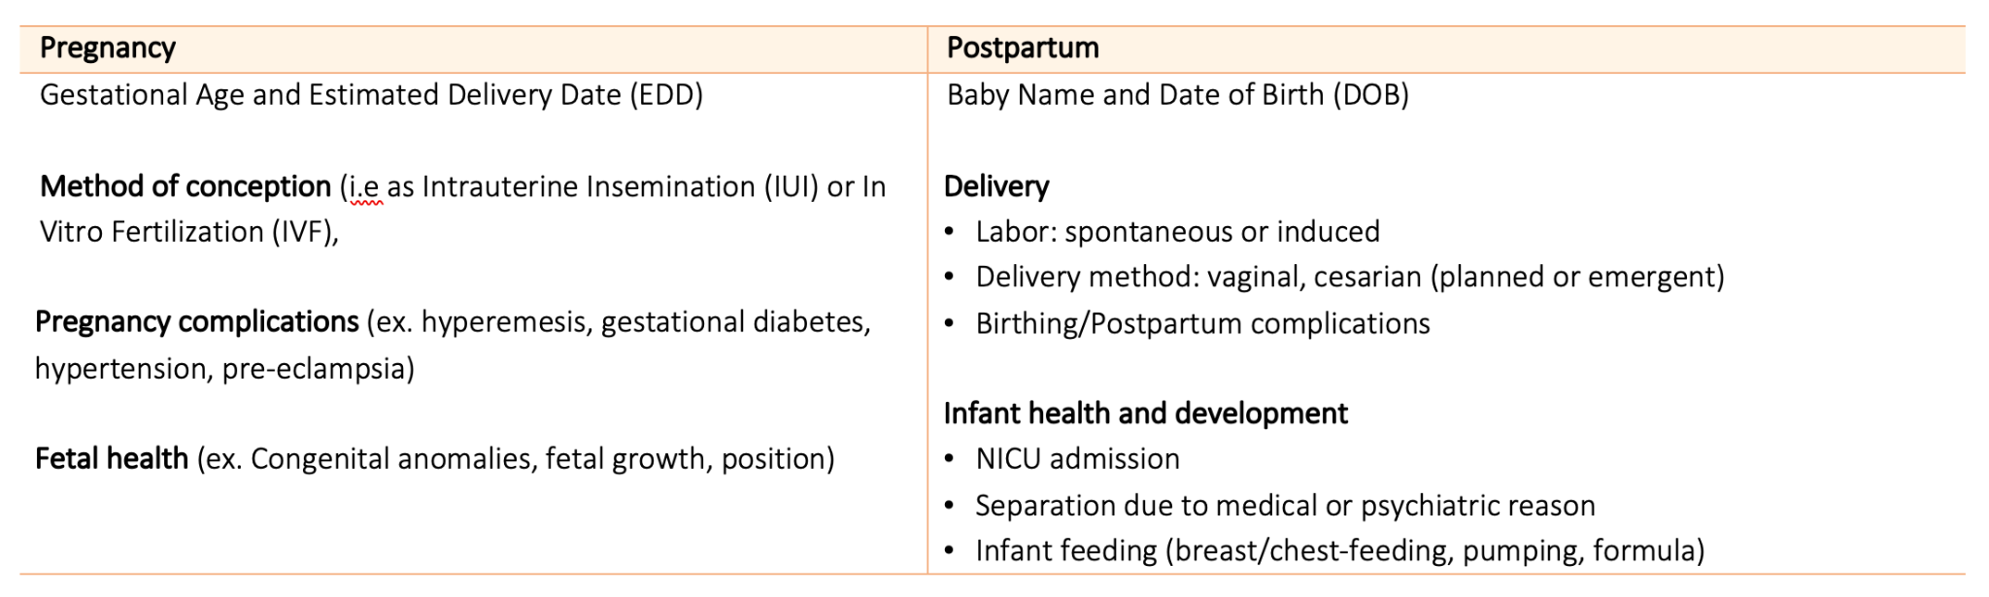
Perinatal Assessment: Taking a Reproductive History
Notes:
Obstetric Care i.e OBGYN, midwife
Prior Pregnancies: number, outcome, and associated psychiatric symptoms
Fertility treatment: type, outcome, and associated psychiatric symptoms
Menstrual History: presentation and associated psychiatric symptoms
Sexual history

Slide 21
Diagnosing unipolar perinatal depression
Perinatal Prevalence: 6-11%
Major depressive disorder with peripartum onset
requires ≥ five of the following symptoms (one must be depressed mood or anhedonia), beginning in pregnancy or within 4 weeks of delivery
Depressed mood, often overshadowed by severe anxiety, crying episodes, feel trapped/overwhelmed
Markedly diminished interest or pleasure in activities- lack of interest in baby/not feeling close to baby
Appetite disturbance- food has no taste, forces self to eat, poor gestational weight
Sleep disturbance- cannot fall or stay asleep - even when the baby is sleeping
Physical agitation (on-edge) or feeling slowed down
Fatigue or loss of energy, exhausted
Feelings of worthlessness or excessive or inappropriate guilt – feeling like a bad mother
Decreased concentration or ability to make decisions
Recurrent thoughts of death or suicidal ideation –my family/baby would be better off without me
  †Symptoms must be present most of the day nearly every day for ≥ two weeks.
Notes:
Consistent with DSM-5 perinatal onset, However ICD-10 =onset within 6 weeks postpartum and the WHO and CDC =onset within 12 months postpartum
Common/Distinctive features:
Lack of interest in baby/not feeling close to baby
Feeling like their a bad mother
Thoughts of harming the baby or self
Feeling trapped
Increased crying and irritability
Often involves significant anxiety symptoms around baby
Focus is around parenthood/child
6-11% prev. rate in perinatal women
Very high co-morbidity with anxiety
Feelings of sadness or depression in perinatal period can bring up feelings of shame, people may feel uncomfortable talking about their feelings. All parents should be approached in an open and non-judgmental questioning manner

Slide 22

Baby blues or PPD
Putnam et al 2017; Jordan et al 2019; Putnick DL et al. 2020
Call Project TEACH!
1-855-227-7272
 | Baby Blues | Postpartum Depression
Prevalence | 50-85% | 6-11%
Onset | Within few days of delivery, peaks within a week | Onset during pregnancy or within four weeks postpartum
Duration | Few days, improves/resolves within 2 weeks | 2 weeks to 3 years
Severity | Mood reactivity, tearfulness, anxiety, sleep disturbance | Depressed mood, anhedonia, guilt, rumination, can include suicidal ideation
Impaired function | No | Yes
Course | Resolves spontaneously, not a psychiatric disorder | Usually requires treatment
Risk | Unrelated to stress or prior psychiatric history | Common in women with history of mood d/o and predictive of future episodes
Notes:
Natural to have a change in psychological functioning following birth. Not only is there the biological changes there is also the sudden onset of having new responsibilities and roles. Most individuals will experience in the setting of these changes, the baby blues.

Slide 23
Diagnosing bipolar disorder
Perinatal Prevalence: 2.8%
Bipolar 1 Disorder: characterized by at least one lifetime manic episode
Bipolar Disorder: characterized by at least one lifetime hypomanic episode AND a depressive episode
2.8% prev. rate in perinatal women
Manic episode (sx for 7 consecutive days) and Hypomanic episode (sx for 4 consecutive days) is characterized by abnormally and persistently elevated or irritable mood and increased activity/energy plus 3 or more if mood is elevated, 4 or more if irritable mood with a change in functioning
inflated self-esteem, grandiosity
decreased need for sleep (e.g. feels rested after only 3 hours)
more talkative, pressure to keep talking
flight of ideas, racing thoughts (but not anxious in nature)
Distractibility
increase in goal-directed activity or psychomotor agitation
excessive involvement in activities with high potential for painful consequences
Notes:
BD 1= any instance of manic episode
BD2 = hypomania + depressive episode
MDQ is 5 minute self-report; designed for bipolar 1, less sensitive for bipolar 2; positive screen need YES to 7 or more of the 13 items in Q1 AND YES to Q2 AND moderate or serious problem for Q3
MDQ (sensitivity: 0.58; specificity 0.93)
1 lifetime manic episode = bipolar I
1 lifetime hypomanic episode plus 1 MDE = bipolar II
2.8% prev. rate in perinatal women

Slide 24
Clinical pearls: perinatal bipolar disorder
22.6% of women with postpartum EPDS ≥10 had bipolar disorder (Wisner KL et al 2013)
Retrospective and prospective data show mean rates of a mood episode recurrence during pregnancy between 52% to 85% (Viguera AC et al 2000 & 2007)
• Women who discontinue medication more likely to experience recurrences (85.5% vs. 37%) and spend more time ill (Viguera AC et al, 2007)
• Recurrence risk greater after rapid discontinuation(<2 wks.) than gradual (2 to 4 weeks) (Viguera AC et al 2000 & 2007)
• Most recurrences are depressive or mixed (74%) and 47% occurred in first trimester (Viguera AC et al, 2007)
Notes:
CHECK THESE STUDIES
- LOOK AT THE BIPOLAR LECTURE FOR MORE DATA

Slide 25
Distinguishing between unipolar and bipolar disorder
Call Project TEACH!
1-855-227-7272
BP: History or current hypomania/mania symptoms
BP: Depression with mixed symptoms (distractibility, racing thoughts, irritation, and agitation) more common than pure hypomania/mania
BP: More frequent (>3) episodes of depression
BP: Non-response to 3 or more anti-depressants
BP: Family history of bipolar disorder
Cuellar AK et al, 2005
Notes:
Warning signs/clues for possible bipolar disorder

Slide 26
Postpartum Psychosis
Perinatal Prevalence: 1-2/1000
Strongest risk factor for postpartum psychosis is a personal history of bipolar disorder
Sudden onset within 2 weeks of delivery with >50% of onsets within 3 days of delivery
Often initially presents as irritability, mood lability, anxiety and insomnia that progresses to mania, depression, mixed episode with delusions and rapid deterioration
  Delusions can be pregnancy and child related – may include thoughts around harming self or the baby i.e “altruistic” delusions of harm
  Delusions are ego syntonic and involve limited insight
Often can see disorientation and confusion and disorganized behaviors
Psychiatric Emergency: Associated with increased risk of suicide and potential risk to infant
large differential diagnosis and work-up required
Delirium
Mood
Psychotic
Notes:
50% of women it is their first episode and they have no psychiatric history.
Fix this slide
Diagram – mood psychotic cognitive symptoms
Suicidal and infantiation ideation were present in 19% and 8% of patients
Abnormal thought content: persecutory delusions, dleusions of reference, auditory hallucinations – many can be pregnancy and childbirth related delusions
Strongest risk factor for postpartum psychosis is a personal history of bipolar disorder
-delusional thoughts are ego syntonic and involve limited insight (vs. ppOCD)
Differential diagnosis may include acute infection, anemia due to peripartum blood loss, endocrine and autoimmune disorders such as Grave’s disease or myxedema, and eclampsia.
Metabolic or nutritional deficiencies may result in symptoms of psychosis. Less common medical causes may include primary hypoparathyroidism, uremic encephalopathy, hepatic failure, vitamin deficiency, stroke, and drug or medication-induced psychosis.
Patients presenting with co-occurring neurological symptoms such as seizures, decreased level of consciousness or dyskinesia may require neuroimaging, cerebrospinal fluid analysis and screening for anti-NMDA antibodies
In this study, 98.4 percent of patients achieved remission within the first three steps of the algorithm. In almost all cases, our practice is to start antipsychotic medication immediately, switching to or augmenting with lithium as indicated by response and depending on breastfeeding preferences. ECT is strongly considered in patients with catatonia and depression with psychotic features.

Slide 27
Perinatal Anxiety Disorders
Anxiety disorders
Overall prevalence of having at least 1 or more anxiety disorder is estimated to be 20.7% (1 in 5) (Fawcett EJ et al 2019)
High co-morbidity with perinatal depression, up to 50%
Generalized anxiety disorder (2.4% prev. perinatal)
Excessive worry over many things, for at least 6 months – often focused on fears of fetal/child wellbeing, maternal wellness, and partner illness
Difficulty controlling worry about many issues (rumination) – catastrophizing or overgeneralization
Agitation, irritability, restlessness, inability to sit still, feeling on edge
Poor concentration, easy fatigue, sleep disturbance
Notes:
Perinatal anxiety disorders encompass a group of distinct but interrelated conditions characterized by excessive fear, elevated emotional response to perceived/real threat, and related behavioral disturbances
In total, rates of perinatal anxiety disorders is approximately 20%
High co-morbidity with perinatal depression, up to 50%
Preg/postpartum 12-mo prev:
EtOH use disorder: 3.6/2.9
Any drug use disorder: 1.6/1.3
Nicotine dependence: 12.5/10.7
Any mood d/o: 13.3/15.2
MDD: 8.4/9.3
Bipolar d/o: 2.8/2.9
Any anxiety d/o: 13.0/12.3
Not DSM 5 specified

Slide 28
Perinatal Obsessive Compulsive Disorder
OCD: 2.2% [1.2-3.6] of mothers with DSM dx. Intrusive, obsessive ruminations often involve the infant and are violent in nature but are ego-dystonic (tremendous guilt and shame) and reality testing is intact (Uguz et al, 2007)
11% of postpartum women (at 2 weeks) screened positive for OC symptoms (with no prior OCD hx) of which ½ still had persistent OC symptoms at 6 months PP (Miller ES 2013)
Aggressive intrusive thoughts about: (ask about scary/unusual thoughts)
      Stabbing baby with knife
      Drowning the baby in bathtub
      Images of baby’s head cracked and bleeding
      Throwing baby down flight of stairs
      Fear of mistakenly putting infant in microwave
Contamination, cleaning/washing, checking
Contamination
Symmetry & Ordering
Aggressive or harm
Cuellar AK et al, 2005;
Russell EJ et al, 2013
Notes:
Hypervigilance and precautions taken (avoidance)
Education that thoughts do not equal actions
During times of reproductive transition, risk of OCD rises above that of the general population → see both new onset and exacerbation
General lifetime prevalence of 3.5%
During times of reproductive transition, the risk of OCD rises above that of the general population
Evidence of both new onset and exacerbated OCD in postpartum period
Prevalence rates for pregnancy related OCD around 3.5%, in posptum increases to up to 9%
Meta-Analysis showed that OCD prevalence estimates are higher among pregnant and postpartum women compared with general population, and increased linearly from pregnancy to the postpartum period
Patients with diagnosis of OCD will report pregnancy or the posptartum period as a precipitating stressor for exacerbation of their symptoms; reproted in 25-75% of patients
Highly comorbid with other illness including anxiety disorders and mdd
Risk factors include family history of OCD (strong genetic component),
Cuellar AK et al, 2005; Russell EJ et al, 2013
https://pubmed.ncbi.nlm.nih.gov/23656845/

Slide 29
Perinatal OCD Presentation
Obsessions/Intrusive Thoughts | Compulsions/Avoidance Behavior
“What if I accidentally cut my child with a knife?’ | Throws out knives from the home/avoids cutting things
“What if I don’t see the car, and my baby and I get hit?” | Avoids going outside
“I keep getting images of me drowning my baby” | Avoids washing baby
“I keep imagining that I will touch my baby inappropriately” | Avoids spending time with baby; Avoids changing diaper
“What if I drop my baby?” | Avoids breastfeeding baby
What if my baby stops breathing suddenly? | Stays up at night, frequent checking of baby
Acting on harm thoughts is rare, however can see indirect harm through avoidance/compulsive behaviors

Slide 30
Differentiating OC ”harm thoughts” from psychotic intrusive “harm” thoughts
Postpartum OC intrusive thoughts | Psychotic intrusive thoughts
Thoughts are ego-dystonic (inconsistent with their behavior, personality) | Thoughts are ego-syntonic (consistent with confusion, mood lability, bizarre delusions or hallucinations) i.e I must drown my baby to save them eternal damnation
Thoughts associated with guilt, shame, anxiety | Thoughts may not be distressful
Engages in excessive avoidance and rituals in attempt to control thoughts to ensure they do not act on thoughts | Symptoms are not associated with fears or rituals; rather may see disorganized behavior
Very common, not a psychiatric emergency | Much less common, but is psychiatric emergency
Low risk of harm to infant | Patient at risk for unpredictable aggressive behavior
Call Project TEACH!
1-855-227-7272
Hudak and Wisner 2012;
Brandes M et al, 2004
Notes:
OCD risk – if there is more in the form of unintentional secondary harm i.e parent who has persistent instrusive contamination thoughts about child may wash repeaditely and cause dry skin
Add that the instrusive thought can be delusions of *** (add the religious piece)
Ref: Hudak and Wisner 2012; Brandes M et al, 2004
Examples of psychotic delusions
- I must drown my baby to save them eternal damnation

Slide 31
Thank You !

