Slide 1
Treatment of ADHD in Perinatal Patients
  Jeffrey Iler, MD
  Assistant Professor of Psychiatry
  Medical Director, Program for Mental Health and Gender Wellness
  University of Rochester Medical Center, Rochester NY

Slide 2
Speaker:
Jeffrey Iler, MD
Assistant Professor of Psychiatry
Medical Director, Program for Mental Health and Gender Wellness
University of Rochester Medical Center
Rochester, NY
Contact:
jeffrey_iler@urmc.rochester.edu

Slide 3
Disclosures
I have no relevant financial relationship with a commercial interest to disclose.

Slide 4
Objectives
Recognize the risks associated with untreated ADHD in perinatal patients
Discuss known reproductive risks associated with pharmacological treatments for ADHD
Review non-pharmacological options for perinatal patients with ADHD

Slide 5
Scope:
ADHD estimated to affect 4.4% of American adults¹
ADHD in adults is strongly associated with multiple comorbid psychiatric conditions¹
  OR 2.7-7.5 for any mood disorder
  OR 1.5-5.5 for any anxiety disorder
  OR 1.5-7.9 for any substance use disorder
  OR 3.7 for intermittent explosive disorder
Estimated ratio in adults is 1.6:1 male to female²
  Less often recognized in female patients, and female patients are often diagnosed at a later age (and may have a more severe symptom profile which ultimately leads to recognition later in life)

Slide 6
Trend:
Awareness and concern about ADHD in adults is steadily increasing
  No longer viewed as “just a childhood illness”
    An estimated 60% of children with ADHD will continue to have clinically relevant symptoms as adults³
  Inattentive symptoms in particular frequently persist, although hyperactive symptoms may also persist in some cases
Some question of differing presentations of ADHD in adults vs children
  Higher rates of emotional dysregulation (up to 59%) reported in adults with ADHD⁴

Slide 7
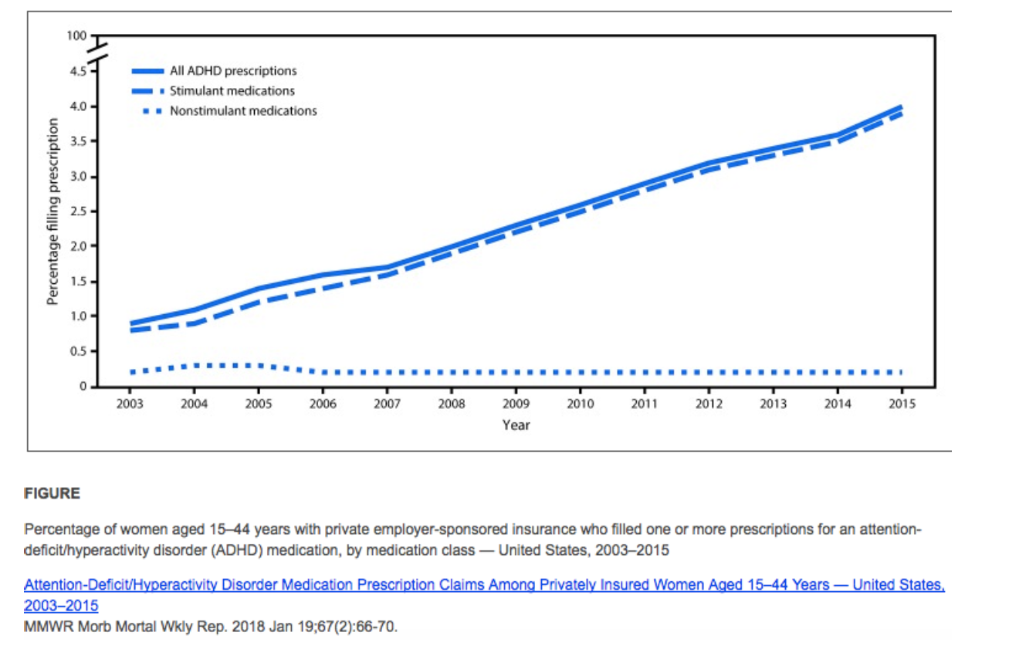
Concurrently, treatment for ADHD is also increasing
The increase in prescriptions is being driven by stimulants

Slide 8
Risks associated with perinatal ADHD
Limited studies have shown some specific perinatal risks associated with ADHD
  Murray et al reported higher risk for maternal stress, comorbid depressive symptoms, and significant impact on social supports
  They also found significantly higher rates of tobacco use and preterm birth, but this lost significance when adjusted for confounding factors⁵
  Poulton et al found an increased risk of multiple negative outcomes including pre-eclampsia, pre-term labor/birth, higher incidence of surgical delivery, and higher need for neonatal resuscitation and higher likelihood of neonatal admission, although they were unable to confidently ascribe these outcomes to parental ADHD, use of psychostimulants, or other correlated factors⁶

Slide 9
More broadly, untreated ADHD in adults is associated with a range of negative outcomes^{1, 4, 7, 8, 9}
  Elevated risk of multiple medical comorbidities, especially neurological, metabolic, musculoskeletal and respiratory illnesses
  Elevated risk of all cause mortality, especially non-natural mortality (e.g. accidental death, suicide)
  Elevated rates of substance misuse
  Elevated risk of mood disorders, anxiety disorders, heightened impulsivity/increased risk-taking behaviors
  Elevated rates of criminal behavior/legal system involvement⁵
  Decreased academic and vocational success, higher rates of financial stress⁵
  Decreased social supports, higher rates of divorce²⁰

Slide 10
Why treat during pregnancy?
Treatment of ADHD has been shown to not only improve core symptoms of ADHD, but also to reduce rates of medical morbidity/mortality⁷, improve psychiatric comorbidities, and reduce emotional dysregulation and impulsivity associated with ADHD⁴
Treatment may have positive impact on:
    Employment and financial resources
    Social connection and support
    Rates of accidental injury/death
    Rates of use of substances of abuse
    Engagement in health-promoting behaviors
    Comorbid conditions such as anxiety or mood disorders

Slide 11
Non-pharmacological interventions
Psychoeducation
Behavioral treatments (e.g. CBT)
Peer support
Coaching
Environmental modifications (e.g. prioritizing public transport over driving, accommodations in school/work, etc.)

Slide 12
Risks associated with pharmacological treatment of ADHD in pregnancy: Stimulants
Increased risk of birth defects
    Possible small increase with methylphenidate (cardiac), no association with amphetamines¹⁰
    Other studies have found no association between exposure and birth defects¹¹
Adverse pregnancy outcomes
    Higher risk of preterm birth and being large for gestational age¹¹
    Other studies have shown growth restriction¹³
    Hypertensive disorders^{6, 12, 14}
Increased risk of preterm birth^{11, 14}
Increased rates of neonatal morbidity
    More likely to require NICU care, and more likely to experience CNS disorders (e.g. seizures)¹¹
    More likely to require caesarian delivery, have low APGAR scores, require NICU care⁶
    No study has found stimulant associated increase in neonatal death
Notes:
With the exception of substance abuse, no firm evidence of harm from exposure to psychostimulants exists at this time

Slide 13
Risks associated with pharmacological treatment of ADHD in pregnancy: Bupropion
Increased risk of birth defects?
  Early studies said maybe, but more recent data are reassuring^{15, 16}
Few other reported negative pregnancy outcomes
Low risk for postnatal adaptation
Less effective than stimulants, but may be a reasonable option for patients with comorbid depression and/or nicotine use disorder

Slide 14
Risks associated with pharmacological treatment of ADHD in pregnancy: Atomoxetine
Limited data available
No evidence of increased risk of birth defects^{17, 18}
No evidence of increased risk of pre-eclampsia or preterm birth¹⁴
No evidence of increased risk of long-term developmental problems including growth problems or autism¹⁸

Slide 15
Risks associated with pharmacological treatment of ADHD in pregnancy: α2 agonists
Very little published data and what is known is confounded – most studies are from patients being treated for severe hypertension, which can have significant effects on pregnancy outcomes
Clonidine has not associated with impairments in development or growth¹⁸
Guanfacine was similarly not associated with development or growth impairments after exposure during pregnancy¹⁹

Slide 16
References
Kessler, R. C., Adler, L., Barkley, R., Biederman, J., Conners, C. K., Demler, O., Faraone, S. V., Greenhill, L. L., Howes, M. J., Secnik, K., Spencer, T., Ustun, T. B., Walters, E. E., & Zaslavsky, A. M. (2006). The prevalence and correlates of adult ADHD in the United States: results from the National Comorbidity Survey Replication. The American journal of psychiatry, 163(4), 716–723.
Quinn PO, Madhoo M. A review of attention-deficit/hyperactivity disorder in women and girls: uncovering this hidden diagnosis. Prim Care Companion CNS Disord. 2014;16(3):PCC.13r01596
Young, J. L., & Goodman, D. W. (2016). Adult attention-deficit/hyperactivity disorder diagnosis, management, and treatment in the dsm-5 era. The Primary Care Companion For CNS Disorders.
Reimherr, F. W., Marchant, B. K., Gift, T. E., Steans, T. A., & Wender, P. H. (2015). Types of adult attention-deficit hyperactivity disorder (ADHD): baseline characteristics, initial response, and long-term response to treatment with methylphenidate. Attention deficit and hyperactivity disorders, 7(2), 115–128.
Murray, A. L., Taut, D., Baban, A., Hemady, C. L., Walker, S., Osafo, J., Sikander, S., Tomlinson, M., Toit, S. D., Marlow, M., Ward, C. L., Fernando, A., Madrid, B., Van Thang, V., Tuyen, H. D., Dunne, M., Hughes, C., Fearon, P., Valdebenito, S., & Eisner, M. (2022). Associations Between ADHD Symptoms and Maternal and Birth Outcomes: An Exploratory Analysis in a Multi-Country Cohort of Expectant Mothers. Journal of attention disorders, 26(14), 1882–1894.
Poulton, A. S., Armstrong, B., & Nanan, R. K. (2018). Perinatal Outcomes of Women Diagnosed with Attention-Deficit/Hyperactivity Disorder: An Australian Population-Based Cohort Study. CNS drugs, 32(4), 377–386.

Slide 17
References
Du Rietz, E., Brikell, I., Butwicka, A., Leone, M., Chang, Z., Cortese, S., D'Onofrio, B. M., Hartman, C. A., Lichtenstein, P., Faraone, S. V., Kuja-Halkola, R., & Larsson, H. (2021). Mapping phenotypic and aetiological associations between ADHD and physical conditions in adulthood in Sweden: a genetically informed register study. The lancet. Psychiatry, 8(9), 774–783.
Li, L., Zhu, N., Zhang, L., Kuja-Halkola, R., D'Onofrio, B. M., Brikell, I., Lichtenstein, P., Cortese, S., Larsson, H., & Chang, Z. (2024). ADHD Pharmacotherapy and Mortality in Individuals With ADHD. JAMA, 331(10), 850–860.
Chang, Z., D'Onofrio, B. M., Quinn, P. D., Lichtenstein, P., & Larsson, H. (2016). Medication for Attention-Deficit/Hyperactivity Disorder and Risk for Depression: A Nationwide Longitudinal Cohort Study. Biological psychiatry, 80(12), 916–922.
Huybrechts, K. F., Bröms, G., Christensen, L. B., Einarsdóttir, K., Engeland, A., Furu, K., Gissler, M., Hernandez-Diaz, S., Karlsson, P., Karlstad, Ø., Kieler, H., Lahesmaa-Korpinen, A. M., Mogun, H., Nørgaard, M., Reutfors, J., Sørensen, H. T., Zoega, H., & Bateman, B. T. (2018). Association Between Methylphenidate and Amphetamine Use in Pregnancy and Risk of Congenital Malformations: A Cohort Study From the International Pregnancy Safety Study Consortium. JAMA psychiatry, 75(2), 167–175.
Nörby, U., Winbladh, B., & Källén, K. (2017). Perinatal Outcomes After Treatment With ADHD Medication During Pregnancy. Pediatrics, 140(6), e20170747.
Newport, D. J., Hostetter, A. L., Juul, S. H., Porterfield, S. M., Knight, B. T., & Stowe, Z. N. (2016). Prenatal Psychostimulant and Antidepressant Exposure and Risk of Hypertensive Disorders of Pregnancy. The Journal of clinical psychiatry, 77(11), 1538–1545. https://doi.org/10.4088/JCP.15m10506chiatry, 75(2), 167–175.

Slide 18
References
Wright, T. E., Schuetter, R., Tellei, J., & Sauvage, L. (2015). Methamphetamines and pregnancy outcomes. Journal of addiction medicine, 9(2), 111–117.
Cohen, J. M., Hernández-Díaz, S., Bateman, B. T., Park, Y., Desai, R. J., Gray, K. J., Patorno, E., Mogun, H., & Huybrechts, K. F. (2017). Placental Complications Associated With Psychostimulant Use in Pregnancy. Obstetrics and gynecology, 130(6), 1192–1201.
Turner, E., Jones, M., Vaz, L. R., & Coleman, T. (2019). Systematic Review and Meta-Analysis to Assess the Safety of Bupropion and Varenicline in Pregnancy. Nicotine & tobacco research : official journal of the Society for Research on Nicotine and Tobacco, 21(8), 1001–1010.
Cole, J. A., Modell, J. G., Haight, B. R., Cosmatos, I. S., Stoler, J. M., & Walker, A. M. (2007). Bupropion in pregnancy and the prevalence of congenital malformations. Pharmacoepidemiology and drug safety, 16(5), 474–484.
Bröms, G., Hernandez-Diaz, S., Huybrechts, K. F., Bateman, B. T., Kristiansen, E. B., Einarsdóttir, K., Engeland, A., Furu, K., Gissler, M., Karlsson, P., Klungsøyr, K., Lahesmaa-Korpinen, A. M., Mogun, H., Nørgaard, M., Reutfors, J., Sørensen, H. T., Zoega, H., & Kieler, H. (2023). Atomoxetine in Early Pregnancy and the Prevalence of Major Congenital Malformations: A Multinational Study. The Journal of clinical psychiatry, 84(1), 22m14430.
Bang Madsen, K., Robakis, T. K., Liu, X., Momen, N., Larsson, H., Dreier, J. W., Kildegaard, H., Groth, J. B., Newcorn, J. H., Hove Thomsen, P., Munk-Olsen, T., & Bergink, V. (2023). In utero exposure to ADHD medication and long-term offspring outcomes. Molecular psychiatry, 28(4), 1739–1746.
Philipp E. (1980). Guanfacine in the treatment of hypertension due to pre-eclamptic toxaemia in thirty women. British journal of clinical pharmacology, 10 Suppl 1(Suppl 1), 137S–140S.
Klein, R. G., Mannuzza, S., Olazagasti, M. A., Roizen, E., Hutchison, J. A., Lashua, E. C., & Castellanos, F. X. (2012). Clinical and functional outcome of childhood attention-deficit/hyperactivity disorder 33 years later. Archives of general psychiatry, 69(12), 1295–1303. https://doi.org/10.1001/archgenpsychiatry.2012.271

Slide 19
Untreated ADHD has minimal risks in comparison to medication exposure, so medication treatment during pregnancy is rarely warranted
Yes
No

Slide 20
Which of these medications would you feel comfortable prescribing for a pregnant patient with ADHD?
Methylphenidate (e.g. Ritalin)
Mixed amphetamine salts (Adderall)
Lisdexamfetamine (Vyvanse)
Guanfacine (Intuniv)
Atomoxetine (Strattera)
Bupropion (Wellbutrin)

Slide 21
In your practice, what proportion of your patients are being treated for ADHD?
0-25%
26-50%
51-75%
Greater than 75%

