Slide 1
How can I safely prescribe psychotropics to pregnant patients?
An evidence-based approach to considering medications in the treatment of psychiatric disorders in pregnancy/lactation.
Nicole Tchalim, MD
Fellowship Director for the CUIMC Women's and Reproductive Mental Health (WARM) Program
Columbia University, Clinical Instructor of Psychiatry
New York, NY
Notes:
Just so that we are better harmonized this training, I would suggest focusing on the risks of untreated/undertreated perinatal depression/bipolar/psychosis and how to interpret literature on risk of meds (broadly speaking- absolute vs relative risk), the challenges with the current literature. The specific meds and specific risks will be considered in the other modules so this session can be an overview and intro the following modules which will dive into specific med risks. I like the risk stratification on slide 15 too since that applies broadly across diagnoses. I think for psychiatrists it is important to get them in the habit of documenting a risk/benefit/alt. discussion in their charts, before pts are pregnant, stress the importance of preconception counseling and documenting in EMR. Feel free to modify Joshna’s slides, they are found on the link at basecamp.

Slide 2
Disclosures
“Neither I nor my spouse has a relevant financial relationship with a commercial interest to disclose.”

Slide 3
Do you treat patients with psychiatric diagnosis who can become pregnant ?
Notes:
1.Always
2.Often
3.Sometimes
4.Rarely
5.Never

Slide 4
Do you feel prepared to care for perinatal individuals on psychiatric medications ?
Notes:
1.Always
2.Often
3.Sometimes
4.Rarely
5.Never

Slide 5
General Consideration
50% of all pregnancies unplanned
83% of mothers breastfeed,60% till 6 months and 30% till 12 months
10.3% women in reproductive age on antidepressants
6.8% use anti-depressants in first trimester
6-15% of pregnant patient with psychiatric d/o are prescribed antipsychotic
Ref: Finer et al 2014, Dawson et al 2016, Pratt et al 2017, Ko JY et 2012, Edinoff et al 2022, Hanley 2014
Notes:
Hanley, G.E.; Mintzes, B. Patterns of psychotropic medicine use in pregnancy in the United States from 2006 to 2011 among women with private insurance. BMC Pregnancy Childbirth 2014, 14, 242. [Google Scholar] [CrossRef] [PubMed][Green Version]

Slide 6
Common Reasons for unease with perinatal prescribing
Concern around potential effects on neonate/child
Concern around quality of information/studies on use of medications in the perinatal period
Lack of knowledge/discomfort around expected volume/metabolic changes in pregnancy/postpartum and how this effects medications
Lack of knowledge around risks of untreated/undertreated psychiatric illness
Poor understanding of current FDA recommendations around perinatal medication prescribing

Slide 7
Prescribing in the perinatal
Role of the prescriber:
Maintain euthymia
Practice non-judgement
Stay up-to-date with the literature
Provide support and appropriate psychoeducation
Be mindful/aware of any bias
Start the conversation early
Remember that different patients will make different decisions
Stay Calm

Slide 8
When to consider psychiatric medication treatment in the perinatal period?
In general, consider starting or continuing psychiatric medications in the perinatal period if the individual currently or previously has had symptoms of moderate to severe levels with functional impact
In addition to medication management, always remember to consider other important support/treatment alternatives such as:
Childbirth and infant care education and support
Psychoeducation around perinatal mental health challenges
Pregnancy and new parent groups
Individual/group/family therapy
Bolstering family/community support

Slide 9
Risk Stratification
Diagnosis
History of recurrence
Severity of illness
Availability of resources
Age
Psychosocial factors

Slide 10
Risk of Relapse
70% risk of relapse of depression, 50% in first trimester
5X the risk if they stop abruptly
71% risk of recurrence of bipolar d/o during pregnancy
Women who stop mood stabilizer have 2X the risk of recurrence and 4X more rapidly then who stayed on medication
ref: Cohen et al 2006,Viguera 2007, Sharma et al 2018

Slide 11
An Approach to Medication Management
Use what works! When reasonable start with medications known to work for the patient in the past. Remember many medications are compatible with pregnancy.
Less is more! When possible avoid polypharmacy
Treat to effect! Use lowest medication amount needed to reach symptom relief
Be mindful of pregnancy and postpartum related changes! Due to a mix of changes in plasma volume, renal clearance, and enzyme functioning in the perinatal period, you may need to adjust medications to maintain euthymia or avoid toxicity
Most medications are compatible with breastfeeding! Remember, exposure through breast milk is generally less as compared to transplacental passage
Discuss safe sleep practices with anyone using sedating medications
When in doubt: call project teach!

Slide 12
Additional Considerations during Lactation
ACOG recommends that relative infant dose <10% acceptable for lactation
Practice of pumping and dumping is not advised
Can consider timing short half life medications after breastfeeding
Sleep deprivation increases risk of relapse for mother
Collaborate with pediatrician
Ref:Burkey et al 2013

Slide 13
Perinatal Pharmacokinetic Changes
Blood Volume: In pregnancy, maternal blood volume increases by up to 50% in the third trimester.
Renal Clearance: In pregnancy, renal blood flow and glomerular filtration increase up to 65% to 85% respectively. Can see an increased clearance of lithium and other renally excreted medications
Liver Metabolic Alterations: In pregnancy, changes occur in the hepatic enzyme system, which can affect the metabolization of various psychiatric medications. In particular, elevating levels of estradiol in pregnancy induce liver enzymes that breakdown lamotrigine; can see lamotrigine levels drop by 50% in pregnancy
Postpartum System “Reset”: There is a rapid re-equilibration to pre-pregnancy metabolic systems and volume; can see quick toxic build up medications like lithium and lamotrigine

Slide 14
Considering the literature
Certain studies may be more likely to misrepresent risk:
• Comparing apples to oranges: When comparing pregnancies exposed or not-exposed to psychotropic medications, many early studies did not account for the underlying mental illness (ie. indications for the prescribed medication).
Self-report: Early databases relied on self-report registries, which introduced reporting bias and other inaccuracies, without input from clinicians on diagnosis and dosing.
Polypharmacy: Early studies were less rigorous in controlling for polypharmacy and co-morbid medical conditions.
Advances in literature over the past 30 years
Electronic medical records have increased the power of retrospective studies
More recent studies control for confounding factors and account for risks associated with underlying mental illness
Continued challenges
Though increasing, continue to have relatively fewer studies on longterm outcomes for various perinatal medication exposures
Rare Randomized controlled prospective studies
Notes:
Add MGH
Springer link

Slide 15
How to stay up to date on literature
Project Teach!
Subscribe to journals with reproductive psychiatry sections
MGH Women’s mental health
Lactmed

Slide 16
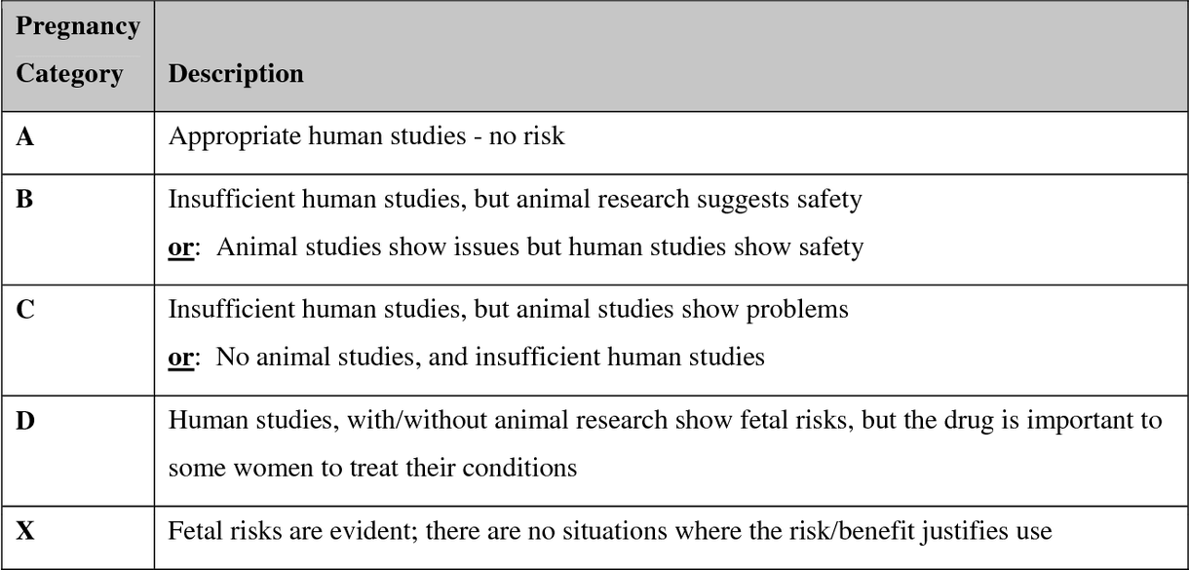
FDA Guidelines: 2014 Pregnancy and Lactation Labeling Rule (PLLR)
We do not use the FDA Lettering system anymore!
PLLR system
Pregnancy: risk summary, clinical considerations, available data
Lactation: risk summary, clinical considerations, available data
Female and Male Reproductive potential: impact on pregnancy testing, contraception, and infertility
Notes:
chrome-extension://efaidnbmnnnibpcajpcglclefindmkaj/https://www.fda.gov/files/advisory%20committees/published/An-Evolution-of-Labeling-Information-for-Pregnant-Women--PLLR-History.pdf

Slide 17
The “Risk Risk” Discussion of Perinatal Prescribing
 | Risk of Untreated Psychiatric Illness | Risk of Medication Exposure
Maternal Risks: this includes potential impact on mental health, social and occupational functioning, and potential fertility and obstetric complications
Fetal/Child Risks: this includes potential teratogenicity, early and late neonatal effects and long-term developmental effects
Breastfeeding Risks: this includes potential impact on maternal wellbeing, milk supply, drug transfer in milk, and the
Notes:
Write it out!

Slide 18
Case Discussions

Slide 19
Preconception Counselling: Case 1
35 female with history of postpartum depression without suicide ideation with first child that responded well to Lexapro 5mg in the postpartum period. Continues to be on Lexapro 5mg 2 years after birth. Reports no other history of depressive symptoms. Is presenting for counseling around medication use in pregnancy as she is currently hoping to get pregnant.
Assessment:
Assess for residual symptoms: currently asymptomatic
Assess for additional supports: is married with strong social and family support. Not currently in therapy
Assess for additional risk factors: due to job reporting plan to take around only 3 weeks of parental leave
Notes:
Mild symptoms, no h/o of depression, PPD: Psychotherapy and continue medication (patient comfort, psycho-social support

Slide 20
Case 1: Treatment recommendations
- General Risk Stratification: low
- General recommendation:
Complete Risk Risk Discussion
Can consider medication discontinuation/lowering with plan for 3-6 month stability before starting attempts to conceive. Discuss plan to restart/increase medications if evidence of symptom redevelopment
- Consider additional supports:
Therapy
Postpartum planning: Discuss concerns around childcare/provide relevant resources

Slide 21
Depression in Pregnancy: Case 2
40 female, with history of recurrent MDD disorder, history of suicidal ideation without attempt or intent, currently 10 weeks pregnant. Presenting for counseling around continued use of Zoloft
Assess for residual symptoms: reporting some moderate symptoms of depression. Denies any current thoughts of self harm
Assess for additional supports: reports close friends and supportive job environment
Assess for additional risk factors: unplanned pregnancy, currently living alone. Poor family supports
Notes:
Illness can be so unpredictable and I cant promise if patient gets unwell I can get them better on same medication so yes the risk is exposure to medication but this patient may be on low dose of medication but if she gets sick I cant promise I can get her better on same med and low dose . If have lost time. I am also unsure that after an episode of acute illness is she ready to take the stress of pregnancy. I would like to see her stable for 6 months rather then just 1 month
Cover breast feeding

Slide 22
Treatment recommendations
- General Risk Stratification: Moderate
- Complete risk risk discussion
Recommend continued medication use; in fact you will want to consider increase/augmentation as patient is currently symptomatic. Remember goal is to treat to effect!
Recommend additional supports: therapy, psychoeducation childbirth/parenting classes, support groups, help identify other social/community support sources etc
- If patient chooses to discontinue medication:
Discuss importance of close monitoring during perinatal period

Slide 23
Bipolar Disorder & Pregnancy: Case 2
Case 3: 27 year old female, with history of bipolar disorder, 2 prior hospitalizations for manic episodes, history of prior suicide attempt via cutting, presenting now with unplanned pregnancy at 16 weeks following recent manic episode; now stable on Zyprexa.
Assess for residual symptoms: currently denying additional symptoms
Assess for additional supports: reports close relationship with therapist
Assess for additional risk factors: history of postpartum psychosis in grandmother, history of postpartum depression in mother

Slide 24
Quick word: Mood stabilizers such as Lithium and Depakote have higher neonatal risk profiles than antipsychotics. Recommend getting specialist support for cases with individuals on these medications
Treatment Recommendations:
- General Risk Stratification: High
- Complete risk risk discussion
Recommend continued medication use
Recommend continued therapy
Recommend additional supports: psychoeducation childbirth/parenting classes, support groups, help identify other social/community support sources etc
Important to discuss plans around optimizing sleep in postpartum period.
Family meeting to discuss risks of the postpartum period
Inter-team disciplinary approach
- If patient chooses to discontinue medication:
Discuss importance of close monitoring during perinatal period

Slide 25
Thank You !

Slide 26
Post Test Questions
1. I feel comfortable starting the conversations about need for treatment and safety of medications in pregnancy in women with psychiatric illness on medications.
2. I feel comfortable completing a risk risk discussion around perinatal medication treatment for pregnancy
3. I feel comfortable starting early planning about medication usage in breastfeeding in individuals with psychiatric illness.
Notes:
1.Strongly Agree
2.Agree
3.Disagree
4.Strongly Disagree

