Slide 1
Intensive Training:
Child and Adolescent Mental Health for the Primary Care Clinician
April 14-15, 2024

Slide 2
Welcome!
David L. Kaye, MD
Executive Director, Project TEACH
Professor of Psychiatry, UB Jacobs School of Medicine
dlkaye@buffalo.edu
mp246@buffalo.edu

Slide 3
You can get anything you want… at Alice’s Restaurant
You can get anything you want… at Alice’s Restaurant
Walk right in it’s around the back
Just a half mile from the railroad track
You can get anything you want at Alice’s Restaurant!

Slide 4
And if three people do it! Can you imagine three people walkin' in, singin' A bar of "Alice's Restaurant" and walkin' out? They may think it's an Organization!
And can you imagine fifty people a day? I said FIFTY people a day Walkin' in, singin' a bar of "Alice's Restaurant" and walkin' out? Friends They may think it's a Movement, and that's what it is
Arlo Guthrie
Notes:
18:34

Slide 5

Link to ESyllabus
Notes:
Ira updated 4/12FOLDER, END TIME, BREAKS

Slide 6

Link to ESyllabus

Slide 7

Intensive Training: Follow-up Session Dates & Topics
Link to Registration
Register today using the QR code. A link will also be emailed.
Registrants receive the live link and/or access to the recorded sessions.

Slide 8
What to Know About the
Intensive Training
Cover the most common conditions seen in primary care.
Emphasis on principle that good treatment rests on a GOOD ASSESSMENT.
  Builds on your existing skills and relationships
  Use evidence based screening and assessment tools
Good treatment involves the whole child:
family, school, community, psychotherapy and medications
Fair payment for our services is essential and CAN BE DONE!
  Our last presentation on Billing/Coding:
  Log into our Learning Management System and go to IT 5/7/23 https://lms.projectteachny.org/content/module-4-reimbursement-implementation-ensuring-appropriate-payment-mental-health-services-0

Slide 9




Project TEACH
Funded by

Slide 10
Families Thrive With Good Mental Health
Supporting Perinatal and Pediatric Clinicians to
deliver quality mental health care in New York State.
Project TEACH is New York State’s Psychiatry Access Program
Notes:
Focus today is CAP Services – MMH Advisory Meeting is scheduled for Monday, April 4th

Slide 11
Mission
  To strengthen and support New York’s:
  Pediatric Primary Care Clinicians to deliver care to children and families who experience mild-to-moderate mental health concerns.
  Ob/Gyns and other primary care clinicians to expand their ability to assess and manage maternal mental health concerns.
  In other words we are doing all we can to support and educate physicians and other health care professionals to care for their patients within the medical home
Notes:
Focus today is CAP Services – MMH Advisory Meeting is scheduled for Monday, April 4th

Slide 12





Supporting Agencies & Organizations

Slide 13
Services: How We Help
All at no cost to clinicians or patients

Slide 14


Telephone Consultations
  Project TEACH allows PCCs to immediately speak with
  child and adolescent psychiatrists and reproductive psychiatrists.
  Ask questions, discuss cases, or review treatment options.
  Whatever PCCs need to support their ability to manage their patients.
  1-855-227-7272
  Monday-Friday • 9:00 am – 5:00 pm

Slide 15
What happens when you call?
Physician/clinician or other staff calls: 1-855-227-7272 (M-F, 9-5)
Liaison Coordinator (LC) is first responder: Answers call and documents clinician contact info and brief description of patient case and question.
If calling only for referral support, then LC will respond immediately.
If clinician has question for psychiatrist, then Child/Adolescent Psychiatrist (CAP) or Reproductive Psychiatrist (RP) will call the prescriber within 30 minutes or at a time that is convenient for
the prescriber.
Notes:
KRISTINA

Slide 16
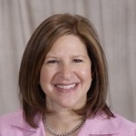
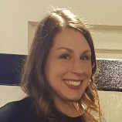
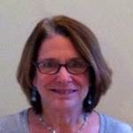
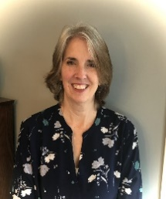

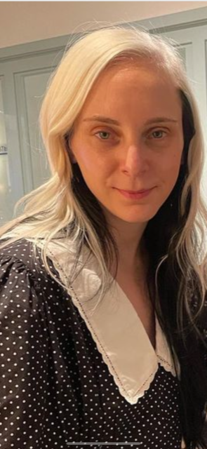
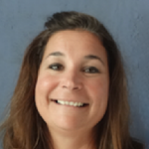
Project TEACH Liaison Coordinators
Amy Lyons, LCAT
University of Rochester
Kristin McGinley, LCSW
University at Buffalo
Leslie Cummins, LCSW
Donald and Barbara Zucker School of Medicine
Hofstra University - Northwell Health
Maureen Ryan, PsyD
Upstate Medical University
Sasha Miller, LMSW
Donald and Barbara Zucker School of Medicine
Hofstra University - Northwell Health
Kayla Tombank, LMHC
Albany Medical Center
Katherine Carnicelli, LCSW
Columbia University Irving Medical Center
New York State Psychiatric Institute

Slide 17
Child and Adolescent Psychiatry (CAP) Team
University at Buffalo
• David Kaye, MD*
• Sourav Sengupta, MD
• Beth Smith, MD
University of Rochester
• Michael Scharf, MD*
• Jim Wallace, MD
• Viki Katsetos, MD
SUNY Upstate Medical University
• Wanda Freemont, MD*
• Eric McMaster, MD
• Nayla Khoury, MD
* Medical Director
Columbia University/NYSPI
• Rachel Zuckerbrot, MD*
Zucker Hillside Hospital/Northwell Health
• Victor Fornari, MD*
• Carmel Foley, MD
• Zoya Popivker, MD
Albany Medical Center
• Suzanne Sumida, MD
• Naema Qureshi, MD
Albert Einstein College of Medicine
• Jason Herrick, MD*

Slide 18
Reproductive Psychiatrists and Psychologists
University at Buffalo
• Joshna Singh, M.D.
University of Rochester
• George Nasra, M.D., MBA
• Jeffrey Iler, M.D.
• Ellen Poleshuck, Ph.D.
SUNY Upstate Medical University
• Seethalakshmi Ramanathan, M.D.
• Nevena Radonjic, M.D., Ph.D.
Columbia University / NYSPI
• Elizabeth Fitelson, M.D.
• Catherine Monk, Ph.D.
• Nicole Tchalim MD
Zucker Hillside Hospital / Northwell Health
• Kristina Deligiannidis, M.D.*
• Yardana Kaufman, M.D.
• Khatiya Moon, M.D.
Albany Medical Center
• Mark Rapp, M.D.
Albert Einstein College of Medicine
• Rubiahna Vaughn, M.D.
Julia Vileisis, M.D.
* Medical Director
Notes:
Updated Ira 4/12/24

Slide 19
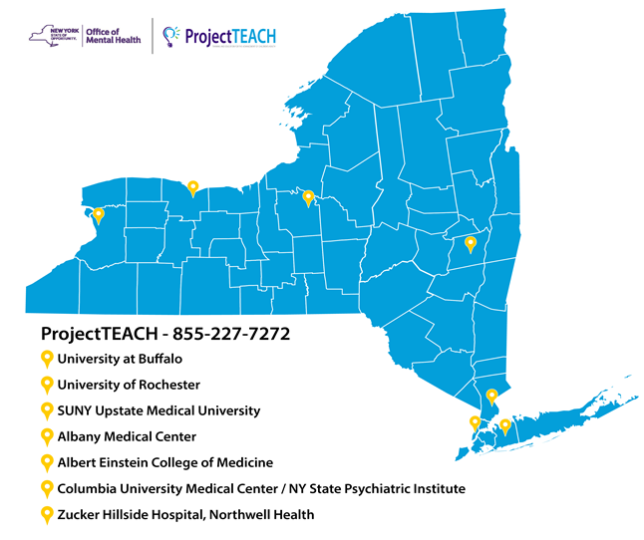

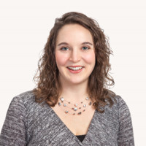
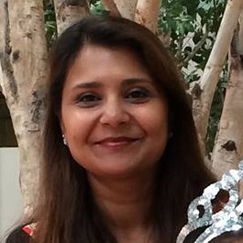
Program Administration
David Kaye, MD
Executive Director
Michele Phillips
Sr. Project Director
Ira Bhatia, MA
Sr. Project Administrator
No matter where you are in
New York State,
our team is here to support you!

Slide 20
Specialty Consultants
• Specialty Consults are provided at the request of a PCC or at the recommendation of the CAP.
• After a telephone consultation with the PCC, the specialty consult may offer a face-to-face eval.
0-5 Years
• Evelyn Berger-Jenkins, MD, MPH (Columbia)
• Kenya Malcolm, Ph.D. (U of Rochester)
Autism Spectrum Disorder
• Michael Cummings, MD (Buffalo)
• Breck Borcherding MD
• Pankhuree Vandana MD (NYSPI)
• Jeremy Veenstra-VanderWeele, MD
Substance Use
• Scott Krakower, DO (Northwell)
• Deepa Camenga, MD (Yale)
LGBTQ
• Richard Pleak, MD (Northwell)
Problem Sexual Behaviors
• Peter Martin, MD, MPH (Buffalo)
• Barbara Libov, Ph.D. (Northwell)
• Jamie Gaglianese, MS, LMHC (Syracuse)
Notes:
IB Updated 4/12/24

Slide 21
Primary Care Champs
Diane Bloomfield, MD (AEMC)
Mary DeGuardi MD (UHS Pediatrics)
Jessica Grant, MD (Manhattan Valley Peds)
Amy Jerum, DNP, FNP-PMC, CPNP-PC (U of Rochester)
Rachel Kaufman MD (Buffalo Pediatrics)
Ed Lewis MD (Lewis Pediatrics)
Mark Lashley, MD (Allied Health)
Colleen Mattimore, MD (WNY and Main Pediatrics)
Maureen Montgomery, MD (Amherst Peds., retired)
Molly Scharf, MD (RIT and Shortsville Family Practice
Presenting at the training this weekend.

Slide 22

Child and Adolescent Face-to-Face Evaluations
  PCCs can also request face-to-face evaluations with child and adolescent psychiatrists for the children and families in their practices.
  If a PCC’s office would like to offer evaluations via telehealth, Project TEACH regional provider teams can work with him/her to make this service available.
  Face-to-face evaluations occur within two weeks of requests. All face-to-face evaluations are followed by written reports within 2 days to the referring clinician.

Slide 23


Referrals and Linkages
  Our Liaison Coordinators (LCs), are experts in helping
  primary care clinicians and families identify and access
  community mental health and support services including:
  Clinical treatment
  Care management
  Patient and family support
  Project TEACH provides referrals to PCCs for
  Children and adolescents (up to age 22)
  Women with maternal mental health concerns.
  NOTE: We do not interface directly with patients. However,
  any staff member from your office who is familiar with the case can call to request referral support.
Notes:
KRISTINA

Slide 24

Training
  CME At NO COST
  Intensive Trainings
  - Twice per year (1 virtual, 1 in-person)
  - 16 h CME
  Core Trainings
  - 5 hour CME in your practice!
  Live 1 hour Webinars
  - 5/year (Child) and 3/year (Maternal MH)
  Archived Webinars
  - Click “Earn CME” on our website:
  www.projectteachny.org
Notes:
KRISTINA

Slide 25



Upcoming Events
Maternal Mental Health
Intensive Training • Live, Virtual Event • 6.0 CME
April 21st “The Essentials and Beyond in Perinatal Psychiatry:
Noon-4 pm Psychopharmacology and Psychotherapy”
Presented by Project TEACH’s team of Reproductive Psychiatrists and Psychologists
4.0 CME credits offered live and 2.0 offered during Follow-up Sessions on April 29 & May 6
Webinar Wednesday Series • Noon – 1 pm • 1.0 CME
June 26th “The New, FDA-approved Antidepressants for
Postpartum Depression: Clinical Update and Case Presentation”
Presented by Kristina Deligiannidis, MD
Nov. 20th “Substance Use Disorders in Pregnancy and Peripartum:
Principles of Management”
Presented by Seetha Ramanathan, MD and Tolani Ajagbe, MD, FASAM
Notes:
This slide can be found in the following basecamp folders: Maternal MH, Marketing & Web, HQ, CAP
Michelle to update this slide

Slide 26


Upcoming Events
Child and Adolescent Mental Health
Webinar Wednesday Series • Noon – 1 pm • 1.0 CME
May 15th “Untangling Behavior and Emotional Problems in Children with
Developmental Disabilities and Autism: A Primary Care Perspective”
Presented by Breck Borcherding, MD
July 24th “Practical Tools for Addressing Anxiety in Primary Care”
Presented by Nayla Khoury, MD and Jessica Grant, MD
Sept. 18th “Even Grandma Won’t Babysit: The PCP’s Role on the Team
for Managing Aggression in Young Children”
Presented by Evelyn Berger-Jenkins, MD, MPH and Kenya Malcolm, Ph.D.
Dec. 18th “Are You Saying It’s All in My Head? Addressing Somatic Symptom Disorder
and Related Conditions in Primary Care”
Presented by Michael Scharf, MD
Substance Use Webinar Series • August 21 & 28 • 8 am – 9 am
“Helping Teens Escape The Vape: Assessment & Treatment
Strategies for Primary Care Clinicians” Presented by Deepa Camenga, MD, MHS, FAAP
Notes:
This slide can be found in the following basecamp folders: Maternal MH, Marketing & Web, HQ, CAP
Michelle to update this slide

Slide 27
Educational Resources
  On our website and in our emails, you can find:
  Physician Resources
    Rating scales, prevention education, journals and guides
    MMH Toolkit: in development
  Patient and Family Resources
    Videos and PDFs on mental health topics
    4 child and adolescent and 2 maternal resources added each year
  Available freely to the public in 7 languages.
?
Notes:
KRISTINA OR MICHELE

Slide 28
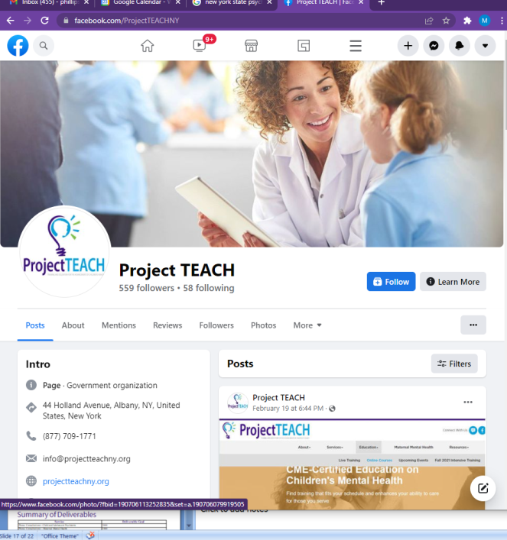

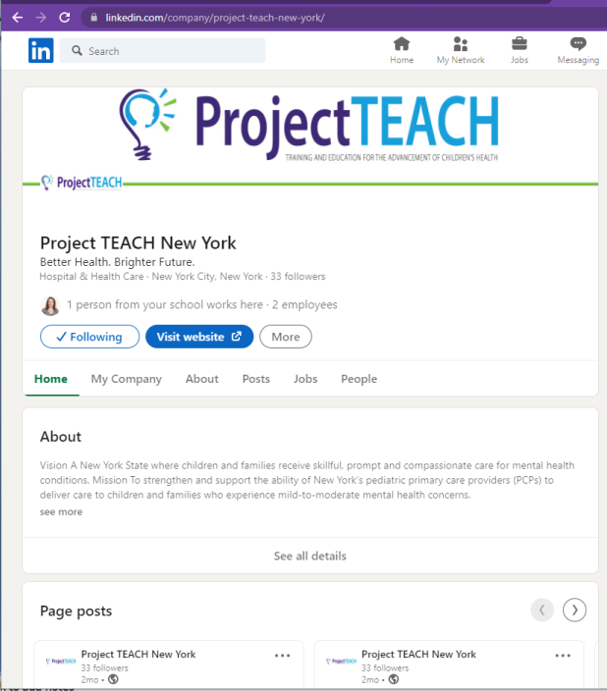
Website - www.ProjectTEACHny.org
Stay in touch with us, get program updates,
access resources & register for events.
Facebook
LinkedIn
Notes:
KRISTINA OR MICHELE

Slide 29
The Big Picture Numbers
 | 2021 | 2022 | 2023 | Cumulative (2010-2023)
PCP’s | 254 | 822 | 824 | 6090
New cases | 1038* | 1610 C 129 M | 1524 C 249 M | 16134 C 378 M
Referrals | 1026 | 1294 | 1431 | 10690
CAPCONS | 2070 | 2167 C 100 M | 2194 C 214 M | 24509 C 314 M
FTFs | 235 | 224 | 223 | 3338
Notes:
Ira updated 3/8/24 :
743 RT ( 2010 to 2017)
*Only region 1& 3 Data .
Peak year (CAPCON +FTF=2550)

Slide 30
You are now part of a movement…. to improve the mental health of children and families in New York!
Let’s Work Together!
    CALL US! 1-855-227-7272
      Consults
      Referral assistance
    Attend our other education programs
    Tell a colleague about Project TEACH services
    Like our Facebook and/or LinkedIn pages
Notes:
DAVID

Slide 31
Questions?

