Slide 1
Aggression Management in Primary Care

Slide 2
Speaker:
Maureen Montgomery MD
Assistant Clinical Professor of Pediatrics, SUNY Buffalo, School of Medicine
Contact:
memontgomery163@gmail.com

Slide 3
Disclosures
“Neither I nor my spouse/partner has a relevant financial relationship with a commercial interest to disclose.”

Slide 4
Aggression is a common presenting symptom in primary care

Slide 5
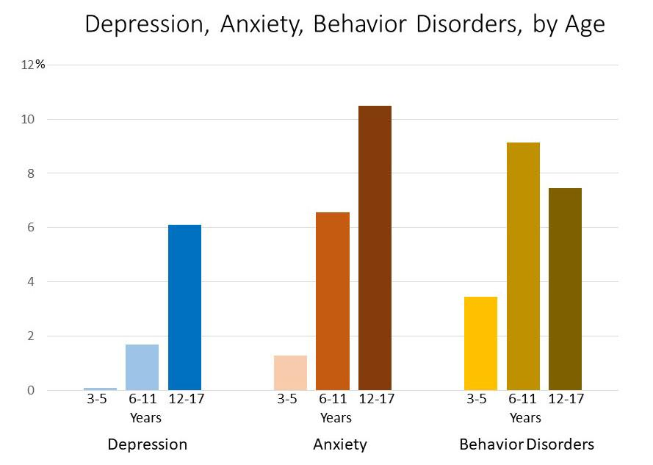

Slide 6
REMEMBER CLIFF?

Slide 7
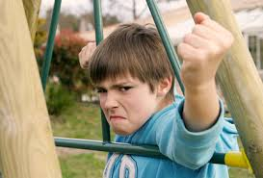
Remember Cliff?

Slide 8
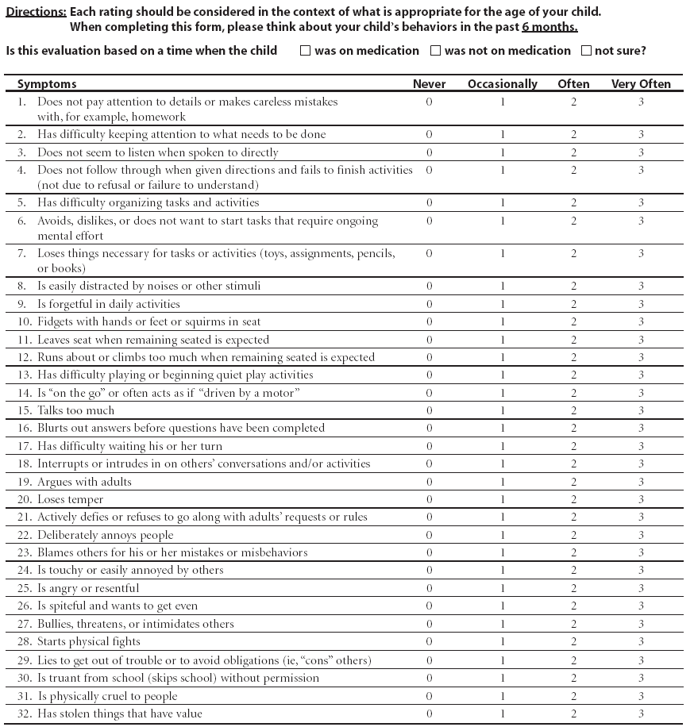
NICHQ Vanderbilt Assessment Scale:
Parent information
Notes:
Updated 8/26/13 by PSJ
THIS SLIDE IS HIDDEN – INCLUDED HERE MOSTLY FOR THE PRESENTER. YOU CAN “UNHIDE” IT IF YOU WISH.

Slide 9
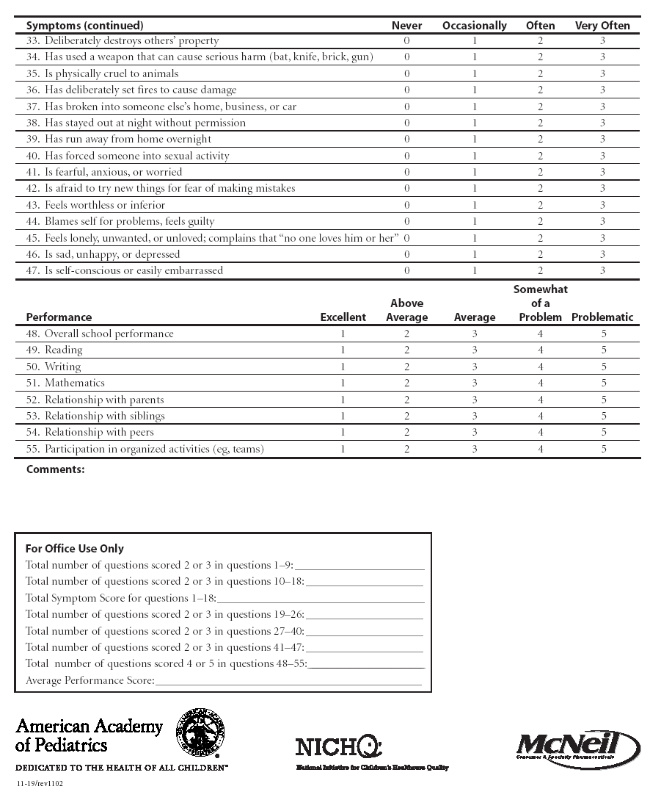
NICHQ Vanderbilt Assessment Scale:
Parent information
Notes:
Updated 8/26/13 by PSJ
THIS SLIDE IS HIDDEN – INCLUDED HERE MOSTLY FOR THE PRESENTER. YOU CAN “UNHIDE” IT IF YOU WISH.

Slide 10
Cliff is back: Vanderbilt
Total number of questions scored 2 or 3 in questions 1-9: Inattention | 2
Total number of questions scored 2 or 3 in questions 10-18: Hyperactivity | 1
Total Symptom Score for questions 1-18: Inattention and hyperactivity | 3
Total number of questions scored 2 or 3 in questions 19-26: Oppositional | 5 > 4 = ODD
Total number of questions scored 2 or 3 in questions 27-40: Conduct | 0
Total number of questions scored 2 or 3 in questions 41-47: Anxiety and depression | 0
Total number of questions scored 2 or 3 in questions 48-55: Performance | 8
Average Performance Score:

Slide 11
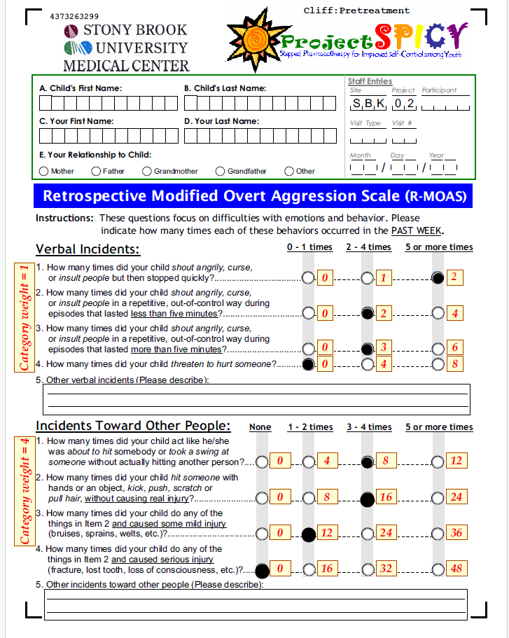

Slide 12
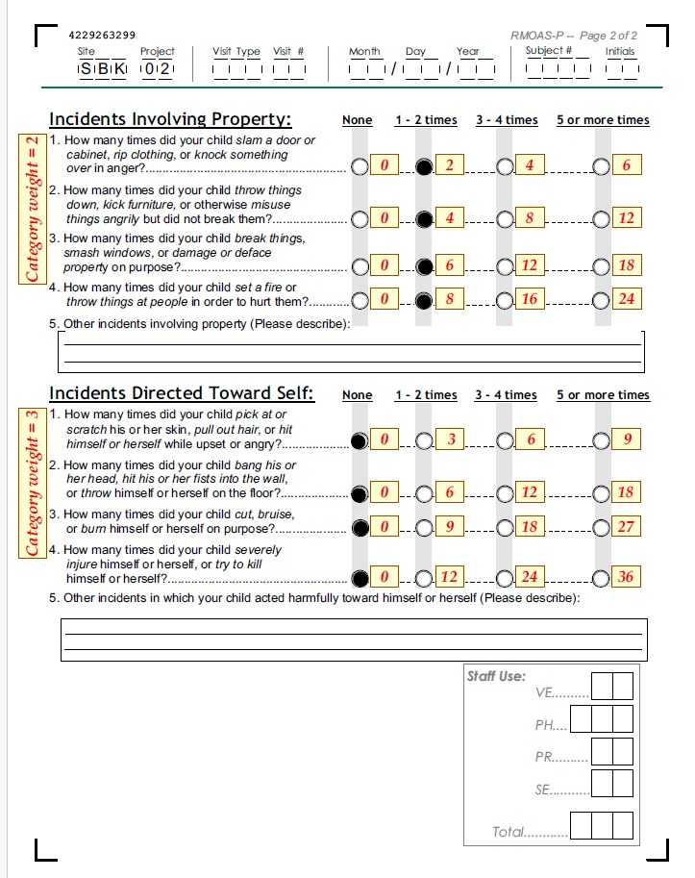

Slide 13
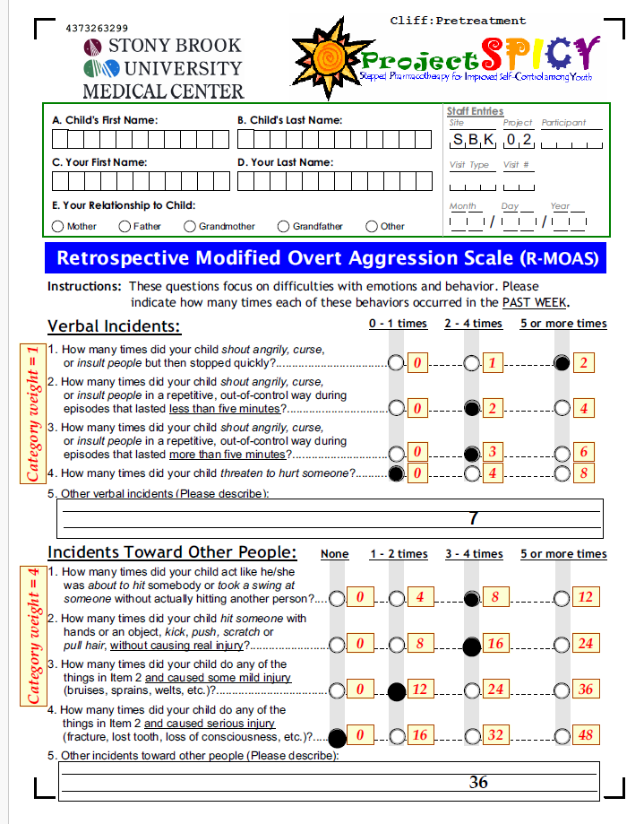

Slide 14
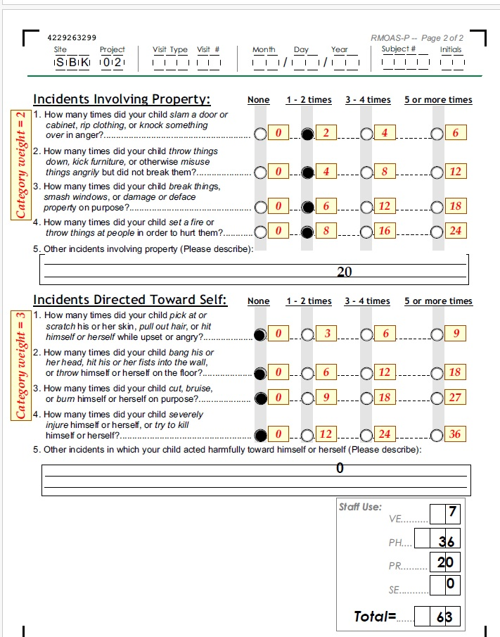

Slide 15
Cliff - clinical summary
assessment completed, including standardized rating scales
Diagnosis: ADHD with severe aggression and
No additional co-morbidities
No history of trauma, bullying or substance use
ADHD symptoms are well controlled on stimulant medication

Slide 16
What would you do next?

Slide 17
Psychoeducation Pearls
Present your understanding that the child’s “system is on overload” and what is underpinning the aggression
“No fault” position with parents and child
Parents need support but also strategies
Tension often builds up to a “red zone”: encourage observing the precipitants, evolution, places of detouring
Positive approach
Positive reinforcement
“Catch the child being good”
Don’t reward negative behaviors unwittingly

Slide 18
School
Make contact (or ensure parents do) with school point person
Obtain information and identify resources that school may be able to provide
504 or IEP

Slide 19
Psychosocial Treatment First Line: Connect before you Correct!
Provide or assist the family in obtaining evidence based psychotherapy (first line).
Assist and support in maintaining consistent behavioral strategies
Generally referred to as
parent management training or behavior management
Coping skills for child
For severe situations consider more intensive or “wraparound” services

Slide 20
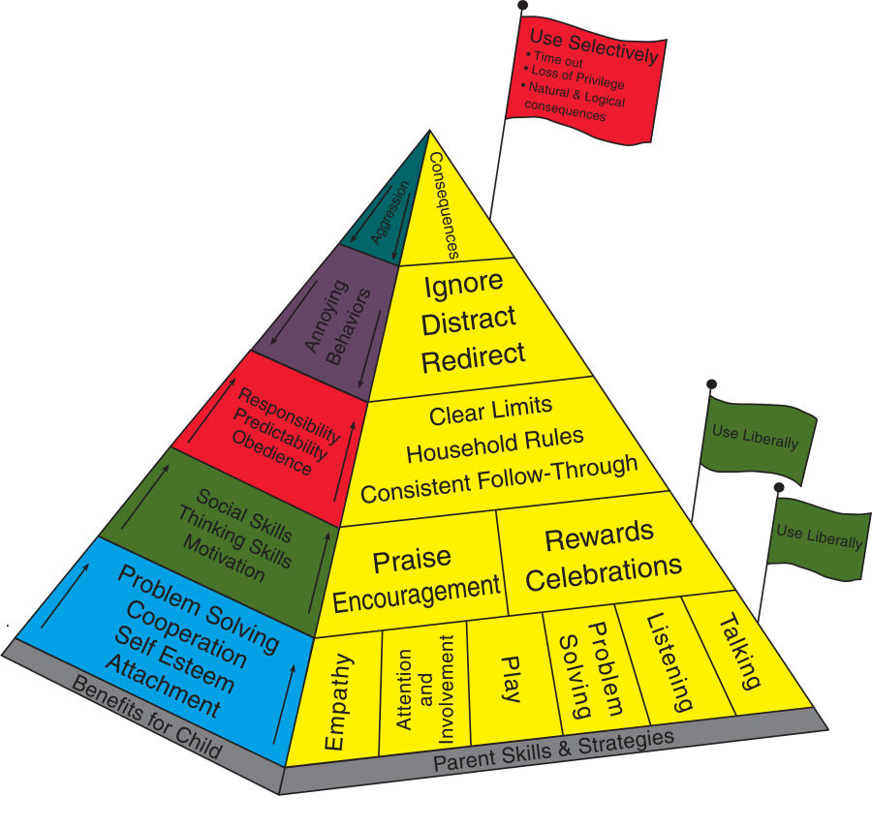
Incredible Years Parenting Pyramid

Slide 21
Now We Get to Medication Management: Treat the Underlying Condition First
Cliff’s ADHD symptoms well managed
No other comorbidities
Level of aggression severe and major life consequences appear likely
Injured mother
Frequent episodes of verbal and physical aggression at home, school
Removed from after school program

Slide 22
What would you do next?

Slide 23
A) Switch to a different class of stimulant
B) Add an alpha agonist
C) Start Risperidone
D) Increase dose of Concerta
E) Call Project Teach

Slide 24
Start alpha agonist
Pros: lower side effect burden
Con: less likely to be effective
Start Risperidone
Pros: more likely to be effective
Cons: higher side effect burden, especially weight gain

Slide 25
Cliff was prescribed a low dose of Risperdal, initially 0.25 mg hs
and later increased to 0.25 mg bid

Slide 26
Cliff 2 weeks later

Slide 27
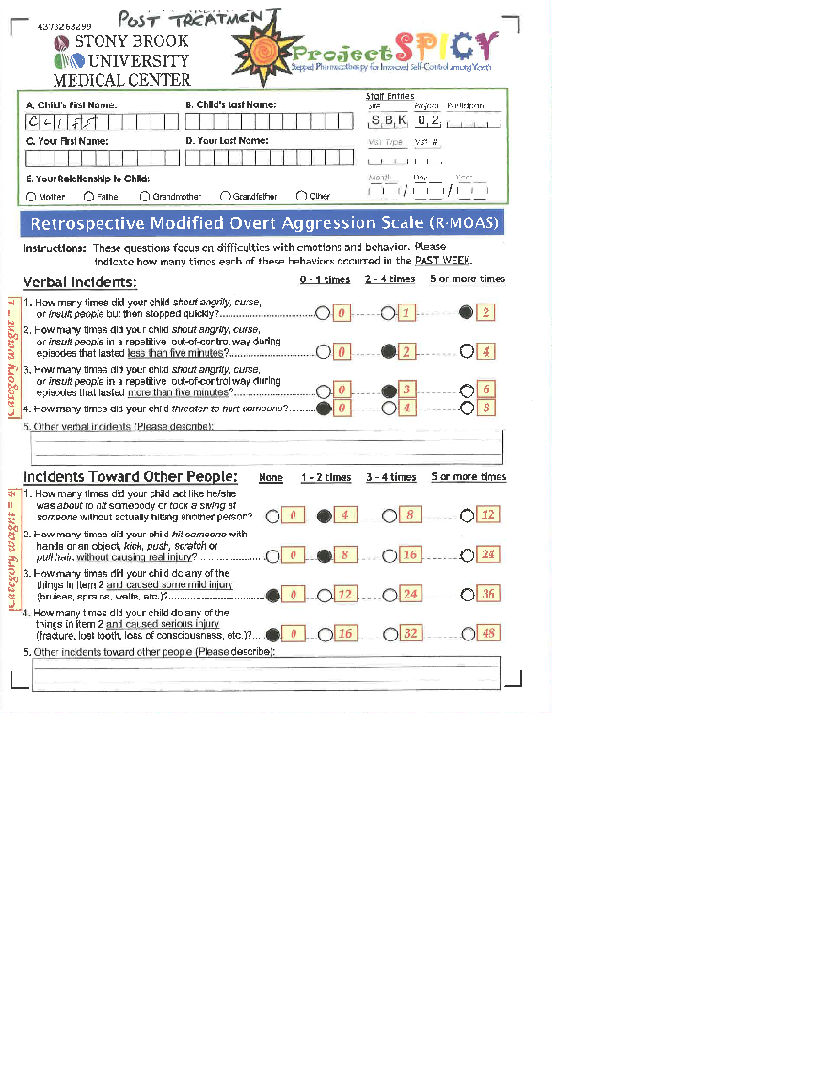

Slide 28
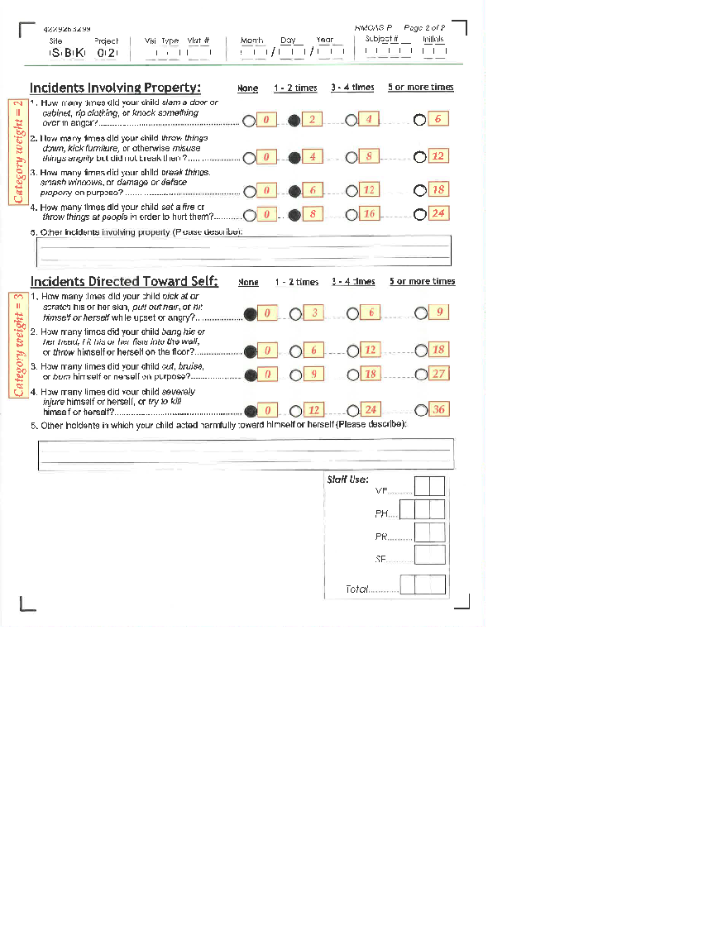

Slide 29
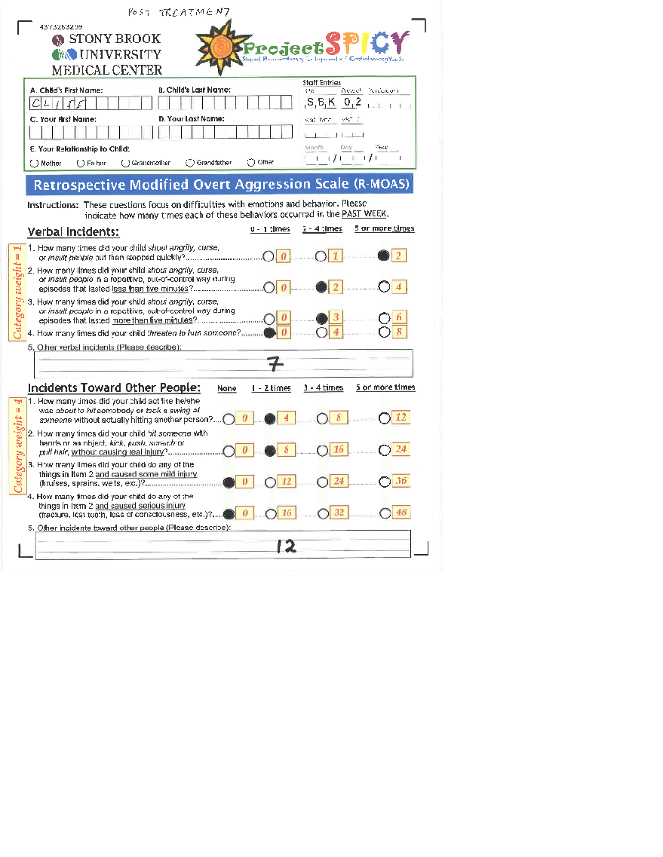

Slide 31
What would you do next?

Slide 32
A) Increase the Concerta
B) Add an alpha agonist
C) Increase Risperidone to 0.5 mg BID
D) Call Project Teach

Slide 33
Cliff’s Risperdal was increased to 0.5 BID

Slide 34
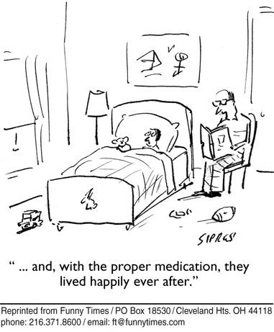

Slide 35
Cliff 1 month later
Much improved, doing well at home, school
Continues in therapy.
MOAS score has dropped further to 8
Continue risperidone 0.5 BID

Slide 36
Cliff 6 months later
Doing well.
Continues in therapy.
MOAS score 3
Self esteem has improved
Consider tapering Risperdal by .25 mg Q1-2 months
Follow-up and discontinue Risperdal if appropriate

Slide 37
40% of severe adult aggression begins before age 8
Treating childhood aggression can reduce the likelihood of persistence into adolescence and adulthood

Slide 38
Summary - aggression mgmt in primary care
Aggression - common symptom in primary care
Multifactorial - associated with many mental health dx
STEP 1 - Thorough assessment (identify primary diagnosis and co-morbidities, severity)
STEP 2 - Treat primary diagnosis to remission if possible, using multimodal E/B interventions
If aggression persists and is severe (safety), consider SHORT TERM use of atypical antipsychotic
Call Project Teach for assistance

Slide 39
PCP can and should be skilled in prescribing atypical antipsychotics for severe aggression
Use of atypical antipsychotics is indicated only after completion of a thorough work-up and failure of E/B treatments
Use of atypical antipsychotics in primary care is time limited and includes careful follow up and monitoring for side effects

Slide 40
Clinical pearls
How we talk to parents about the complex factors that play a
role in oppositional/aggressive behaviors sets the
stage for treatment
PCP commitment to child and family for the long-haul is
crucial

Slide 41
QUESTIONS?

Slide 42
Conclusions: Assessment and First Steps
Aggression is a symptom and need to understand what is underlying condition and precipitant(s)
Engage the family and child
Conduct a thorough assessment to understand
Severity and dangerousness of the aggression (use rating scales)
Rule out trauma
Factors relevant to aggression in the child/adolescent (what’s driving the aggression and what tipped over apple cart?)
Provide psychoeducation and support

Slide 43
Conclusions: Treatment
First: triage safety
Second: psychosocial interventions first line
Third: if unresponsive to psychosocial interventions or aggression serious, consider medications
Fourth: with medications, first treat the underlying condition
Fifth: if all else fails, aggression severe, consequences serious consider an atypical antipsychotic
Sixth: if first atypical fails then try 2nd
Seventh: if still doing poorly, refer
At any step don’t hesitate to call Project TEACH
1-855-227-7272!

