Slide 1
Aggression - Treatment
  Breck Borcherding MD
  Spring 2024

Slide 2
Speaker:
Breck Borcherding MD
Contact:
Project TEACH

Slide 3
Disclosures
There are no relevant financial relationships
or commercial interests to disclose.

Slide 4
Aggression is a symptom/sign
(like fever or pain),
not a diagnosis.

Slide 5
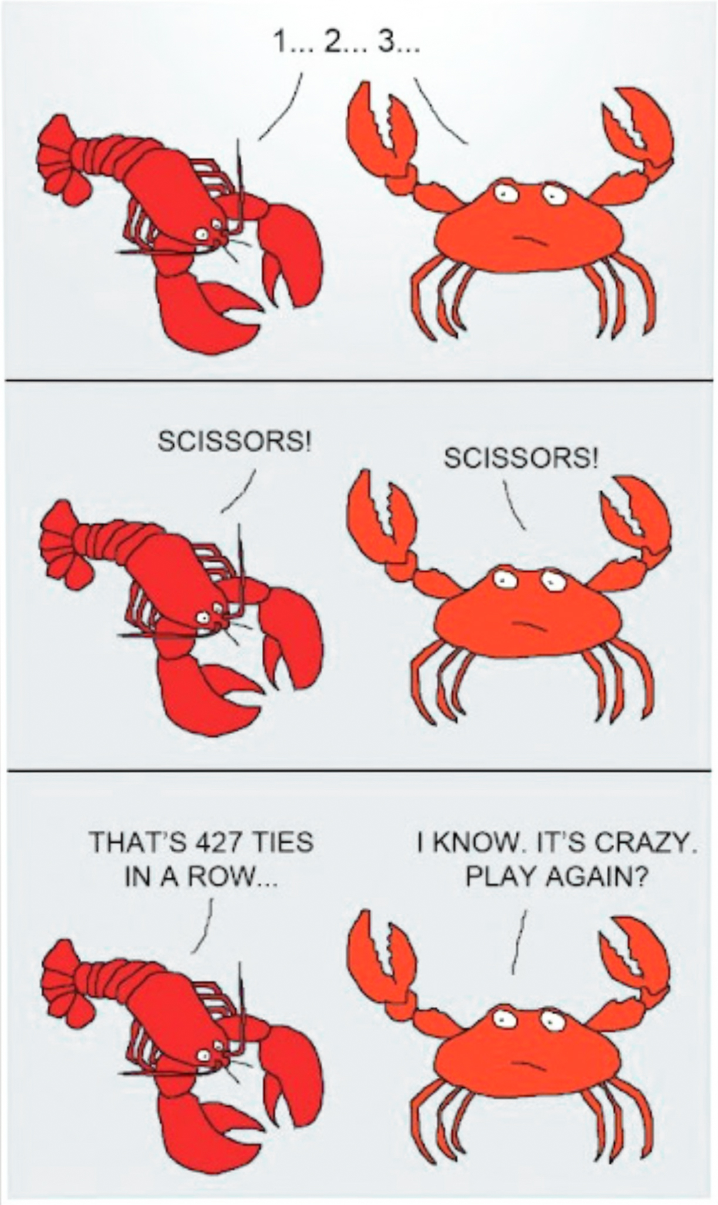
If you only have one strategy, you will never win.

Slide 6
Aggression algorithm
Assess the case thoroughly for comorbidity and REVIEW SAFETY.
Review the case formulation with parents and the team to be sure everyone is on the same page.
Set up psychosocial therapies and supports (always needed).
Treat complex comorbidity intensely.
Are short-term antipsychotics necessary to treat aggression as a serious symptom? Get consultation.
Follow-up with the team, and seek consultation as needed.

Slide 7
Aggression algorithm
1Assess the case thoroughly and REVIEW SAFETY CONCERNS.
Do a thorough psychosocial and comorbidity assessment.
What has been done before? What are antecedents to the behavior, and what are effective and ineffective consequences?
Set targets to review for treatment response. Use MOAS for aggression, other scales for comorbidity.
ASSESS SAFETY. Is an emergency assessment/ intervention needed?

Slide 8
Aggression algorithm
2 Review the case formulation and a plan with parents and the team to be sure everyone is on the same page.
  Review with both parents and therapist(s)/treatment team
    Formulation
    Target behaviors
    Comorbidity (psychiatric or psychosocial)
    Need for a comprehensive plan if problem is severe
  Is everyone on the same page? Get the treating therapist opinion.

Slide 9
Aggression algorithm
3 Set up psychosocial therapies and supports (always needed).
What therapies to consider?
Age (and diagnosis) related variables

Slide 10
3 Psychosocial therapies for aggression and comorbidity targets
Individual child therapies
  CBT (cognitive behavioral) therapies for self management
  Treatments for trauma or other comorbidity
Parent-child therapies for behavior
  Parent education
  PCIT
  Triple P/PPP
  Behavioral therapies focusing on managing antecedents and consequences
School related supports and therapies
  Data gathering and positive behavioral supports
Systemic therapies for older patients
  Individual/parental/marital/family therapies
  Multisystemic therapy

Slide 11
3 Child only psychotherapies
  Coping skills for child: learning how to calm self, what puts them in the “red zone”, what to do to prevent, when best time to intervene
  An individualized recipe such as “modular” therapies (Match-ATDC Bruce Chorpita and John Weisz) for comorbidity of anxiety, trauma, depression, conduct
  But BEST in concert with parent-child work

Slide 12
3 Parent-child therapies for aggression
Coercive aggressive processes within a family are intergenerational (Patterson,1980s)
  Child observes modeled “successful” aggression in family
  Escalation of violence by child to have family submit to child’s wants (appeasement)
  Pattern of aggression is reinforced in all family members
Antecedents and consequences of aggression are important to consider in all cases.

Slide 13
3 Parent-child therapies
First focus on engagement and positives (e.g. play, read, “catching them being good”
Attention to how limits set/structure provided
  Proactive parents better than reactive
  Parents need to be clear about what problem behaviors targeted
  Clear about when occurrence is a problem
  Pre-decided realistic rewards and consequences and ignoring
  Focus on positive behavior to reward
  Apply fairly and nonjudgmentally/ “emotionally neutral”
  All parental figures work together and follow through

Slide 14
Aggression algorithm
View aggression
as a symptom,
not a diagnosis!
4 Treat complex comorbidity intensely with therapies and meds.
  ADHD
  Mood/DMDD/Anxiety
  Developmental problems/autism
  Others-
    Oppositional defiant disorder
    Trauma
    Bullying
    Undersocialized conduct disorder with callous traits

Slide 15
Severe
Anxiety
ADHD
spectrum
Mood
spectrum
Tourette’s
/OCD
PTSD
Cluster B
personality disorders
Developmental
disorders
Antisocial
Borderline
Impulsivity
and
Aggression
Conduct
Disorder
Substance
abuse
Autism
Spectrum
disorders
Schizophrenia
Spectrum
Impulse
control
disorders
Slide from REACH program

Slide 16
4 An example of ADHD and aggression
ADHD and aggression
  Aggression common in ADHD as impulsivity-associated problem
  Maximizing stimulant dosing may negate the need for more complicated and problematic med regimens (Joseph Blader et al JAACAP 2021)
  Balance positive target effects and problematic side effects
  Consider adding alpha-adrenergics (clonidine and guanfacine) as additions at higher doses
  Double-down on nonmedication psychotherapies for ADHD

Slide 17
4 What if an anxiety disorder?
Example: a recent onset of strong aggressive outbursts at school consistent with worsening anxiety at the start of a new school program in setting of chronic separation anxiety.
  Aggression is only a symptom
  Is there trauma?
  Active intense treatment of separation anxiety marshalling family and school planning and resources to treat anxiety
  Strong but careful consideration of an SSRI and CBT
  Decrease in acute anxiety may likely decrease target aggression at school

Slide 18
4 What about chronic tantrums or mood fluctuations with aggression?
Children or adolescents may have chronic (or intermittent) frequent violence associated with inability to control temper possibly associated with chronic irritability (or periods of fluctuating strong mood swings)
  Aggression is only a symptom. Look at mood checklist data. Has there been trauma?
  Consider depression and associated chronic irritability
  Consider bipolar disorder/manic agitation, though rare
  Assess suicidality and safety
  Individual and family-oriented therapies and supports are indicated
  Assess for appropriateness of SSRI or mood stabilizers

Slide 19
4 What about autism or a significant neurodevelopmental disorder with increasing aggression?
A child has autism and significant aggression associated with demands being placed on him regarding his adherence to class routine versus his insistence on rigid interests and routines.
  Aggression is only a symptom. Look at antecedent-behavior-consequence (ABC) data. What leads to or maintains the symptom behavior? Is safety a concern?
  Is there comorbid ADHD or anxiety to treat?
  Aggression in developmental disability has a strong behavioral component typically. Is there a behavioral specialist involved?
  Is this a case for risperidone or aripiprazole consideration when other interventions have failed?

Slide 20
Case example- Cliff
Cliff (our example child with long-standing ADHD) has been treated successfully with Adderall XR 10 mg until this year. There have been recent episodes of aggression in an afterschool program serious enough for him to be considered for dismissal from it. On one occasion, another child was injured and sent to the emergency room. At this time, which of the following would be an inappropriate further sequence for investigation or intervention?
Assess any acute stressors such as bullying or family issues.
Start 0.25 mg of risperidone in the morning.
Increase Adderall dosage in the morning.
A trial of clonidine in the afternoon.
Relook at diagnoses.
Referral for further assessment and therapy support.
All could be appropriate in
a thoughtful sequence!

Slide 21
Cliff’s case
A reasonable sequential approach to changes in presentation
Assess any acute stressors such as bullying or family issues.
Relook at diagnoses.
Increase Adderall dosage in the morning.
A trial of clonidine in the afternoon.
Referral for further assessment and therapy support.
Start 0.25 mg of risperidone.

Slide 22
Aggression algorithm
5 Consider carefully antipsychotics (SGA’s) for acute use in any aggression case.
Use if …
  there are significant safety concerns
  and
  after other interventions (med AND psychosocial/ behavioral) fail
Identify target symptoms, review past treatments as adequate for the problem, and consider any other alternative first.

Slide 23
5 Where do antipsychotics fit in the aggression algorithm
  Liberally refer or seek consultation at this point.
  CMS has introduced Measures Inventory Tool 2800 (metabolic monitoring) and 2801 (first line psychosocial treatments) as part of their compliance monitoring of health systems
  Educate the family about risks and short term duration as goal. These meds are powerfully effective and families may argue about discontinuation when they work. Discontinue slowly after 6 months or one year of a trial. Make sure other nonmedication therapies are in place.
  Choose risperidone or aripiprazole as a trial. These are only FDA approved for irritability in autism.

Slide 24
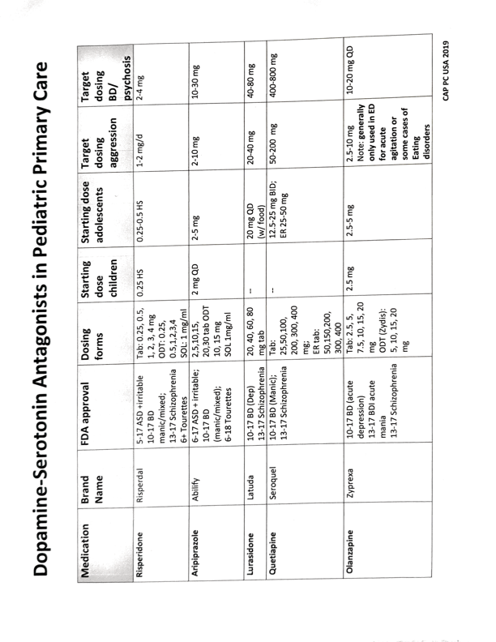
5 Antipsychotic use in aggression
SEE HANDOUTS FOR NEWEST VERSION

Slide 25
5 Antipsychotic side effects
Common, serious: weight gain, hyperlipidemia, diabetes
Rare, serious: Neuroleptic malignant syndrome, agranulocytosis (mostly clozapine), increased LFTs, tardive dyskinesia (long term)
Cognitive: sedation, slowed, memory
Neurologic: dystonia, akathisia, akinesia, rigidity, tremor, lowered seizure threshold, withdrawal dyskinesia
Endocrine: elevated prolactin, gynecomastia, galactorrhea, fertility concerns (with risperidone, NOT aripiprazole)
Cardiovascular: increased QT (ziprasidone), orthostatic hypotension

Slide 26
56e) Antipsychotic monitoring5
5

Slide 27
5 Other meds in aggression
    Valproate
    Carbamazepine
    Neurontin
    Lamotrigine
    Lithium
    Propranolol
    Although often used, and sometimes effective in individual cases, there is not good data on their general effectiveness before using previous parts of the algorithm.
    Seek consultation.

Slide 28
Aggression algorithm
6 Follow-up
Intermittently follow-up regarding progress on target symptoms with all treatment team members, monitoring comorbidity and adjusting the plan as necessary.
Seek consultation as needed

Slide 29
Aggression algorithm
Assess the case thoroughly and REVIEW SAFETY.
Review the case formulation with parents and the team to be sure everyone is on the same page.
Set up psychosocial therapies and supports (always needed).
Treat complex comorbidity intensely.
Are short-term antipsychotics really necessary?
Follow-up with the team, and seek consultation as needed.

