Slide 1
Assessment of Aggression in Children and Adolescents
Wanda Fremont MD
Professor, Department of Psychiatry and Family Medicine
Norton College of Medicine SUNY Upstate Medical University

Slide 2
Speaker:
Wanda Fremont MD
Professor, Department of Psychiatry and Family Medicine
Norton College of Medicine SUNY Upstate Medical University
Contact:
bborcher@montefiore.org

Slide 3
Disclosures
My family has no relevant financial relationship with a commercial interest to disclose.

Slide 4
Goals and Objectives
Learn the various types of aggression presenting in clinical settings
Differentiate among pediatric problems that present with aggression, including depression, ADHD, bipolar disorder, psychosis, and conduct disorder.
Learn how to assess and evaluate for children who present with aggressive symptoms

Slide 5
Let’s Meet Cliff and his Mother

Slide 6
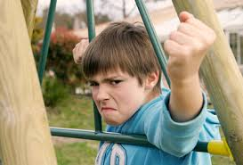

Slide 7
Cliff
Identifying Information:
Cliff is a 9 year old boy who lives with his parents and 2 siblings. He attends 4th grade.
Chief Concern:
“We’ve had a tough spring and summer with Cliff. He gets his Concerta every morning. His problems with poor attention and hyperactivity have improved and his grades are better. But his temper is a real problem.”

Slide 8
Cliff: History of Present Illness
History of Present Illness:
Cliff has had difficulties with attention and hyperactivity for years.
He was started on Concerta 18 mg a year ago.
The dose was gradually raised up to 54 mg with continued improvement.
His mother now reports increased oppositional behaviors at home: he is
constantly testing limits and tantrums when he does not get his way.
His tantrum episodes occur almost daily at home and out of the house, which is embarrassing for mom and is is getting worse.
He threw a toy at his mother and she needed to go to the emergency room for stitches.

Slide 9
Cliff: History of Present Illness cont.
On one occasion Cliff slammed a door and it broke a picture.
School staff have noticed oppositional and aggressive behaviors. He is mean to other children and his classmates do not want to play with him. He pushed a boy in the lunchroom.
Cliff gets mad when he does not get his way but at other times is a cheerful child. Cliff denies feeling sad. He is not a worrier and has no thoughts of killing himself. He punches walls when he gets angry but has no other self-injurious behavior. He is sleeping and eating well. The only recent stressor at home has been that Cliff’s aunt can no longer help with babysitting.

Slide 10
Cliff
Past Psychiatric Illness: Prior history of ADHD treated by PCP
Medical History: Well child
Developmental History: Normal pregnancy and delivery. Walked at 11 months, first words 14 months, phrases by 2 years
Abuse: Denies. Mom and Dad have yelled at Cliff recently when they are frustrated with him
Family Medical & Psychiatric History: Mom has been treated for depression. Dad had “behavioral problems as a child”

Slide 11
Cliff’s Vanderbilt

Slide 12
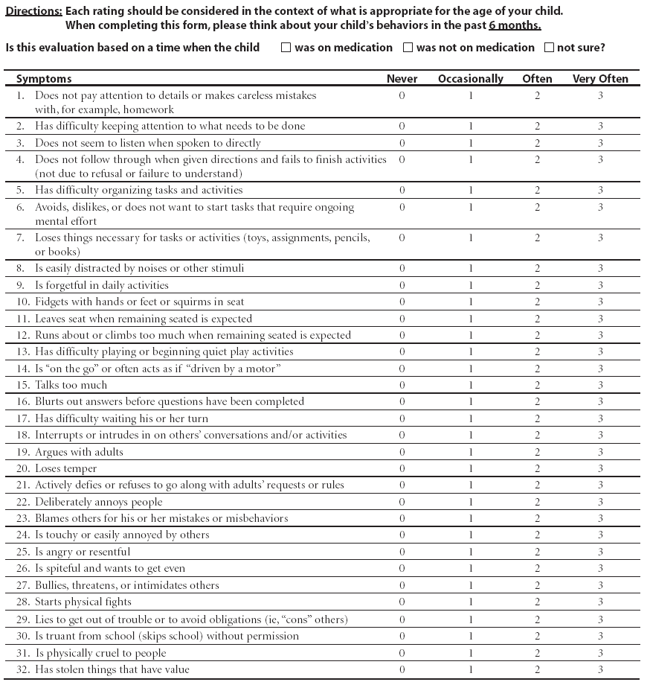
NICHQ Vanderbilt Assessment Scale:
Parent information
Notes:
Updated 8/26/13 by PSJ
THIS SLIDE IS HIDDEN – INCLUDED HERE MOSTLY FOR THE PRESENTER. YOU CAN “UNHIDE” IT IF YOU WISH.

Slide 13
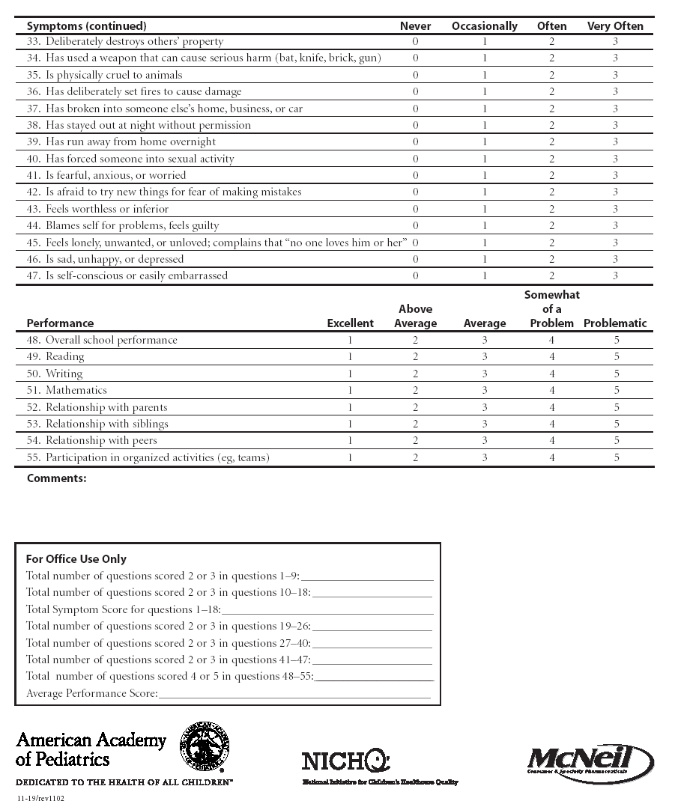
NICHQ Vanderbilt Assessment Scale:
Parent information
Notes:
Updated 8/26/13 by PSJ
THIS SLIDE IS HIDDEN – INCLUDED HERE MOSTLY FOR THE PRESENTER. YOU CAN “UNHIDE” IT IF YOU WISH.

Slide 14
Cliff’s Vanderbilt - Scored
Total number of questions scored 2 or 3 in questions 1-9: Inattention | 2
Total number of questions scored 2 or 3 in questions 10-18: Hyperactivity | 1
Total Symptom Score for questions 1-18: Inattention and hyperactivity | 3
Total number of questions scored 2 or 3 in questions 19-26: Oppositional | 5 > 4 = ODD
Total number of questions scored 2 or 3 in questions 27-40: Conduct | 0
Total number of questions scored 2 or 3 in questions 41-47: Anxiety and depression | 0
Total number of questions scored 2 or 3 in questions 48-55: Performance | 8
Average Performance Score:

Slide 15
What would you do?

Slide 16
Assessment of Aggression The “Fever” of Psychiatry

Slide 17
Aggression in Children & Adolescents
Most common reason for psychiatric referral
Aggression is not a psychiatric diagnosis
Complicates treatment and leads to poorer outcomes
Frequent use of atypical antipsychotics and multiple medications
Lack of controlled trials to inform physicians’ prescribing practices

Slide 18
Aggression in Children & Adolescents
Aggression is “final common pathway” when system overwhelmed
Associated with almost all DSM diagnoses
Occurs when the demands of the world outstrip our resources (internal and external)
Aggression typically stems from excessive anger and is a secondary emotion
Questions to ask:
What changed? What tipped over the
What tipped over the apple cart??

Slide 19
Impulsive-Aggressive Spectrum
ADHD spectrum
Severe
Anxiety
Bipolar spectrum
Tourette’s
/OCD
Schizophrenia
Spectrum
Developmental
Disorders
Impulsivity and
Aggression
Autism Spectrum
Disorders
PTSD
Conduct
Disorder
Substance abuse
Cluster B personality
disorders

Slide 20
Type | Clinical Description | Representative DSM Dx
Impulsive | Unprovoked, brief, rapid, thoughtless, inability to delay reward/recognize consequences; out of proportion and out of the blue | ADHD TBI ID Bipolar
2. Affective Storm/”Hot” | Exaggerated response to affectively provoked or charged (i.e. difficulty modulating arousal), reactive. “Hot blooded” aggression. Extended duration (30+ minutes) | ADHD ASD/ID Substance abuse MDD/DMDD Bipolar
3. Anxious/hyperarousal | Overstimulation, overwehelmed, response to xs anxiety; lash out with relief of tension | PTSD PDD OCD
4. Cognitive/disorganized | Distorted perceptions, impaired reasoning, delusions, paranoia | Psychosis Bipolar Schizophrenia TBI/FASD Substance Abuse
5. Predatory/”Cold” | Premeditated, consciously executed, instrumentally motivated, “cold blooded” | Conduct Disorder Antisocial PD

Slide 21
Assessment of Aggression

Slide 22
Clinical Pearl
In children, first consider trauma and loss, then look for what condition(s) is underpinning aggression:
- ADHD
- Anxiety
- Depression

Slide 23
Differential Diagnosis
ADHD spectrum
Severe
Anxiety
Bipolar spectrum
Tourette’s
/OCD
Schizophrenia
Spectrum
Developmental
Disorders
Impulsivity and
Aggression
Autism Spectrum
Disorders
PTSD
Conduct
Disorder
Substance abuse
Cluster B personality
disorders

Slide 24
Assessing Aggression
Characterize the aggression:
What kind of aggression? Verbal? Physical?
Who/what is target? Self? Others? Property?
How severe, frequent and dangerous is the aggression?
Other important questions to answer:
Do they have a condition that might be underpinning the aggression?
What tipped the apple cart over and when?
Is the child being abused or bullied?

Slide 25
Aggression Assessment: Take your time!
Resist the need to prescribe on the first visit!
- Interview family together – observe dynamics
- Interview patient and parent/guardian
separately
Family History, Psychosocial History and strengths
Get input directly from school
Use standardized rating scales
Physical examination and labs (typically none)
Notes:
Updated 8/26/13 by PSJ
Comprehensive diagnostic interview with patient and parent/guardian.
Contact prior treating physicians
Review treatment records
Identify other medications being taken
Conduct a physical examination
Order appropriate laboratory studies
Background Information
A psychiatrist should conduct a comprehensive diagnostic interview with children/adolescents and their parents/guardians before initiating or altering treatment regimens. It is important to contact physicians who have previously treated the patient and to obtain all prior treatment records, including prior medications. Since some symptoms may have an organic basis, it is also essential for the patient to have a physical examination and to undergo appropriate laboratory studies.

Slide 26
Use Standardized Measures
Underlying condition
Vanderbilt, SCARED, PHQ, etc.
Aggression
Modified Overt Aggression Scale (MOAS)
Nisonger Child Behavior Rating Form (N-CBRF)

Slide 27
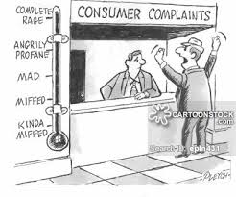

Slide 28
Modified Overt Aggression Scale (MOAS)
Aggression subtypes
- Verbal Incidents
- Incidents involving property
- Incidents towards other people
- Incidents directed towards self

Slide 29
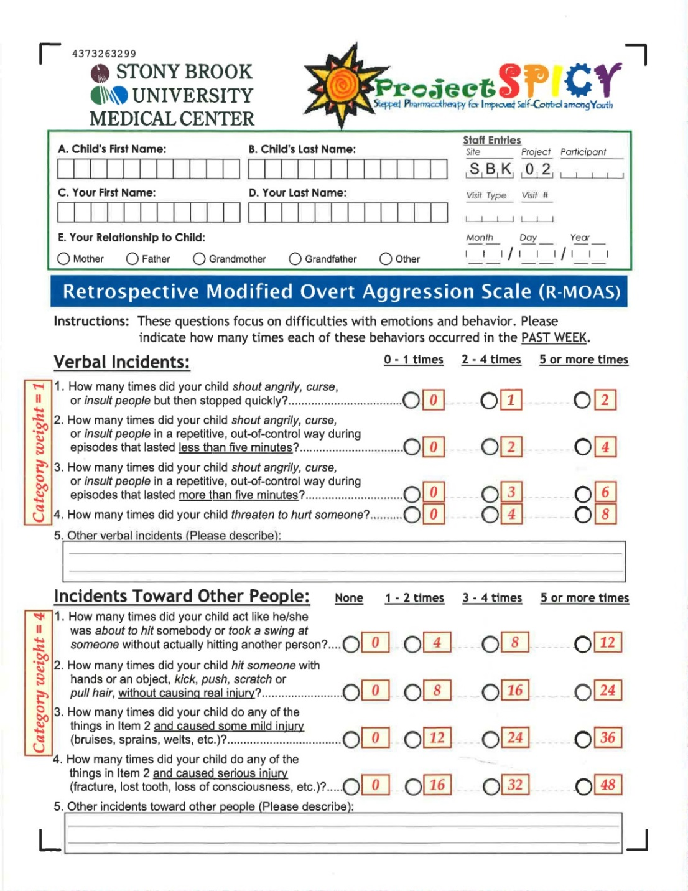

Slide 30
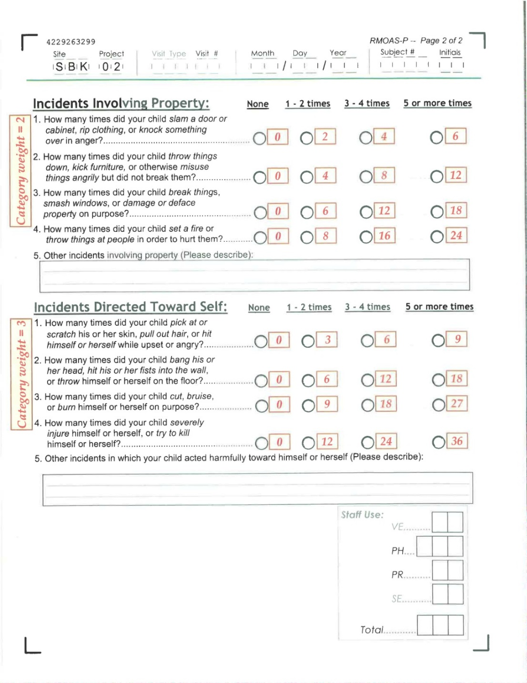

Slide 31
Develop Initial Treatment Plan
Safety assessment and referral: Mental Health specialist or ER
Be sure there is no ongoing maltreatment/trauma
Partner with family and child in developing step by step plan
What has been tried?
Family and patient preference and capacity
Strengths and resources

Slide 32
Conclusions: Assessment and First Steps
Aggression is a symptom and need to understand what is underlying condition and precipitant(s)
Engage the family and child
Conduct a thorough assessment to understand
Severity and dangerousness of the aggression (use rating scales)
Rule out trauma
Factors relevant to aggression in the child/adolescent (what’s driving the aggression and what tipped over apple cart?)
Provide psychoeducation and support

