Slide 1
Treatment of
Anxiety Disorders in Children and Teens
  Zoya Popivker, D.O.
  Child and Adolescent Psychiatrist
  Northwell Health
Notes:
Decide what font you want to use for titles/heading and make them the all same.

Slide 2
Speaker:
Zoya Popivker, D.O.
Northwell Health
zpopivker@northwell.edu
516-927-1630

Slide 3
Disclosures
Neither I nor my spouse/partner has a relevant financial relationship with a commercial interest to disclose.

Slide 4
Anxiety:
Objectives for Primary Care
Gain resources for anxiety education
Discuss the role of avoidance in anxiety disorders
Understand which kind of psychotherapy is best for anxiety
Identify the first line of medication for pediatric anxiety disorders

Slide 5

Emily
8 yo girl who is brought in because of stomach aches
Evaluated by GI and no medical condition identified
Difficulties getting her to school since kindergarten
  Crying at drop off, clingy to parent
In 2nd grade missed 10 days of school
Now in 3rd grade, has missed 20 days of school to date
  Even when she gets to school, she goes to nurse often with stomach aches, sometimes the only resolution is mother picking her up early
No academic issues
If mom unable to pick her up Emily calls frequently to “check in” and make sure that “nothing bad happened”
At home she appears comfortable, pleasant, watches TV
Maintains friendships with small group of girls she has know since pre-K
  Does not enjoy play dates or want sleepovers at friend’s homes
During office visit, she is quiet, but smiles easily
PE is unremarkable
No known trauma/loss
SCARED: 38
Notes:
School avoidance
Somatic sxs

Slide 6
What treatment would you recommend ?
a. Write a letter for Home Instruction
b. Refer for therapy and collaborate with the school
c. Start a medication for anxiety
d. Wait and monitor for now

Slide 7
1. Lifelong Anxious Temperament
2. Family History of Anxiety Disorders
Early Intervention
For “At Risk” Kids

Slide 8
Goals of Early Intervention
Parents education about anxiety
Prevent Anxiety Disorders in children with anxious temperament
  Reward and model curiosity, exploration
  Reduce avoidance and overprotectiveness
Prevent generational transmission of Anxiety
Adapted from Slide courtesy of Dr. Zuckerbrot

Slide 9
Anxiety Education
What is Anxiety?
  Anxiety is normal and helpful in small doses
Why me?
  Genes, temperament and experiences
  Development of “thinking traps”
  Behavior trap - escape and avoid leads to more anxiety
Slide courtesy of Drs. Albano and Rynn

Slide 10
Treatment of Anxiety Disorders
It Depends on Severity
Consider the 3 ‘Ps’:
Pervasive
Persistent
imPairing
Mild
Moderate
Severe

Slide 11
Severity
 | SCARED | Distress | Avoidance
Mild | <30 | Some | Minimal
Moderate | 30-40 | Good deal | Some
Severe | 41+ | A lot | A lot
Notes:
SCARED = 38
Distress???
Avoidance = 20+ school days missed

Slide 12
Mild Anxiety Disorder
Treatment Planning
  Educate/support/monitor/nudge
  Bibliotherapy
  Online programs
    1. BRAVE for Children (can be purchased by parent)
    2. Camp Cope-A-Lot (can be purchased by a “therapist”)
Slide courtesy of Dr. Zuckerbrot

Slide 13
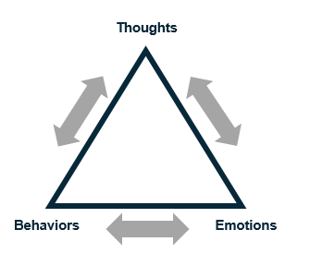
Cognitive Behavioral Therapy
Educate the patient and parent
Teach self-soothing and somatic management
Identify and change maladaptive thinking
Increase proactive approach behavior (graduated EXPOSURE)
Notes:
From Dr. Foley:
Exposure-based CBT has the most empirical support for the treatment of anxiety disorders in youth
Psychoeducation (educating the patient and the family about the disorder, its course, management and treatment)
Somatic Management Skills training (relaxation, diaphragmatic breathing, self-monitoring)
Cognitive restructuring (challenging negative exectations and modifying negative self-talk)
Exposure methods (imaginary and in vivo exposure with gradual desensitization to feared stimuli)
Relapse prevention plans (booster session sna coordination with parents and school)
Coping Cat (Kendall, 1990) –just google

Slide 14
Goals of CBT
Extinguish avoidance behavior
Increase healthy problem-solving
Facilitate insight and self-efficacy
Solidify gains and promote generalization
Slide courtesy of Drs. Albano and Rynn
Notes:
From Dr. Foley:
Exposure-based CBT has the most empirical support for the treatment of anxiety disorders in youth
Psychoeducation (educating the patient and the family about the disorder, its course, management and treatment)
Somatic Management Skills training (relaxation, diaphragmatic breathing, self-monitoring)
Cognitive restructuring (challenging negative exectations and modifying negative self-talk)
Exposure methods (imaginary and in vivo exposure with gradual desensitization to feared stimuli)
Relapse prevention plans (booster session sna coordination with parents and school)
Coping Cat (Kendall, 1990) –just google

Slide 15
Somatic Management
Breathing Retraining
Progressive Muscle Relaxation
Cue Controlled Relaxation
Goals
Develop tolerance of normal, expected levels of anxiety
Learn & utilize strategies to calm self during stressful/ fear provoking situations or tasks
Slide courtesy of Drs. Albano and Rynn

Slide 16
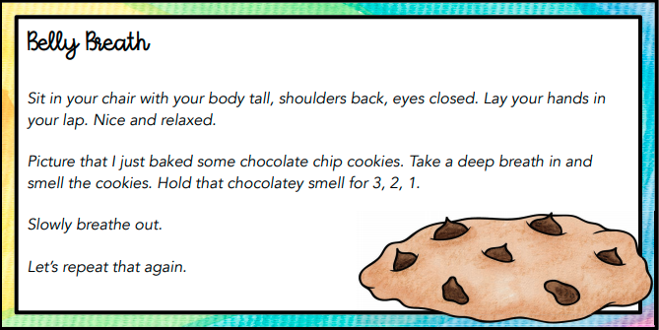
Notes:
I would describe these a quick examples that can be done in pcp office.
Consider the Ollendick Chocolate Cookie deep breathing example – easily done in the office

Slide 17



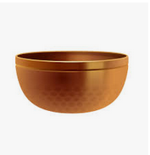
Apps
Headspace
Calm
Insight Timer
Stop, Breathe and Think
Notes:
Some are available for free for medical professionals

Slide 18
Q: What part of CBT is known to have the most powerful impact in lowering anxiety?
a. Psychoeducation – understanding anxiety
b. Relaxation Strategies – deep breathing, meditation
c. Exposure – doing what makes the patient anxious
d. Identify and change maladaptive thinking

Slide 19
Anxiety Fear Hierarchy
Fear Thermometer (SUDS)
Separation Anxiety Fear Hierarchy
Most Anxiety
Situation SUDS
Spending night at friend’s house 10
Spending 2 hours at friend’s– w/o mom 8
Spending 30 mins at friend’s– w/o mom 7
Mom leaving home for 30 minutes 6
Mom leaving home for 15 minutes 5
Mom going out to get mail 3
Mom going in a different room–nighttime 2
10
9
8
7
6
5
4
3
2
1
0
Least Anxiety
Slide courtesy of Drs. Albano and Rynn
Notes:
I might say quickly that this is an example of graduated exposure. JW
IS BOX ON RIGHT FORMATTED CORRECTLY?

Slide 20
Moderate Anxiety
Exposure-based CBT
or
Psychopharmacology

Slide 21
CAMS-
Child Anxiety Multimodal Study Overview
Separation Anxiety DO, Social Phobia, Generalized Anxiety DO
N = 488, ages 7-17
12-week acute trial: CBT, Sertraline, Comb, Pill PBO
Pills-only double blinded
Random assignment, blind Independent Evaluators
Phase II: 6 month maintenance for treatment responders
Slide courtesy of Drs. Albano and Rynn

Slide 22
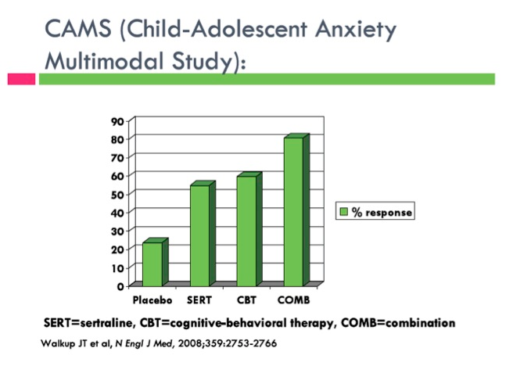
Child Anxiety Multimodal Study CAMS
COMB > CBT = SRT > PBO
81%
55%
60%
24%
CGI-I 1 and 2 (ITT, LOCF)
Walkup et al., 2008

Slide 23
Q: What medication have you prescribed for anxiety?
a. SSRI (sertraline, fluoxetine, escitalopram)
b. SNRI (duloxetine, venlafaxine)
c. Benzodiazepine (lorazepam, alprazolam, clonazepam)
d. Buspirone
e. None

Slide 24
Serotonin Reuptake Inhibitors with FDA Approval
Approved for OCD
  Sertraline > 6 yrs (SSRI)
  Fluoxetine > 7 yrs (SSRI)
  Fluvoxamine > 8 yrs (SSRI)
  Clomipramine > 10 yrs (TCA)
Approved for Depression
  Fluoxetine > 8 yrs (SSRI)
  Escitalopram > 12 yrs (SSRI)
Approved for Non-OCD Anxiety
  Escitalopram > 7 yrs GAD (SSRI)
  Duloxetine > 7 yrs GAD (SNRI)
Slide courtesy of Dr. Walkup
Notes:
21
How about for GAD, Social Anxiety and Social Phobia? None and Duloxetine only lately.

Slide 25
SRI Efficacy for Anxiety Disorders
Social Anxiety DO, Generalized Anxiety DO and Social Phobia
  Fluvoxamine – RUPP, 2001
  Fluoxetine – Birmaher et al, 2003
  Sertraline (CAMS) – Walkup et al, 2009
Social Phobia
  Paroxetine - Wagner et al, 2004
  Fluoxetine - Beidel et al 2007
  Venlafaxine - March et al, 2007-
Generalized Anxiety DO
  Sertraline - Rynn et al., 2001
  Venlafaxine, Rynn et al., 2007
  Duloxetine, Strawn et al 2015
  Buspirone in GAD, unpublished negative trial
Slide courtesy of Dr. Walkup

Slide 26
When to Choose SSRI Treatment with Moderate Anxiety
Patient and Parent preference
Exposure-based CBT unavailable
Patient is too anxious to start CBT
Good CBT has failed or only partially resolved symptoms

Slide 27
Severe Anxiety
Exposure-based CBT
and
Psychopharmacology

Slide 28
SSRIs
Are first-line pharmacologic treatment
Sertraline (Zoloft)
Fluoxetine (Prozac)
Escitalopram (Lexapro)

Slide 29
Sertraline
FDA approval for OCD (ages 6 to 17)
Start 25mg, increase by 25mg Increments
Therapeutic Range 50 to 200mg
Average dose in CAMS study 136mg!

Slide 30
Fluoxetine
Long-acting SSRI
FDA approval for OCD (ages 7 to 17) and MDD (ages 8 to 17)
Start 10mg
Therapeutic range 20mg to 40mg, max doses 60 to 80mg

Slide 31
Escitalopram
In May 2023, FDA approved for GAD in ages 7 to 17
Start 5mg, increase by 5mg increments
Therapeutic range 10 to 20mg

Slide 32
SSRIs
Anxiety often needs higher doses
Lower doses to start due to hypervigilance for side effects
WARN about side effects
Start low but use full therapeutic dosage range
Younger kids respond well but may have more side effects
Support, monitor progress and side effects at 2-4 weeks
Continue 6-12 months of remission before tapering
Plan the taper around expected stressors and school year

Slide 33
SSRI Side Effects
Common Side effects of SSRI’s:
  Dry mouth
  GI: Constipation, Diarrhea
  Sweating, rashes
  Sleep disturbance
  Sexual dysfunction
  Irritability
  “Disinhibition” (risk-taking behaviors, increased impulsivity, or doing things that the youth might not otherwise do)
  Agitation or jitteriness
  Headache
  Appetite changes

Slide 34
Side Effects
More serious side effects
  Serotonin syndrome (fever, hyperthermia, restlessness, confusion, etc)
  Akithisia
  Hypomania
  Discontinuation syndrome (dizziness, drowsiness, nausea, lethargy, headache)
  Suicidality
What to do about activation/disinhibition?
Lower dose or switch to another SSRI or SNRI

Slide 35
Benzodiazepines
Have NOT shown efficacy in controlled trials in childhood
Clinically, used as an adjunctive short-term treatment with SSRI’s to address severe anxiety symptoms (give small supply)
Contraindications: adolescents with substance abuse
Possible side effects: sedation, disinhibition, cognitive impairment, difficulty with discontinuation
  Less incentive to work in CBT
Notes:
I want to include

Slide 36
Summary
PCPs can identify anxiety early and educate the family
Effective treatment includes education, medication and exposure-based CBT
  Medication should not be considered “last resort”
Pediatricians’ support of treatment options liberates and empowers parents!
Adapted from slide courtesy of Dr. Walkup
Notes:
Tools include: psychoeducation, bibliotherapy, CBT, and meds

Slide 37
References and Resources
Walkup, J.T., Albano, A.M., Piacentini, J., Birmaher, B., Compton, S.N., Sherrill, J.T., et al. (2008) Cognitive Behavioral Therapy, Sertraline, or a Combination in Childhood Anxiety. New England Journal of Medicine, 359, 2753-2766.
Ginsburg GS, Kendall PC, Sakolsky D, Compton SN, Piacentini J, Albano AM, et al. Remission after acute treatment in children and adolescents with anxiety disorders: findings from the CAMS. J Consult Clin Psychol. 2011;79:806–13.
Walter HJ, Bukstein OG, Abright AR, Keable H, Ramtekkar U, Ripperger-Suhler J, Rockhill C. Clinical Practice Guideline for the Assessment and Treatment of Children and Adolescents With Anxiety Disorders. J Am Acad Child Adolesc Psychiatry. 2020 Oct;59(10):1107-1124.
Special Thanks to Jim Wallace for helping with editing.

Slide 38
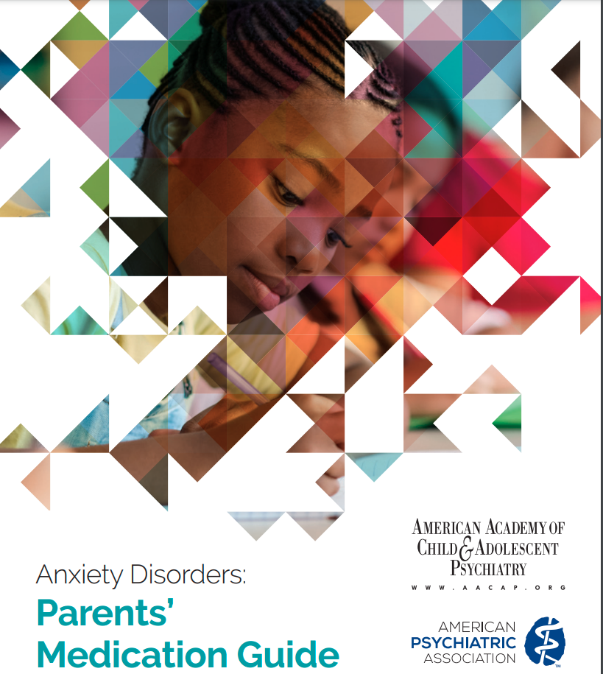

Slide 39
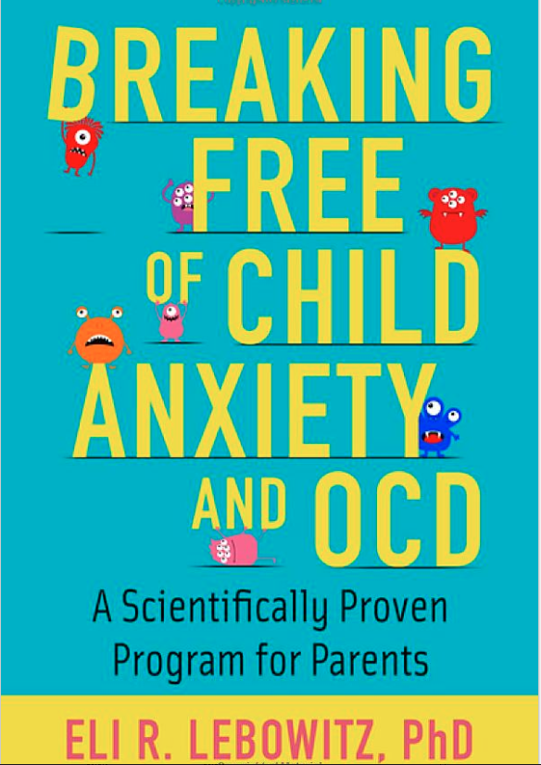
Books for Parents (and their doctors!)

Slide 40


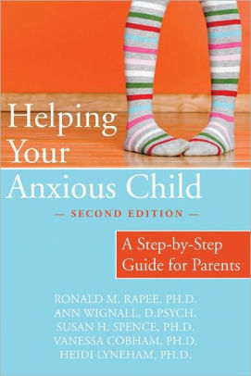

Books for Parents (and their doctors!)
Slide courtesy of Dr. Zuckerbrot
Notes:
I would be super quick on these slides and list them in references at the end.

Slide 41
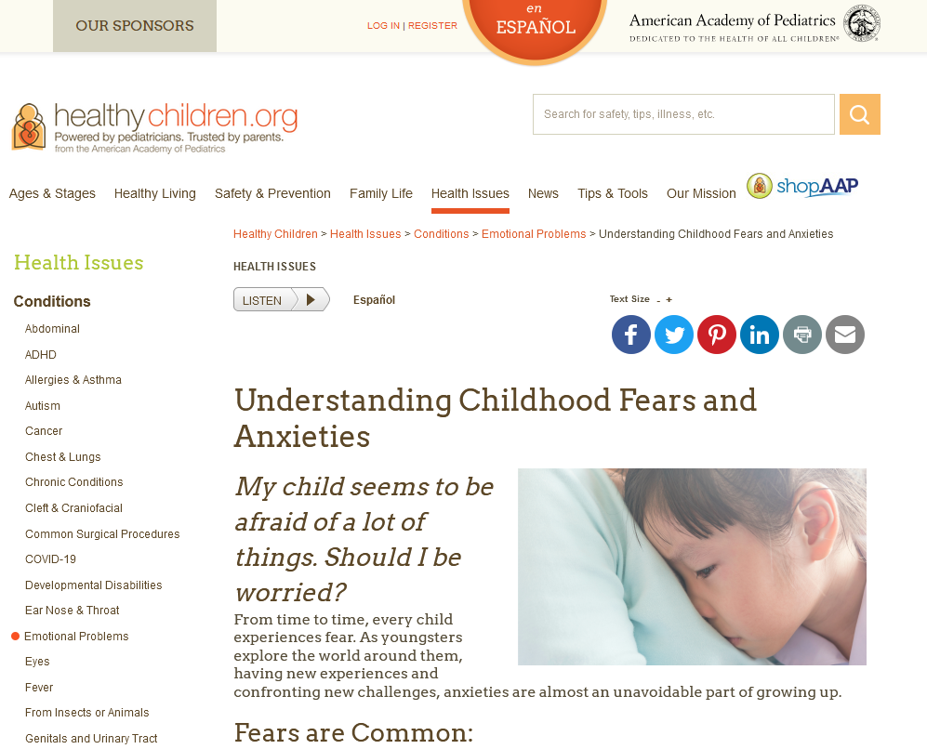
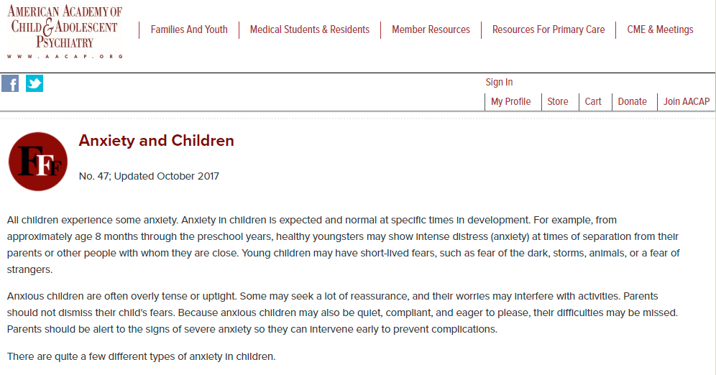
Psychoeducation
Notes:
List resources at the end

Slide 42
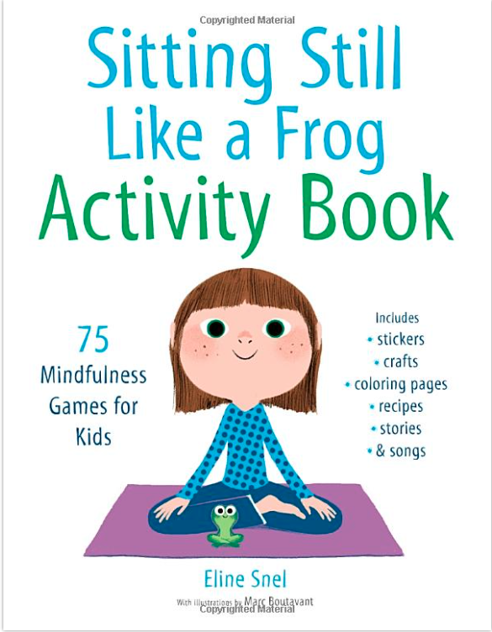



Books for Kids and Teens
https://www.shambhala.com/sittingstilllikeafrog/
Notes:
Again, quick look and list references at the end.

