Slide 1
Assessment and Diagnosis of
Anxiety Disorders
in Children and Teens
April 2024

Slide 2
Speaker:
Jay Herrick, MD
Director of Behavioral Health MMG
Montefiore Einstein
jherrick@montefiore.org

Slide 3
Disclosures
Dr. Jason Herrick serves as consultant to MVP Health on the Pharmacy and Therapeutics Review Committee

Slide 4
Goals and Objectives
Distinguish between anxiety and an anxiety disorder
Review the epidemiology of pediatric anxiety disorders
To recognize the signs and symptoms of anxiety disorders in children and adolescents at different ages
To know how to screen and assess for these conditions
Notes:
USPTF just receommended screening for anxiety over 8 yo

Slide 5
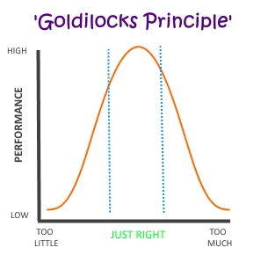
What is anxiety?
Feeling of apprehension, “nervous”, “worry”, or unease
Anticipation of danger
May be experienced somatically as well as emotionally/cognitively
Normal
Adaptive: helps us focus and prepare
Temporary

Slide 6
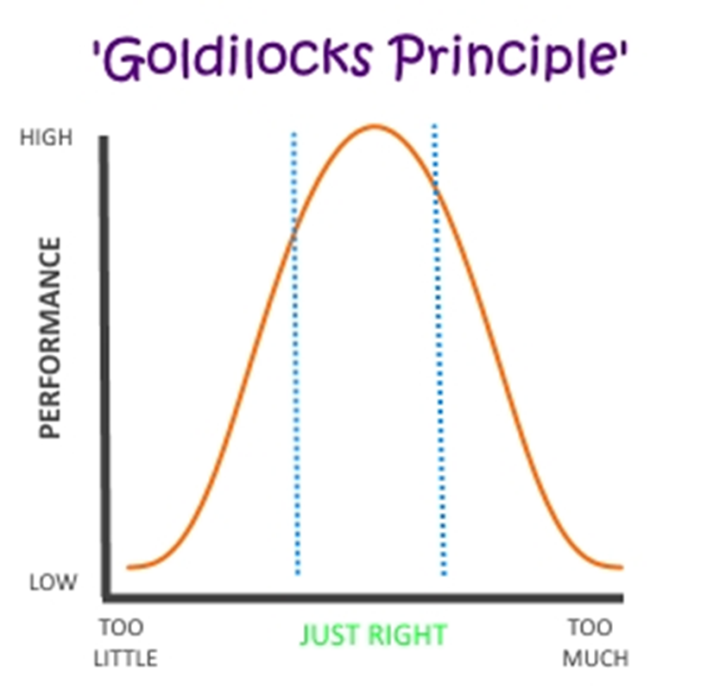
When is Anxiety a Disorder?
“Hijacked” Fight/Flight/Freeze response
Frequent and persistent (6 months)
Avoidance
          Restriction/resistance of activity
          Impairment
            Need for parental accommodations
            “Missing out”
            Tantums/Aggression

Slide 7
Subtypes of Anxiety Disorders
Younger children:
  Selective Mutism (cousin of Social Anxiety)
  Separation Anxiety Disorder
Older school aged and Adolescents:
  Phobias
  Generalized Anxiety Disorder
  Social Anxiety Disorder
  Panic Disorder
Note:
OCD and PTSD were included as Anxiety Disorders in DSM-IV.
In DSM-V they are better classified as obsessive-compulsive or trauma and stressor related disorders respectively

Slide 8
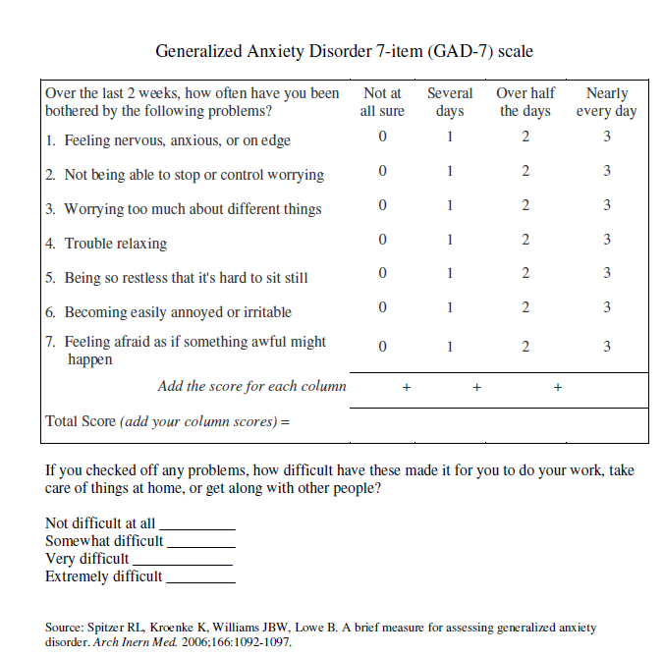
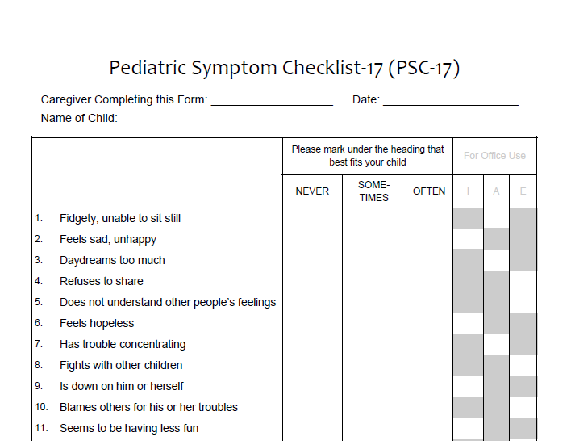
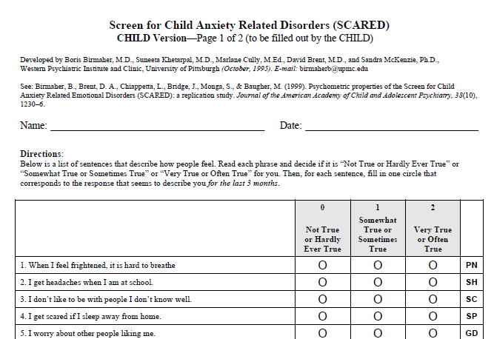
Why should we screen for anxiety?
High prevalence
  Up to 20% lifetime – increasing in youth
High morbidity
Highly treatable
Low detection
  <25% identified
  As many as 50% never receive treatment
USPTF recommends @ 8yo

Slide 9
Anxiety ignored can derail development?
Family difficulties
  Undermines development of independence (avoidance vs. overprotection)
  Increased family conflict (parents, sibs) as others feel “controlled”
At risk for substance abuse
School absence
  Academic delays/loss
  Underdeveloped social-emotional skills (“muscles”)
Restricted range of activities
  Lack of development of social-emotional skills
  Loss/lack of development of peer relationships
  Decreased opportunities for pleasure and skill development

Slide 10
How does anxiety present?
Emotional/Cognitive:
    Thoughts and feelings of apprehension in anticipation of danger (internal or external); need for excessive reassurance
  Commonly experienced as “worry” or “nervousness” but some kids don’t have words for and/or don’t recognize
Behavioral:
  Avoidance, absence, tantrums, aggression
Physical symptoms:
  Headaches, stomach aches, difficulty breathing, swallowing (often without insight)
4. Sleep disturbance

Slide 11
Presentation of anxiety at Different Ages
Elementary School | Middle School | Adolescent
Developmental regression Crying Midline physical sx Clingy Separation fears Fearful -> oppositional Sleep problems | Midline physical sx School refusal Test/performance anxiety Poor concentration Sleep problems Irritability Defiant and avoidant | In addition to all sx of Middle school… Social performance anxiety Restricted life activities School refusal Substance abuse

Slide 12
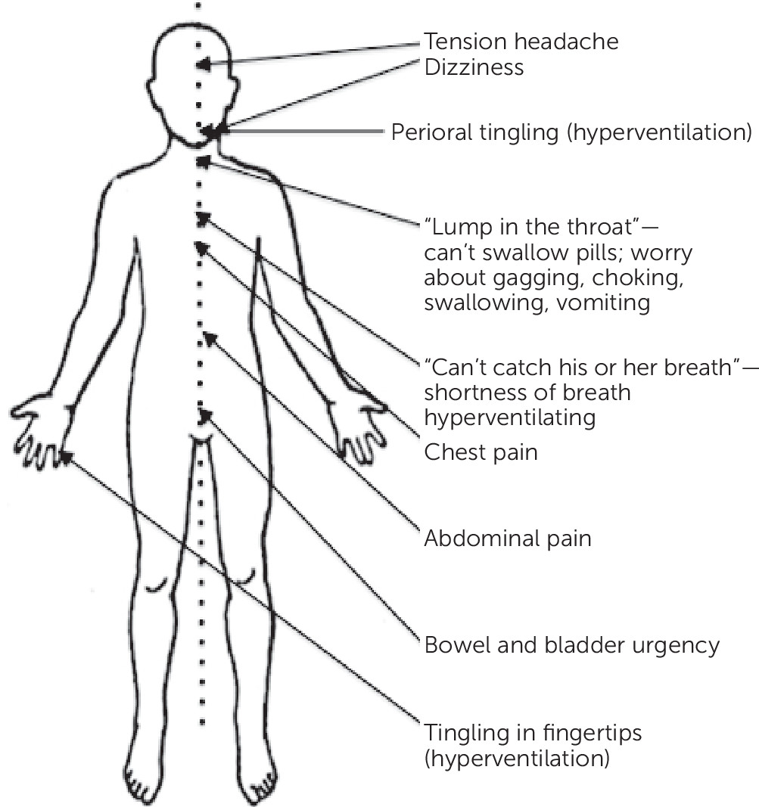
Midline Physical Symptoms

Slide 13

Emily
8 yo girl who is brought in because of stomach aches
Evaluated by GI and no medical condition identified
Difficulties getting her to school since kindergarten
  Crying at drop off, clingy to parent
In 2nd grade missed 10 days of school
Now in 3rd grade, has missed 20 days of school to date
  Even when she gets to school, she goes to nurse often with stomach aches, sometimes the only resolution is mother picking her up early
No academic issues
If mom unable to pick her up Emily calls frequently to “check in” and make sure that “nothing bad happened”
At home she appears comfortable, pleasant, watches TV
Maintains friendships with small group of girls she has know since pre-K
  Does not enjoy play dates or want sleepovers at friend’s homes
During office visit, she is quiet, but smiles easily
PE is unremarkable
No known trauma/loss
Notes:
School avoidance
Somatic sxs

Slide 14
Assessment
Interview child/adolescent alone
Interview parent(s) with/without child as indicated
Use validated screening tools – i.e. SCARED
Assess for any acute stressors (trauma, loss, moved, etc.)
Consider known developmental history
Consider other psychiatric causes
Targeted PE
  Guided by somatic complaints
Work up and rule out medical causes/related issues as indicated
  Thyroid dysfunction
  Inflammatory bowl
  Asthma
  Migraine
Note: physical health causes rarely present with anxiety in isolation

Slide 15
Screening
Pediatric Symptom Checklist (PSC): Broad universal screener assessing 3 domains - attention, externalizing and internalizing
GAD-7: 13+, anxiety specific, youth self report; 0-21 scores
  5-9 mild anxiety
  10-14 moderate anxiety
  15-21 severe anxiety
SCARED: 8y+, anxiety specific, parent and self report measures
  >25 is positive screen
  >30 almost always reflects an anxiety disorder

Slide 16
www.projectteachny.org

Slide 17
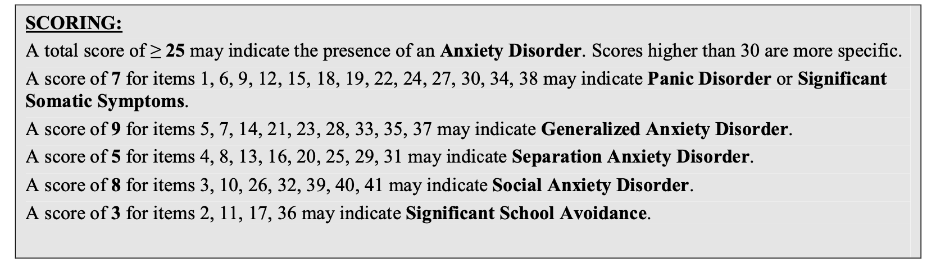
Scoring the SCARED
Separate Parent, Child forms (8-18 yo)
10 minutes
Subscales differentiate types of anxiety

Slide 18
Psychiatric Differential
Dx | Overlaps
ADHD | Restless, inattentiveness
Depression | Inattention, sleep problems, somatic
Bipolar | Restless, irritable, sleep problems
Learning Disorder | Generate worries about academics
Psychosis | Restless, social withdrawal
Autism spectrum | Social withdrawal/avoidance, repetitive behaviors, need for routine

Slide 19
Medications/Substances that cause/worsen Anxiety
Prescribed medications
  Albuterol, steroids, SSRI’s, stimulants, thyroid medications, antipsychotics
Caffeine – carbonated beverages, energy drinks
OTC medications – cold medications, decongestants, diet pills, antihistamines, CAM
Nicotine/vaping
Substance intoxication/abuse (pot, cocaine, methamphetamine, PCP, LSD) and/or withdrawal

Slide 20
Diagnosis
Potentially some urgency, very unlikely an emergency
Use DSM-V criteria as guide
Allow for complete work-up of potential physical health causes
Remember avoidance is hallmark
Establish the diagnosis with confidence
  Assess severity/level of impairment
  Provide psychoeducation
  Screen for common comorbidity (i.e. MDD, ADHD)

Slide 21
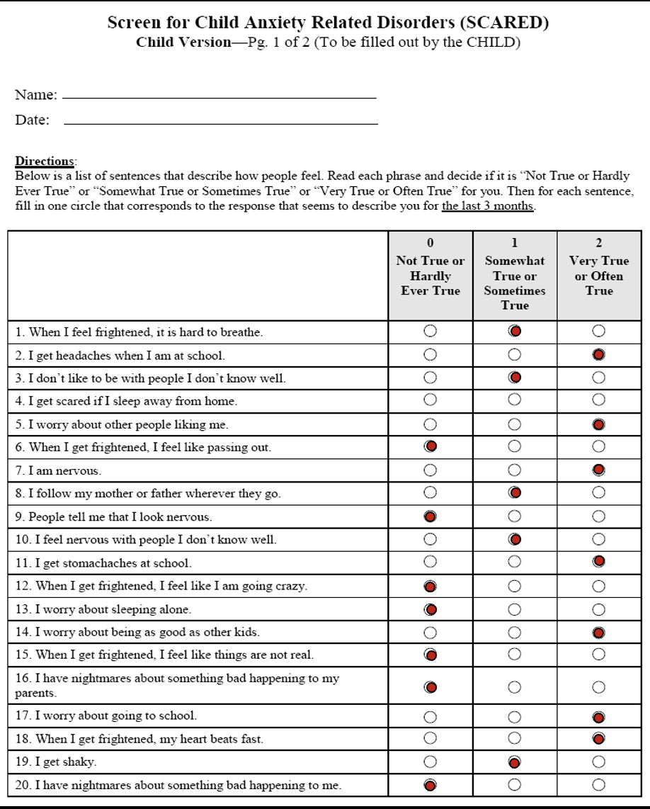
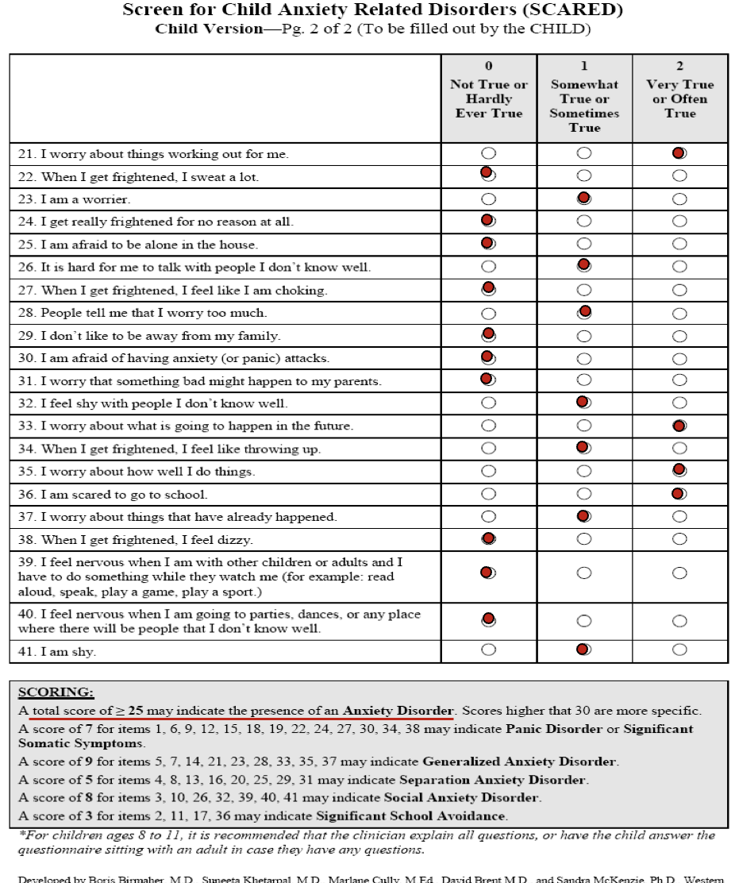
Emily
8 yo girl who is brought in because of stomach aches, GI w/u (-), increase in school avoidance, maintaining grades, frequent reassurance seeking, okay at home and with small group of friends.
During office visit, she is quiet, but smiles easily, PE is unremarkable, no known trauma/loss
SCARED Total Score: 34
Notes:
School avoidance
Somatic sxs

Slide 22

Do we think Emily has an Anxiety Disorder?
How would you rate severity?

Slide 23
Severity
 | SCARED | Distress | Avoidance
Mild | <30 | Some | Minimal
Moderate | 30-40 | Good deal | Some
Severe | 41+ | A lot | A lot
 | SCARED | Distress | Avoidance
Mild | <30 | Some | Minimal
Moderate | 30-40 | Good deal | Some
Severe | 41+ | A lot | A lot
SCARED = 38
Distress???
Avoidance = 20+ school days missed

Slide 24
Summary
Anxiety disorders as a category are the most common mental health condition in adolescents
Commonly goes undiagnosed (akin to ADHD:IT; “quiet”, “good” kids)
Universal screening recommended by USPTF for 8-18
  i.e. (+) PSC/YPSC and signs of anxiety -> SCARED
When work up is suggestive of anxiety, make the diagnosis!
  R/O Trauma/loss
  Consider medical/medication/substance contributions
Severity assessment supports medical decision making/treatment planning
Assess for comorbid conditions

Slide 25
Appendix

Slide 26
GAD DSM5 Criteria
Excessive anxiety and worry (apprehensive expectation)
  occurring more days than not
  for at least six months,
  about several events or activities
The person finds it difficult to control the worry.
Associated with three or more of the following six symptoms:
  Restlessness or feeling keyed up or on edge
  Being easily fatigued
  Difficulty concentrating or mind going blank
  Irritability
  Muscle tension
  Sleep disturbance (difficulty falling or staying asleep, or restless unsatisfying sleep)
Not attributable to the physiological effects (e.g., a drug of abuse, a medication) or another medical condition (e.g., hyperthyroidism).
Notes:
Not focused on ONE issue (e.g. social, weight, health, separation, panics)

Slide 27
Separation Anxiety Disorder DSM5
Inappropriate and excessive fear or anxiety concerning separation from attachment figures, as evidenced by persistent anxiety in at least 3 of the following:
  Anticipating or experiencing separation from home or from major attachment figures.
  Losing major attachment figures or about possible harm to them, such as illness, injury, disasters or death.
  Untoward event that causes separation from a major attachment figure.
  Persistent reluctance or refusal to go out, be away from home, go to school, go to work, or elsewhere because of fear of separation.
  Being alone or without major attachment figures at home or In other settings.
  Sleep away from home or to go to sleep without being near a major attachment figure.
  Nightmares involving the theme of separation
  Physical symptoms (eg.headaches, stomach aches, nausea, vomiting) when separation from major attachment figures occurs or is anticipated.
Lasting at least 4 weeks in children and adolescents and typically >6 months in adults.
Notes:
Casuses impairment of functioiing

Slide 28
Social Anxiety Disorder DSM5
A. Intense fear of one or more social or performance situations in which the person is exposed to unfamiliar people or to possible scrutiny by others. The individual fears that he or she will act in a way (or show anxiety symptoms) that will be embarrassing and humiliating.
B. Exposure almost invariably provokes anxiety
C. The person recognizes that this fear is unreasonable or excessive.
D. The feared situations are avoided or else are endured with intense anxiety and distress.
E. interferes significantly with the person's normal routine, or there is marked distress about having the phobia.
F. Persistent, lasting 6 or more months.
G. Not due to direct physiological effects of a substance (e.g., drugs, medications) or a general medical condition
NOTE: Selective Mutism separate diagnosis but thought of as variant of Social Anxiety Disorder

Slide 29
Gen Medical Differential Diagnosis: Uncommon
  Hyperthyroidism
  Migraine
  Asthma
  Seizure disorders
  Lead intoxication
  Even less Common: Hypoglycemia, arrhythmias
  Rare: Pheochromocytoma, CNS disorders (ex delirium/brain tumor)

