Slide 1
Trauma Informed Care: Working with families & youth
Notes:
Nayla
the different types of trauma
how to diagnose
how to treat.

Slide 2
Speaker:
Nayla M. Khoury, MD, MPH
Assistant Professor of Psychiatry
SUNY Upstate Norton School of Medicine
Wellness Officer
Medical Director Upstate Nation Behavioral Health Collaborative
Contact: khouryn@upstate.edu
Notes:
nayla

Slide 3
Speaker:
Mike Scharf
Michael A. Scharf, M.D.
Mark and Maureen Davitt Professor and Director of Child and Adolescent Psychiatry
Psychiatrist-in-Chief, Golisano Children’s Hospital
Associate Chair for Children and Youth
Department of Psychiatry, University of Rochester
Notes:
mike

Slide 4
Disclosures
Neither we nor our spouses/partners has a relevant financial relationship with a commercial interest to disclose.
Notes:
mike

Slide 5
Learning Objectives
Learn trauma informed care principles & strategies for applying to your practice.
Identify developmentally appropriate strategies for assessing and diagnosing trauma and trauma-related disorders.
Understand evidence based treatments for treating trauma and trauma-related disorders and strategies for supporting resilience.
Notes:
mike

Slide 6
A call to action:
Increase funding for mental health access
Continue telehealth options
Increase school based mental health options
Accelerate integrated mental health in primary care
Strengthen prevention programs
Promote and pay for trauma informed care to support resilience
Address acute care needs and staff shortages
Advance mental health parity laws
Notes:
mike:
Before pandemic, suicide was a problem affecting young ppl, being second leading cause of death in the us 10—25 yrs of age and rising rates for young black youth which is thought to be multifactorial, health care disparities being one of them.
Unexpectedly, however, our hospital did not observe this increase during the early months of the pandemic and the number of adolescents presenting for acute mental health emergencies dropped precipitously. This radical shift in numbers raised many concerns regarding the state of adolescent mental health and wellbeing. Many of us worried that youth needing mental health support were not seeking help due to fear of COVID-19. These concerns have been substantiated; over the past month, the number of youth seeking emergent mental health care in our hospital and emergency department is twice normal for this time of year.
Cloutier RL, Marshaall R. A dangerous pandemic pair: Covid19 and adolescent mental health emergencies. Am J Emerg Med. 2021;46:776-777. https://libezproxy.syr.edu/login?url=https://www.proquest.com/scholarly-journals/dangerous-pandemic-pair-covid19-adolescent-mental/docview/2555958068/se-2?accountid=14214. doi: http://dx.doi.org/10.1016/j.ajem.2020.09.008.
More than 140,000 children in the United States lost a primary and/or secondary caregiver, with youth of color disproportionately impacted. We are caring for young people with soaring rates of depression, anxiety, trauma, loneliness, and suicidality that will have lasting impacts on them, their families, and their communities.
for more context, Suicide among our youth has always been a major problem as the second leading cause of death and continues to be a problem now, particularly for young female teens who have been visiting theh EDD due to suicide attempts more than pre pandemic.
We also know that the rates among black youth have risen faster than any other racial/ethnic group, particularly among latency age kids, highlighting the intereactions between our dual pandemics of covid19 infection and structural racism in this country.
While the reasons are not completely known, our discussion of ACES today or adverse childhood experiences, are thought to be part of these disparities, as well as important disparities regarding access and treatment.

Slide 7
Trauma informed community begins with ourselves
Be mindful of your own responses.
Find care practices that work for you and are sustainable.
Know you are not alone in this work.
Get to know your resources (internal and local).
Advocate for the team you need to do this work.
Notes:
mike

Slide 8
The cure for burnout isn’t and can’t be self care.
It has to be all of us caring for each other.
~Emily & Amelia Nagoski
Dare to lead Podcast with Brene Brown
Notes:
Nayla – let’s practice!

Slide 9
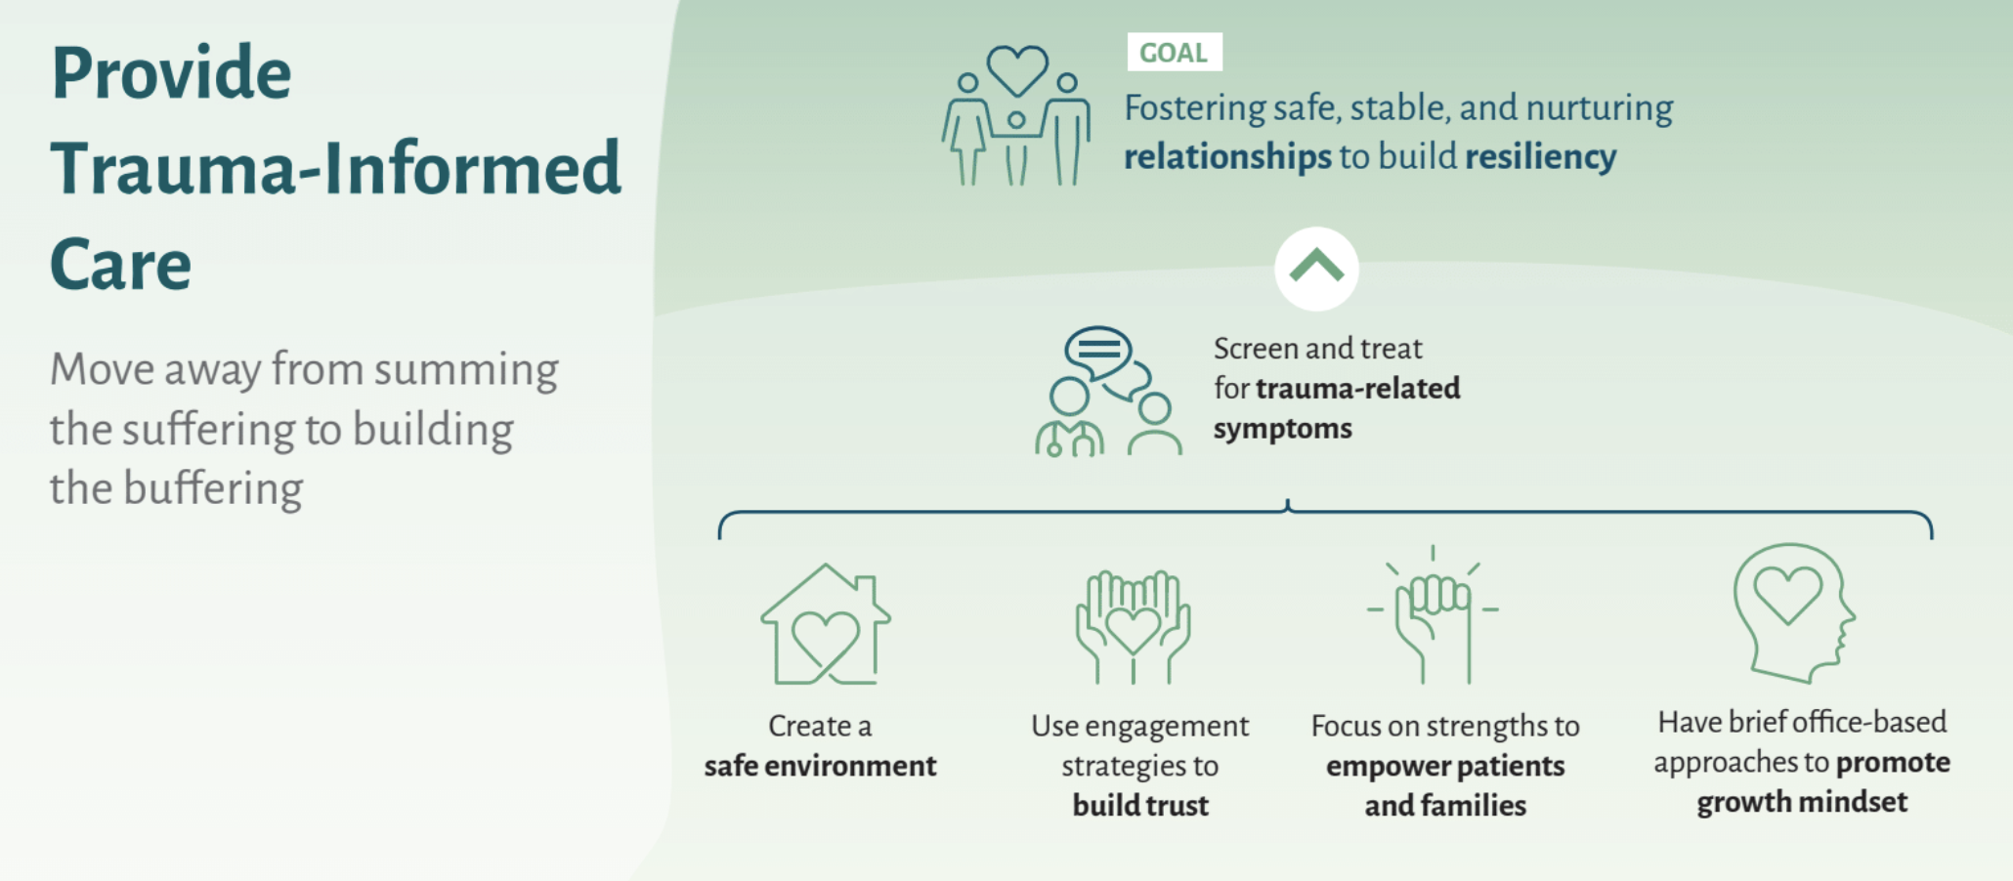
Notes:
Nayla

Slide 10
What is resiliency?
Notes:
Nayla

Slide 11
Resiliency
Withstanding and rebounding from adversity.
Regaining the ability to thrive, with the potential for transformation and positive growth forged through the searing experience.
(Walsh, 2020)
Fostered by shared beliefs
To make meaning of the crisis and challenges.
To (re)gain a positive, hopeful outlook that supports active agency.
Notes:
Nayla: Walsh, Froma. (2020). Family Process. 59(3): 883-897. Loss and Resilience in the Time of COVID‐19: Meaning Making, Hope, and Transcendence.
Heart rate variability is a promising biomarker of mental health resilience.
•Heart rate variability is an index of flexibility and ability to adapt to stress.

Slide 12
Protective factors
Community:
School engagement.
Family & neighborhood.
Participation in after school activities.
Relationships:
Relationships with one supportive adult
Friends
Individual:
Positive thoughts of self
Self-regulation
Social competence
Flexible thinking
Notes:
nayla

Slide 13
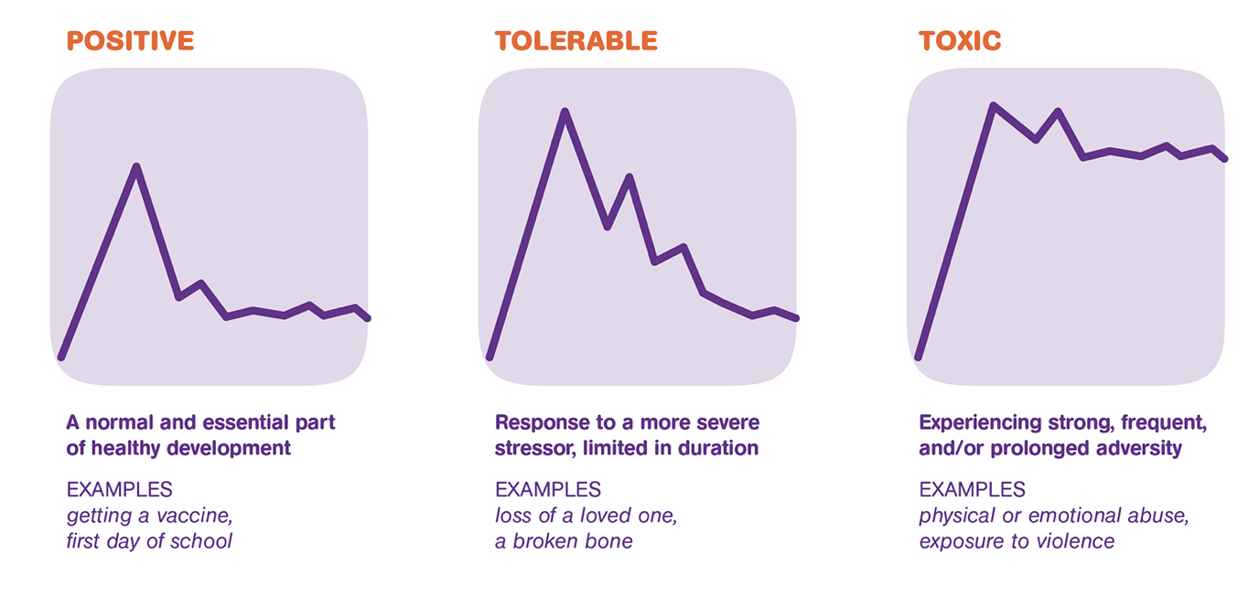
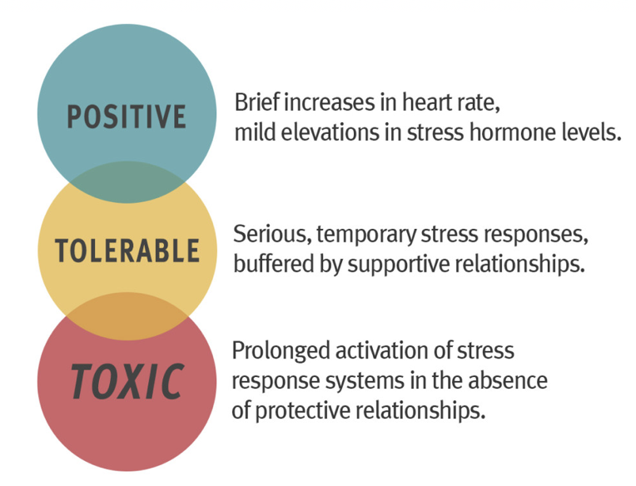
When is stress “Toxic”?
Stress is a normal and necessary part of development.
Toxic when prolonged; in absence of protective relationships.
Notes:
Nayla
Stress can categorized as:
Positive: promoting growth
Tolerable: not helpful, but not damaging
Toxic: overwhelming a child’s coping mechanisms and leading to long term impairment
In absence of protective relationships.. Supportive relationships can make the difference.
http://developingchild.Harvard.edu

Slide 14
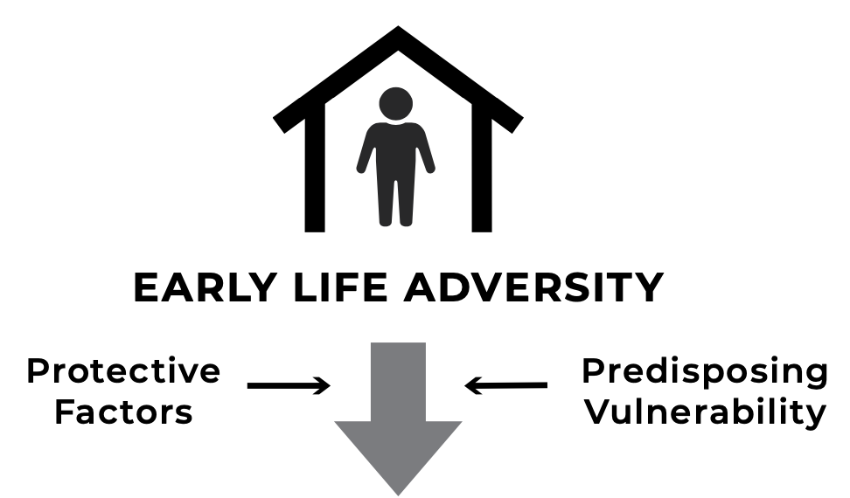
Role of primary care
Supportive relationship over time.
A safe place:
Patient centered medical home.
Targeting modifiable/preventable ACES.
Leveraging resilience factors.
Notes:
Nayla
You can make a difference.

Slide 15
Trauma informed care (TIC): Framework
Understanding the prevalence of trauma & adversity & its impacts.
Recognizing the effects of trauma & adversity on health and behavior.
Training leadership, providers, and staff on responding with TIC best practices.
Integrating knowledge about trauma into policies, procedures, practices.
Resisting re-traumatization by approaching patients with non judgmental support.
Notes:
Nayla

Slide 16
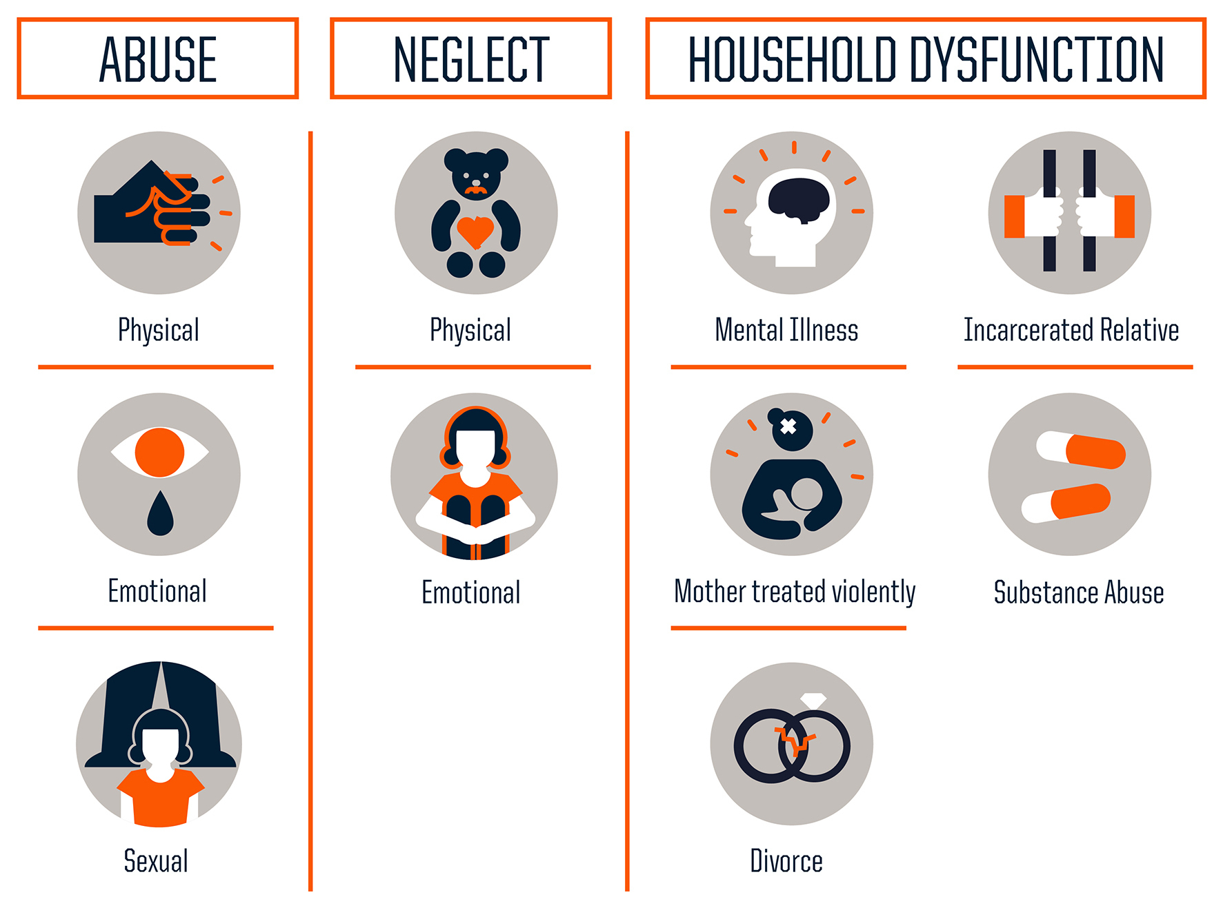
Childhood adversity common pre pandemic
Adverse childhood experiences
Community Violence
Bullying
Disasters
Medical trauma
Refugee trauma
Terrorism
Traumatic Grief
Historic & Racial trauma
Notes:
Nayla
We will focus on whats known about the effects of ttrauma andWe also know that childhood adveersitty is common pre pnadmeic. Oon the left here are thee typese of abusee, neglect and hoouseehold dysfunction which areee known as the aces – adveersee childhood expeerienees, studied retroospectiveeley in a largeee sample of middle class americans in the 90s by Kaiser permanenteee. The results showed us howo common childhood adversity is and the risks it is associated with, psychiatrically and medically. We now know that trauma ooutsidee of the home can also impact young ppl, trauma such as community violence, bullying or the trauma tha tmany have experienced as a result of covid, such as medical trauma ro traumatic grief. For underrepresented minorities, this mayb eompounded by hihstoric trauma, trauma that is transmitted socially and genetticaly across generations and racial trauma of everyday life.
Extended ACES – adversity outside of homes and embedded in low-resource communities affects communities of color disproportionately.
Trauma + loss. Experience matters.
Up to 80% children experience at least one traumatic experience in childhood; minority children are disproportionately impacted by trauma and continue to have high rates of contact with the health care system.
In times of pandemic, ptsd/trauma related sx being seen for kids and adults alike
Historical – impacts entire communities, cumulative and transmitted across generations
Mechanisms include social as well as biologic transmission
Ex. African American communities and legacy of slavery, displacement of Native Americans and boarding schools
Racial - trauma due to witnessing or experiencing racism, discrimination or structural prejudice
Increased vigilance, suspicion, sensitivity to threat, sense of foreshortened future
Potential maladaptive response to stress, particularly for youth in low-income communities with increased risk for community violence and victimization

Slide 17
Known risk between adversity and wellbeing
Notes:
Nayla
https://vetoviolence.cdc.gov/apps/phl/resource_center_infographic.html
Adult Alcoholism/Liver Disease
Chronic Depression/Suicide Attempts
Perpetrating Domestic Violence/Being raped
Difficulty Parenting
As the number of ACEs increases so does the risk for the following:
Myocardial infarction
Asthma
Mental distress
Depression
Smoking
Disability
Reported income
Unemployment
Lowered educational attainment
Coronary heart disease
Stroke
Diabetes

Slide 18
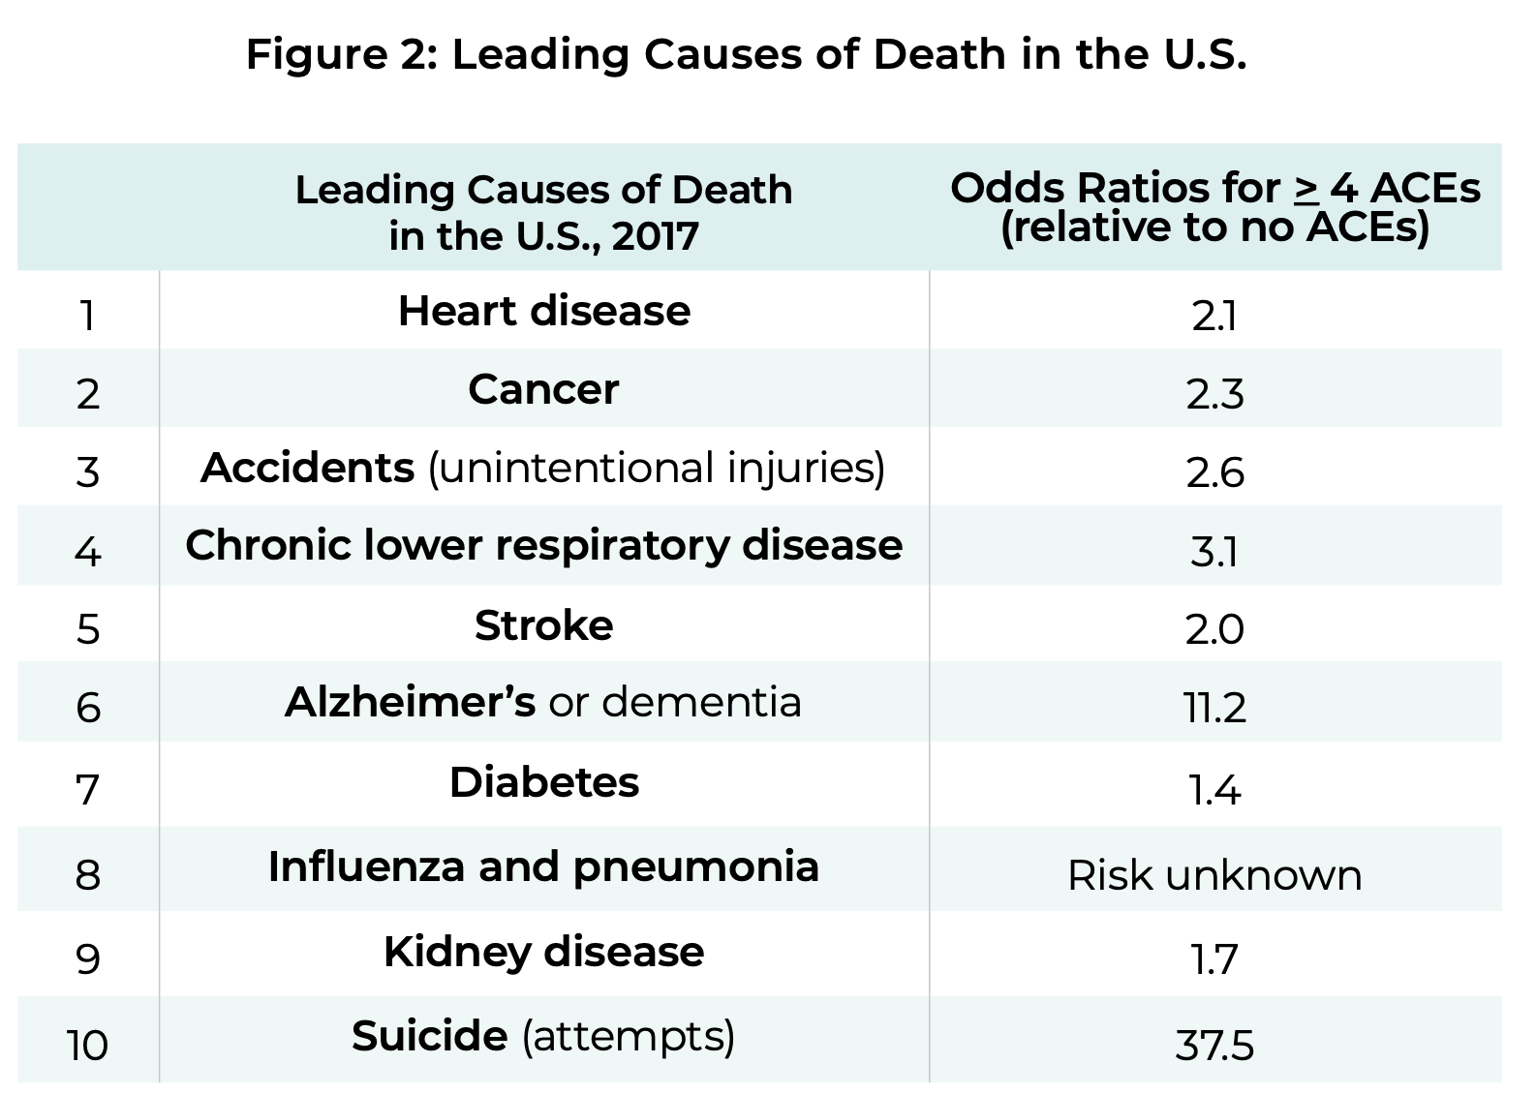
Notes:
nayla
The long term effects of trauma and aces are remarkable.
https://www.cdc.gov/violenceprevention/aces/about.html

Slide 19
Who goes on to experience trauma sequelae?
All Kids who experience childhood trauma develop PTSD.
True.
False.
Notes:
Mike
: All Kids who experience Childhood trauma develop PTSD- True or False.
Answer: false!

Slide 20
Who goes on to experience trauma sequelae?
All Kids who experience childhood trauma develop PTSD.
True.
False.
Notes:
Mike
: All Kids who experience Childhood trauma develop PTSD- True or False.
Answer: false!

Slide 21
Exposure doesn’t equal trauma disorder
Keep in mind the three e’s of trauma:
Exposure
Experience
Effects
Not everyone with a trauma history needs extensive trauma therapy.
Careful assessment Is helpful.
Notes:
Mike

Slide 22
Post Traumatic Stress Disorder
Traumatic event (Criterion A) + 4 clusters + impairment x one month
Clusters:
B: Intrusive symptoms
For kids – repetitive play with trauma themes
Frightening dreams without recognizable content
Trauma reenactments during play
C: Persistence avoidance
D: Negative changes in cognition and mood
E: Hyperarousal and reactivity changes
Notes:
Mike
Exposure to actual or threatened death, serious injury, or sexual violence in one (or more) of the following ways:
Directly experiencing the traumatic event(s).
Witnessing, in person, the event(s) as it occurred to others.
Learning that the traumatic event(s) occurred to a close family member or close friend. In cases of actual or threatened death of a family member or friend, the event(s) must have been violent or accidental.
Experiencing repeated or extreme exposure to aversive details of the traumatic event(s) (e.g., first responders collecting human remains; police officers repeatedly exposed to details of child abuse). Note: Criterion A4 does not apply to exposure through electronic media, television, movies, or pictures, unless this exposure is work related.
▪Tightening of the A1 Criterion
▪Eliminating the A2 Criterion (fear, horror, helplessness)
▪4 (rather than 3) Symptom Clusters
▪Special Criteria for Preschool Children (children 6 and younger)
▪Addition of a Dissociative Subtype

Slide 23
Notes:
Mike
Pediatricians and pcp care for many children at riskf or traumatic s tress
Type I
A single, unexpected event
Examples: one time assault, natural disaster, car accident, or witnessing a horrible event.
May lead to “typical”DSM PTSD or depression.
Type II
Chronic, repetitive events, which become an expected part of life.
Examples: chronic physical or sexual abuse, living in a severely chaotic/unpredictable environment.
Clinical sequela more complicated, may lead to “atypical” PTSD or personality disorders.
(Lenore Terr)
Dyadic model – so much of complex aces and traumas are relational and multigenerational. PCP observational skills – transform observation into clinical description. What did you see? What did it feel like in the room? Foundations of attachment and attachment relationships.

Slide 24
Most Kids who experience Trauma are resilient:
True
False
Notes:
Nayla
POLLL!!
Most Kids who experience Trauma are resilient- True or False
Answer: true!

Slide 25
Most Kids who experience Trauma are resilient:
True
False
Notes:
Nayla
POLLL!!
Most Kids who experience Trauma are resilient- True or False
Answer: true!

Slide 26
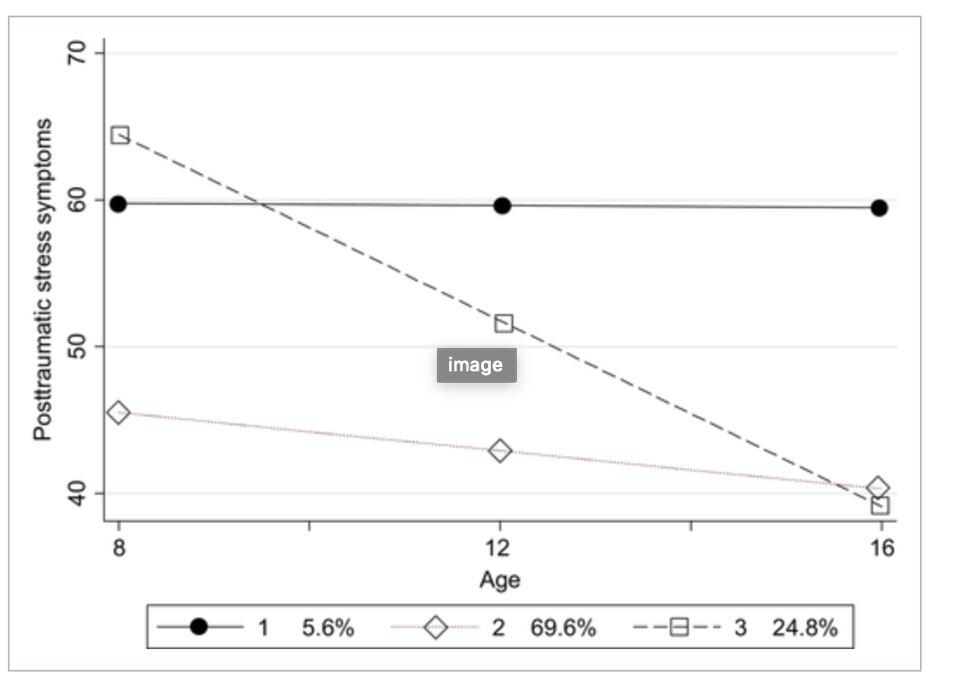
PTSD patterns over time: Fortunately, most improve with support
3 patterns of symptoms:
70 % Resilient
25 % Clinical-Improving
5 % Borderline-Stable
From longitudinal Study of Child Abuse & Neglect
N = 1,178 at-risk children
Multiple evals between 4-18 years of age.
(Miller-Graff & Howell, 2017).
Borderline‐Stable
Clinical‐Improving
Resilient
Notes:
nayla
N = 1,178 at-risk children living in High-Risk environments
Child Protective Services (CPS)
Clinical-Improving group differs from Resilient
1. More likely to have CPS reports of
physical abuse
2. More likely witness violence at home and
community
3. Less likely to report homes were safe
4. More likely to report anger
Van der kolk 2003:
Because infants and toddlers who have been traumatized multiple times often experience developmental delays across a broad spectrum, including cognitive, language, motor, and socialization skills [36], they tend to display complex disturbances with various, often fluctuating, presentations. They generally meet numerous clinical diagnoses. In one study of 364 abused children in the United States [35], 58% met criteria for separation anxiety/overanxious disorder, 36% for phobic disorder, 35% for PTSD, 22% for attention deficit hyperactivity disorder, and 22% for oppositional defiant disorder. In prospective study by Putnam [37] of a group of sexually abused girls, anxiety, oppositional disorder, and phobia were clustered in one group, whereas depression, suicidality, PTSD, attention deficit hyperactivity disorder, and conduct disorder represented another cluster [37]. The spectrum of biologic, emotional, and cognitive abnormalities is ex- pressed in a multitude of psychological, somatic, and behavioral problems that range from learning disabilities to aggression against self and others [38–42]. ~~~
Remnants of trauma makes these youth vulnerable to subsequent trauma.
Traumatic remnants.

Slide 27
Trauma informed care: Principles
Establish physical and emotional safety of patients and staff.
Build trust between providers and patients.
Recognize the signs and symptoms of trauma exposure on physical and mental health.
Promote patient-centered, evidence-based care.
Ensure collaboration by bringing patients into process of goal-setting, treatment-planning.
Provide culturally sensitive care.
Notes:
Nayla
The principles!

Slide 28
Trauma informed care principles with Dan
Patient-centered
How to make time and space for mom and Dan, together and separate?
Team-based approach
Who screens? Which screens?
Who follows up if positive?
What do you need to assess and treat this family?
Collaboration
Take time for introductions, getting to know values, goal setting.
Build trust & recognize sx of trauma
Balancing safety screening with building resiliency
Notes:
Nayla
How are they greeted by the receptionist
What do they see in the waiting room while they wait
What do you like to be called? Preferred names and pronouns
How are you approaching them in terms of your positioning in the room – giving family and kid an exit as a way to promote safety
And then who screens? What screens? Who follws up
What do you need- what are your supports, your rituals, your compassionate boundaries, your limits?
Multidscipilinary team
Care coordination
availability of home health, nutrition

Slide 29
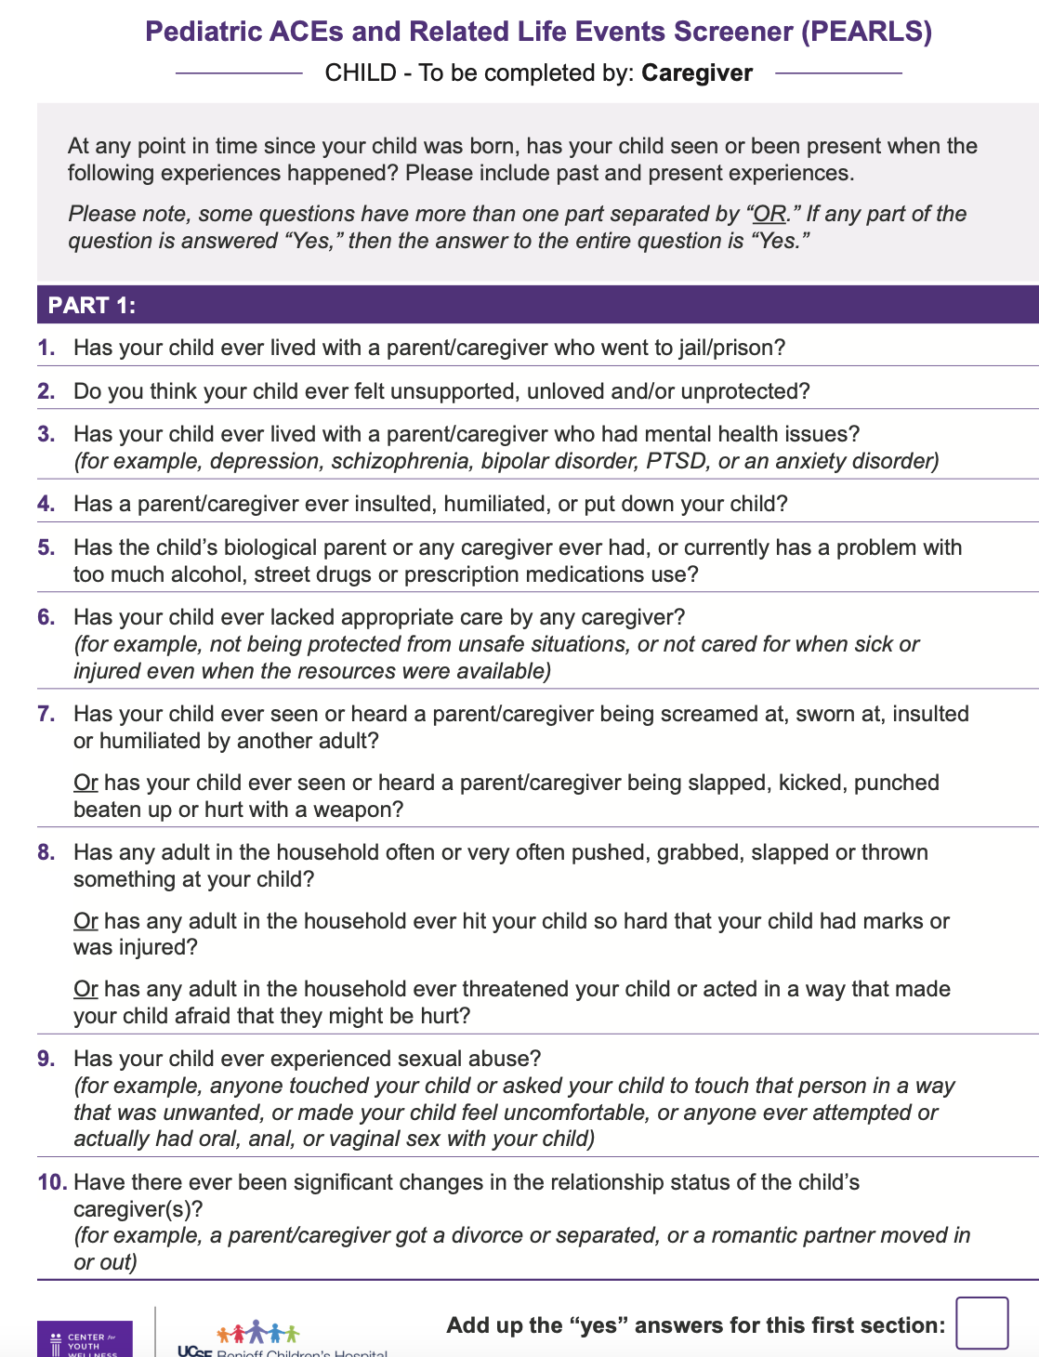
Universal Screening tools
ACES/PEARLS& BCES
parents
youth
SEEK for 0-5 youth
Notes:
nayla
https://intermountainhealthcare.org/ckr-ext/Dcmnt?ncid=529796906

Slide 30
Open ended trauma inquiry
“Has anything bad or scary happened to you or your child since I last saw you?”
“Stressful and scary events sometimes happen. Has there been a time where you felt really scared for your safety or someone else’s at home or in the community?”
Notes:
Nayla
Avoidance of discussing trauma is typically rooted in one or more of the following:
The belief that bringing it up will cause painful recollection or worsening of symptoms.
One’s own avoidance of painful discussions.
Fear of tainting the child’s description of the trauma (e.g. upcoming court testimony.)
Solutions:
Listen more than talk.
Be careful not to ask leading questions.
Be clear as to your role: e.g. Clinical vs. Forensic

Slide 31
Resilience inquiry
Tell me a little bit about yourself:
What are some things you are really proud of?
What are your parents really proud of?
If something difficult were to happen, who would be available to help you?
If something good were to happen, who would be cheering for you?
All of us have somethings from our childhood that are so wonderful. All of us have things that we hope to protect our children because they were hard. What do you want your children to get from you and what would you want to protect them from?
Notes:
Nayla
Avoidance of discussing trauma is typically rooted in one or more of the following:
The belief that bringing it up will cause painful recollection or worsening of symptoms.
One’s own avoidance of painful discussions.
Fear of tainting the child’s description of the trauma (e.g. upcoming court testimony.)
Solutions:
Listen more than talk.
Be careful not to ask leading questions.
Be clear as to your role: e.g. Clinical vs. Forensic

Slide 32
Rating scales for PTSD
Child and Adolescent Trauma Screen (CATS)
Self report, children 7-17
Caregiver report 3-17
Score >12 suggests need to refer and possibly treat
Child PTSD Symptom Scale (CPSS)
Self report, 8-18
Score >15 suggests PTSD highly likely.
Notes:
Mike– how a rating scale eventually helped her feel ready to share.

Slide 33
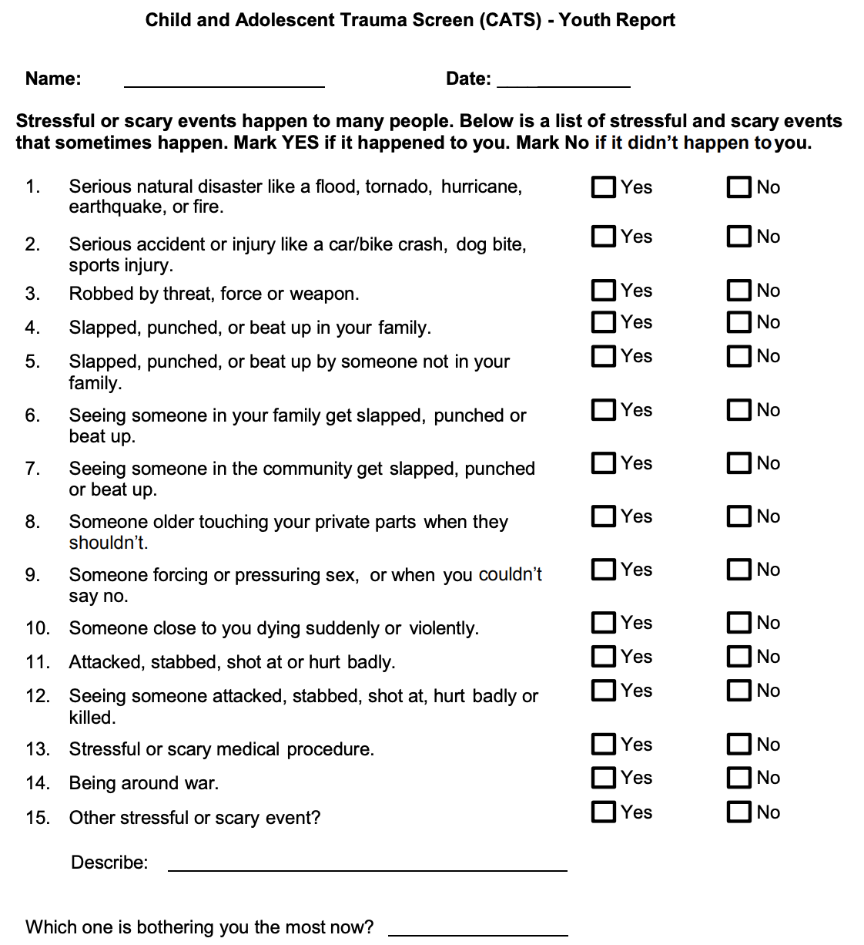
Notes:
Mike

Slide 34
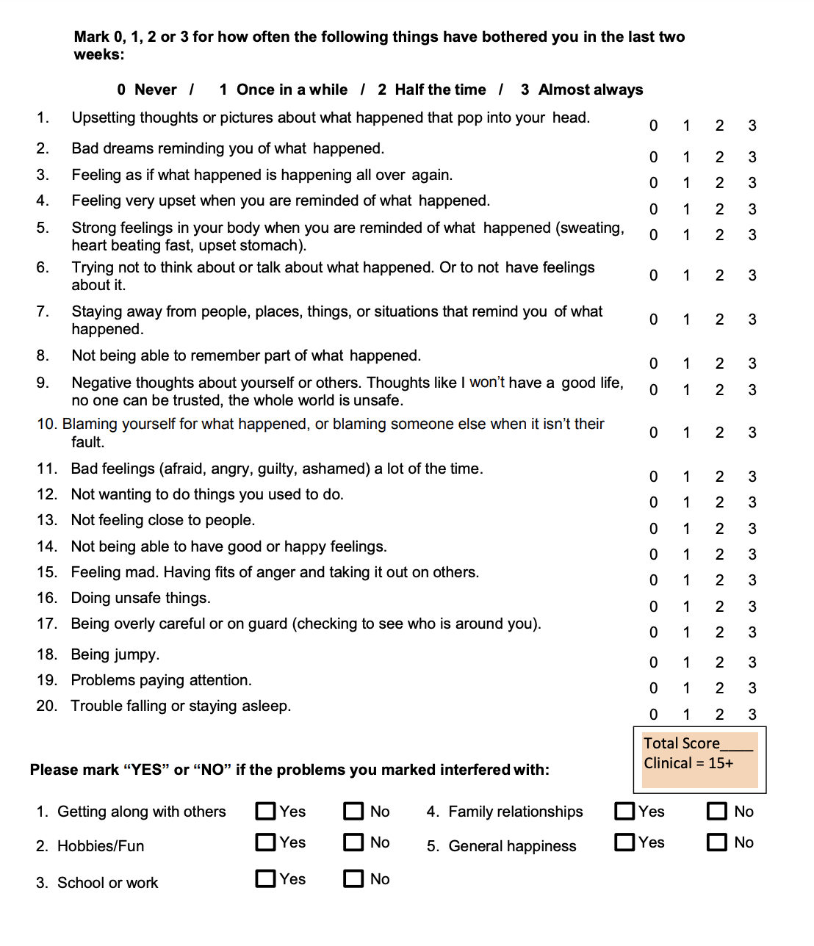
Notes:
Mike

Slide 35
Evidence-based tx
At-risk youth
Multiple ACES/At-risk youth
Parent-child interactive therapy
Child parent psychotherapy to help child & parent attune
PTSD & Complex trauma
Complex trauma
ARC: Attachment, regulation, competency
ITCT: Integrative treatment of complex trauma
PTSD
Trauma focused CBT (ages 3+)
Child and family traumatic stress intervention
Notes:
Mike
PCIT or CPP attunement thnx – to help child and parent attune.
Tf-cbt for trauma and ptsd –
Complex trauma – arc; itct-c, itct-a
Primary and secondary preventin
Brazelton touch points

Slide 36
PTSD Essential TX components
Direct exploration of trauma – building narrative, exposure
Stress management techniques
Exploration and correction of inaccurate attributions regarding trauma (cognitive reprocessing)
Parental inclusion if possible, to help understand and validate trauma narrative
Notes:
Mike
Involves encouraging a child, through relaxation and desensitization procedures, to describe the event with diminished hyperarousal and negative affective states (“reprocessing.”)
Many experts believe this to be the most critical component of PTSD treatment.
Example: With Ron, help him tell his story of what happened when his father went to jail and use coping skills when he notices anxiety or other strong emotions.
Stress management techniques
Sense of control over thoughts and feelings
Relieve acute distress when sx occur
Techniques:
Mindfulness exercise
Progressive muscle relaxation
Thought stopping
Positive imagery
Deep breathing
Examples:
Square breathing
5-4-3-2-1
Holding Ice or putting cold washcloth over temples
Rumination vs reprocessing
Reprocessing (Good)
Thinking of an experience in a new way, or having new feelings when remembering.
What happens in good psychotherapy.
Data suggesting biologic changes occur.
Repeating the same story or experience again and again in exactly the same way.
NOT associated with any sort of improvement and may make some feel worse.
🡪 Re-traumatizing

Slide 37
PTSD Tx Components in Primary care
Understanding a person’s reaction to the trauma, without necessarily going into the trauma itself.
Stress management techniques
Planting psychoeducation seeds.
Meeting families where they are in regards to acknowledgement.
Notes:
Mike

Slide 38
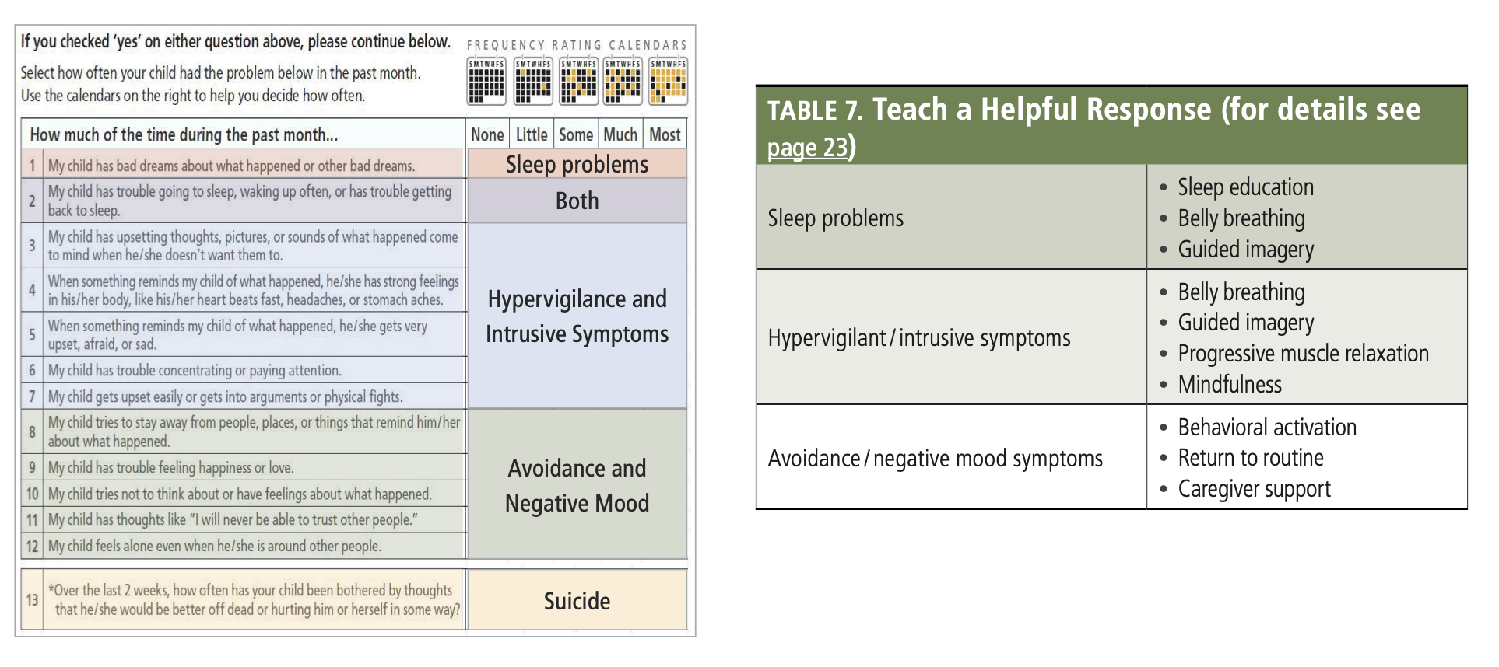
Brief interventions
Notes:
Mike

Slide 39
Psychopharmacology
Adjunctive - NOT one of the established elements of treatment
Theories; some reports of med efficacy; no randomized trials.
Medications used to treat prominent symptoms or co-morbid psychiatric conditions.
Core PTSD sx
Hyperarousal & nightmares- alpha agonistst
Notes:
Mike

Slide 40
Take aways
Trauma is ubiquitous & most youth are resilient.
Most severe trauma sequalae occurs in the absence of protective relationships.
You can have an important role in promoting resilience in a child & family's life.
What changes are needed to embody and integrate TIC into your practice?
Notes:
Mike

Slide 41
Incorporating TRAUMA INFORMED CARE in Pediatric Practice Amy Jerum, DNP, PMHNP, FNP, CPNP-PC, PMHS-BC University of Rochester Medical Center, Dept of Pediatrics Assistant Professor, St. John Fisher University
Notes:
Nothing to disclose (not sure if I have to say this or show this slide??)
Objective - Acquire a framework for incorporating trauma informed care into practice
(We must acknowledge how our own perceptions affect the care we provide)
Becoming a TIC Practice
Remind participants that
Focus on:
Recovery and healing are possible
neuroplasticity, neurogenesis
Protective factors facilitate healing and resilience
Healing takes place in the context of safe and supportive relationships

Slide 42
Eli, 8 yrs old
Cc: “angry and moody whenever I ask him to do anything”
Brought to appointment by stepmother. He lived with birth mother until age 7. He was removed by CPS for neglect.
At first, he was eager to please and very easygoing. He is very loving towards his 2-year-old stepsister.
Lately, he will become angry and yell at his stepmother when she tells him to do his homework, or clear the table, or get ready for bed.
Some nights, the stepmother can hear him crying softly in his room. When she asks him what is wrong, he will either yell to leave him alone, or tell her that she won’t understand.
He has above average grades and likes to read. He has one friend in his class.
His father works 12-hour days as a delivery man and the stepmother is alone with Eli for most of the day.
On Exam: Well groomed, down cast eyes, sad affect, shame when stepmother speaks, only smiles when step sib brings him a toy.
Notes:
Amy – paraphrase the case and set the stage for discussion.
“As we share, I would ask that you tell us your name (first name is fine if you prefer) and in one sentence, tell us anything important that we should know about your practice setting”
Amy asks the group: What might you do next?
How would you incorporate trauma informed care approaches/principles to assessment?
Explain that we are going to discuss Eli in the context of one TIC model that can be used in practice

Slide 43
Trauma Informed Care Models
Embrace & demonstrate new mental models informed by trauma theory
Intermountain Healthcare’s Care Process Model (2020)
https://intermountainhealthcare.org/ckr-ext/Dcmnt?ncid=529796906
Missouri Model (2014)
Stages of becoming “Trauma Informed”
“Three Pillars” (Bath, 2008)
Safety
Connections
Managing emotions
Notes:
Bloom (1994), Fallot & Harris (2009), Bath (2008), Missouri Model (2014)
Focus for today is on Bath model:
Although there is debate about the number of critical factors, there are three that are common to most approaches.
Amy’s notes: van der Kolk and Courtois (2005) put it this way: “Clinicians have learned to focus on issues of safety, affect regulation, coping and self-management skills as well as on the therapeutic relationship itself” (p. 387). One does not need to be a therapist to help address these three crucial elements of healing: the development of safety, the promotion of healing relationships, and the teaching of self-management and coping skills.

Slide 44
“Three Pillars” Model (Bath, 2008)
Safety
Connections
Managing emotions

Slide 45
I. Safety
Three Pillars Model
Creating a safe place
Consistency
Reliability
Predictability
Availability
Honesty
Transparency
Include child in decision-making
Provision of knowledge about their circumstances (where appropriate)
Notes:
Any healing must start by creating an atmosphere of safety
Establishing a sense of safety may take some time but formal therapy is unlikely to be successful until this critical element is in place ([Ricky] Greenwald, 2005)
Considerable emphasis on ensuring that children have appropriate power and control over their circumstances where it is developmentally and practically possible ([Bruce] Perry, 2006)

Slide 46
II. Connections
Three Pillars Model
Restructure these associations so that the child/adolescent can develop positive emotional responses (e.g., happiness, joy, feelings of security) with some adults
Learn to accurately distinguish between those who threaten harm and those that do not
Peer Support – including families of traumatized children or with hx of trauma
The qualities of the therapeutic relationship itself account for twice as much positive change as the particular therapeutic technique
Notes:
Comfortable connections between traumatized children and their care providers and mentors.
Positive relationships are necessary for healthy human development, but trauma undermines these life-giving connections. These are the critical ingredients in healing and growth.
From a neurodevelopmental perspective, it appears that the brains of traumatized children have learned to associate adults with negative emotions which, in turn, lead to behaviors characterized by suspicion, avoidance, and/or outright hostility. The task for care providers and other mentors is to help restructure these associations so that the children can develop positive emotional responses (e.g., happiness, joy, feelings of security) with some adults and can learn to accurately distinguish between those who threaten harm and those that do not

Slide 47
III. Emotion & Impulse Management
Three Pillars Model
A primary focus of work with traumatized children needs to be on teaching and supporting them to learn new ways of effectively managing their emotions and impulses
Teaching self-regulating skills
May need adults who are willing to “co-regulate” with them when their emotions run wild, rather than relying on coercive approaches (Bath, 2008)
The basic skills of active listening have a central role, especially the reflective skills which promote the labelling of feelings.
Notes:
The most pervasive and far-reaching impact of complex trauma is the dysregulation of emotions and impulses. It has also been observed that the ability to manage emotions adaptively or to self-regulate is one of the most “fundamental protective factors” for healthy development (Alvord & Grados, 2005).
So the focus of working with these kids should be on teaching and supporting them to learn new ways of effectively managing their emotions and dealing with impulses. THIS CAN BE TOUGH FOR PARENTS – HOW TO PREVENT THE CORRECTIONS THAT ADULTS USE FROM SABATOGING THE CONNECTIONS KIDS NEED

Slide 48
Becoming a TIC Organization
Guiding principles: safety, trustworthiness, choice, collaboration, and empowerment.
Building awareness and generating buy-in for a trauma-informed approach;
Supporting a culture of staff wellness;
Hiring a workforce that embodies the values of trauma-informed care; and.
Creating a safe physical, social, and emotional environment.
Notes:
Ask audience for examples of how they might do this in their own setting

Slide 49
Notes:
(My notes, I won’t say this)
Ensuring that the physical and emotional safety of an individual is addressed is the first important step to providing Trauma-Informed Care.
Next, the individual needs to know that the provider is trustworthy. Trustworthiness can be evident in the establishment and consistency of boundaries and the clarity of what is expected in regards to tasks.
Additionally, the more choice an individual has and the more control they have over their service experience through a collaborative effort with service providers, the more likely the individual will participate in services and the more effective the services may be.
Finally, focusing on an individual's strengths and empowering them to build on those strengths while developing stronger coping skills provides a healthy foundation for individuals to fall back on if and when they stop receiving services.

Slide 50
Coping with Secondary Exposure to Trauma
“The Cost of Caring” (Figley, 1982)
Signs & Sx
Secondary Traumatic Stress
Vicarious Trauma/ Compassionate Fatigue
Burnout
Managing Risk
UB School of SW – “Self Care Starter Kit”
Awareness
Balance
Connection
Process for incorporating into practice
Champion
Normalize
Notes:
Warning signs – Anxiety, sleep issues, change in appetite, hypervigilance, loss of purpose, poor self-esteem, pervasive hopelessness, self-doubt, decr concentration, apathy, anger, emotional rollercoaster, decr in intimate relationships, poor self-care

Slide 51
Summary
Kids who have experienced developmental trauma need
adults in their lives who can understand the impact of their experiences
People who can recognize the pain from ruptured connections that can lead to challenging behaviors
A trauma-informed approach that promotes healing and connections
Important to consider cultural, historical, and gender issues
Efforts must be culturally sensitive and free of prejudices based on biases and stereotypes

Slide 52
Table exercise: Eli, 8 yrs old
Cc: “angry and moody whenever I ask him to do anything”
Interview with child:
Admits he has nightmares about being sent back to his birth mother.
Describes times his birthmother or her friends hurt him.
Admits he has thought of running away from home.
CPSS 18
What next?
What might you recommend to family? What are some interventions you can offer in the office?
…and how do you incorporate this into your practice?
Notes:
Amy sets up table exercise and leads discussion

Slide 53
References & Resources
Berlinner, L et al. (2016). Trauma Informed Care: A Commentary and Critique. Child Maltreatment. Vol. 21 (2) 168-172.
Drury et al. (2012). Molecular psychiatry. 17:719-727.
Finkelhor, D. (2015). JAMA Pediatr.2015; 169(8): 746-75.
Harris, Nadine B. (2019). The Deepest Well.
Lane, S. et al. (2017). Neighborhood Trauma Due to Violence: A Multilevel Analysis. Journal of Health Care for the Poor and Underserved. 28: 416-462.
McLaughlin et al. Childhood Adversities and First Onset of Psychiatric Disorders in a National Sample of US Adolescents. Arch Gen Psychiatry. 2012; 69 (11): 1151-1160
Van der kolk, B. (2003). The neurobiology of childhood trauma and abuse. Child Adolesc Psychiatric Clin N Am. 12:293-317.
Miller-Graff & Howell (2015). Posttraumatic Stress Symptom Trajectories Among Children Exposed to Violence. Journal of traumatic stress.
Notes:
Victor

Slide 54
More Resources
https://vetoviolence.cdc.gov/apps/phl/resource_center_infographic.html
https://www.acesaware.org/
https://intermountainhealthcare.org/ckr-ext/Dcmnt?ncid=529796906
https://projectteachny.org/prevention-science/
https://Thenationalcouncil.org
http://developingchild.Harvard.edu
Notes:
Victor
Aces to give a sense of risks – will capture more kids – more sensitive
Ptsd to give a sense of disorder – more specific – will be more specific
Right questions for evidence based treatment? Do they do trauma specific therapy.
Best practice although not sure how common for therapist to share treatment plan with pediatric provider –
With not having enough support in your practice.
This is So challenging – im sure you aren’t alone in feeling overwhelmed by the burdens of doing it all. How can we advocate for what is needed – nursing staff to help triage calls, emails and refills… how do we move towards more team based care so that you dont have to do it all – its an important part of TIC is amking sure all parts of the team feel engaged in the work

Slide 55
Thank You

