Slide 1
Patient Simulation: Assessing and Managing Suicide Risk
April 14, 2024

Slide 2
Friday Afternoon: 4:45 PM
You have one more patient in a room and some brief information as a door note/HER/triage info
Notes:
30 minutes for Casey. 15 minutes for table exercise and debrief. 15 minutes for Q and A: Total: 60 minutes

Slide 3
Door Note for Casey
Patient Name: Casey Long
Chief complaint: 15-year-old previously healthy patient who screened positive for minimal depression on the PHQ-9 at their well child visit 2 weeks ago. During this visit, brief interventions including behavioral activation techniques were encouraged. Returns today for follow up mental health video visit.
Repeat PHQ-9 modified administered prior to visit: Score 12 (completed screen attached)
• PMH: None
• Meds: None
• Allergies: None
(They/Them)

Slide 4
Notes:
Because your office does universal screening for suicide for teens you have her PHQ9. What are your immediate thoughts?

Slide 5
Suicide and Safety Assessment
Do an evidence-based suicide screen
Plan to assess risk and make safe disposition
Try to avoid a toxic emergency room visit if that is safely possible

Slide 6
Dr. XXX and Casey
Notes:
Freeze when the pcp has thanked patient for sharing and voiced their concern for safety.

Slide 7
Suicide and Safety Assessment
The PCP should acknowledge the patient’s feelings and express appreciation for their open communication.
The PCP should then explain that some of the things they shared are concerning and that the PCP is worried for their safety.

Slide 8
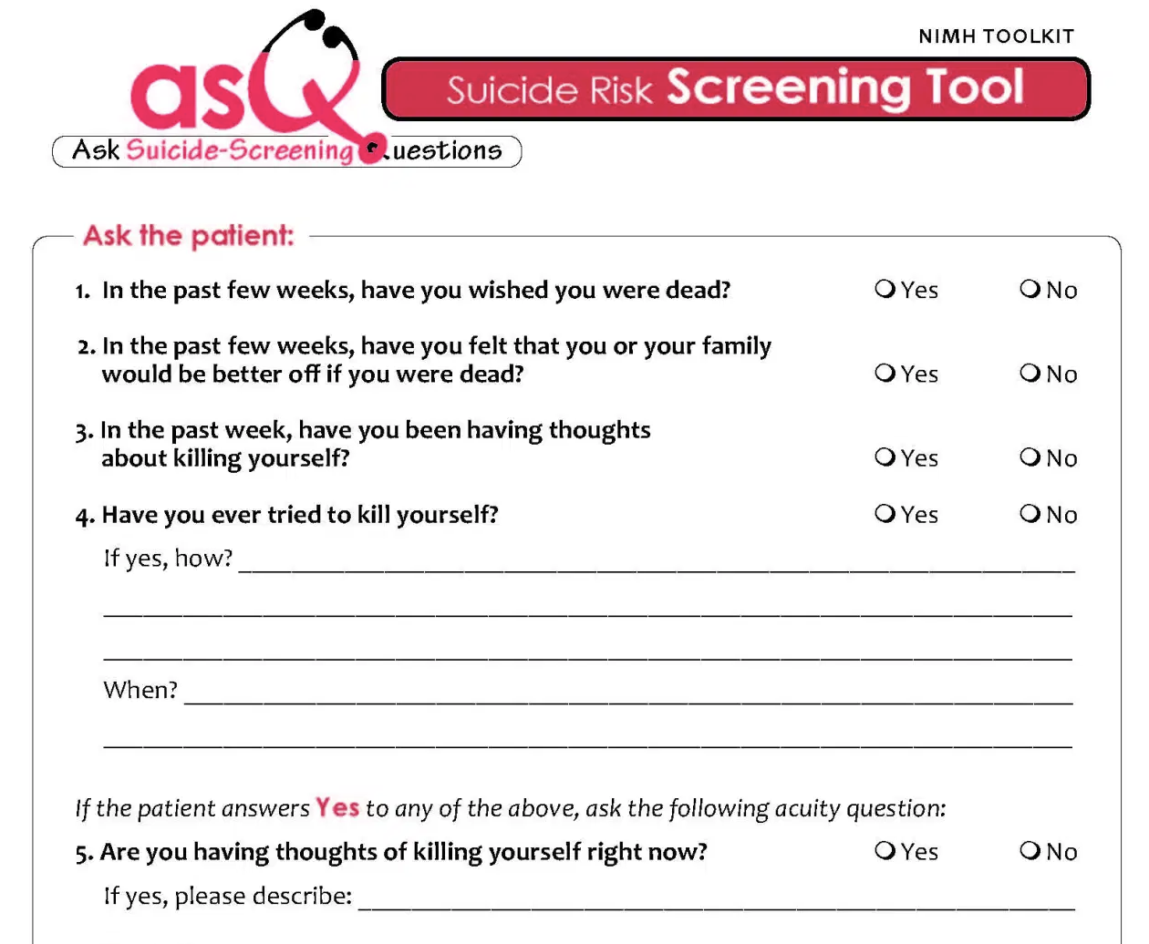
https://www.nimh.nih.gov/sites/default/files/documents/research/research-conducted-at-nimh/asq-toolkit-materials/youth-outpatient/suicide_risk_screening_pathway_outpatient_youth.pdf
Notes:
Choose a validated screening tool
Options include ASQ, PHQ-9, CSSRS
Understand how to score and document results
Identify screening workflow
Discuss differences between standardized depressive symptoms screening tools (i.e. PHQ-9) vs standardized suicide-specific screening tools (i.e. ASQ, C-SSRS)
Phq9 > passive suicidality , and history of suicide attempt
CSSRS > active suicidality

Slide 9
Notes:
No what do you do?

Slide 10
What would you do now?
To help keep the patient safe, the PCP should communicate that it is important to involve a parent and to develop a safety plan together.
Notes:
Discuss how HIPPA and confidentiality is trumped by safety concerns. If necessary, explain that to the patient.

Slide 11
Dr. XXXX and Casey

Slide 12
Partnering with the Parent
“Your child shared they have thoughts of wanting to die and some intention on acting on these thoughts. Have they shared this with you?”
Describe some (making home safer and making a safety plan together) interventions to the patient and parent.
You may use the BSSA worksheet as a reference for communication tips.
Notes:
Freeze after pcp shares concerns with parent and starts to describe intervention and initiated BS safety plan

Slide 13
Partnering with the Parent
Make a safety plan with the patient and parent using the Stanley & Brown Safety Template.

Slide 14
988

Slide 15
Partnering with the Parent
Counsel on lethal means restriction
Research has shown that limiting access to dangerous objects saves lives.
Let’s work together to make your environment safe.
Notes:
Discuss the pluses and minuses of speaking to the parent alone or with patient to discuss lethal means restriction

Slide 16
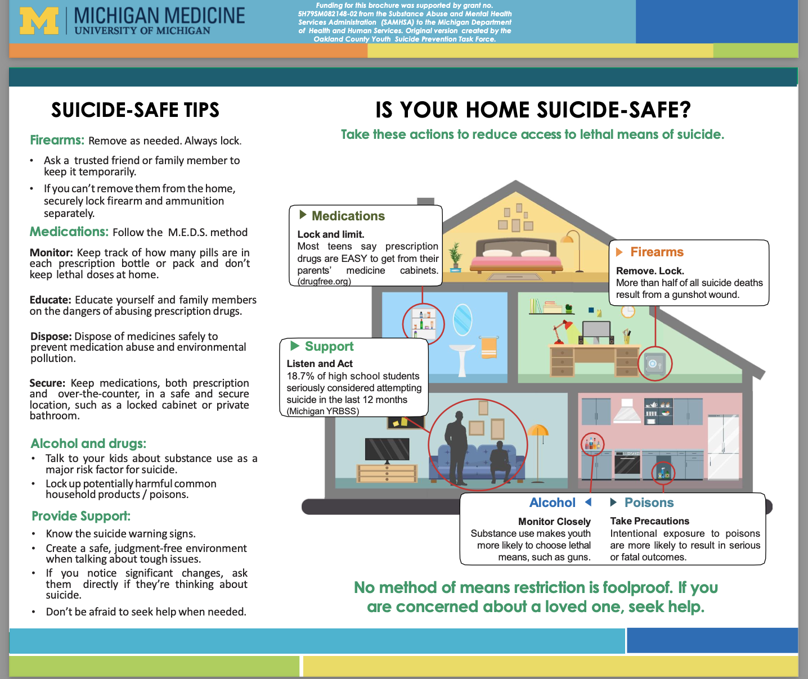

Slide 17
Partnering with the Parent
Guns are the most frequent method of suicide death. Do you have guns in your home?
Pills are the most frequent method of suicide attempts. Do you have pills in your home? How about over-the-counter medication such as Tylenol, aspirin? How are they stored?
What type of building do you live in? In a high rise, limiting access to the rooftop and installing window guards increases safety.

Slide 18
Table exercise and Group debrief: 15 minutes total

Slide 19
Table Exercise: Safety Planning
Casey’s PHQ-9 modified was concerning as her answers were not trustworthy
PCP gave her an ASQ after they established more rapport

Slide 20
Identifying Suicide Risk: Screening Tools
If yes on any of 1-4 and NO to Q4 and Q5?
Brief Suicide Safety Assessment
https://www.nimh.nih.gov/sites/default/files/documents/research/research-conducted-at-nimh/asq-toolkit-materials/youth-outpatient/suicide_risk_screening_pathway_outpatient_youth.pdf
Notes:
Choose a validated screening tool
Options include ASQ, PHQ-9, CSSRS
Understand how to score and document results
Identify screening workflow
Discuss differences between standardized depressive symptoms screening tools (i.e. PHQ-9) vs standardized suicide-specific screening tools (i.e. ASQ, C-SSRS)
Phq9 > passive suicidality , and history of suicide attempt
CSSRS > active suicidality

Slide 21
Safety Planning
Casey was assessed as moderate risk. She had no suicidal plans and didn’t wish she were dead. Her mood was quite depressed, and she thought her family might prefer if she wasn’t around. She was isolating herself in her room and ignoring her circle of friends.
Notes:
This whole exercise is about that middle group in the grey area of risk.

Slide 22
Table Exercise: Safety Planning
Assignment: (8 minutes)
Pick one person at the table to play “Danielle”, another her mom.
Everyone else takes turns as the doctor working on a safety plan with Danielle and her mom (copy on the table).
There are six components to the safety plan and more than one answer in each component.
Everyone should develop at least one thing for the safety plan in collaboration with Danielle and her mom.

Slide 23
Table Exercise: Cheat Sheet
1. Can you think of any warning signs that might precede thoughts that your family would be better off without you? These can include experiences, thoughts, feelings, behaviors, or situations.
2. What are some of the things you can do to distract you from your depressive thoughts?
3. Are there people or social settings that can distract you from your upsetting thoughts?
4. Are there people; adults, relatives, older friends, that you could ask for help if you have a suicidal crisis?
5. What are the professional resources to help during a crisis?
6. What are the ways to keep your environment safe?

Slide 24
Table Exercise: Whole Room Debrief (4 minutes)
Ask the Caseys and the Caseys’ moms how they experienced the safety plan collaboration
Did they feel supported?
Did they feel respected?
Did they like the final product?
Did they learn any clinical pearls from the experience of being on the other side?

Slide 25
Question and Answer

