Slide 1
Assessing and Managing
Adolescent Suicide Risk In Primary Care
April 14, 2024

Slide 2
Welcome!
David Kaye, MD
Professor of Psychiatry, University at Buffalo, Jacobs School
of Medicine and Executive Director, Project TEACH
DLKaye@Buffalo.edu
Michele Phillips
Michele Phillips
Sr. Project Director, Project TEACH
Sr. Project Director, Project TEACH
mp246@buffalo.edu
MP246@Buffalo.edu

Slide 3
Disclosure
I have no relevant financial relationships with ineligible companies
Notes:
DAVID

Slide 4

The way through it is by talking about it……….
Suicide risk grows in silence

Slide 5
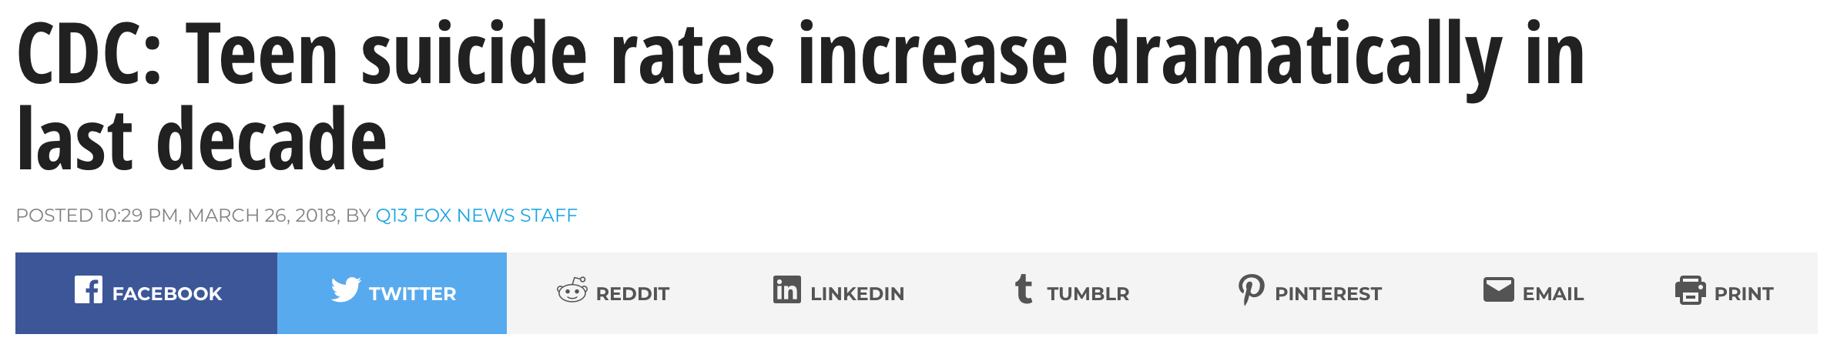
Increase
56%
Notes:
OVERALL RATE 13/100,000; 10-14: tripled over this time period, now 3/100,000; 15-19 6.8 to 10.6

Slide 6
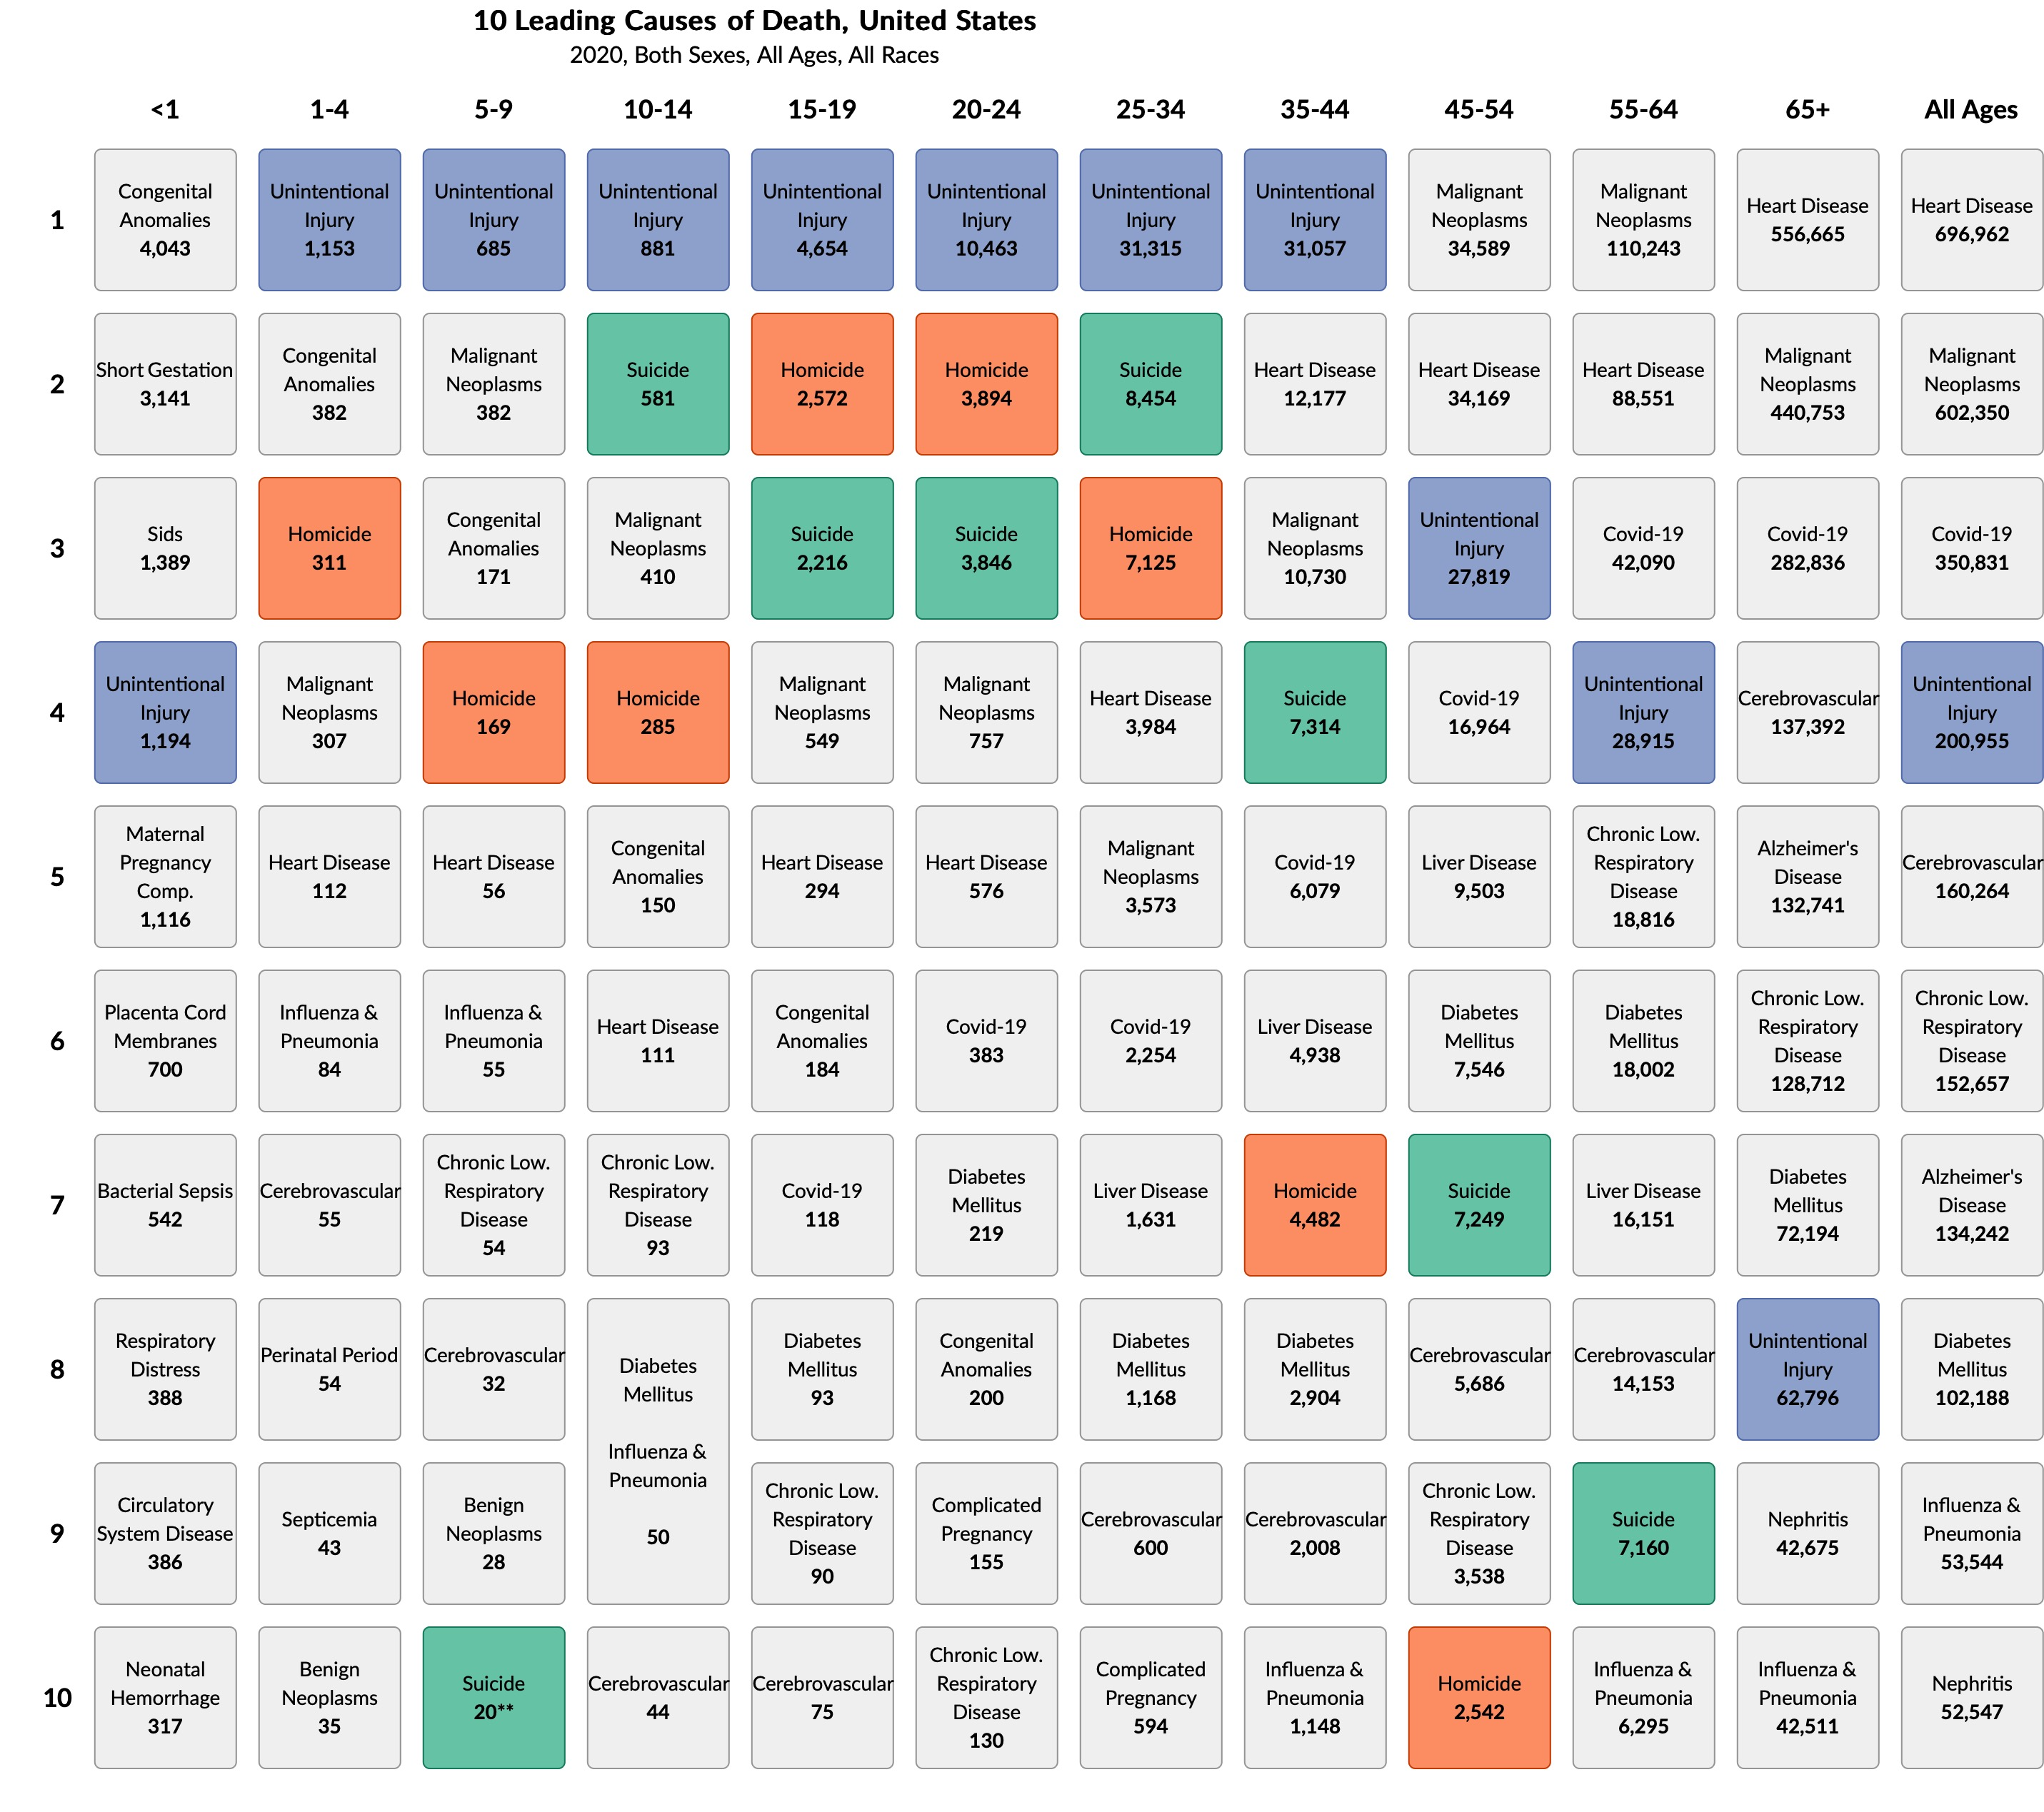
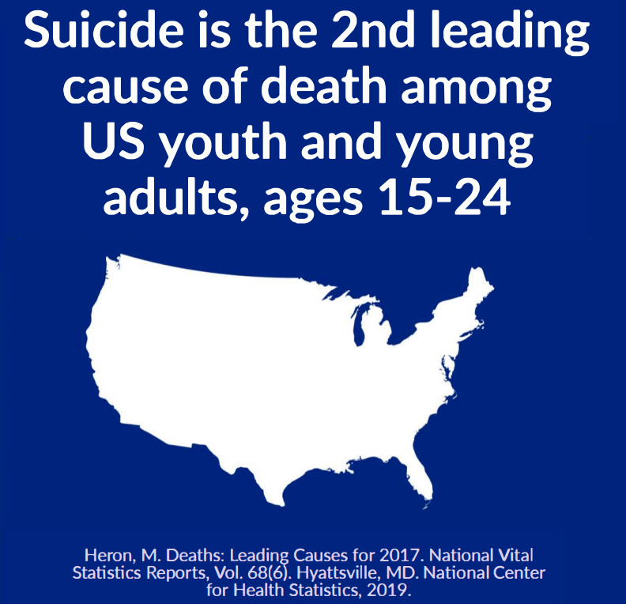

Slide 7
Firearms #1 Cause, 15-19 yo
Notes:
Girls suffocation 52%, firearms 23%, 14% OD; 10-14:

Slide 8
40% of youth who died by suicide visited a primary care medical setting within the month prior

Slide 9
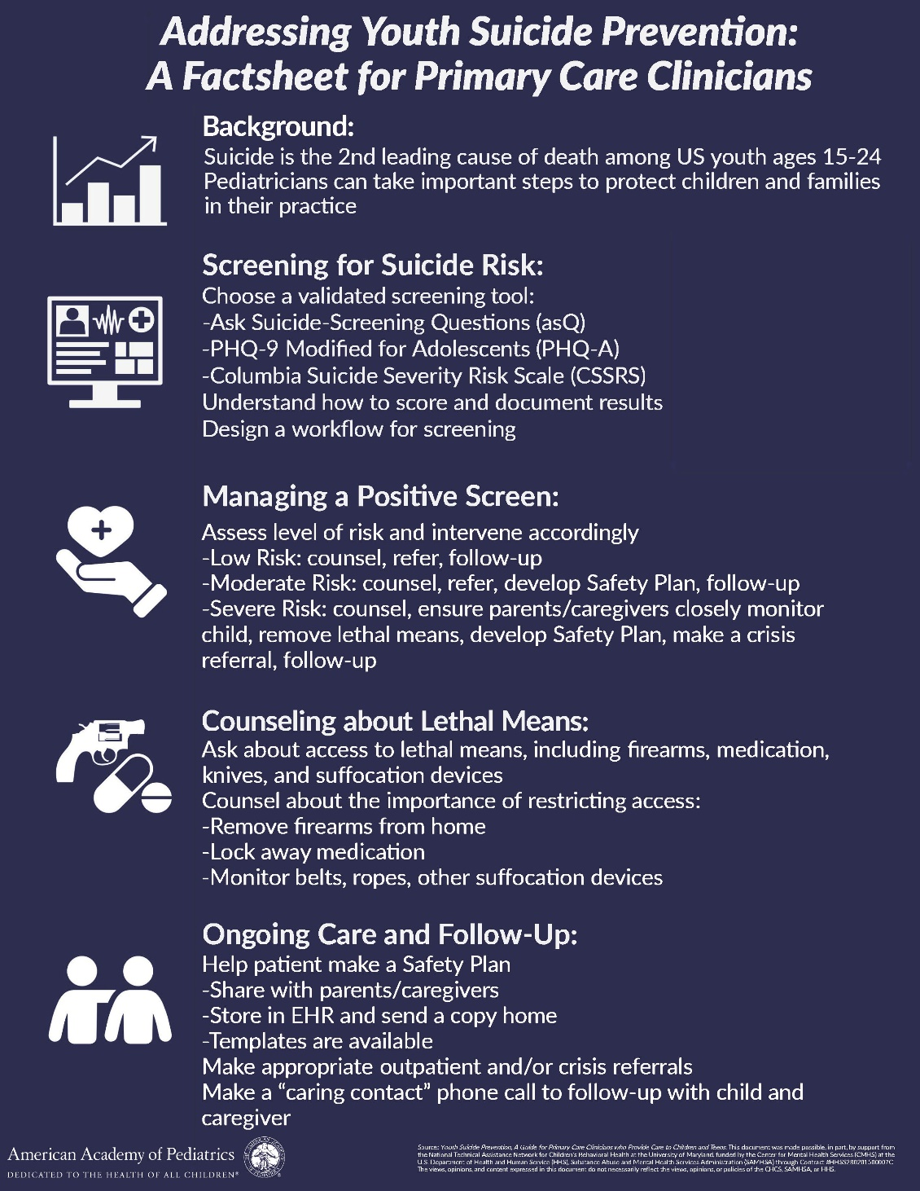
AAP Blueprint for
Youth Suicide Prevention
https://www.aap.org/en/patient-care/blueprint-for-youth-suicide-prevention/

Slide 10
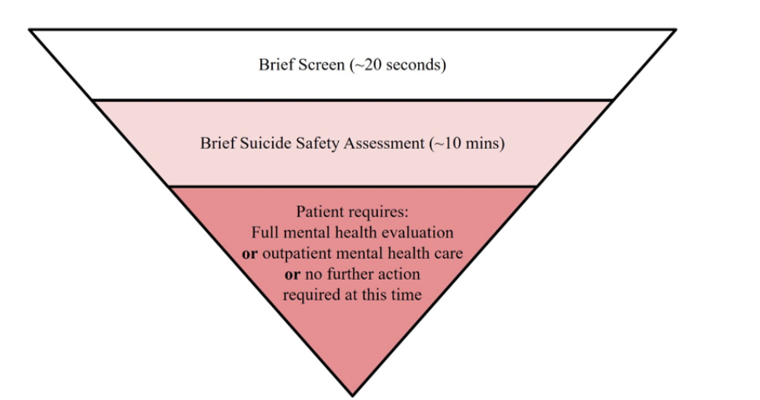
3-Step Approach
Brief Screen (universal)
<1 minute
Ages 12 +
8-11 if at risk
Brief Suicide Safety Assessment
If identified to be at risk
10-15 minutes
Stratify Risk (to determine disposition)
Imminent
Further evaluation needed
Low Risk
https://www.aap.org/en/patient-care/blueprint-for-youth-suicide-prevention/strategies-for-clinical-settings-for-youth-suicide-prevention/clinical-pathways-for-suicide-prevention/

Slide 11
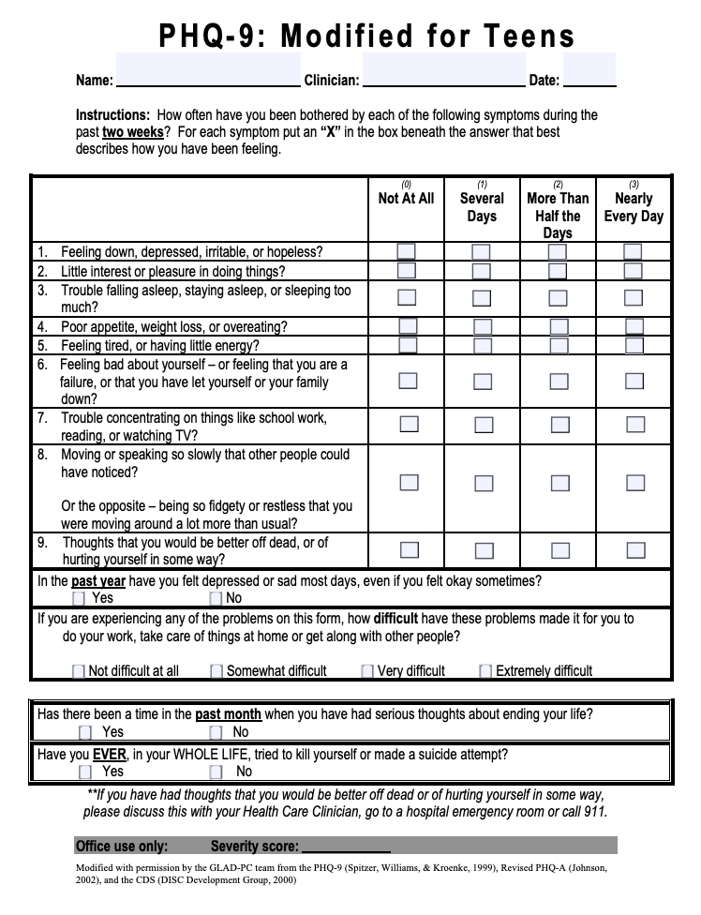
Identifying
Suicide Risk:
Depression
Screening Tools
Notes:
Choose a validated screening tool
Options include ASQ, PHQ-9, CSSRS
Understand how to score and document results
Identify screening workflow
Discuss differences between standardized depressive symptoms screening tools (i.e. PHQ-9) vs standardized suicide-specific screening tools (i.e. ASQ, C-SSRS)
Phq9 > passive suicidality , and history of suicide attempt
CSSRS > active suicidality

Slide 12
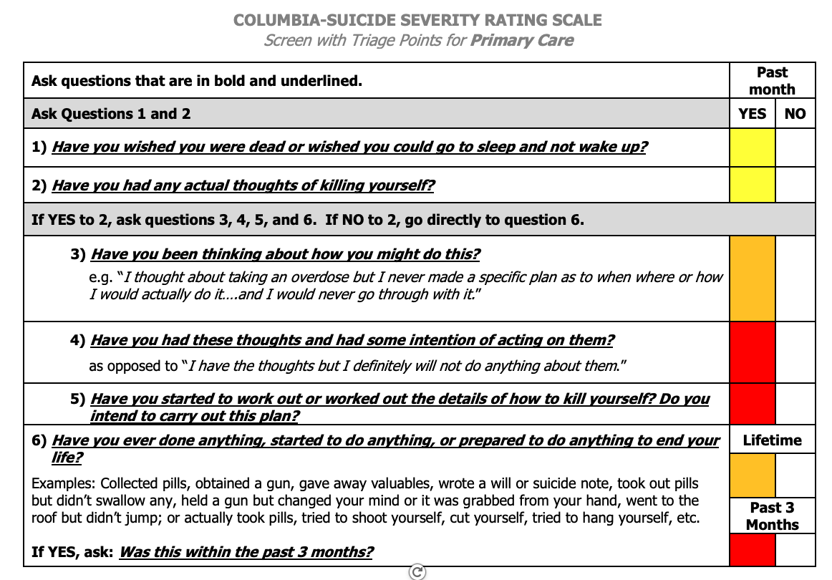
Identifying Suicide Risk:
Suicide Brief Screen
Notes:
Management of a positive screen begins with assessing the level of risk in order to intervene accordingly
When using the C-SSRS, triage works the same in most settings -The only thing that changes are next steps, which are setting specific.
The most worrisome answers are a recent (past month) “yes” to items 4 or 5 for suicidal ideation and/or any recent (3 months) behavior
Once you have identified someone at risk for suicide you want to determine what is that level of risk
Phq9 > passive suicidality , and history of suicide attempt
CSSRS > active suicidality
** NYP Guidelines include: C-SSRS screening tool will be completed in Ambulatory Care as follows:
-Adolescent patients(12 and older): Pre-screening with PHQ9 modified for teens will be completed at every visit that will prompt a C-SSRSif suicide/self-harm responses are positive.
-Youth 11years and under will receive the screening based on clinician’s judgment

Slide 13
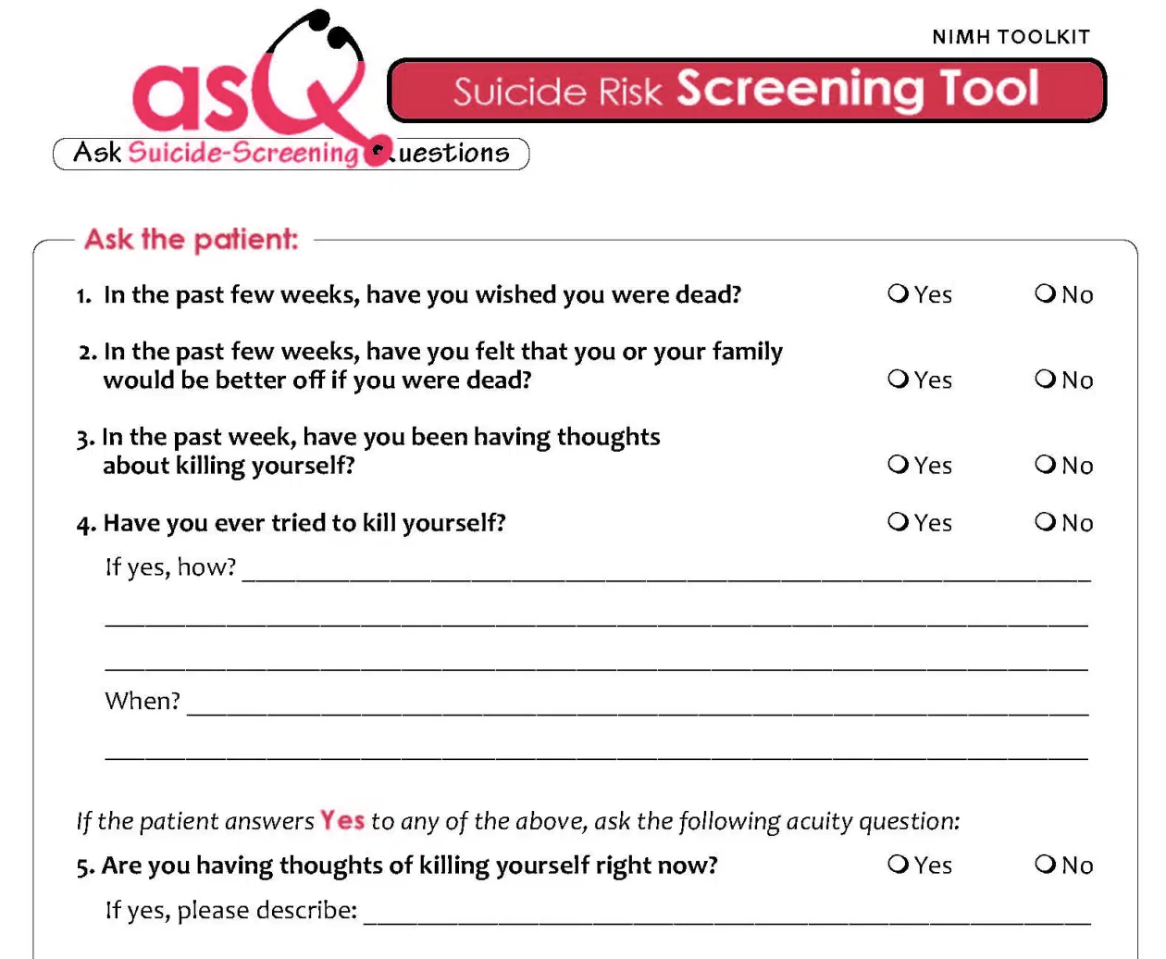
Identifying Suicide Risk:
Suicide Brief Screen
https://www.nimh.nih.gov/sites/default/files/documents/research/research-conducted-at-nimh/asq-toolkit-materials/youth-outpatient/suicide_risk_screening_pathway_outpatient_youth.pdf
Notes:
Choose a validated screening tool
Options include ASQ, PHQ-9, CSSRS
Understand how to score and document results
Identify screening workflow
Discuss differences between standardized depressive symptoms screening tools (i.e. PHQ-9) vs standardized suicide-specific screening tools (i.e. ASQ, C-SSRS)
Phq9 > passive suicidality , and history of suicide attempt
CSSRS > active suicidality

Slide 14
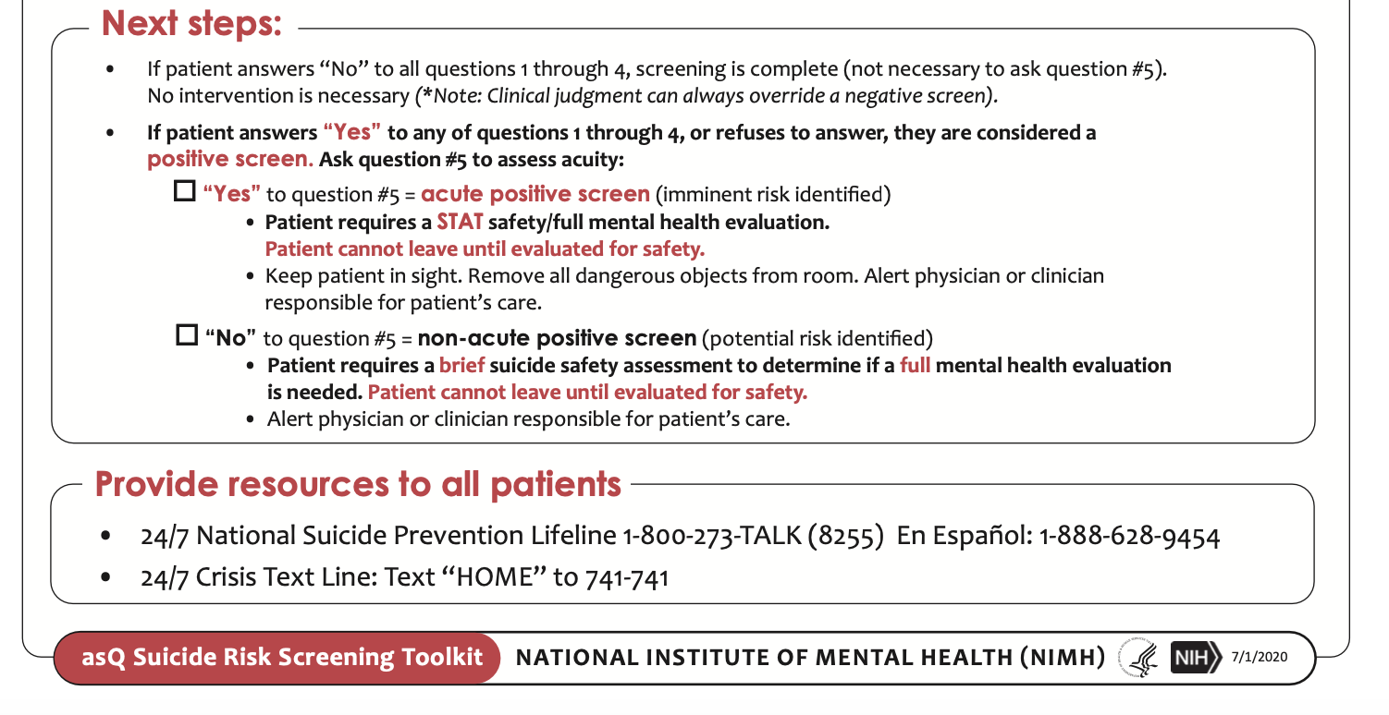
If Q1-4 “Yes” then it is a positive screen……

Slide 15
If the AsQ Positive then…
Brief Suicide Safety Assessment
1. Convey Respect of the patient (feel appreciated)
2. Assess the patient – frequency; plan; past behavior; symptoms , social support& stressors
3. Interview patient and parent together, alone
4. Make a safety plan (including means restriction) if appropriate
5. Determine a disposition
6. Provide resources

Slide 16
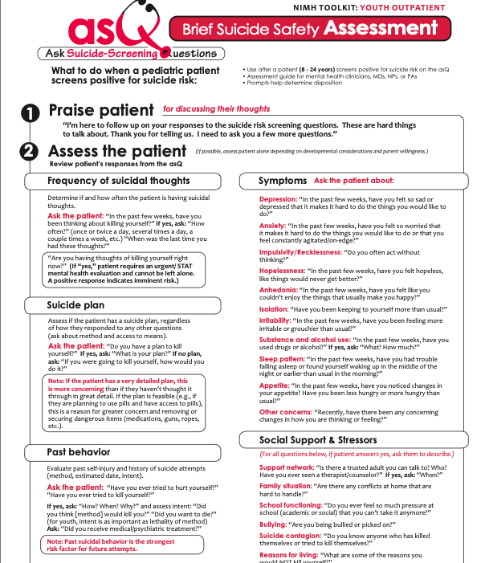
ASQ BSSA

Slide 17
Further Questions to Assess (ideally alone)
Have you had thoughts of killing yourself?
How often do you have thoughts of killing yourself or that you wished you were dead?
Do you have a plan of how you would kill yourself? What have you thought about?
When was last time?
How long do these thoughts stay with you?
Are they hard to get out of your mind? Does it interfere with functioning?
At those times Is there anything you do that helps? Makes it better?
Is there anyone you can talk to when you feel like that?
On a scale of 0-10 (0=none, 10=actually doing something) how close have you come to actually done something to hurt or kill yourself?
What stopped you from doing anything? What keeps you wanting to be alive?

Slide 18
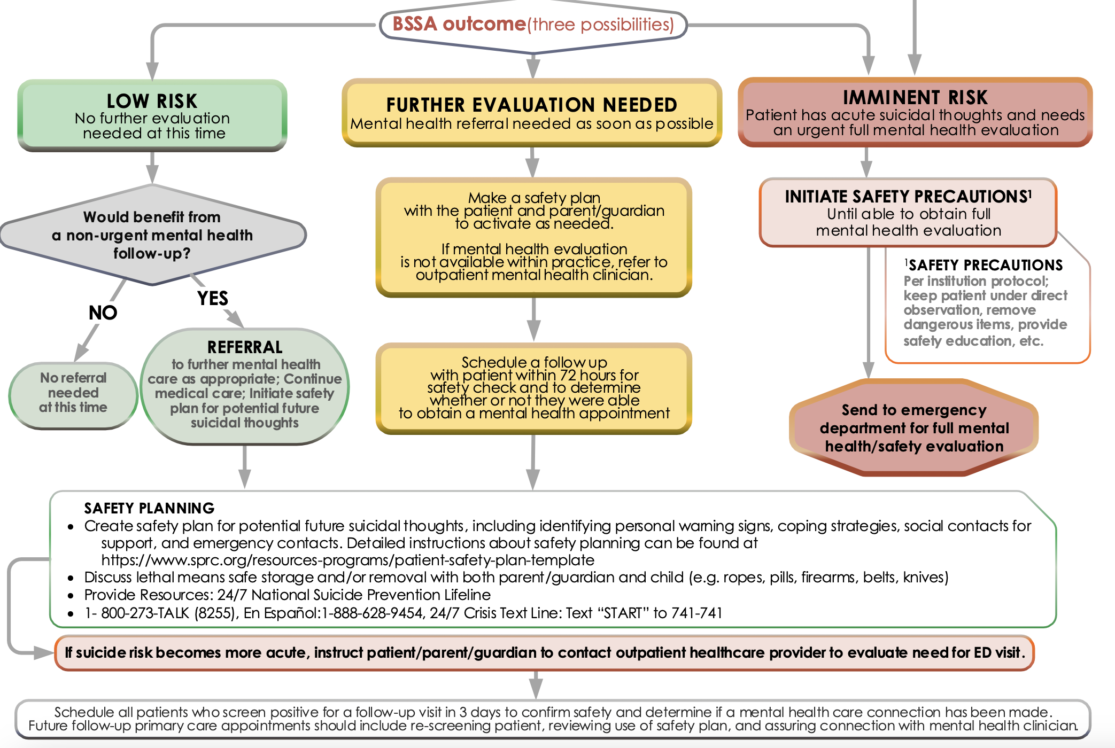
Disposition Based
On BSS Assessment

Slide 19
Safety Plan Intervention
A brief intervention to mitigate risk for mild-moderate risk.
NOT A NO SUICIDE CONTRACT
Intent is to collaboratively help individuals lower their imminent risk by constructing
  a predetermined set of personal coping strategies and
  a list of individuals and/or agencies they can contact.
Results in a one page document to use when suicide risk is emerging.
Suicide risk fluctuates over time, SPI is for staying safe when these feelings emerge.
Notes:
SPI – determined best practice by Suicide prevention resource center

Slide 20

Best Safety Plans: for staying safe when these feelings emerge.
Brief, Feasible
Collaborative: include the
patient’s own words,
Done Side by side
Done BEFORE imminent risk
Involve family members

Slide 21
https://projectteachny.org/app/uploads/2023/10/safety-plan-stanley-template.pdf

Slide 22
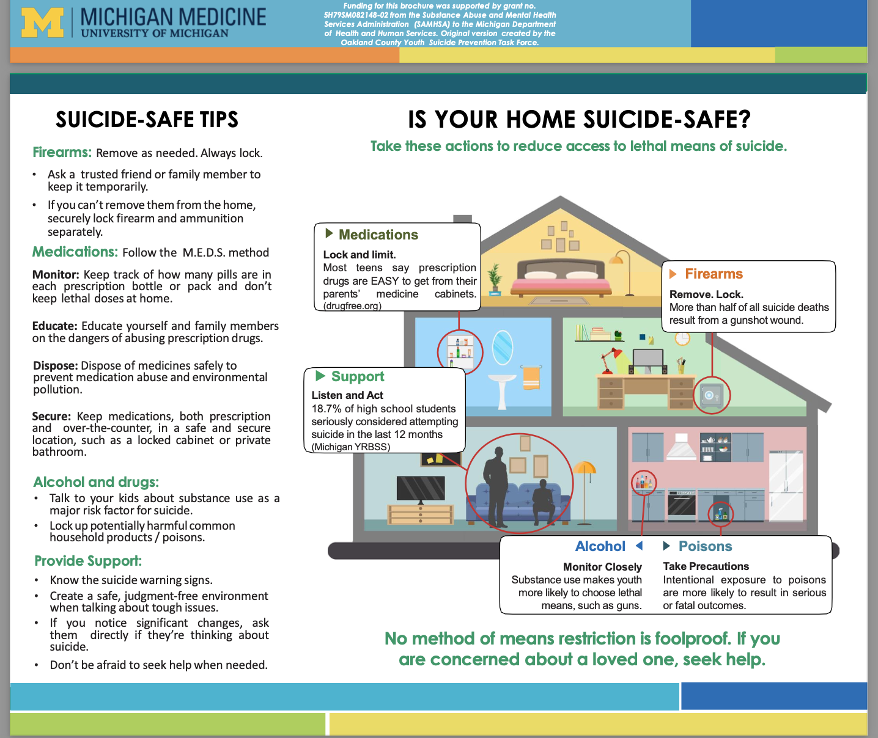

Slide 23
Resources for Parents and Teens
Phone/chat resources
  Know your local/regional crisis services
  988
  1-800 273-Talk
  Text Got5 to 741-741
Trevor Project https://www.thetrevorproject.org/get-help-now/ (LGBTQ)
  1-866-488-7386
  Text START to 678-678
Trans Lifeline https://translifeline.org/hotline/ 1-877-565-8860
Now Matters Now (peer based DBT skills) https://www.nowmattersnow.org/
JED Foundation https://www.jedfoundation.org/

Slide 24
Resources for Professionals
AAP Suicide Prevention https://services.aap.org/en/news-room/campaigns-and-toolkits/suicide-prevention/
Ask Suicide Screening Toolkit (ASQ) https://www.nimh.nih.gov/research/research-conducted-at-nimh/asq-toolkit-materials/index.shtml
UPMC STAR Center (for adolescents and families) https://www.starcenter.pitt.edu
Suicide Prevention Resource Center How EDs can help prevent suicide among at-risk patients: 5 Brief Interventions
http://www.sprc.org/micro-learning/how-emergency-departments-can-help-prevent-suicide-among-risk-patients-five-brief

Slide 25
Conclusions: Suicide is preventable
Suicide in adolescents is a major public health problem
and tragedy when it occurs
Suicide risk grows in silence—talking saves lives
Universal screening opens up the conversation
Suicidal ideation is often linked with depression; depression can be treated..…if it’s recognized!
Suicide is often impulsive
  promote limiting access to means and
  Promote bridging relationships:
  Pediatric clinicians CAN BE THAT BRIDGE

