Slide 1
Management and Treatment of
Adolescent Depression
Jessica Grant, MD, FAAP
Founder, Partner, and Pediatrician, Manhattan Valley Pediatrics, New York, NY
Project TEACH, Primary Care Champ

Slide 2

PCP CHAMP:
Jessica Grant, MD, FAAP
Founder, Partner, and Pediatrician, Manhattan Valley Pediatrics, New York, NY
Project TEACH, Primary Care Champ

Slide 3
Disclosures
“My spouse/partner and I have the following relevant financial relationship with a commercial interest to disclose:

Slide 4
POLL-Raise your hands
Should Pediatric Primary Care Providers treat major depressive disorder in teens?
1. Yes. Always.
2. No. Never.
3. Yes, if the patient is not psychotic or actively suicidal.
4. Yes, only to bridge care while patients wait for a psychiatrist.

Slide 5
Let’s continue where we left off…

Slide 6
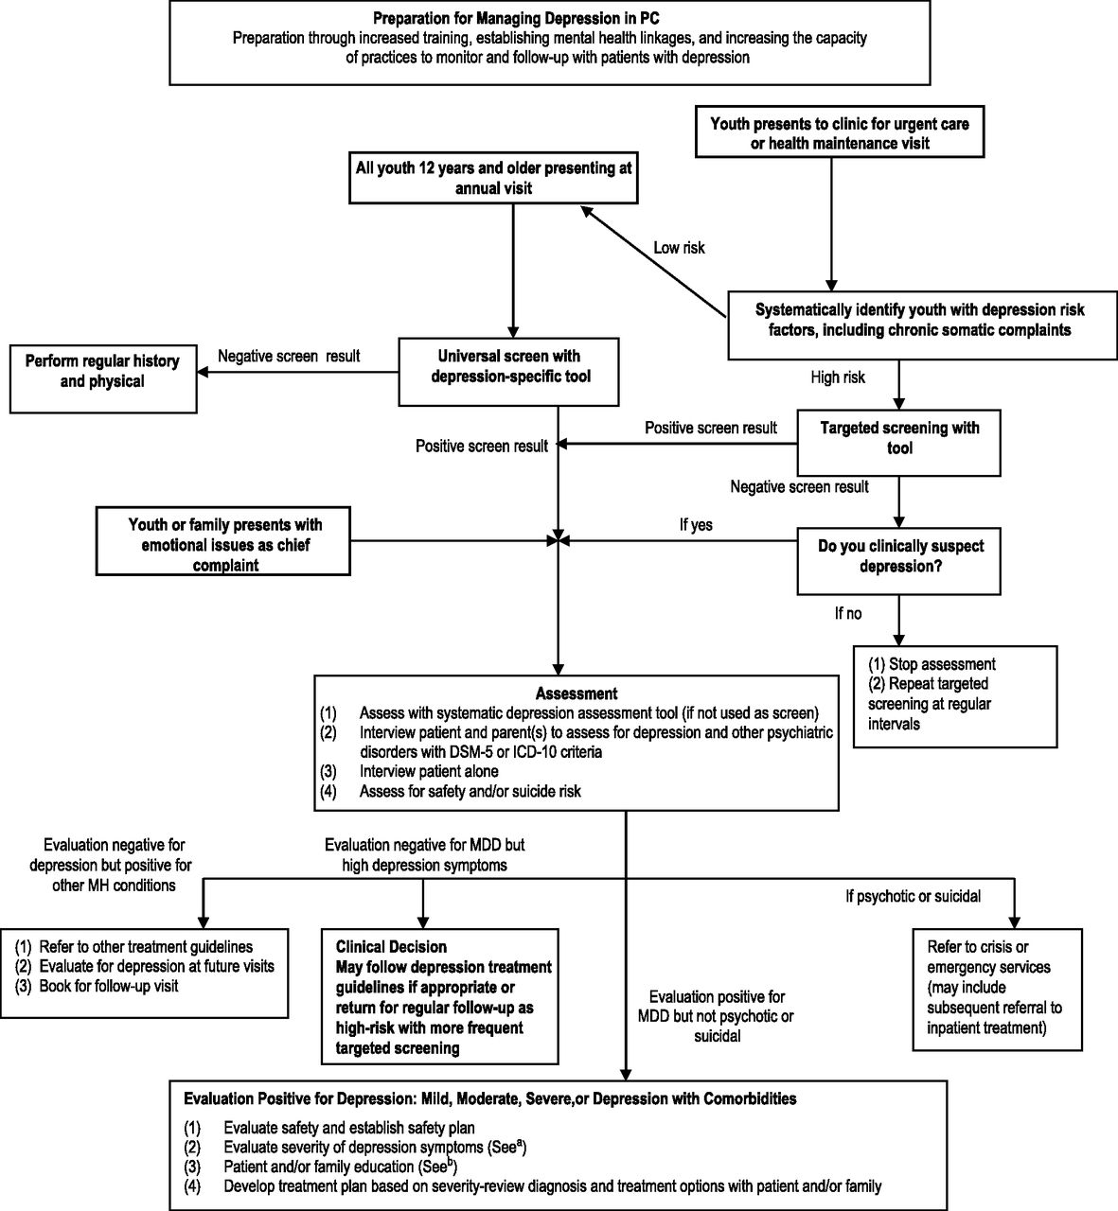

Clinical assessment flowchart.
Rachel A. Zuckerbrot et al. Pediatrics doi:10.1542/peds.2017-4081
©2018 by American Academy of Pedatrics

Slide 7
Initial Management
A. Decide if Mild, Moderate or Severe
B. Establish a Safety Plan
C. Educate Patient and Family
D. Develop a treatment plan based on severity

Slide 8
A. How to Decide?
MILD MODERATE SEVERE
Clinical impressions from interview
Standardized rating scales scores
Number of DSM-5 criteria
Degree of impairment from baseline
Safety issues (suicidality, self-injury)

Slide 9
CASE: Danielle
Mild, Moderate, or Severe?

Slide 10
B. Safety Planning
Assess current risk – ASQ screen
If safe to go home, have parents “sanitize” the home from risk
Make a written plan
  NOT A PROMISE TO NOT HARM
  Hierarchy of support systems and comforting activities (music, art, sports, etc.)
      When should friends be contacted
      When should parents be contacted
      When should the PCP be contacted
      When should 911 be contacted
      When should a suicide crisis line be contacted

Slide 11
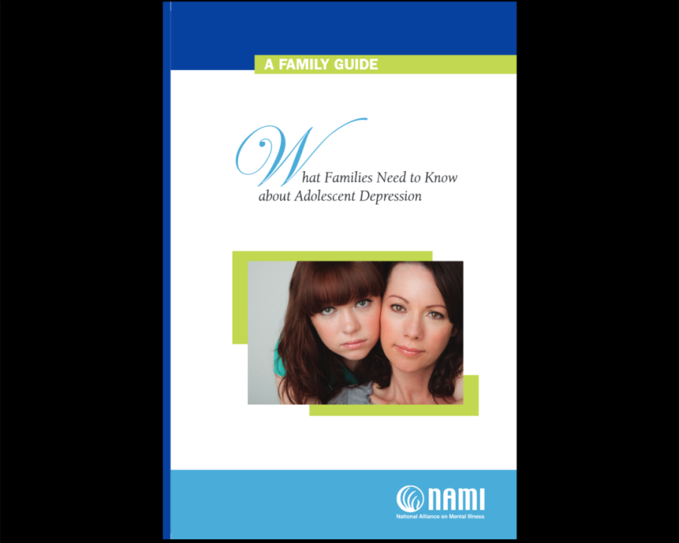
C. Patient and Family Education
Explaining depression as a common and treatable condition is one of the most important steps to be done in primary care
Written materials can go a long way in helping to keep them engaged in the mental health process
  NAMI FAMILY GUIDE
  GLAD-PC Toolkit Handouts

Slide 12
C. Patient and Family Education: Basic Interventions to help oneself or one’s child
  Behavioral Activation
  Exercise
  Nutrition
  Spend time outside (commune with nature)
  Hang out with supportive friends
  Spiritual or other supportive community
  Altruism (volunteer opportunities)
  Sleep
  Limit screen time/ social media

Slide 13
D. Develop a Treatment Plan Based on Severity
Now we go to Part II of the guidelines and the second flowchart
Notes:
Resources at the end

Slide 14
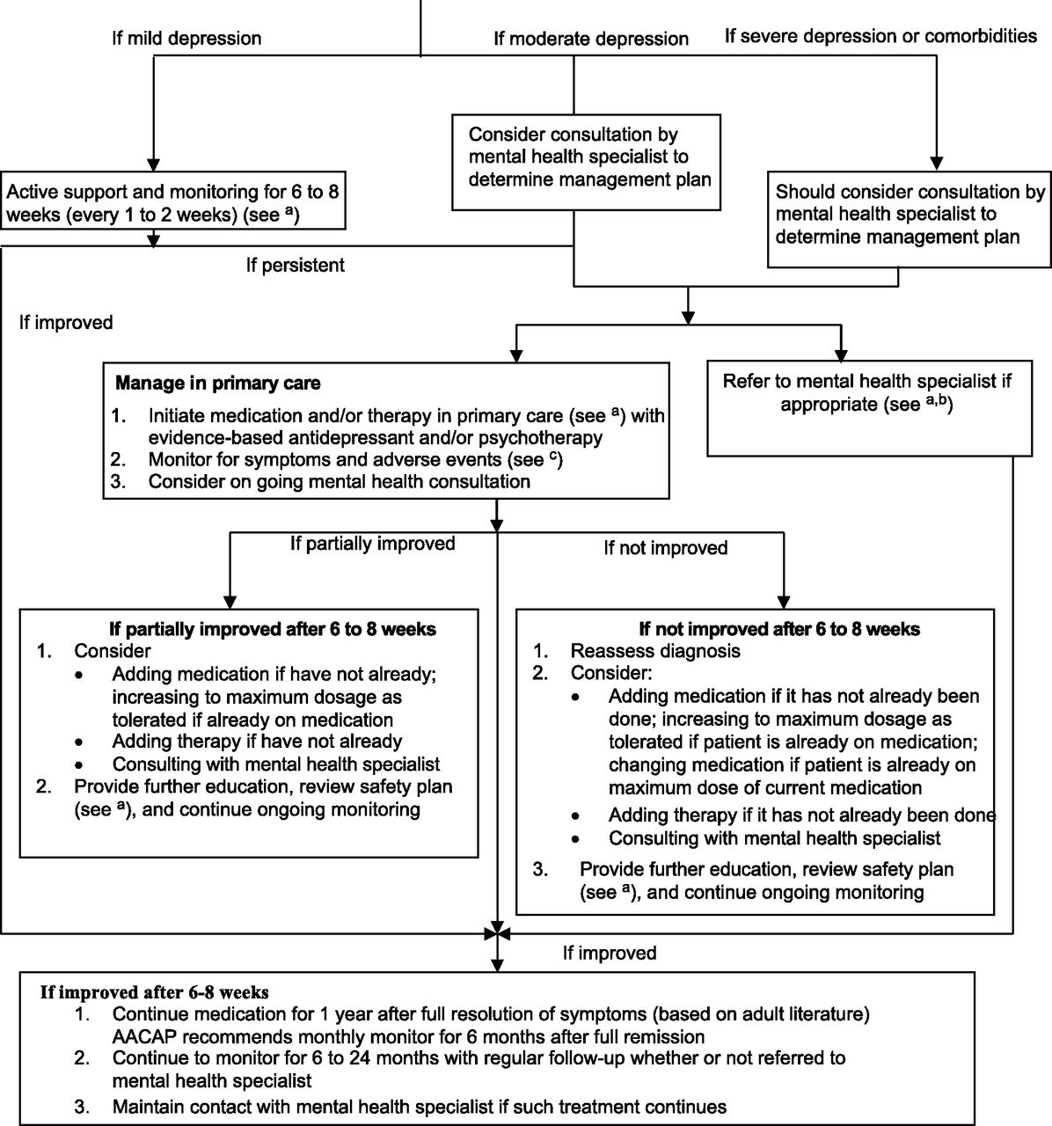
D. Develop a Treatment Plan Based on Severity
Amy H. Cheung et al. Pediatrics doi:10.1542/peds.2017-4082
©2018 by American Academy of Pediatrics
Notes:
Clinical management flowchart. ªPsychoeducation, supportive counseling, facilitate parental and patient self-management, refer for peer support, and regular monitoring of depressive symptoms and suicidality. ^{b}Negotiate roles and/or responsibilities between PC and mental health and designate case coordination responsibilities. Continue to monitor in PC after referral and maintain contact with mental health. ^{c}Clinicians should monitor for changes in symptoms and emergence of adverse events, such as increased suicidal ideation, agitation, or induction of mania. For monitoring guidelines, please refer to the guidelines and/or toolkit. AACAP, American Academy of Child and Adolescent Psychiatry.

Slide 15
Managing Mild Depression

Slide 16
Clinical Assessment Flowchart
Zuckerbrot RA, Cheung A, Jensen PS, Stein REK, Laraque D; GLAD-PC Steering Group. Guidelines for Adolescent Depression in Primary Care (GLAD-PC): Part II. Treatment and Ongoing Management. Pediatrics. 2018;141(3):e20174082
Notes:
Just stay a few seconds on cluttered slides

Slide 17
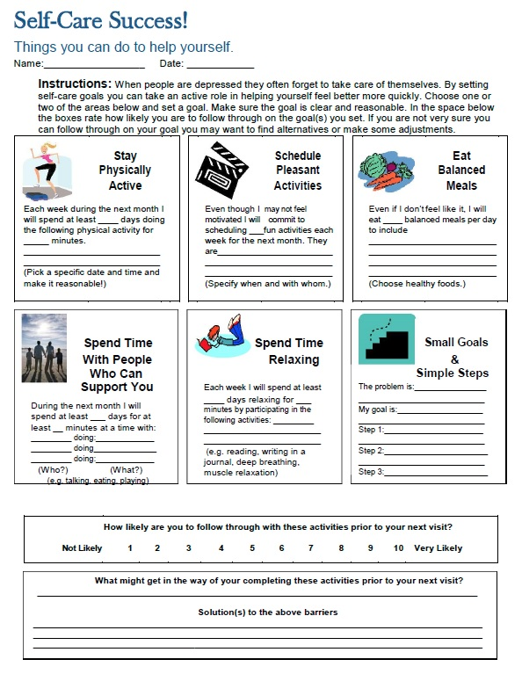
Active Monitoring & Close Follow-Up

Slide 18
Managing Moderate to Severe Depression
Notes:
Weave Danielle in and how you would deal with her in your practice.

Slide 19
Clinical Assessment Flowchart
Zuckerbrot RA, Cheung A, Jensen PS, Stein REK, Laraque D; GLAD-PC Steering Group. Guidelines for Adolescent Depression in Primary Care (GLAD-PC): Part II. Treatment and Ongoing Management. Pediatrics. 2018;141(3):e20174082
Notes:
Just stop by

Slide 20
Referral for Evidence-based Therapy
Explain to the family why you are referring them.
Explain what the provider will do, use names and describe office if possible.
Explain your continued role in their care.
Communicate with referral provider.
Establish roles and responsibilities with mental health provider.

Slide 21
Clinical Assessment Flowchart
Zuckerbrot RA, Cheung A, Jensen PS, Stein REK, Laraque D; GLAD-PC Steering Group. Guidelines for Adolescent Depression in Primary Care (GLAD-PC): Part II. Treatment and Ongoing Management. Pediatrics. 2018;141(3):e20174082
Notes:
Quick stop

Slide 22
Psychotherapy for Depression
Cognitive Behavioral Therapy (CBT)
Interpersonal psychotherapy- Adolescent (IPT-A)
Other therapies are difficult to manualize and test in a RCT (does not mean that they are ineffective)

Slide 23
Cognitive Behavioral Therapy
GETS KIDS MOVING and BUILDS SKILLS
Behavioral Activation (Go watch the other kids play basketball even if you are too tired and not interested).
Cognitive restructuring (The world is not out to get you. That is the depression talking.)
Coping skills training (What can you do next time when you get into a fight instead of trying to hurt yourself?)
Stress management (Deep breathing, listening to music, etc).

Slide 24
Psychopharmacotherapy for Depression
SSRIs (Selective Serotonin Reuptake Inhibitors) are first-line treatment in Adolescent Depression
Notes:
Updated 8/26/2013 - PSJ
FACULTY: Please briefly draw learners’ attention to the 3 following RESOURCE SLIDES, which both show the CBT is effective, that SSRI’s are effective, AND that CBT appears to offer a modest benefit over and above Medication-alone, as in the TADS study – The COMB group also had less suicidal ideation, compared to the SSRI-only group – described in the early Unit of the Black Box

Slide 25
Choosing an SSRI
FDA Approval for MMD in Teens?
RCT Evidence for MDD in Teens?
FDA Approval for other Disorders in Teens?
Fluoxetine
Escitalopram
Fluoxetine
Escitalopram
Sertraline
Citalopram
Fluoxetine
Sertraline
Fluvoxamine

Slide 26
Other Considerations
Prior treatment history
Comorbidity
Family member response
Family preference
Clinical experience

Slide 27
Treatment of Adolescent Depression Study (TADS)
March et al, 2004
439 adolescents, 12-17 years old, 13 sites, 12 weeks
Study groups:
  Medication (fluoxetine) alone: 60.6%
  Cognitive Behavioral Therapy alone: 43.2% (not statistically different from placebo at 12 weeks)
  CBT + fluoxetine: 71%
  Placebo: 34.8%

Slide 28
CBT for Relapse Prevention
Adding CBT after initial response to meds will keep improvement for longer-reduce time to relapse
CBT booster sessions also help prevent relapse and deterioration of CBT skills
Notes:
Put references at the end

Slide 29
Follow-Up
Amy H. Cheung et al. Pediatrics doi:10.1542/peds.2017-4082
©2018 by American Academy of Pediatrics
Notes:
Quick visit - Walk through moderate to severe. Emphasize the psychiatric consult here. CBT and meds will be on following slides in detail.

Slide 30
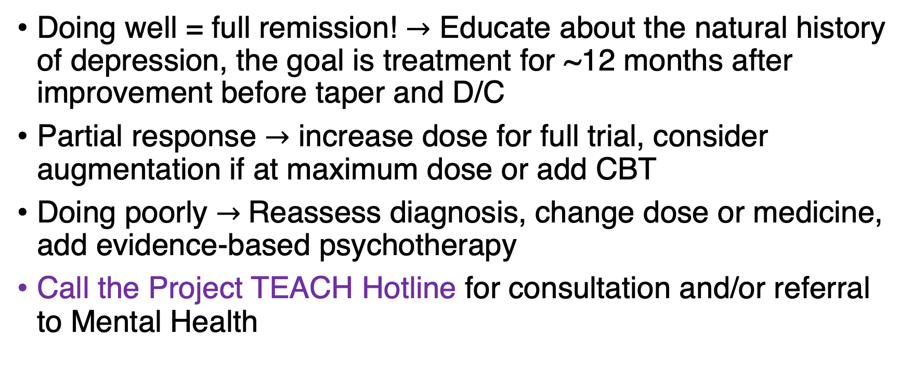
FOLLOW UP: How’s it going?
Doing well = full remission! $→$ Educate about the natural history of depression, the goal is treatment for ~12 months after improvement before taper and D/C
Partial response $→$ increase dose for full trial, consider augmentation if at maximum dose or add CBT
Doing poorly $→$Reassess diagnosis, change dose or medicine, add evidence-based psychotherapy
Call the Project TEACH Hotline for consultation and/or referral to Mental Health

Slide 31
SSRI How-To: Part I
Try to start with a first-line medication (FDA approved) unless other considerations take precedence
Start at a dose lower than the expected therapeutic dose (e.g fluoxetine 5 or 10 mg instead of 20 mg or escitalopram 5 mg instead of 10 mg)
If there are no side effects, go up in a week.
Warn families that the early doses are to acclimate and test the waters and not to expect a sudden recovery.
Get to a therapeutic dose in 2-4 weeks (clinical judgement).
Patients should respond somewhat to therapeutic dose in 2-3 weeks.
If no response, increase dose.
If some response, wait 4-6 weeks (for full response to take effect) to decide if dose should be increased.

Slide 32
SSRI How-To: Part II
Monitor for side effects
Monitor for suicidality
Monitor for improvement in symptoms and functioning
If patient does not respond at higher doses of SSRI, consider change of medication
Next step in medication is to try a different SSRI (not to switch classes)
How to switch from one medication to another (cross-tapering vs. stopping and starting, cross-tapering slowly vs cross-tapering quickly, etc.) depends on many factors including but not limited to which specific SSRIs, the side effects, the response, and the clinical picture→ CALL PROJECT TEACH

Slide 33
What could go wrong?
Side effects – many are possible (see GLAD PC toolkit for list)
  Serotonin syndrome: Start low and titrate up
  Suicidality: Medication-induced versus medication undertreatment?
  GI / stomach upset: usually transient after a few weeks
  Sexual: Must be discussed at onset alone with teens and followed
  Activation and Mania
Patients often stop meds for “side effects” that are actually part of the primary disorder – fatigue, appetite changes, etc.
Recurrence/relapse – more likely if you treat partially (too low a dose or too short a duration)

Slide 34
Danielle

Slide 35
POLL
If your patient has been referred to specialty mental health, should you make a depression follow-up appointment in primary care?
1. Yes. Always.
2. No. Never.
3. Yes, just to make sure they are engaged in treatment, and then no need to follow-up after that.

Slide 36
How to Decide When to Use Any Medicine?
Determine risks
Determine benefits
Assess risk-benefit ratio
Discuss risk-benefit relationship with patient and caregivers
Monitor for adverse events
  Known and unknown
Notes:
Pcn IM v PO for strept

Slide 37
Barriers to Success
Time:
  schedule appropriately
  bill for your valuable time
Parental Resistance:
  Bring up medications early
  Discuss the risk of not treating
  Emphasize importance of informed decision-making
Knowledge and Confidence
  Start small and ”easy”
  Use Project Teach
Provider Fatigue
  Decompress, discuss, and delegate

Slide 38
The Boxed Warning

Slide 39


Boxed Warnings
FDA requires a boxed warning when a medication causes a serious undesirable effect
Over 600 medications carry boxed warnings
Over 40% patients in outpatient setting receive at least 1 medication with a boxed warning
Wagner 2006
© 2017 New York State Office of Mental Health

Slide 40
Antidepressant Boxed Warning
2004
2007
Warning up to the age of 18
Warned of increased suicidality
Called for weekly visits for 4 weeks, every other week visits for another 8 weeks, and then monthly visits
Warning up to age 24
Risk must be balanced with the clinical need.
Risk of suicide from depression itself highlighted.
Monitor patients closely for clinical worsening, suicidality, or unusual changes in behavior. Families and caregivers should be advised of the need for close observation and communication with the prescriber.

Slide 41
FDA Boxed Warning on Antidepressants
Prompted by warning of increased suicide risk in adolescents treated with paroxetine, by British MHRA in June 2003
FDA pooled data from 24 studies examining antidepressant use in children for depression and anxiety disorders
Notes:
Data pooled from 24 studies
Pharmaceutical data (23 total studies)
15 for MDD
8 for other mental health disorders (obsessive-compulsive disorder, anxiety, ADHD)
TADS (Treatment of Adolescent Depression) study
FDA data was based on spontaneous reports, not a systematic suicide risk assessment done uniformly across studies
Columbia University needed to reclassify these events,
Data had significant limitations:

Slide 42
Limitations of the FDA review
Limitations
  Post-hoc analyses, multiple sub-analyses
    none of original 24 studies were designed to evaluate this
  Few events of “suicidality” (78/4400)
  Substantial differences between studies in classification
  Noncompliance not considered
  Patients with severe pathology excluded

Slide 43
FDA Analysis Results
September 2004,FDA reports increase in suicidality on medication
  Suicidality defined as
    new onset SI
    worsening of SI
    new or increased suicidal behaviors
  **3.8% on SSRIs vs 2.1% on placebo**

Slide 44
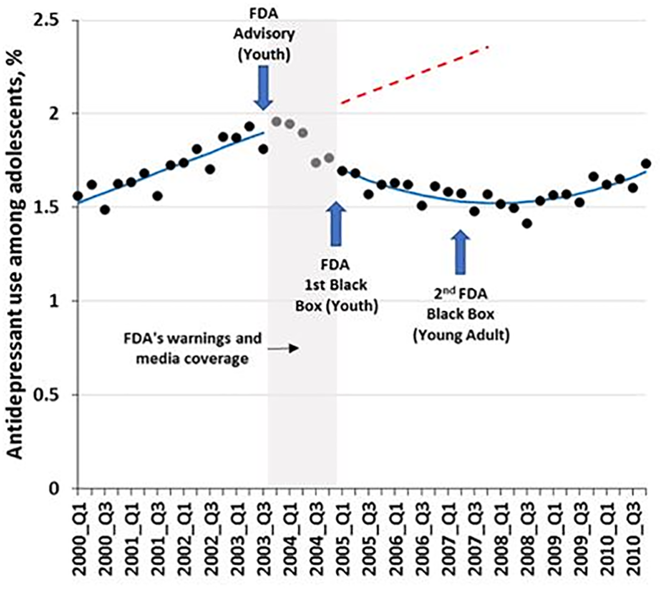
Unintended Consequences
© 2017 New York State Office of Mental Health

Slide 45
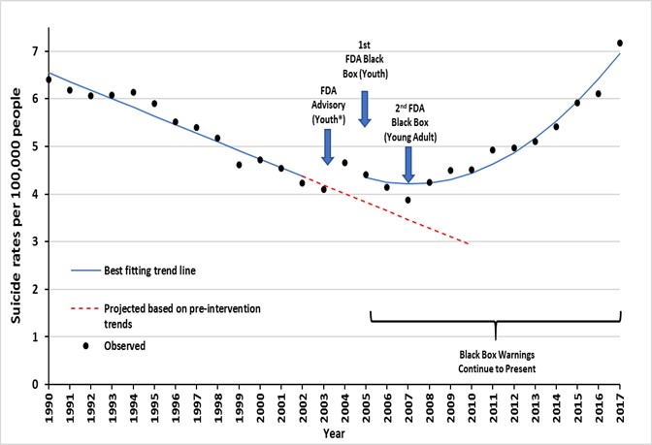
Unintended Consequences
© 2017 New York State Office of Mental Health

Slide 46
Unintended Consequences
Rates of antidepressant drug prescriptions declined by 50%
Rate of diagnosis of MDD reduced by 40%
Increase in psychotherapy did NOT occur as expected
Increased utilization of Benzo and antipsychotic medications
Studies suggested actual increased rate of suicide
Formaro 2019
© 2017 New York State Office of Mental Health

Slide 47
TAKE HOME POINT #1:
SUICIDAL RISK on ANTIDEPRESSENTS
No deaths / no completed suicides
Across ALL studies with 4400 children and adolescents
© 2017 New York State Office of Mental Health

Slide 48
Take Home Point #2: SUICIDE RISK
Increased risk of suicide with untreated depression
© 2017 New York State Office of Mental Health

Slide 49
In Summary: Managing Depression in Children and Adolescents
Depression in children & adolescents is common, identifiable and treatable
Psychotherapy acceptable/emphasized as a first line in mild/moderate MDD
Based on FDA meta-analysis, share with families
  There is a 2-3 OR 2-4% RISK of SI ON MEDS vs. 1-2% on placebo.
  But the TADS study shows a 60-70% chance of improvement of MDD with medication treatment
Fluoxetine and Escitalopram are FDA approved to treat Depression in Adolescents (although may have good reason to use others)
Educate families to watch for and report :
  Increase in agitation or uncharacteristic behavior change or Suicidal/Self-Injurious Thoughts/Behaviors and how to get help if concerned
Monitor closely

Slide 50
The Take-Away…
Depression can be managed in a Primary Care setting
Protocols for safety planning, psycho-education, and treatment planning based on severity are vital components
Tailor Treatment (psychotherapy, SSRI, behavior activation)
Follow up to monitor and support (see soon and often)
Adjust treatment plan (dosage, meds, therapy)
Stay involved as story unfolds

Slide 51
DO NOT MAKE KIDS SUFFER!

Slide 52
REFERENCES
Pediatrics. 2018;141(3):e20174081
http://pediatrics.aappublications.org/content/141/3/e20174081
Guidelines for Adolescent Depression in Primary Care (GLAD-PC): I. Practice Preparation, Identification, Assessment, and Initial Management
Zuckerbrot RA, Cheung AH, Jensen PS, Stein REK, Laraque D; GLAD-PC Steering GroupPediatrics. 2018;141(3):e20174082
Pediatrics. 2018;141(3):e20174082
http://pediatrics.aappublications.org/content/141/3/e20174082
Guidelines for Adolescent Depression in Primary Care (GLAD-PC): II. Treatment and Ongoing Management
Cheung AH, Zuckerbrot RA, Jensen PS, Laraque D, Stein REK; GLAD-PC Steering Group
Am J Psychiatry. 2014 Oct;171(10):1083-90. doi: 10.1176/appi.ajp.2014.13111460.
Sequential treatment with fluoxetine and relapse--prevention CBT to improve outcomes in pediatric depression.
Kennard BD, Emslie GJ, Mayes TL, Nakonezny PA, Jones JM, Foxwell AA, King J.
Notes:
This can go at the end

Slide 53
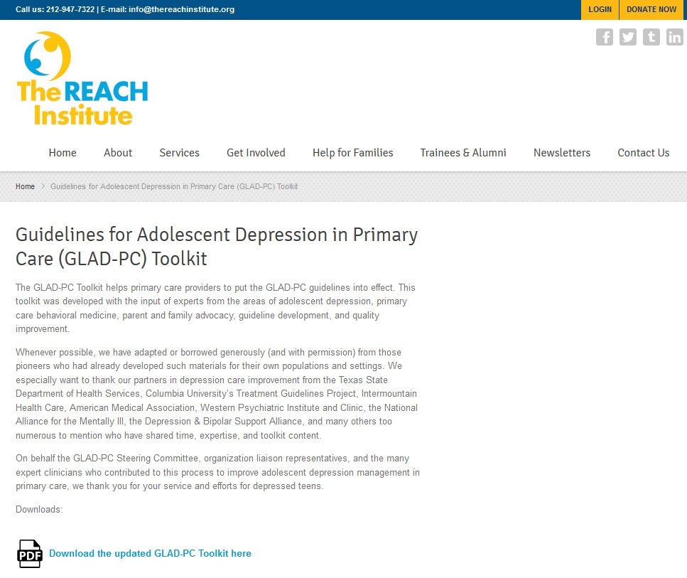
GLAD-PC Toolkit: www.gladpc.org
Notes:
Resource list at the end

Slide 54
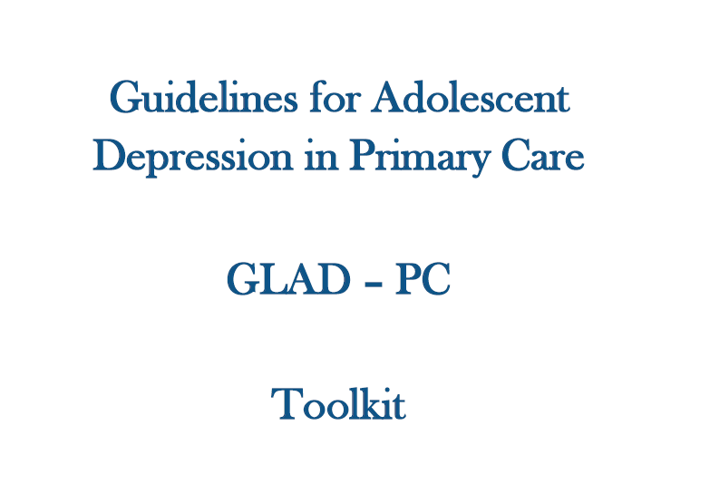
Notes:
redundant

Slide 55
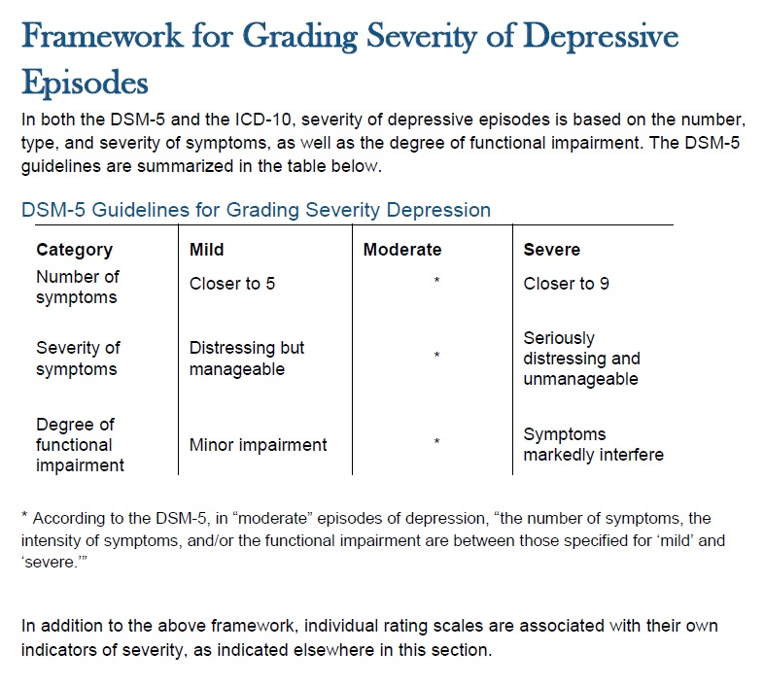
Severity Determination
Notes:
redundant

Slide 56
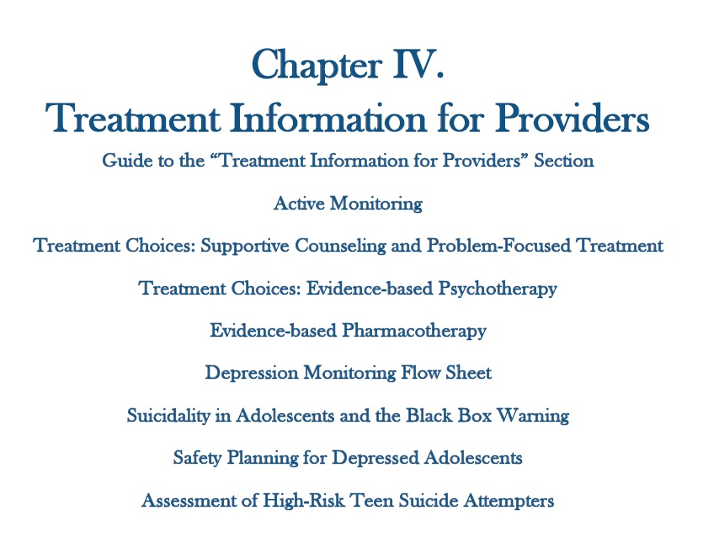
GLAD-PC Toolkit Chapter IV

Slide 57
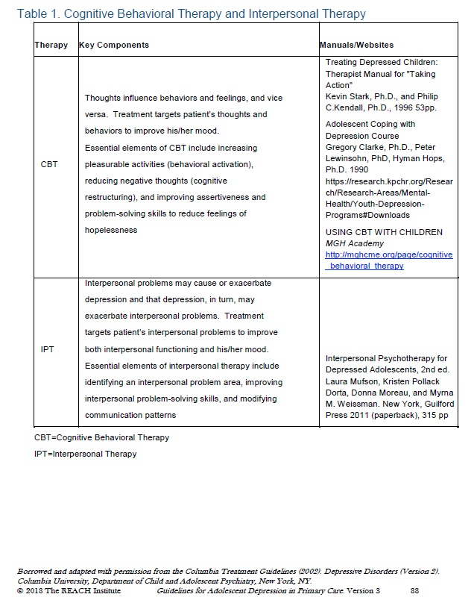
Evidence-Based Psychotherapy:
Information for PCPs
Notes:
Resources at the end

