Slide 1
What’s Next?
ADHD treatment when medication is not “working”…
Jason Herrick, MD
Director of Behavioral Health, Montefiore Medical Group
Montefiore Einstein

Slide 2
Speaker:
Jay Herrick, MD
Montefiore Medical Group

Slide 3
Disclosures
Dr. Herrick serves consultant to MVP Health P&P Committee

Slide 4
Poll Everywhere
Please take a few seconds to scan this QR code to allow you to participate in interactive aspects to this presentation

Slide 5
Meet Percy, a 9-year-old with ADHD. Over the next 20-30 minutes we will work together to help Percy and his family navigate common issues that we encounter especially when we get that call… “This is not working!”

Slide 6
Percy - ADHD: Combined Type - Parents sought behavioral intervention; they continue to work with therapist - Notice of “promotion in jeopardy” in March of 2nd grade prompted motivation for medication - Started Concerta 18mg, increased to 27mg during last 5 weeks of school a/w improvement, but residual symptoms. - Held Rx over summer - Restarted at 27mg a week before school started - Now 9yo and towards the middle of Oct. in 3rd grade…

Slide 7
The medication is not helpful!
His grades are even worse than they were at this time last year!
School says he’s behaving, but you should see him at home!
I think we need to try something else!

Slide 8
What does it mean when ADHD medication is not “working”?
Poll Everywhere 1
Notes:
What does “working” mean?

Slide 9
What are most common reasons a medication may “not be working”?
Adherence
Insufficient dose
Observation time
Diagnostic question
Comorbidity

Slide 10
What are reasons a medication may not “work”?
Adherence
Insufficient dose
Observation time
Diagnostic question
Comorbidity
Is medication being TAKEN?
Who administers?
What prompts taking of medication?
Diversion?

Slide 11
What are reasons a medication may not “work”?
Adherence
Insufficient dose
Observation time
Diagnostic question
Comorbidity
Has dose been increased?
Has patient grown?
Is there an increase in demands on patient?

Slide 12
What are reasons a medication may not “work”?
Adherence
Insufficient dose
Observation time
Diagnostic question
Comorbidity
When is it not working?
Could medication be wearing off?
Is onset of action delayed?
Rebound phenomenon?

Slide 13
What are reasons a medication may not “work”?
Adherence
Insufficient dose
Observation time
Diagnostic question
Comorbidity
Are we sure we are treating the right thing?
Review differential?
Additional work-up?

Slide 14
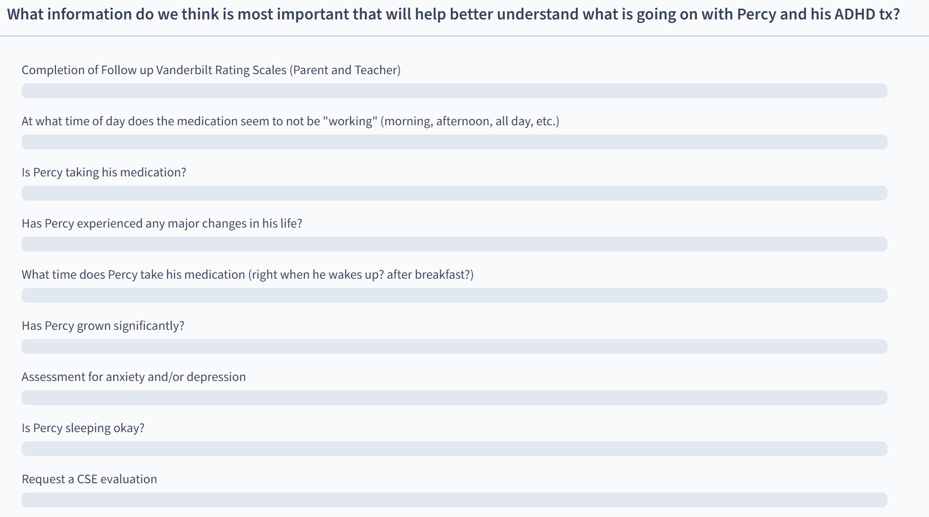
What information do we want to obtain from caregiver/collateral?
Poll Everywhere 2
Notes:
Rank order Poll Everywhere:
FUVRS
When taking
Is he taking
Changes in life
When is medication not working
Growth
Sleep
Comorbidity
CSE need

Slide 15
Percy – 9yo - Mother gives medication (Concerta 27mg) after breakfast every morning - Behaving fine in school, “at least not getting calls at work”, mornings may be little worse - “Terrible” when he gets home; “won’t listen”, “all over the place”, “cannot get him to do any homework”, “it’s exhausting” - He really has hard time settling down to go to bed, but this is not “new”
Notes:
Taking medication!
Wears off or rebound - booster
Delayed onset – consider taking before meal
Sleep disruption – booster vs clonidine

Slide 16
Percy – 9yo - FUVRS (p) – Consistent with ADHD:CT - FUVRS (t) – Consistent with ADHD:CT, comment notes that “seems to do better around 10am, but has hard time by end of day” - Both teacher and parent note difficulties in reading - Remains “bright and cheerful” with peers and sibling - Mother was promoted and is now working later more frequently and not home for most of after school routine
Notes:
CSE need?
Depression less likely
Change in afternoon routine?

Slide 17
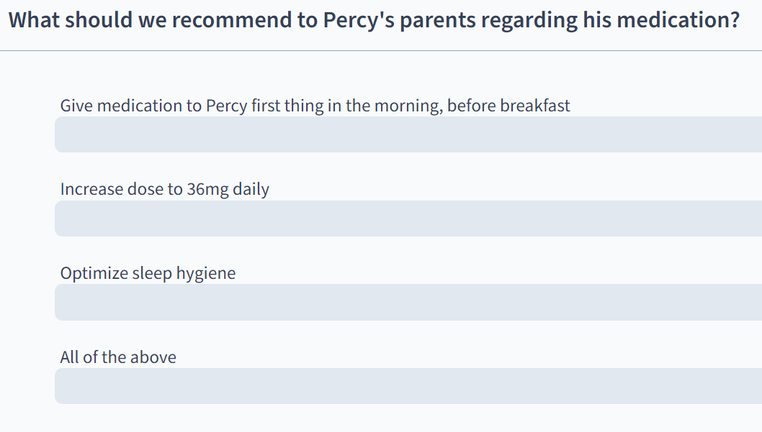
What is our next step?
Poll Everywhere 3

Slide 18
Percy – 9yo…4 weeks later…better, but still “not working”… - Dose increased to 36mg and parents instructed to give before breakfast - Associated with improved behavior in school, both in the morning and through the end of school day - Father continues to express frustration with Percy’s focus and attention on HW and increased activity after school - Sleep hygiene addressed as per recommendations, but onset of sleep remains problematic. - Falling further behind in reading
Notes:
Rebound vs wear off -> Booster? Alpha or stimulant
CSE?

Slide 19
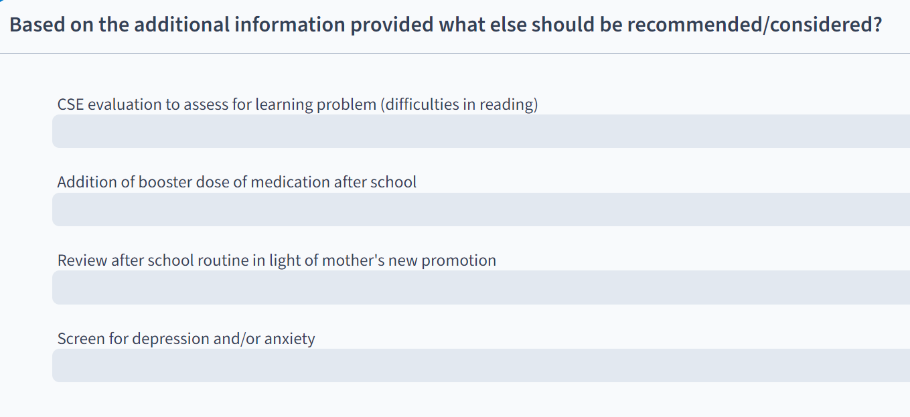
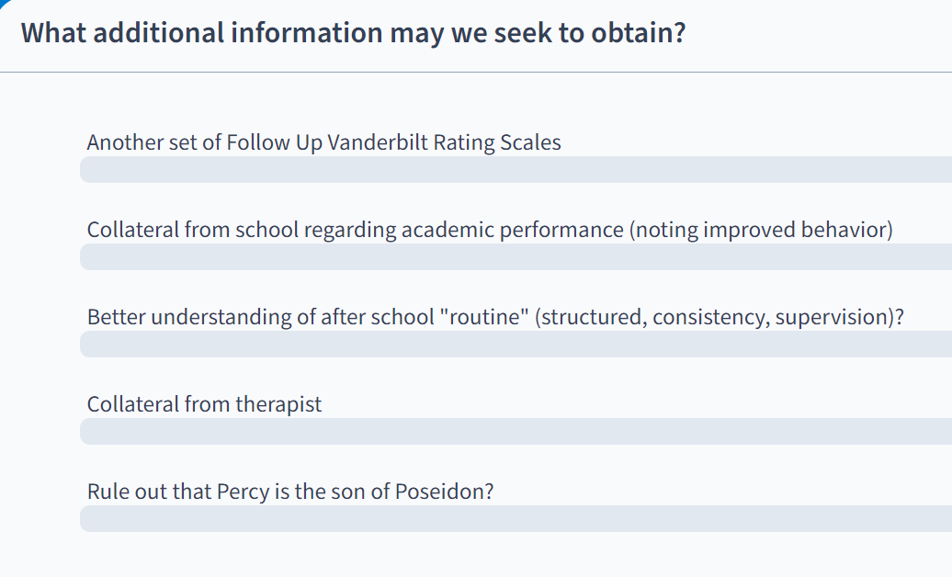
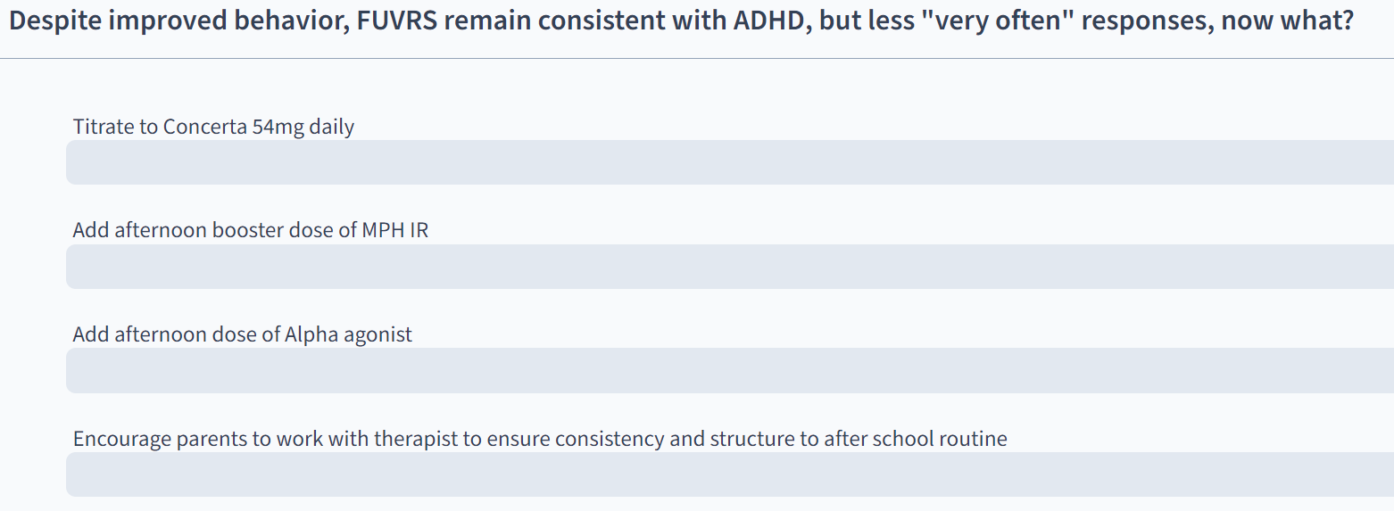
What is our next step?
Poll Everywhere 4-6
Notes:
Treat to remission – FUVRS again!
Booster? Alpha or stimulant
CSE?

Slide 20
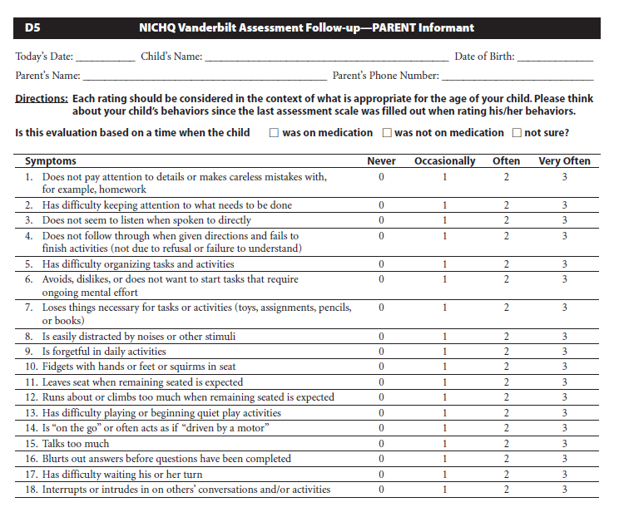
Titration Considerations:
Start low and go slow holds…but not too slow!
Goal to optimize response vs. settling for improvement
If child is a PARTIAL responder on the max dose of stimulant, switch to another stimulant OR consider augmentation (usually with an alpha 2 agonist)
Treat to remission!

Slide 21
If With Your Initial Trial of a Stimulant You Have Optimized the Dose and Unacceptable Side Effects Supervene
Switch to the alternative stimulant type e.g. from a methylphenidate derivative to an amphetamine derivative or vice versa
There is no absolute equivalency
Can use web-based calculators as guide:
https://www.adhdmedcalc.com/
Also helpful in world of stimulant shortages

Slide 22
If there is a good “daytime” stimulant response and later day coverage is the issue?
Can a “booster” of a short acting version of the AM stimulant be added without impact on sleep?
Timing of 2nd dose depends on wear off time of the AM medicine
If hyperactivity/impulsivity is most problematic later in the day an alpha 2 agonist like Guanfacine (Tenex) or Clonidine (Catapres) may be suitable
This may also be preferred if stimulant is already significantly impacting food intake/weight

Slide 23
Considerations when adding an Alpha 2 Agonist
Hyperactivity/Impulsivity > Attention
Sedation
What amount is tolerable? Is it advantageous?
Clonidine > Guanfacine
HR/BP
Adherence
Rebound hypertension
Notes:
Clonidine start 0.1mg
Guanfacine 0.5mg

Slide 24
Other Things to Consider If Stimulants Are Not Working: Comorbidity/Diagnostic Issue
Other Comorbidity?
What about co-occurring Anxiety/Depression
Is it mild/moderate enough for CBT
Remember your screening tools - PHQ-9, SCARED
Does this require an SSRI trial?
Learning Disorder
CSE evaluation for IEP need
Neuropsychiatric Testing
ODD
Parenting-based intervention recommended -> Parent Behavior Management Training
Notes:
Again highlight need to understand why not working?

Slide 25
Percy – 9yo… 5 months later… - Titrated to 54mg with improved behavior and academic performance in school, continued to have (+) sxs on Parent FUVRS, Teacher FUVRS (-) - Despite implementation of reward plan for after school to improve behavior, father continues to express frustration with Percy’s focus and attention on HW and increased activity after school - Sleep hygiene addressed as per recommendations, but onset of sleep remains problematic. - Falling further behind in reading - Appetite reduced
Notes:
Rebound vs wear off -> Booster? Alpha or stimulant
CSE?

Slide 26
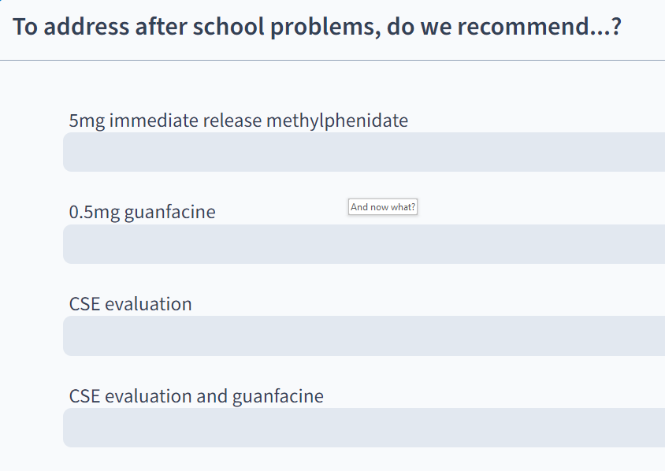
And now what?
Poll Everywhere 7
Notes:
Booster? Alpha or stimulant
CSE?

Slide 27
When Might A Stimulant’s “Failure” Be More Predictable?
Existing Tic Disorder –
May consider atomoxetine which is less associated w/ tic exacerbation
If tic causes impairment, could target both tic and ADHD sxs with Alpha-Agonist

Slide 28
When Might A Stimulant’s “Failure” Be More Predictable?
Significant Anxiety
Treat anxiety – CBT, SSRI, etc.
Atomoxetine – less likely to exacerbate anxiety vs stimulant…but questionable efficacy

Slide 29
When Might A Stimulant’s “Failure” Be More Predictable?
Children with ASD
Generally more sensitive to side effects
With ADHD: hyperactive/impulsive type and/or with aggression consider alpha first.

Slide 30
Take homes…when medication doesn’t seem to “work”
There is not a SINGLE “right way”
Dosing:
Adherence
Treat to remission
Use FUVRS and other collaterals to guide MDM and titration recommendations
If partial response to max dose, consider switching to alternative vs augmenting with alpha
Booster (stim or alpha) if wear off is likely
Comorbidity vs. Misdiagnosis
Consider learning disorders – CSE evaluation
Use screeners to help rule out (PHQ9, SCARED, GAD7, CRAFFT, CPSS-V)
Life circumstances – Adjustment D/O

Slide 31
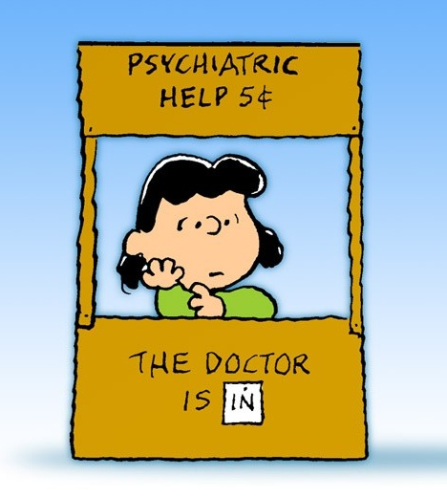
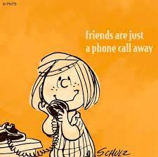
Whenever in doubt, always remember, with Project Teach….

Slide 32
Garden Variety ADHD
4. Alternate Class (MPH or AMP)
1. Diagnostic Assessment
3. MPH or AMP (plus parent management usually)
7. Bupropion (not FDA approved)
2. Multimodal treatment plan with family and child
6. ATX alone or as add on
5. GFXR (alpha agonist) alone or as add on

Slide 33
ADHD + Anxiety/Depression
Comorbidities and ADHD
4. Alternate Class (MPH or AMP)
1. Diagnostic Assessment
3. Psychosocial tx + MPH or AMP
2. Multimodal treatment plan with family and child
6. If residual anxiety, add SSRI
5. ATX alternate as first line
Notes:
This is same for any comorbidity—start the psychosocial tx for that comorbidity and if after treating ADHD with good meds and after good psychosocial tx, there is residual sx of comorbidity, tx it with another rmed

Slide 34
Toolkit Published by AAP 2020

