Slide 1
The Treatment of ADHD
Diane Bloomfield MD
Associate Division Chief, Clinical Affairs, Academic General Pediatrics
Medical Director, Family Care Center, Pediatrics
Children’s Hospital at Montefiore

Slide 2
Speaker:

Slide 3
Disclosures
Neither I nor my spouse/partner have
a relevant financial relationship with a commercial interest to disclose

Slide 4
ADHD Rule of Threes
3 Main Symptoms
Inattention, Impulsivity, Hyperactivity
Impacts 3 Basic Functions
Focus, Motivation, Planning/Organization
3 Mainstays of Treatment
Pharmacotherapy, Behavioral therapy, Accommodations

Slide 5
Evidence-Based PharmacotherapyTreatment
First Line: Stimulants
Stimulants have 70-90% response rate
May require trials with various formulations to get optimal response
65-70% respond to one class; up to 90% respond to either
Side effects profile similar
Difference in preparations primarily in duration of action
Evidence provided by MTA Study
Notes:
Weight based dosing not effective

Slide 6
Evidence Based Treatment
The M.T.A study:
1) medication alone – methylphenidate
2) medication and behavior therapy
3) behavior therapy alone
4) treatment as usual
Results:
1)MTA style medication management alone – very good outcome
2)Combined with behavioral therapy – even better, 10% advantage , especially for anxious kids
3)Behavior therapy alone - little benefit
4)Community care: Treatment as usual – poor outcome
Notes:
Defining, landmark study for the treatment of ADHD

Slide 7
MTA Study: Remission Rate Increased with Increasing Dose
Remission rates
Average dosing, mg
Notes:
MTA Study: Remission Rates Increased With Increasing Dose
Message: In the MTA trial only 25% of patients receiving community care achieved remission compared to 56% of those in the medication arm, who received adequately titrated methylphenidate treatment. Under dosing of methylphenidate in the community was largely responsible for this difference.
Content: In the MTA study, average methylphenidate dose was only 22.6 mg in the community care population, and this dose resulted in a 25% remission rate. The average dose in the medication arm was 37.7 mg and this dose resulted in a 56% remission rate. In the medication arm, 28.8% of children were assigned to low doses (≤15 mg/day), 32.8% to moderate doses (16-34 mg/day), and 38.4% required high doses (≥35 mg/day).
References: 1.Swanson J, et al. Clinical relevance of the primary findings of the MTA: success rates based on severity of ADHD and ODD symptoms at the end of treatment. JAACAP 2001;40:168-79. 2. Greenhill L, et al. Impairment and deportment responses to different methylphenidate doses in children with ADHD: the MTA titration trial. JAACAP 2001;40:180-7.

Slide 8
ADHD Medication
How did the MTA trial achieve high-rates of remission?
- Higher stimulant doses
- Better coverage in the evenings
- Follow-up visits monthly for 30 minutes
- Active contact with school and support network
- Follow-up Vanderbilts from home and school at each visit
Use rating scale data to determine place of optimum response and duration of action of AM dose

Slide 9
Dose Effect Time of Stimulant Preparations (hours)
Methylphenidate
Ritalin/Focalin 4
Ritalin LA/Metadate CD/ 6-8
Focalin XR 8
Concerta MPH 10-12
Amphetamine
Dextro/Levo amphetamine (Adderall) 6
Adderall XR 8-12
Vyvanse 10-12
**Different charts say different things and people are variable!
Notes:
The different preparations of stimulant medications are critical to managing ADHD symptoms. The longer-acting preparations show a maintained efficacy for at least one year, improved medication compliance that persisted nine months and parent preference even if they were blind to which preparation they were using.
A shorter effect time can mean an inadequate dose although there is some individual variation in effect time. Due to variability of the dose needed, dose effect time, rebound reactivity and difference in children’s routines and environments, active titration sometimes combining preparations can lead to the best response. The detriment of combining stimulant preparations is adding complexity, losing some compliance and compounding copays that families have to pay for the medications.
1. Discuss generics-Concerta issue
2. Discuss formulary issue
3.Discuss short-acting in preschoolers—more side effects and the need to go to sleep sooner

Slide 10
Side Effects
Common
Appetite suppression
Sleep disturbance
Headache
GI upset
Less common
Tic exacerbation
Rebound
Irritability/Emotional lability/Social withdrawal
Reduction in growth velocity
Hypertension/Tachycardia/Arrhythmia
Rare
Psychosis
Abuse potential/Diversion
Notes:
Over focusing/blunting Sudden death from cardiac disease

Slide 11
Titration and Follow-Up
Benefits and side effects occur right away
Seeking maximum effect with minimum side effects.
Treat for remission — Improvement is not enough!
Follow up in one week by phone or in–person
Follow rating scales and side effects
Physical exam: height, weight, bp, pulse.
Follow-up a few days after dose change.
When initially stable see monthly as multimodal plan is put in place then every three months.
Reassess every new school year

Slide 12
Alternative to Stimulants
Although there is evidence to support their relative effectiveness compared to placebo, the gold standard is the stimulants due to a much larger effect size
Norepinephrine Reuptake Inhibitor
Atomoxetine (Strattera)
Viloxazine (Qelbree)
Alpha 2-Agonists
Clonidine (Catapres,Kapvay)
Guanfacine (Tenex, Intuniv)
Notes:
Bupropion has been shown to be effective in limited clinical studies, to be well-tolerated and to be specifically helpful with the co-morbidity of ADHD and depression. It has its own side effects that can include insomnia, agitation and headaches and it may exacerbate tics and increase the risk of seizures.
Atomoxetine is a new norepinephrine reuptake inhibitor that has been shown in limited clinical trials to have some of the same effects as stimulant medications, improving symptoms of ADHD and ODD, not improving co-morbid anxiety or depression. It seems not to cause insomnia and in fact to often be sedating. It does have negative effects on height, weight, blood pressure and pulse similar to stimulants. There is a six week delay to peak effect and positive effects are demonstrated to last at least a year.
Tricyclic antidepressants have shown efficacy in ADHD, anxiety, depression and tics. They are plagued with side effects like dry mouth, constipation, fatigue and tachycardia. There are worrisome cardiaovascular effects, require monitoring with blood levels and EKG’s and may be fatal in an overdose. (desipramine, imipramine, nortriptyline)
The Alpha2-Agonists guanfacine and clonidinehave limited data on efficacy but may be effective for ADHD, tics and aggression. They can cause dizziness and sedation and nausea but can be useful in combination with stimulants if the titration of stimulants is limited by side effects.

Slide 13
Atomoxetine
Dosing based on weight
Common AEs: irritability, sedation or insomnia, decreased appetite, GI
Rare accounts of liver damage, suicidal ideation: boxed warning
Advantages:
Once Daily dosing ( max 10 Hours)
Little abuse potential (adolescents)
No apparent effects on growth
Does not seem to exacerbate tics
Disadvantages:
Delayed onset (takes 3-6 weeks)
Generally not as effective

Slide 14
Atomoxetine Dosing
1. Starting dose 0.5mg/kg for first 4 days
2. Advance to TARGET dose as close to 1.2 to 1.4mg/kg as you can get. (typical max is 100mg)
3. Can be given ONCE or TWICE a day
4. Stay at target dose for a month
How supplied: 10, 18, 25, 40, 60, 80, 100mg

Slide 15
Viloxazine (Qelbree)
Dosing for children 6 to 11
100mg week 1
200mg week 2
300mg week 3
400mg week 4
Dosing for Adolescents 12 to 17
200mg week 1
400 mg week 2
Can go to 600mg week 3
Supplied as 100, 150, 300 & 400 capsules
Can be sprinkled on soft food.

Slide 16
Alpha-2-Adrenergic Agonists
Guanfacine - start at 0.5mg once or twice a day, 6mg max
Intuniv (Guanfacine ER) start at 1mg daily- advance weekly, max of 6mg
Clonidine- start at 0.05mg once at bedtime, advance weekly, 0.4mg max
Side effects: sedation, lower BP therefore MUST taper when stopping and daily compliance is a safety issue
Advantages
Sedating (sleep difficulties)
LA forms given once daily (Kapvay may need BID)
Better for hyperactivity and impulsivity than inattention
Adjuncts for children with partial response to stimulant
Notes:
Due to effects on blood pressure daily compliance is important and tapering from higher doses is prudent

Slide 17
Clonidine Added to Stimulants to Treat ADHD: Efficacy
p=.0002
p<.0001
p<.0001
p=.003
p<.0001
p=.006
p=.08
p=.07
p=.03
Clonidine mean daily dose: 0.25 mg (alone) and 0.28 mg (combination)
Methylphenidate mean daily dose: 25.7 mg (alone) and 26.1 mg (combination)
Tourette’s Syndrome Study Group. Neurology 2002.
Notes:
16-week study. P values: active versus placebo
Placebo: mean age 9.7; 91% male; combined 19%, inattentive 81%; prior stimulant treatment 63%, prior clonidine treatment 56%
Methylphenidate: mean age 10.7; combined 32%, inattentive 65% hyperactive/impulsive 3%; prior stimulant treatment 62%, prior clonidine treatment 27%
Clonidine: mean age 9.7; combined 21%, inattentive 76%, hyperactive/impulsive 3%; prior stimulant treatment 62%, prior clonidine treatment 32%
Combined: mean age 10.6; combined 33%, inattentive 64%, hyperactive/impulsive 3%; prior stimulant treatment 45%, prior clonidine treatment 30%
Methylphenidate (alone or combined group): 1 year older, more pubertal cases, fewer inattentive and more combined, lower baseline Conners-ASQ-Teacher scores.
Combined versus other: more girls

Slide 18
Medication Treatment Responsive Groups
Children
Teenagers
Adults
Preschoolers (Short et al . 2004, Greenhill et al., 2007)
Individuals with Intellectual Handicaps (Pearson et al.2004)
ADHD co-morbid with Other Diagnoses
Tourette’s Disorder
Autism Spectrum Disorder
Anxiety/Mood Disorder
Conduct Disorder
Oppositional Defiant Disorder
Substance Abuse Disorder
Notes:
You can treat! You just cannot be the only one helping the kid if there are serious other comorbidities!!!! BUT you can still treat.

Slide 19
Garden Variety ADHD
4. Alternate Class (MPH or AMP)
1. Diagnostic Assessment
3. MPH or AMP (plus parent management usually)
7. Bupropion (not FDA approved)
2. Multimodal treatment plan with family and child
6. ATX alone or as add on
5. GFXR (alpha agonist) alone or as add on

Slide 20
ADHD + Anxiety/Depression
4. Alternate Class (MPH or AMP)
1. Diagnostic Assessment
3. Psychosocial tx + MPH or AMP
2. Multimodal treatment plan with family and child
6. If residual anxiety, add SSRI
5. ATX alternate as first line
Notes:
This is same for any comorbidity—start the psychosocial tx for that comorbidity and if after treating ADHD with good meds and after good psychosocial tx, there is residual sx of comorbidity, tx it with another rmed

Slide 22
Principles of Behavior Therapy
Positive reinforcement is much better than negative reinforcement
Motivation can be improved with pairing preferred and non-preferred activities- work before play!
Most of us thrive with structure and routine ADHD child needs lots of this!
Tight collaboration with school- behavior plan, daily report card
Avoid shaming and excessive punishment

Slide 23
Non-pharmacological Interventions
Organizational skills training, Peer tutoring
Computer assisted instruction – targets attention and working memory- popular in research sector and commercially. Evidence not clear- reviewed by Rutledge 2012
EndeavorRx FDA authorized video game. Cost $100- 25 minutes, 5 days a week for at least 4 consecutive weeks
Homework focused interventions
School accommodations
Eligibility for a 504 plan
Additional time for exams, quiet setting for exams, training interventions at school
IDEA (Other Health Impairment) creating an Individual Education Plan (IEP)
for appropriate class placement, instructional and behavioral support
Dealing with co-morbid conditions
Social skills training if needed

Slide 24
Social Supports
Support groups (e.g. CHADD)
Online
www.teachingkidstolisten.com
www.Help4ADHD.org
Books
1-2-3 Magic (Tom Phelan)
Making the System Work for Your ADHD Child (Peter Jensen)
Taking Charge of ADHD: The Complete Authoritative Guide for Parents (Russell Barkley)
ADHD: What Every Parent Needs to Know (M Reiff)

Slide 25
Why Should I Treat My Patient’s ADHD
Risk of Not Treating
Academic struggles
Difficult family and peer relationships
Risk of injury
Teen risk-taking and impulsive behavior
Poor vocational performance
Dangerous driving
Risk of Treating
Possible adverse side effects
Medication misuse/abuse

Slide 26
Bottom Line
Titrate closely and relatively quickly
Use your algorithms
Higher stimulant dose is usually the first step
Follow up every 3 months only after stable
Remember psychosocial treatments and school interventions

Slide 27
What would you do for this patient?
Medication
Which one?
Dose?
How soon to follow up
What about sleep?
Behavior Therapy
Suggestions for parents
Accommodations
School-based suggestions?

Slide 28
My thanks to Dr. J. Wallace at University of Rochester for the following accommodations menu

Slide 29
Accommodation Menu
Pro Focus and Attention
____Seat in the front of the classroom
____Seat away from distractions (fish tank)
____Seat near quiet peers and away from disruptive peers
____Increase space between seats
____Private cue to stay on/return to task
____Involve student in discussions/activities
____Make instructions clear and brief
____Select teachers with energetic, engaging style
____Pair written and oral instructions
____Check to be sure assignments are copied correctly
____Break large assignments into parts with deadlines
____Make extra eye contact with student
____each in close proximity to student
____Consider need for smaller environment with more adult support

Slide 30
Accommodation Menu
Impulsivity and Hyperactivity
____Ignore minor impulsive behavior
____Keep student occupied and active
____Supervise closely during transitions
____Reprimand(s) should be brief and private if possible
____Seat near good role model
____Notice and reinforce positive behaviors
____Set up behavior contract with clear short-term goals
____Encourage hand-raising and waiting
____Rewards and consequences should be immediate
____Implement home/school reward token system
____Allow student to stand and move at times
____Provide movement breaks between seated activities
____Consider need for smaller environment with more adult support Pro

Slide 31
Accommodation Menu
Organization and Planning
____Use adults to support organization – teachers, parents, resource
teachers
____Create “Homework Loop” to complete daily assignments
____Check to see that assignments are written down correctly
____Be sure correct books go home or consider extra copies
____Encourage parents to set up homework time and place and assistant
____Have teachers ask for completed assignments
____Empty and reorganize book bag and locker at least weekly
____Use colored dividers and folders
____Consider peer assistant for organization
____Use multi-sensory approaches for giving assignments and teaching
____Consider allowing tape recording of assignments and lessons
____Use consistent repetitive approach to getting organized
____Ask student to repeat instructions

Slide 32
Accommodation Menu
Academic Struggles
____Consider referral for testing for any learning concerns/disabilities
____Explore other possible impairing conditions (speech, hearing, learning disabilities)
____Use multi-sensory techniques in all phases of teaching
____Use games, songs and chants/raps for rote learning and memorization
____Accommodate weaknesses in learning – math, reading, foreign language
____Be aware that learning weaknesses worsen attentional problems and vice versa
____Schedule regular meetings/communication with parents about learning concerns
____Direct parents to practice skills with student
____Parents can consider private tutoring or after-school homework support
____Consider need for formal 504 accommodations or Special Education support
____Consider different levels of support (resource room, consult teacher, self-contained setting)
____Emphasize any areas of interest in academics content

Slide 33
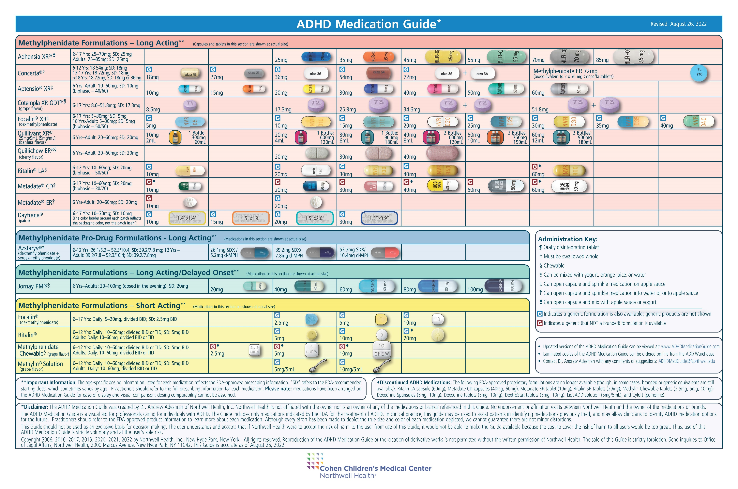
ADHD Medication Guide (www.ADHDMedicationGuide.com) (www.ADHDMedicationGuide.com)
Used with permission Dr. Adesman Northwell Health

Slide 34
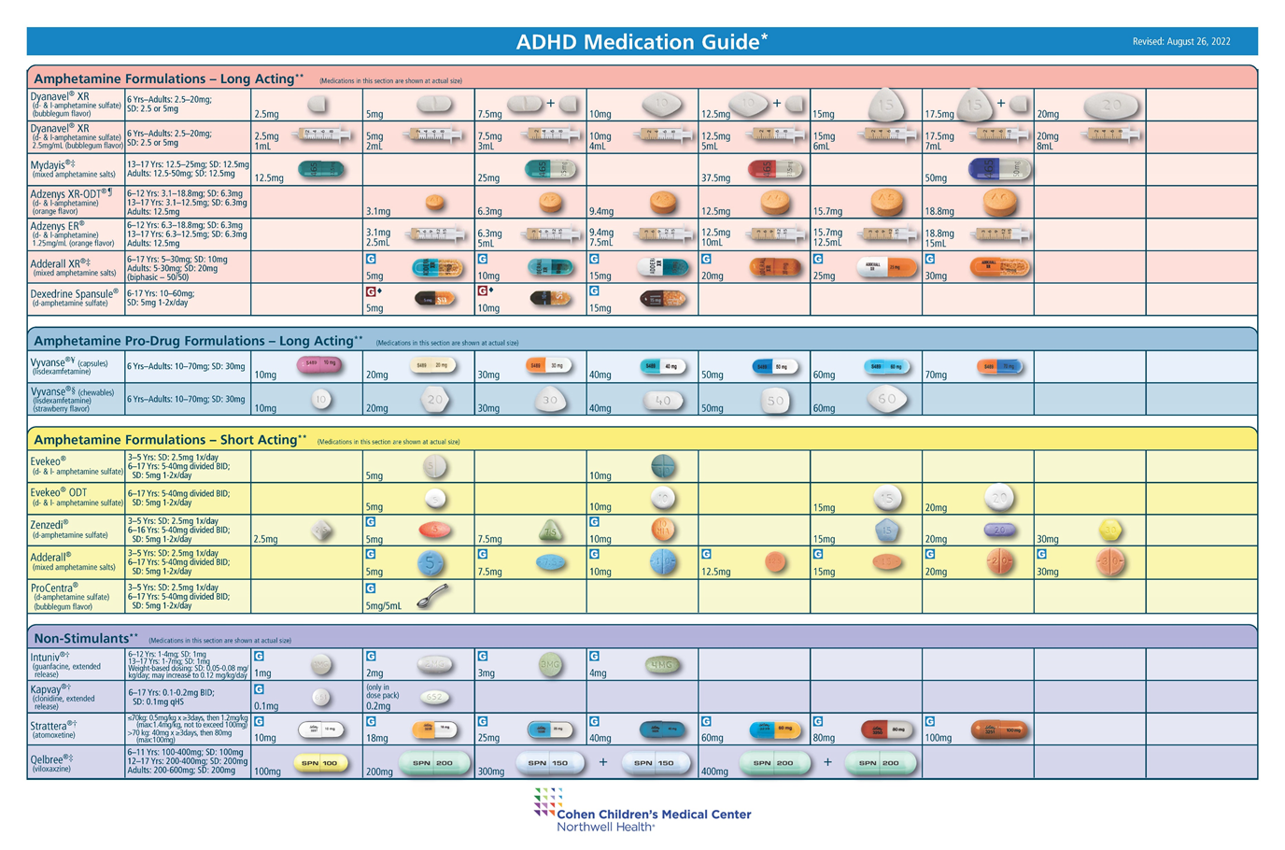
ADHD Medication Guide (wUsed with permission Dr. Adesman Northwell Health ww.ADHDMedicationGuide.com)

Slide 35
Toolkit Published by AAP 2020

Slide 37
