Slide 1
Pcp virtual drop-ins
Strengthening provider resilience through compassion-based practice.
Notes:
Each virtual meeting will include anxiety relief strategies to share with patients, discussion of difficult cases and related issues, and practice skills for self-care
Anyone need anything for themselves here?
Setting intentions.

Slide 2
objectives
1. Practice managing stress through self-care exercises and group support.
2. Discuss difficult cases and strategize how to approach supporting resilient families.
3. Take-away tools and resources for helping providers find resilience through compassion-based practice.
Notes:
Anything in particular that you might need right now – whether to share a particular case or personal experience or to get support with something?

Slide 3
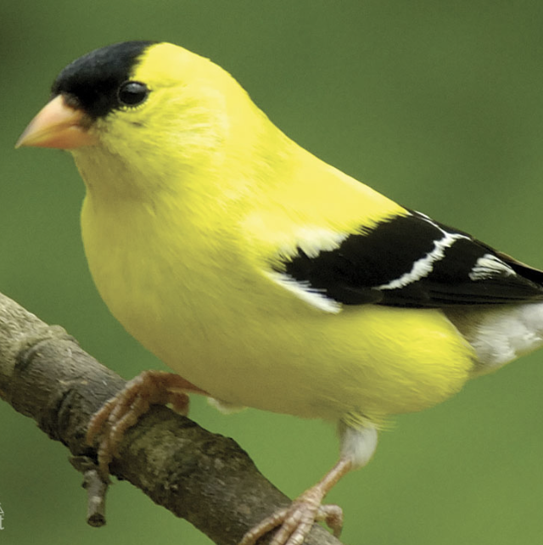
Invitation by mary oliver
It is a serious thing
Just to be alive
On this fresh morning
In the broken world.
Notes:
Oh do you have time to linger for just a little while out of your busy
and very important day for the goldfinches that have gathered in a field of thistles
for a musical battle, to see who can sing the highest note, or the lowest,
or the most expressive of mirth, or the most tender? Their strong, blunt beaks drink the air
as they strive melodiously not for your sake and not for mine
and not for the sake of winning but for sheer delight and gratitude – believe us, they say, it is a serious thing
just to be alive on this fresh morning in the broken world. I beg of you,
do not walk by without pausing to attend to this rather ridiculous performance.
It could mean something. It could mean everything. It could be what Rilke meant, when he wrote: You must change your life.

Slide 4
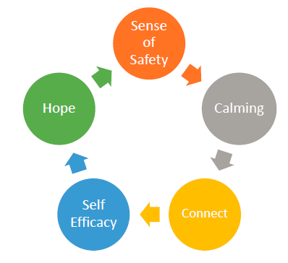
Essential Elements for Recovery Post-Trauma
Slide reproduced with permission from Patricia Watson, PhD NCPTSD

Slide 6
Resilience in health care
Capacity to respond to stress in a healthy way such that goals are achieved at minimal psychological and physical cost
Key to enhancing quality of care, caring & sustainability
Individual factors
Capacity for mindfulness, self-monitoring, limit setting, healthy attitudes
Systemic factors
Structural support, realistic demands, processes that promote self-efficacy & autonomy, community-building practices, work flexibility
(Epstein & Krasner, 2013)
Notes:
individual factors of resilience include the capacity for mindfulness, self-monitoring, limit setting, and attitudes that promote constructive and healthy engagement with (rather than withdrawal from) the often-difficult challenges at work. Cultivating these specific skills, habits, and attitudes that promote resilience is possible for medical students and practicing clinicians alike. Resilience-promoting programs should also strive to build community among clinicians and other members of the health care workforce.
Acad Med
. 2013 Mar;88(3):301-3.
doi: 10.1097/ACM.0b013e318280cff0.
Physician resilience: what it means, why it matters, and how to promote it
Ronald M Epstein, Michael S Krasner
PMID: 23442430
DOI: 10.1097/ACM.0b013e318280cff0
https://jamanetwork.com/journals/jamanetworkopen/fullarticle/2767829

Slide 7
Resilience in health care
Capacity to respond to stress in a healthy way such that goals are achieved at minimal psychological and physical cost
Key to enhancing quality of care, caring & sustainability
Individual factors
Capacity for mindfulness, self-monitoring, limit setting, healthy attitudes
Systemic factors
Structural support, realistic demands, processes that promote self-efficacy & autonomy, community-building practices, work flexibility
How is your individual & group practice supporting resilience at this time?
What gets in the way?
Notes:
individual factors of resilience include the capacity for mindfulness, self-monitoring, limit setting, and attitudes that promote constructive and healthy engagement with (rather than withdrawal from) the often-difficult challenges at work. Cultivating these specific skills, habits, and attitudes that promote resilience is possible for medical students and practicing clinicians alike. Resilience-promoting programs should also strive to build community among clinicians and other members of the health care workforce.
Acad Med
. 2013 Mar;88(3):301-3.
doi: 10.1097/ACM.0b013e318280cff0.
Physician resilience: what it means, why it matters, and how to promote it
Ronald M Epstein, Michael S Krasner
PMID: 23442430
DOI: 10.1097/ACM.0b013e318280cff0
https://jamanetwork.com/journals/jamanetworkopen/fullarticle/2767829

Slide 8
Reaching up, reaching down…
Up
Down
Reflect on & draw from philosophic, ethical, spiritual, religious values.
In
Ground to earth, place, relationship to environment.
Around
Turn towards internal means of engaging in pleasurable experiences, practicing gratitude.
Utilize technology & creativity to foster social support and connection.
Notes:
Fraenkel, P & Cho, WL. (2020). Reaching up, down, in, and around: couple and family coping during the coronavirus pandemic. Family Process. https://doi.org/10.1111/famp.12570
Bio-psycho-social-spiritual framework or cultural

Slide 9
Reaching in: finding loving-kindness
A reflection exercise.
What do I need?
What do I long to hear?
Notes:
https://chrisgermer.com/wp-content/uploads/2017/02/MSC-Finding-Phrases.pdf

Slide 10
Compassion & self-compassion
Compassion:
Deep awareness of the suffering of oneself and other living beings, coupled with the wish and effort to alleviate it.
~Paul Gilbert
Self compassion:
Being open to and moved by one’s own suffering.
Experiencing feelings of caring and kindness towards oneself.
Taking an understanding, non-judgmental attitude towards one’s inadequacies and failures
Recognizing that one’s experience is part of the human experience
~Neff, 2003
Notes:
Meta analysis
21 RCT studies with n=1,285 participants
Significant effects for compassion, self-compassion, mindfulness, depression, anxiety, psychological distress and well being
(Kirby, 2017)

Slide 11
Reaching in: One for me, one for you.
Giving and receiving compassion practices
Savoring the breath
Warming up awareness
In for me, out for you
Notes:
https://chrisgermer.com/wp-content/uploads/2017/02/Giving-and-Receiving-Compassion_2017.pdf

Slide 12
On compassion
Compassion is not a relationship between the healer and the wounded. It's a relationship between equals. Only when we know our own darkness well can we be present with the darkness of others. Compassion becomes real when we recognize our shared humanity.
~Pema Chodron

Slide 13
References & resources
Epstein, RM & Krasner, MS. (2013) Physician Resilience: what it means, why it matters & how to promote it. Acad med. 88(3):301-3.
Fraenkel, P & Cho, WL. (2020). Reaching up, down, in, and around: couple and family coping during the coronavirus pandemic. Family Process. https://doi.org/10.1111/famp.12570
Germer, Christopher. Self compassion practices:
https://chrisgermer.com/wp-content/uploads/2017/02/MSC-Finding-Phrases.pdf
https://chrisgermer.com/wp-content/uploads/2017/02/MSC-Finding-Phrases.pdf

